Slide 1
Lecture 5 – Authenticated encryption
TEK4500
22.09.2020
Håkon Jacobsen
hakon.jacobsen@its.uio.no

Slide 2
Basic goals of cryptography
 | Message privacy | Message integrity / authentication
Symmetric keys | Symmetric encryption | Message authentication codes (MAC)
Asymmetric keys | Asymmetric encryption (a.k.a. public-key encryption) | Digital signatures

Slide 3
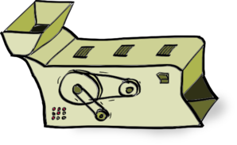




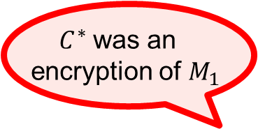






IND-CPA – Indistinguishability against chosen-plaintext attacks
$C^{∗}$ was an
encryption of $M_{1}$
$$Enc(K, ⋅)$$
find stage
$$X_{1}, X_{2},…$$
$$C_{1}, C_{2},…$$
Test me on $M_{0}, M_{1}$
$$C^{∗}$$
$$Enc(K, ⋅)$$
guess stage
$$X_{1}, X_{2},…$$
$$C_{1}, C_{2},…$$

Slide 4





Chosen-plaintext attacks
Public Internet
Google Search (internal)
C
M

Slide 5
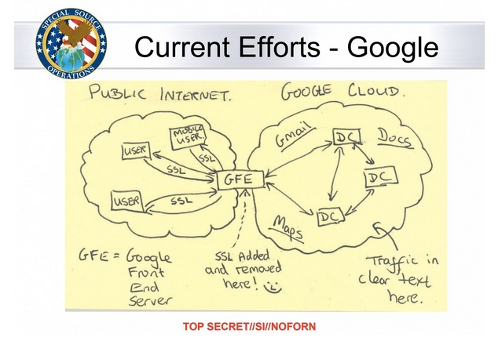
Chosen-plaintext attacks

Slide 6
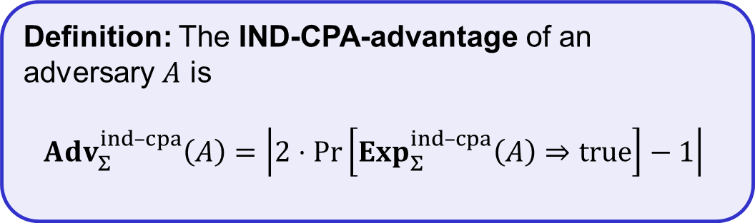
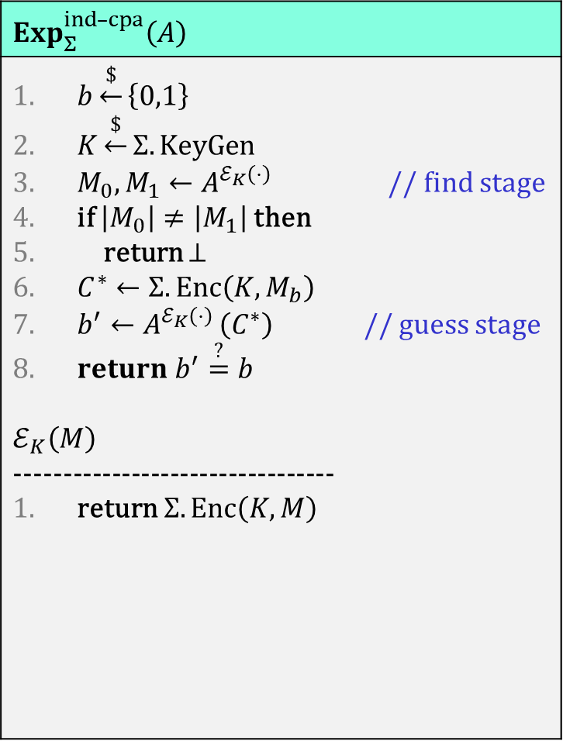
IND-CPA – Indistinguishability against chosen-plaintext attacks
$$Exp_{Σ}^{ind–cpa}\left(A\right)$$
$b\underset{←}{\$}\left\{0,1\right\}$ $K\underset{←}{\$}Σ.KeyGen$ $M_{0},M_{1}←A^{ℰ_{K}\left(⋅\right)}$ // find stage if $\left|M_{0}\right|≠\left|M_{1}\right|$ then return $⊥$ $C^{∗}←Σ.Enc\left(K, M_{b}\right)$ $b^{′}←A^{ℰ_{K}\left(⋅\right) }\left(C^{∗}\right)$ // guess stage $return b^{′}\overset{?}{=}b$ $$ℰ_{K}\left(M\right)$$ --------------------------------- return $Σ.Enc\left(K, M\right)$
$C^{∗}$ was an
encryption of $M_{1}$
$$Enc(K, ⋅)$$
find stage
$$X_{1}, X_{2},…$$
$$C_{1}, C_{2},…$$
Test me on $M_{0}, M_{1}$
$$C^{∗}$$
$$Enc(K, ⋅)$$
guess stage
$$X_{1}, X_{2},…$$
$$C_{1}, C_{2},…$$
Definition: The IND-CPA-advantage of an
adversary $A$ is
$${Adv}_{Σ}^{ind­–cpa}\left(A\right)=\left|2⋅\operatorname{Pr}\left[Exp_{Σ}^{ind–cpa}\left(A\right)⇒true\right]−1\right|$$

Slide 7











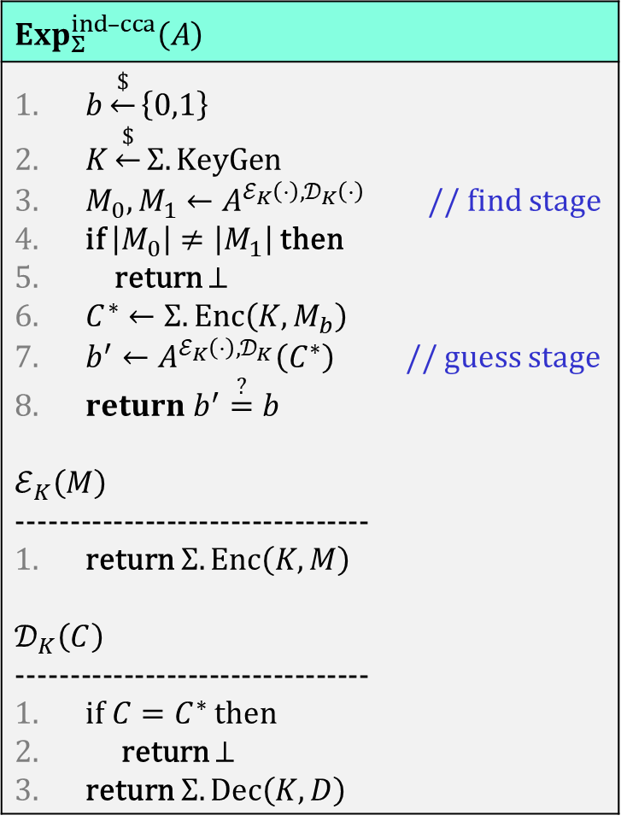


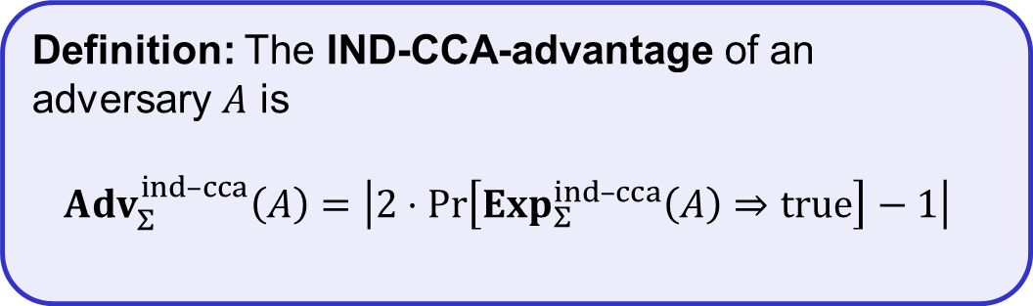
IND-CCA – Indistinguishability against chosen-ciphertext attacks
$$Exp_{Σ}^{ind–cca}\left(A\right)$$
$b\underset{←}{\$}\left\{0,1\right\}$ $K\underset{←}{\$}Σ.KeyGen$ $M_{0},M_{1}←A^{ℰ_{K}\left(⋅\right),𝒟_{K}\left(⋅\right)}$ // find stage if $\left|M_{0}\right|≠\left|M_{1}\right|$ then return $⊥$ $C^{∗}←Σ.Enc\left(K, M_{b}\right)$ $b^{′}←A^{ℰ_{K}\left(⋅\right),𝒟_{K}}\left(C^{∗}\right)$ // guess stage $return b^{′}\overset{?}{=}b$ $$ℰ_{K}\left(M\right)$$ --------------------------------- return $Σ.Enc\left(K, M\right)$ $$𝒟_{K}\left(C\right)$$ --------------------------------- if $C=C^{∗}$ then return $⊥$ return $Σ.Dec\left(K, D\right)$
$C^{∗}$ was an
encryption of $M_{1}$
$$Enc(K, ⋅)$$
$$Exp_{Σ}^{ind–cpa}\left(A\right)$$
$b\underset{←}{\$}\left\{0,1\right\}$ $K\underset{←}{\$}Σ.KeyGen$ $M_{0},M_{1}←A^{ℰ_{K}\left(⋅\right)}$ // find stage if $\left|M_{0}\right|≠\left|M_{1}\right|$ then return $⊥$ $C^{∗}←Σ.Enc\left(K, M_{b}\right)$ $b^{′}←A^{ℰ_{K}\left(⋅\right) }\left(C^{∗}\right)$ // guess stage $return b^{′}\overset{?}{=}b$ $$ℰ_{K}\left(M\right)$$ --------------------------------- return $Σ.Enc\left(K, M\right)$
find stage
$$X_{1}, X_{2},…$$
$$C_{1}^{′}, {C_{2}^{′}}_{ } ,…$$
$$Dec(K, ⋅)$$
$$C_{1}, C_{2},…$$
$$M_{1}^{′} , M_{2}^{′},…$$
Test me on $M_{0}, M_{1}$
$$C^{∗}$$
$$Enc(K, ⋅)$$
guess stage
$$X_{1}, X_{2},…$$
$$C_{1}^{′}, {C_{2}^{′}}_{ } ,…$$
$$Dec(K, ⋅)$$
$$C_{1}, C_{2},…$$
$$M_{1}^{′} , M_{2}^{′},…$$
Definition: The IND-CCA-advantage of an adversary $A$ is
$${Adv}_{Σ}^{ind­–cca}\left(A\right)=\left|2⋅\operatorname{Pr}\left[Exp_{Σ}^{ind–cca}\left(A\right)⇒true\right]−1\right|$$
Definition: The IND-CPA-advantage of an
adversary $A$ is
$${Adv}_{Σ}^{ind­–cpa}\left(A\right)=\left|2⋅\operatorname{Pr}\left[Exp_{Σ}^{ind–cpa}\left(A\right)⇒true\right]−1\right|$$

Slide 8
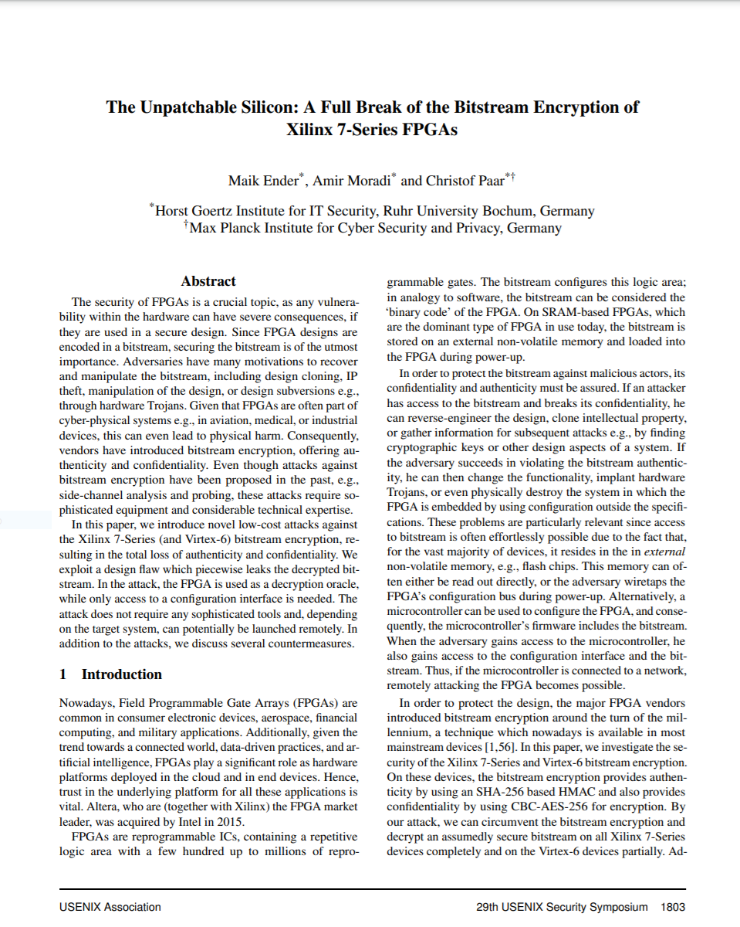
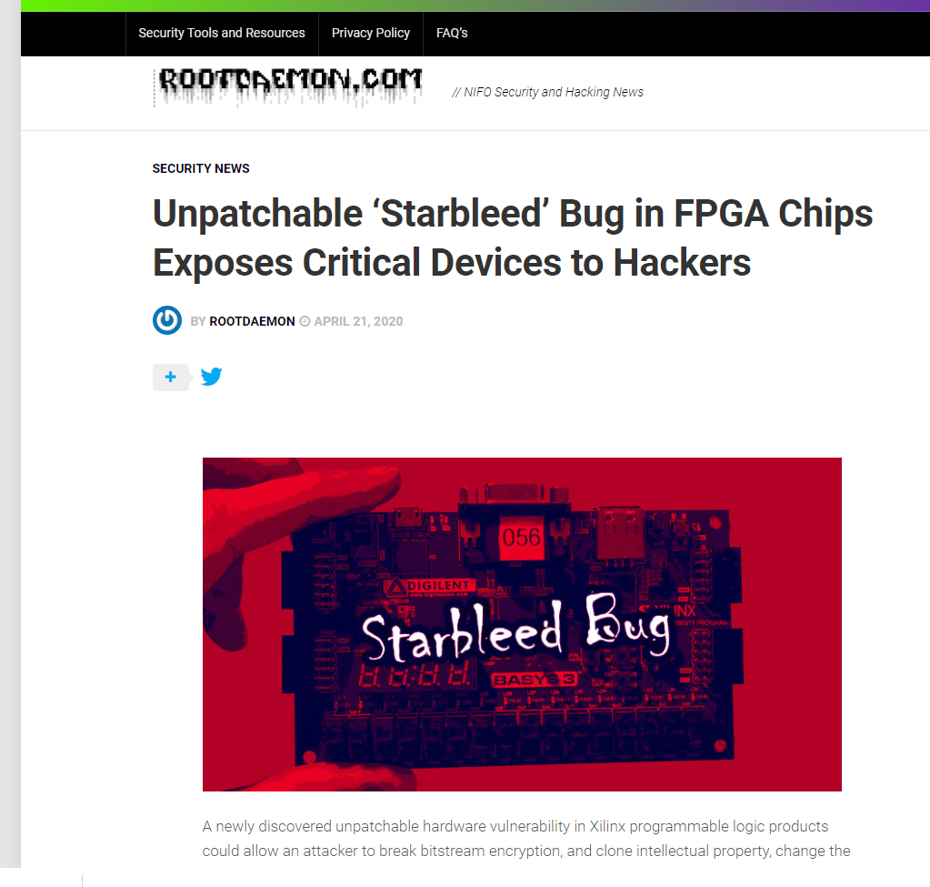
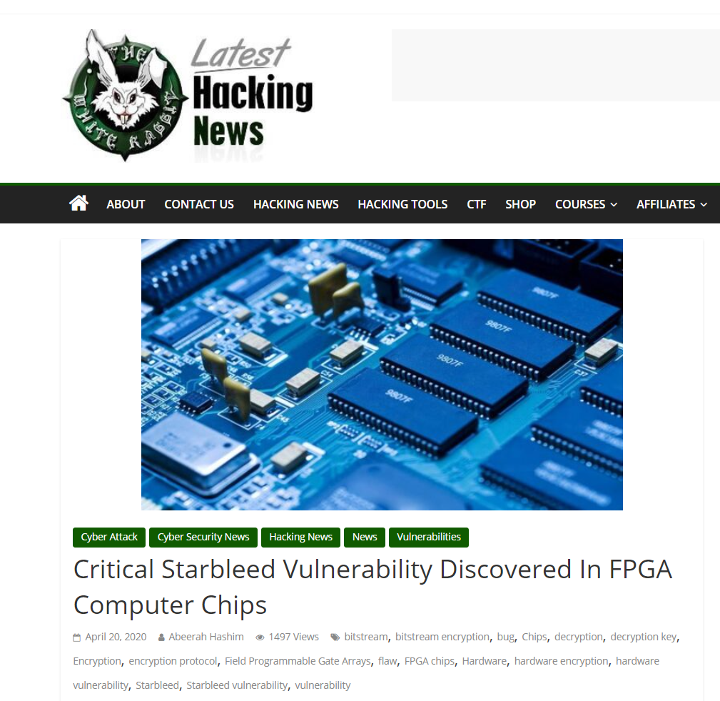
Xilinx FPGA – Starbleed attack

Slide 9
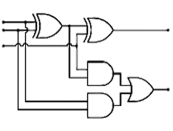

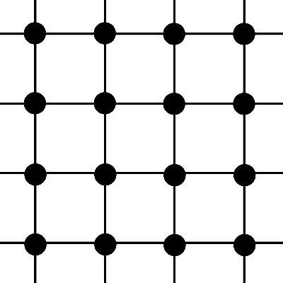
FPGA – Field Programmable Gate Array
Bitstream
“ ”
Configure

Slide 10
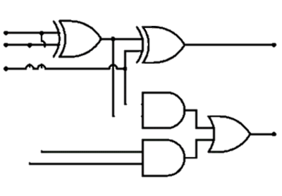
FPGA – Field Programmable Gate Array
Bitstream
“ ”

Slide 11
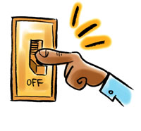
FPGA – Field Programmable Gate Array
Bitstream design typically a business secret (or even a national/military secret)
Bitstream
“ ”
FPGA applications:
  Aerospace and avionics
  Digital signal processors
  Defense and military
  Medical devices
  General hardware accelerators
  (e.g. cryptography)

Slide 12

FPGA – Field Programmable Gate Array
Bitstream
Decrypt bitstream with K
K

Slide 13
FPGA – Field Programmable Gate Array
Bitstream
Decrypt bitstream with K
K

Slide 14
Xilinx Starbleed attack
Bitstream
Decrypt bitstream with K
K
Header
0xaa530282 | ⋯ | ⋯
K_{MAC} | ⋯ | ⋯
⋯ | WRITE WBSTAR | 0x000000000
“ ”
 |  | MAC TAG
WBSTAR: 0x0000000
Encrypted
with AES-CBC
WBSTAR = Warm-Boot Start-address

Slide 15


Xilinx Starbleed attack
Bitstream
Decrypt bitstream with K
K
0xaa530282 | ⋯ | ⋯
⋯ | ⋯ | ⋯
⋯ | WRITE WBSTAR
 |  | BAD TAG
Reboot
Configure
WBSTAR: 0x23da01
Decrypted content of

Slide 16
Xilinx Starbleed attack
Bitstream
Decrypt bitstream with K
“Read out WBSTAR”
K
WBSTAR: 0x23da01

Slide 17
Xilinx Starbleed attack
Bitstream
Decrypt bitstream with K
“Read out WBSTAR”
K
0xaa530282 | ⋯ | ⋯
⋯ | ⋯ | ⋯
⋯ | WRITE WBSTAR
 |  | BAD TAG
Configure
WBSTAR: 0x23da01

Slide 18
Xilinx Starbleed attack
Bitstream
Decrypt bitstream with K
“Read out WBSTAR”
K
0xaa530282 | ⋯ | ⋯
⋯ | ⋯ | ⋯
⋯ | WRITE WBSTAR
 |  | BAD TAG
Reboot
Configure
WBSTAR: 0x556003

Slide 19
Xilinx Starbleed attack
Bitstream
Decrypt bitstream with K
“Read out WBSTAR”
K
0xaa530282 | ⋯ | ⋯
⋯ | ⋯ | ⋯
⋯ | WRITE WBSTAR
 |  | BAD TAG
Reboot
Configure
WBSTAR: 0x009199

Slide 20
Xilinx Starbleed attack
Bitstream
Decrypt bitstream with K
“Read out WBSTAR”
K
0xaa530282 | ⋯ | ⋯
⋯ | ⋯ | ⋯
⋯ | WRITE WBSTAR
 |  | BAD TAG
Reboot
Configure
WBSTAR: 0xffe305

Slide 21
Xilinx Starbleed attack
Bitstream
Decrypt bitstream with K
“Read out WBSTAR”
K
0xaa530282 | ⋯ | ⋯
⋯ | ⋯ | ⋯
⋯ | WRITE WBSTAR
 |  | BAD TAG
Reboot
Configure
WBSTAR: 0x661000

Slide 22
Xilinx Starbleed attack
Bitstream
Decrypt bitstream with K
“Read out WBSTAR”
K
0xaa530282 | ⋯ | ⋯
⋯ | ⋯ | ⋯
⋯ | WRITE WBSTAR
 |  | BAD TAG
Reboot
Configure
WBSTAR: 0x07778d

Slide 23
Xilinx Starbleed attack
Bitstream
Decrypt bitstream with K
“Read out WBSTAR”
K
0xaa530282 | ⋯ | ⋯
⋯ | ⋯ | ⋯
⋯ | WRITE WBSTAR
 |  | BAD TAG
Reboot
Configure
WBSTAR: 0xd65019
Time to fully decrypt 48 MB bitstream: 26 hours

Slide 24
Padding oracles
Full decryption oracles are not always available/needed
Padding attacks:
  Chosen-ciphertext attacks that exploit small timing variations when decrypting different ciphertexts
  Only a limited "decryption" oracle available to the attacker
  First described by Serge Vaudenay (2002) based on CBC-encryption in TLS and IPsec

Slide 25







DTLS padding oracle attack
DTLS padding
$${ C}_{0}$$
$${ C}_{1}$$
$${ C}_{2}$$
$${ C}_{3}$$
 |  |  |  |  |  |  | 01
 |  |  |  |  |  | 02 | 02
 |  |  |  |  | 03 | 03 | 03
$$C=CBC\left(K, M || {MAC}_{K}\left(M\right) || pad\right)$$
$$C=Enc\left(K, M || {MAC}_{K}\left(M\right) || pad\right)$$

Slide 26
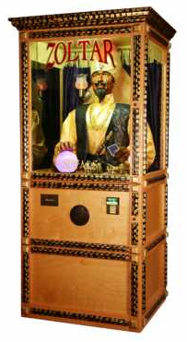
DTLS padding oracle attack
DTLS padding
Valid
$${ C}_{0}$$
$${ C}_{1}$$
$${ C}_{2}$$
$${ C}_{3}$$
 |  |  |  |  |  |  | 01
 |  |  |  |  |  | 02 | 02
Decrypt
 |  |  |  |  | 03 | 03 | 03
 |  |  |  |  | 03 | 03 | 03
$$C=CBC\left(K, M || {MAC}_{K}\left(M\right) || pad\right)$$

Slide 27

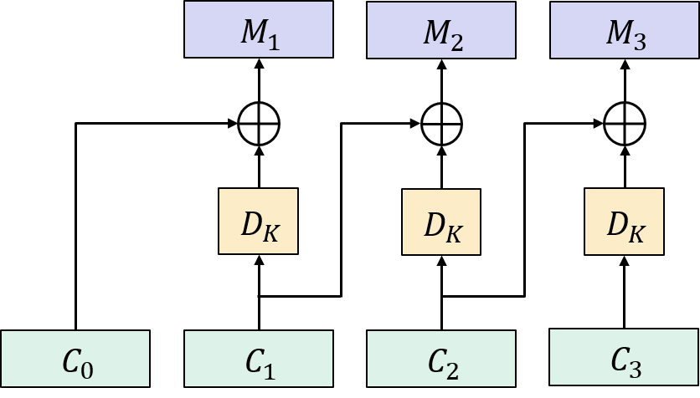




DTLS padding oracle attack
DTLS padding
Invalid
$${ C}_{0}$$
$${ C}_{1}$$
$${ C}_{2}$$
$${ C}_{3}$$
 |  |  |  |  |  |  | 01
 |  |  |  |  |  | 02 | 02
 |  |  |  |  | 03 | 03 | 03
$$R$$
 |  |  |  |  |  |  | 00
Decrypt
$$C=CBC\left(K, M || {MAC}_{K}\left(M\right) || pad\right)$$
 |  | …
 |  |  |  |  |  |  | b3

Slide 28
DTLS padding oracle attack
DTLS padding
Invalid
$${ C}_{0}$$
$${ C}_{1}$$
$${ C}_{2}$$
$${ C}_{3}$$
 |  |  |  |  |  |  | 01
 |  |  |  |  |  | 02 | 02
 |  |  |  |  | 03 | 03 | 03
$$R$$
 |  |  |  |  |  |  | 01
Decrypt
$$C=CBC\left(K, M || {MAC}_{K}\left(M\right) || pad\right)$$
 |  | …
 |  |  |  |  |  |  | 90

Slide 29
DTLS padding oracle attack
DTLS padding
Invalid
$${ C}_{0}$$
$${ C}_{1}$$
$${ C}_{2}$$
$${ C}_{3}$$
 |  |  |  |  |  |  | 01
 |  |  |  |  |  | 02 | 02
 |  |  |  |  | 03 | 03 | 03
$$R$$
 |  |  |  |  |  |  | 02
Decrypt
$$C=CBC\left(K, M || {MAC}_{K}\left(M\right) || pad\right)$$
 |  | …
 |  |  |  |  |  |  | 77

Slide 30
DTLS padding oracle attack
DTLS padding
Invalid
$${ C}_{0}$$
$${ C}_{1}$$
$${ C}_{2}$$
$${ C}_{3}$$
 |  |  |  |  |  |  | 01
 |  |  |  |  |  | 02 | 02
 |  |  |  |  | 03 | 03 | 03
$$R$$
 |  |  |  |  |  |  | 03
Decrypt
$$C=CBC\left(K, M || {MAC}_{K}\left(M\right) || pad\right)$$
 |  | …
 |  |  |  |  |  |  | 32

Slide 31
DTLS padding oracle attack
DTLS padding
Invalid
$${ C}_{0}$$
$${ C}_{1}$$
$${ C}_{2}$$
$${ C}_{3}$$
 |  |  |  |  |  |  | 01
 |  |  |  |  |  | 02 | 02
 |  |  |  |  | 03 | 03 | 03
$$R$$
 |  |  |  |  |  |  | 04
Decrypt
$$C=CBC\left(K, M || {MAC}_{K}\left(M\right) || pad\right)$$
 |  | …
 |  |  |  |  |  |  | b9

Slide 32
DTLS padding oracle attack
DTLS padding
Invalid
$${ C}_{0}$$
$${ C}_{1}$$
$${ C}_{2}$$
$${ C}_{3}$$
 |  |  |  |  |  |  | 01
 |  |  |  |  |  | 02 | 02
 |  |  |  |  | 03 | 03 | 03
$$R$$
 |  |  |  |  |  |  | 05
Decrypt
$$C=CBC\left(K, M || {MAC}_{K}\left(M\right) || pad\right)$$
 |  | …
 |  |  |  |  |  |  | a3

Slide 33





DTLS padding oracle attack
DTLS padding
Valid
$${ C}_{0}$$
$${ C}_{1}$$
$${ C}_{2}$$
$${ C}_{3}$$
 |  |  |  |  |  |  | 01
 |  |  |  |  |  | 02 | 02
$$R\left[0\right]$$
 |  |  |  |  | 03 | 03 | 03
$$R$$
 |  |  |  |  |  |  | 06
Decrypt
$$C=CBC\left(K, M || {MAC}_{K}\left(M\right) || pad\right)$$
 |  | …
 |  |  |  |  |  |  | 01
$$M_{3}\left[0\right]=R\left[0\right]⊕C_{2}\left[0\right]⊕01$$
$$R\left[0\right]⊕Z[0]=01$$
$$Z$$
$$R\left[0\right]⊕\left(C_{2}\left[0\right]⊕M_{3}\left[0\right]\right)=01$$

Slide 34

DTLS padding oracle attack
DTLS padding
Valid
$${ C}_{0}$$
$${ C}_{1}$$
$${ C}_{2}$$
$${ C}_{3}$$
 |  |  |  |  |  |  | 01
 |  |  |  |  |  | 02 | 02
 |  |  |  |  | 03 | 03 | 03
$$R$$
 |  |  |  |  |  |  | 06
Decrypt
$$C=CBC\left(K, M || {MAC}_{K}\left(M\right) || pad\right)$$
 |  | …
 |  |  |  |  |  |  | 01
$$M_{3}\left[0\right]=R\left[0\right]⊕C_{2}\left[0\right]⊕01$$
$$R\left[0\right]⊕Z[0]=01$$
$$Z$$
$$R\left[0\right]←R\left[0\right]⊕01⊕02 (=05)$$

Slide 35
DTLS padding oracle attack
DTLS padding
$${ C}_{0}$$
$${ C}_{1}$$
$${ C}_{2}$$
$${ C}_{3}$$
 |  |  |  |  |  |  | 01
 |  |  |  |  |  | 02 | 02
 |  |  |  |  | 03 | 03 | 03
$$R$$
 |  |  |  |  |  |  | 05
$$C=CBC\left(K, M || {MAC}_{K}\left(M\right) || pad\right)$$
$$M_{3}\left[0\right]=R\left[0\right]⊕C_{2}\left[0\right]⊕01$$
$$Z$$

Slide 36
DTLS padding oracle attack
DTLS padding
Invalid
$${ C}_{0}$$
$${ C}_{1}$$
$${ C}_{2}$$
$${ C}_{3}$$
 |  |  |  |  |  |  | 01
 |  |  |  |  |  | 02 | 02
 |  |  |  |  | 03 | 03 | 03
$$R$$
 |  |  |  |  |  | 00 | 05
Decrypt
$$C=CBC\left(K, M || {MAC}_{K}\left(M\right) || pad\right)$$
 |  | …
 |  |  |  |  |  | 83 | 02
$$M_{3}\left[0\right]=R\left[0\right]⊕C_{2}\left[0\right]⊕01$$
$$Z$$

Slide 37
DTLS padding oracle attack
DTLS padding
Invalid
$${ C}_{0}$$
$${ C}_{1}$$
$${ C}_{2}$$
$${ C}_{3}$$
 |  |  |  |  |  |  | 01
 |  |  |  |  |  | 02 | 02
 |  |  |  |  | 03 | 03 | 03
$$R$$
 |  |  |  |  |  | 01 | 05
Decrypt
$$C=CBC\left(K, M || {MAC}_{K}\left(M\right) || pad\right)$$
 |  | …
 |  |  |  |  |  | 96 | 02
$$M_{3}\left[0\right]=R\left[0\right]⊕C_{2}\left[0\right]⊕01$$
$$Z$$

Slide 38
DTLS padding oracle attack
DTLS padding
Invalid
$${ C}_{0}$$
$${ C}_{1}$$
$${ C}_{2}$$
$${ C}_{3}$$
 |  |  |  |  |  |  | 01
 |  |  |  |  |  | 02 | 02
 |  |  |  |  | 03 | 03 | 03
$$R$$
 |  |  |  |  |  | 02 | 05
Decrypt
$$C=CBC\left(K, M || {MAC}_{K}\left(M\right) || pad\right)$$
 |  | …
 |  |  |  |  |  | de | 02
$$M_{3}\left[0\right]=R\left[0\right]⊕C_{2}\left[0\right]⊕01$$
$$Z$$

Slide 39




DTLS padding oracle attack
DTLS padding
Valid!
$${ C}_{0}$$
$${ C}_{1}$$
$${ C}_{2}$$
$${ C}_{3}$$
 |  |  |  |  |  |  | 01
 |  |  |  |  |  | 02 | 02
$$R\left[1\right]$$
 |  |  |  |  | 03 | 03 | 03
$$R$$
 |  |  |  |  |  | 03 | 05
Decrypt
$$C=CBC\left(K, M || {MAC}_{K}\left(M\right) || pad\right)$$
 |  | …
 |  |  |  |  |  | 02 | 02
$$M_{3}\left[0\right]=R\left[0\right]⊕C_{2}\left[0\right]⊕01$$
$$R\left[1\right]⊕Z[1]=02$$
$$Z$$
$$M_{3}\left[1\right]=R\left[1\right]⊕C_{2}\left[1\right]⊕02$$
$$R\left[1\right]⊕\left(C_{2}\left[1\right]⊕M_{3}\left[1\right]\right)=02$$

Slide 40


DTLS padding oracle attack
DTLS padding
Valid!
$${ C}_{0}$$
$${ C}_{1}$$
$${ C}_{2}$$
$${ C}_{3}$$
 |  |  |  |  |  |  | 01
 |  |  |  |  |  | 02 | 02
 |  |  |  |  | 03 | 03 | 03
$$R$$
 |  |  |  |  |  | 02 | 06
Decrypt
$$C=CBC\left(K, M || {MAC}_{K}\left(M\right) || pad\right)$$
 |  | …
 |  |  |  |  |  | 02 | 02
$$M_{3}\left[0\right]=R\left[0\right]⊕C_{2}\left[0\right]⊕01$$
$$R\left[1\right]⊕Z[1]=02$$
$$Z$$
$$M_{3}\left[1\right]=R\left[1\right]⊕C_{2}\left[1\right]⊕02$$
$$R\left[0\right]←R\left[0\right]⊕02⊕03 (=06)$$
$$R\left[1\right]←R\left[1\right]⊕02⊕03 (=02)$$

Slide 41
DTLS padding oracle attack
DTLS padding
Invalid
$${ C}_{0}$$
$${ C}_{1}$$
$${ C}_{2}$$
$${ C}_{3}$$
 |  |  |  |  |  |  | 01
 |  |  |  |  |  | 02 | 02
 |  |  |  |  | 03 | 03 | 03
$$R$$
 |  |  |  |  | 00 | 02 | 06
Decrypt
$$C=CBC\left(K, M || {MAC}_{K}\left(M\right) || pad\right)$$
 |  | …
 |  |  |  |  | 5d | 03 | 03
$$M_{3}\left[0\right]=R\left[0\right]⊕C_{2}\left[0\right]⊕01$$
$$Z$$
$$M_{3}\left[1\right]=R\left[1\right]⊕C_{2}\left[1\right]⊕02$$

Slide 42
DTLS padding oracle attack
DTLS padding
Invalid
$${ C}_{0}$$
$${ C}_{1}$$
$${ C}_{2}$$
$${ C}_{3}$$
 |  |  |  |  |  |  | 01
 |  |  |  |  |  | 02 | 02
 |  |  |  |  | 03 | 03 | 03
$$R$$
 |  |  |  |  | 01 | 02 | 06
Decrypt
$$C=CBC\left(K, M || {MAC}_{K}\left(M\right) || pad\right)$$
 |  | …
 |  |  |  |  | 87 | 03 | 03
$$M_{3}\left[0\right]=R\left[0\right]⊕C_{2}\left[0\right]⊕01$$
$$Z$$
$$M_{3}\left[1\right]=R\left[1\right]⊕C_{2}\left[1\right]⊕02$$

Slide 43
DTLS padding oracle attack
DTLS padding
Invalid
$${ C}_{0}$$
$${ C}_{1}$$
$${ C}_{2}$$
$${ C}_{3}$$
 |  |  |  |  |  |  | 01
 |  |  |  |  |  | 02 | 02
 |  |  |  |  | 03 | 03 | 03
$$R$$
 |  |  |  |  | 02 | 02 | 06
Decrypt
$$C=CBC\left(K, M || {MAC}_{K}\left(M\right) || pad\right)$$
 |  | …
 |  |  |  |  | 43 | 03 | 03
$$M_{3}\left[0\right]=R\left[0\right]⊕C_{2}\left[0\right]⊕01$$
$$Z$$
$$M_{3}\left[1\right]=R\left[1\right]⊕C_{2}\left[1\right]⊕02$$

Slide 44
DTLS padding oracle attack
DTLS padding
Invalid
$${ C}_{0}$$
$${ C}_{1}$$
$${ C}_{2}$$
$${ C}_{3}$$
 |  |  |  |  |  |  | 01
 |  |  |  |  |  | 02 | 02
 |  |  |  |  | 03 | 03 | 03
$$R$$
 |  |  |  |  | 03 | 02 | 06
Decrypt
$$C=CBC\left(K, M || {MAC}_{K}\left(M\right) || pad\right)$$
 |  | …
 |  |  |  |  | 66 | 03 | 03
$$M_{3}\left[0\right]=R\left[0\right]⊕C_{2}\left[0\right]⊕01$$
$$Z$$
$$M_{3}\left[1\right]=R\left[1\right]⊕C_{2}\left[1\right]⊕02$$

Slide 45

DTLS padding oracle attack
DTLS padding
Valid!
$${ C}_{0}$$
$${ C}_{1}$$
$${ C}_{2}$$
$${ C}_{3}$$
 |  |  |  |  |  |  | 01
 |  |  |  |  |  | 02 | 02
 |  |  |  |  | 03 | 03 | 03
$$R$$
 |  |  |  |  | f7 | 02 | 06
Decrypt
$$C=CBC\left(K, M || {MAC}_{K}\left(M\right) || pad\right)$$
 |  | …
 |  |  |  |  | 03 | 03 | 03
$$M_{3}\left[0\right]=R\left[0\right]⊕C_{2}\left[0\right]⊕01$$
$$Z$$
$$M_{3}\left[1\right]=R\left[1\right]⊕C_{2}\left[1\right]⊕02$$
…continue process until we've found all of $M_{3}$
$$M_{3}\left[2\right]=R\left[2\right]⊕C_{2}\left[2\right]⊕03$$

Slide 46
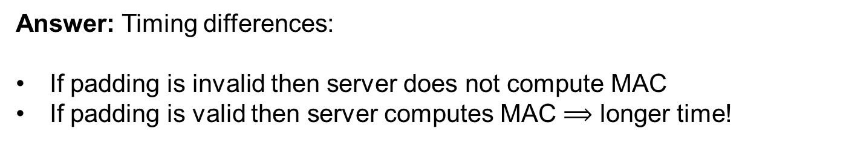

DTLS padding oracle attack
DTLS padding
Valid!
$${ C}_{0}$$
$${ C}_{1}$$
$${ C}_{2}$$
$${ C}_{3}$$
 |  |  |  |  |  |  | 01
 |  |  |  |  |  | 02 | 02
 |  |  |  |  | 03 | 03 | 03
But how do we get to act like ?
$$C=CBC\left(K, M || {MAC}_{K}\left(M\right) || pad\right)$$
Answer: Timing differences:
If padding is invalid then server does not compute MAC
If padding is valid then server computes MAC $⟹$ longer time!
Repeat attack to decrypt $C_{2},$ $C_{1}, …$

Slide 47
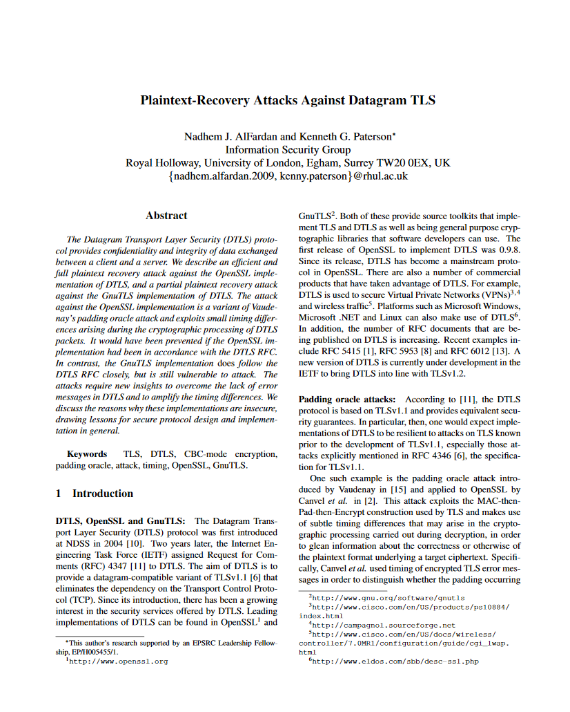
DTLS padding oracle attack
DTLS padding
Valid!
$${ C}_{0}$$
$${ C}_{1}$$
$${ C}_{2}$$
$${ C}_{3}$$
 |  |  |  |  |  |  | 01
 |  |  |  |  |  | 02 | 02
 |  |  |  |  | 03 | 03 | 03
But how do we get to act like ?
$$C=CBC\left(K, M || {MAC}_{K}\left(M\right) || pad\right)$$
Answer: Timing differences:
If padding is invalid then server does not compute MAC
If padding is valid then server computes MAC $⟹$ longer time!

Slide 48
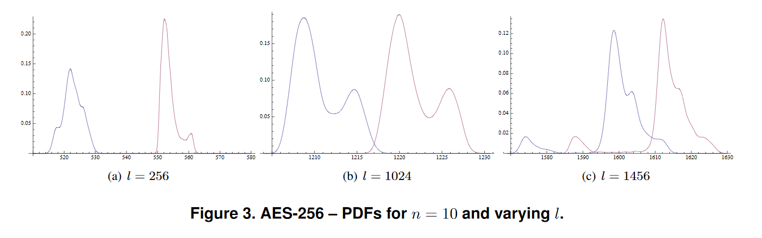
DTLS padding oracle attack
Timing difference between valid and invalid padding: a few μs
  Enough to carry out the attack
  Repeat attack n = 10 – 50 times per byte to filter out timing noise
  Able to decrypt each byte with probability 0.97–0.99
Valid padding
Invalid padding
Notes:
X-axis: RTT in us
Y-axis: probability of observing RTT for n = 10

Slide 49
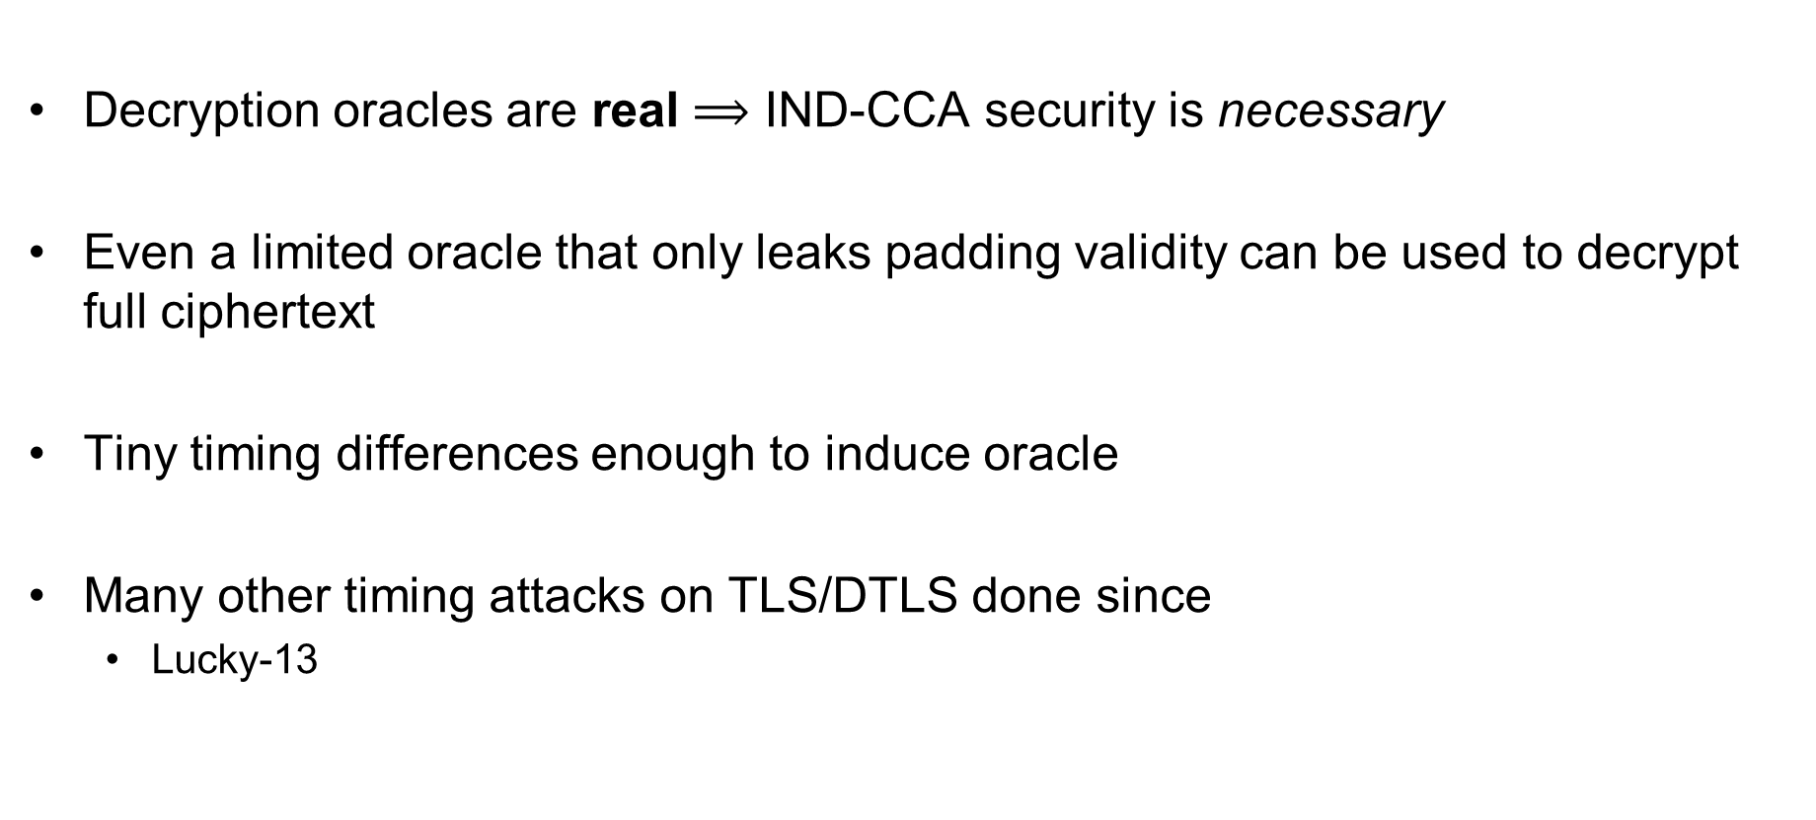
DTLS padding oracle attack – conclusions
Decryption oracles are real $⟹$ IND-CCA security is necessary
Even a limited oracle that only leaks padding validity can be used to decrypt full ciphertext
Tiny timing differences enough to induce oracle
Many other timing attacks on TLS/DTLS done since
  Lucky-13

Slide 50
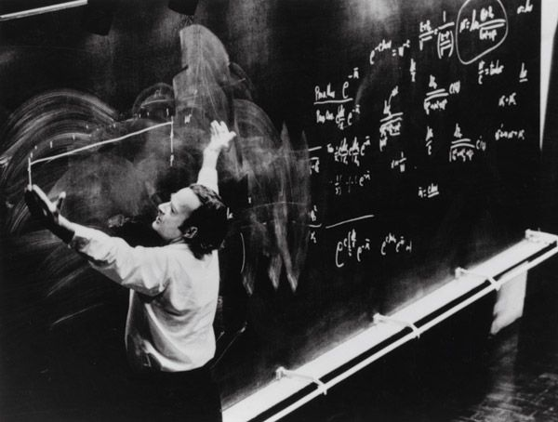
Authenticated encryption – definitions

Slide 51
Authenticated encryption
Want privacy and integrity from a single primitive:
an authenticated encryption scheme
Syntactically the same as a normal encryption scheme

Slide 52
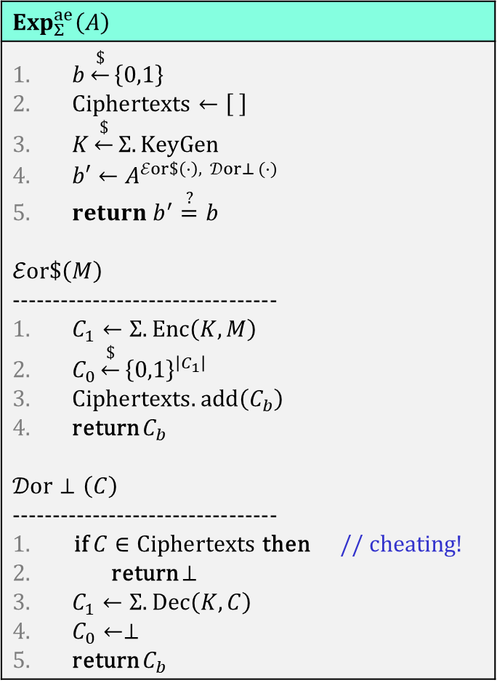
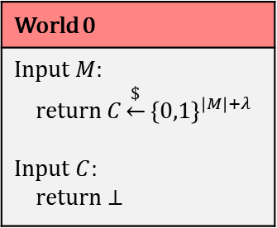
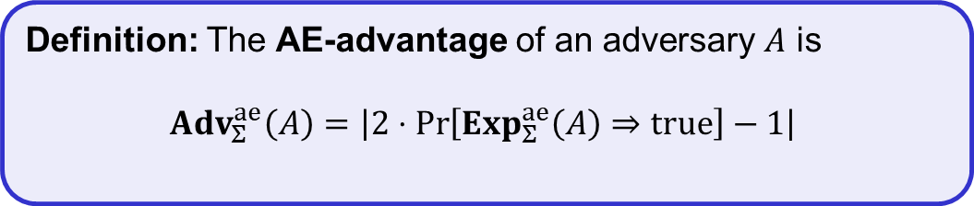
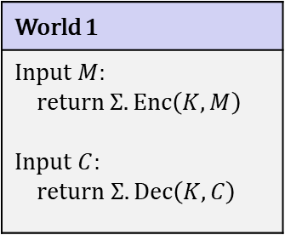
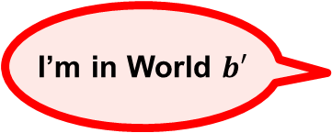
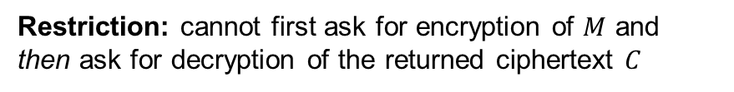
Authenticated encryption – security
$$Exp_{Σ}^{ae}\left(A\right)$$
$b\underset{←}{\$}\left\{0,1\right\}$ $Ciphertexts←\left[ \right]$ $K\underset{←}{\$}Σ.KeyGen$ $b′←A^{ℰor\$\left(⋅\right), 𝒟or⊥ (⋅)}$ $return b^{′}\overset{?}{=}b$ $$ℰor\$\left(M\right)$$ --------------------------------- $C_{1}←Σ.Enc\left(K, M\right)$ $C_{0}\underset{←}{\$}{\left\{0,1\right\}}^{\left|C_{1}\right| }$ $Ciphertexts.add\left(C_{b}\right)$ return $C_{b}$ $$𝒟or⊥\left(C\right)$$ --------------------------------- if $C∈Ciphertexts$ then // cheating! return $⊥$ $C_{1}←Σ.Dec\left(K, C\right)$ $C_{0}←⊥$ return $C_{b}$
World 1
Input $M$: return $Σ.Enc\left(K, M\right)$ Input $C$: return $Σ.Dec\left(K,C\right)$
World 0
Input $M$: return $C\underset{←}{\$}{\left\{0,1\right\}}^{\left|M\right|+λ}$ Input $C$: return $⊥$
I’m in World $b′$
Restriction: cannot first ask for encryption of $M$ and then ask for decryption of the returned ciphertext $C$
Definition: The AE-advantage of an adversary $A$ is
$${Adv}_{Σ}^{ae}\left(A\right)=\left|2⋅\operatorname{Pr}\left[Exp_{Σ}^{ae}\left(A\right)⇒true\right]−1\right|$$

Slide 53
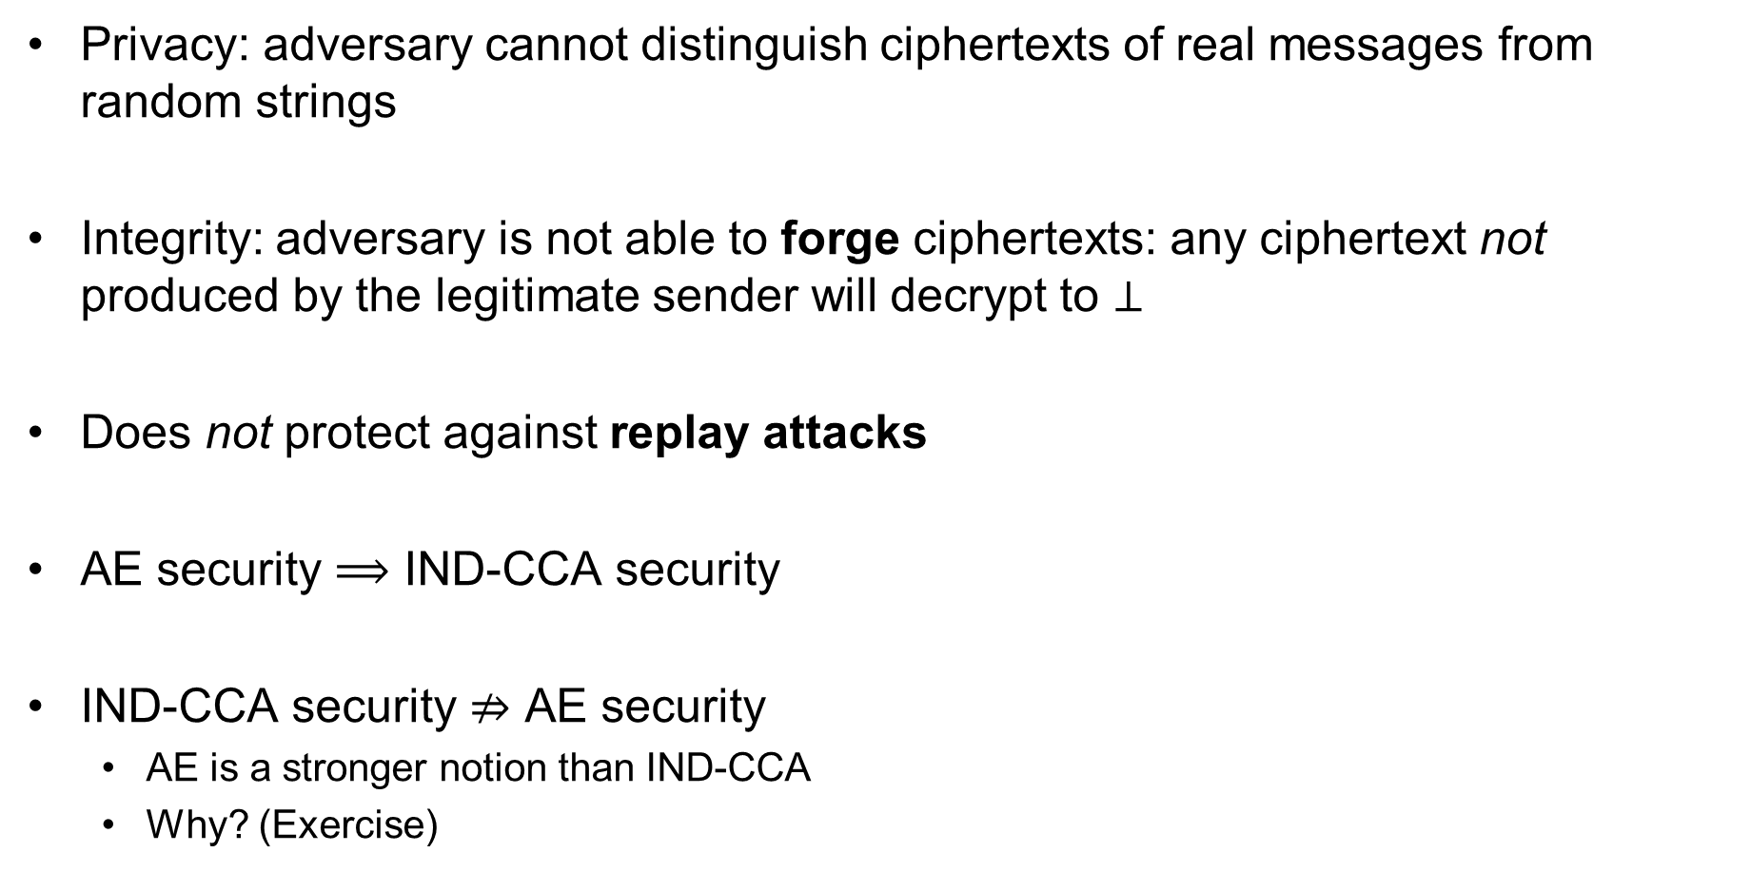
AE security definition – implications
Privacy: adversary cannot distinguish ciphertexts of real messages from random strings
Integrity: adversary is not able to forge ciphertexts: any ciphertext not produced by the legitimate sender will decrypt to $⊥$
Does not protect against replay attacks
AE security $⟹$ IND-CCA security
IND-CCA security $⇏$ AE security
  AE is a stronger notion than IND-CCA
  Why? (Exercise)

Slide 54
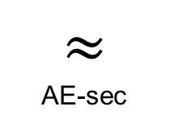
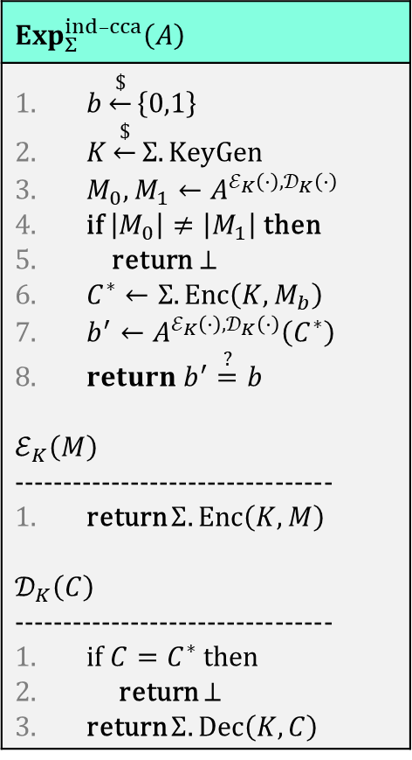

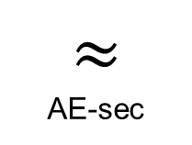
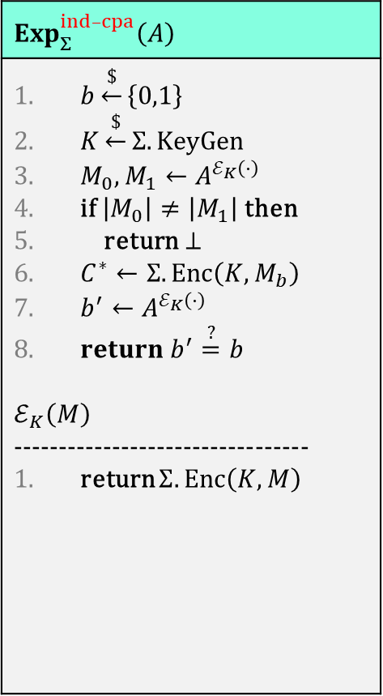
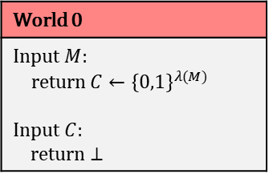
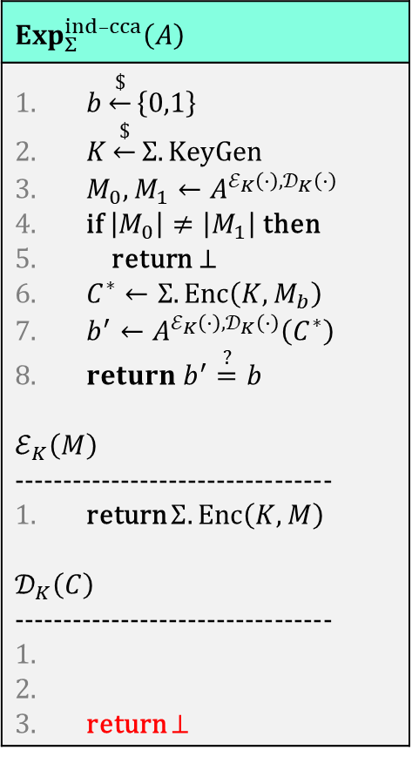
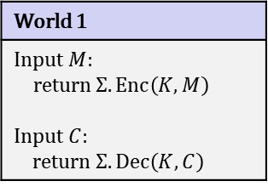
AE $⟹$ IND-CCA
World 1
Input $M$: return $Σ.Enc\left(K, M\right)$ Input $C$: return $Σ.Dec\left(K,C\right)$
World 0
Input $M$: return $C←{\left\{0,1\right\}}^{λ(M)}$ Input $C$: return $⊥$
$$≈$$
AE-sec
$$Exp_{Σ}^{ind–cca}\left(A\right)$$
$b\underset{←}{\$}\left\{0,1\right\}$ $K\underset{←}{\$}Σ.KeyGen$ $M_{0},M_{1}←A^{ℰ_{K}\left(⋅\right),𝒟_{K}\left(⋅\right)}$ if $\left|M_{0}\right|≠\left|M_{1}\right|$ then return $⊥$ $C^{∗}←Σ.Enc\left(K, M_{b}\right)$ $b^{′}←A^{ℰ_{K}\left(⋅\right),𝒟_{K}\left(⋅\right)}\left(C^{∗}\right)$ $return b^{′}\overset{?}{=}b$ $$ℰ_{K}\left(M\right)$$ --------------------------------- return $Σ.Enc\left(K, M\right)$ $$𝒟_{K}\left(C\right)$$ --------------------------------- if $C=C^{∗}$ then return $⊥$ return $Σ.Dec\left(K, C\right)$
$$Exp_{Σ}^{ind–cca}\left(A\right)$$
$b\underset{←}{\$}\left\{0,1\right\}$ $K\underset{←}{\$}Σ.KeyGen$ $M_{0},M_{1}←A^{ℰ_{K}\left(⋅\right),𝒟_{K}\left(⋅\right)}$ if $\left|M_{0}\right|≠\left|M_{1}\right|$ then return $⊥$ $C^{∗}←Σ.Enc\left(K, M_{b}\right)$ $b^{′}←A^{ℰ_{K}\left(⋅\right),𝒟_{K}\left(⋅\right)}\left(C^{∗}\right)$ $return b^{′}\overset{?}{=}b$ $$ℰ_{K}\left(M\right)$$ --------------------------------- return $Σ.Enc\left(K, M\right)$ $$𝒟_{K}\left(C\right)$$ --------------------------------- return $⊥$
$$Exp_{Σ}^{ind–cpa}\left(A\right)$$
$b\underset{←}{\$}\left\{0,1\right\}$ $K\underset{←}{\$}Σ.KeyGen$ $M_{0},M_{1}←A^{ℰ_{K}\left(⋅\right) }$ if $\left|M_{0}\right|≠\left|M_{1}\right|$ then return $⊥$ $C^{∗}←Σ.Enc\left(K, M_{b}\right)$ $b^{′}←A^{ℰ_{K}\left(⋅\right) }$ $return b^{′}\overset{?}{=}b$ $$ℰ_{K}\left(M\right)$$ --------------------------------- return $Σ.Enc\left(K, M\right)$
$$≈$$
AE-sec
$$≈$$

Slide 55
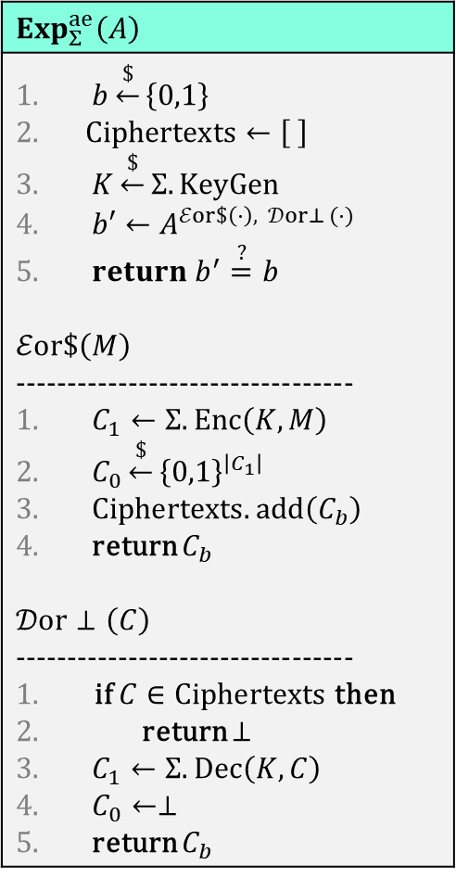
AE $⟹$ IND-CPA
$$Exp_{Σ}^{ae}\left(A\right)$$
$b\underset{←}{\$}\left\{0,1\right\}$ $Ciphertexts←\left[ \right]$ $K\underset{←}{\$}Σ.KeyGen$ $b′←A^{ℰor\$\left(⋅\right), 𝒟or⊥ (⋅)}$ $return b^{′}\overset{?}{=}b$ $$ℰor\$\left(M\right)$$ --------------------------------- $C_{1}←Σ.Enc\left(K, M\right)$ $C_{0}\underset{←}{\$}{\left\{0,1\right\}}^{\left|C_{1}\right| }$ $Ciphertexts.add\left(C_{b}\right)$ return $C_{b}$ $$𝒟or⊥\left(C\right)$$ --------------------------------- if $C∈Ciphertexts$ then return $⊥$ $C_{1}←Σ.Dec\left(K, C\right)$ $C_{0}←⊥$ return $C_{b}$

Slide 56
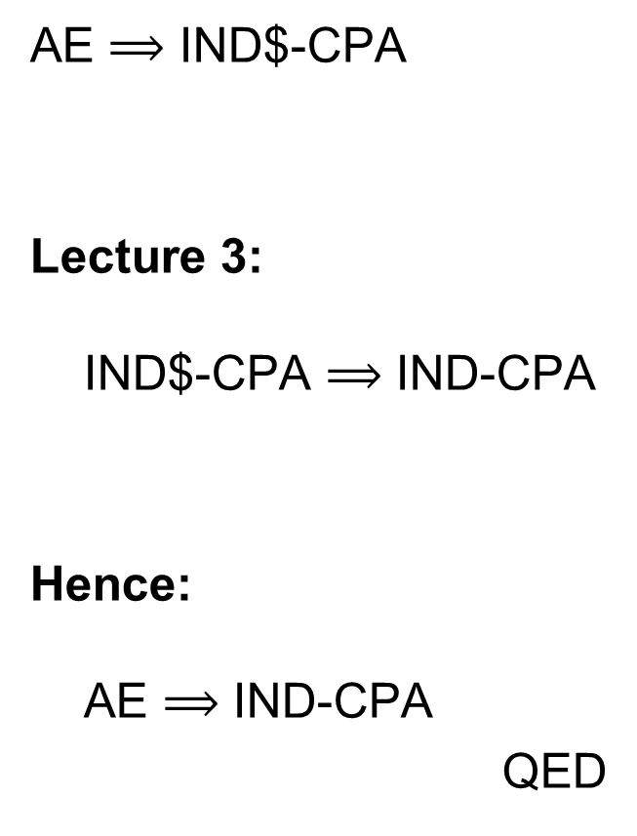

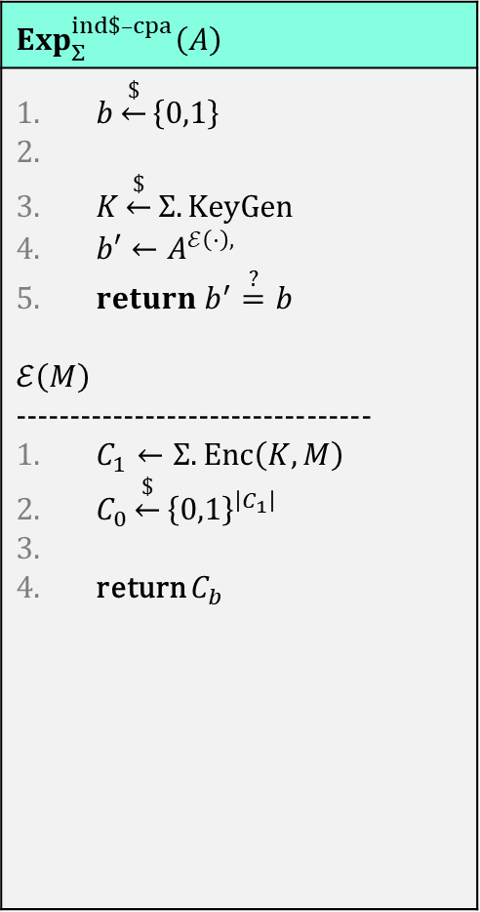
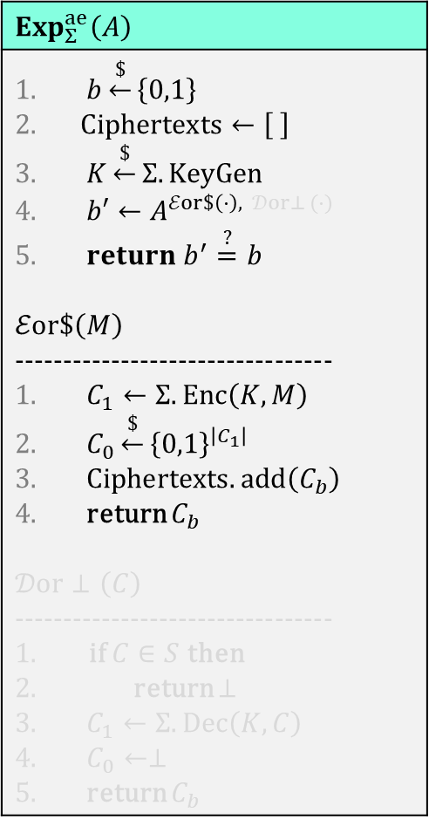
AE $⟹$ IND-CPA
$$Exp_{Σ}^{ae}\left(A\right)$$
$b\underset{←}{\$}\left\{0,1\right\}$ $Ciphertexts←\left[ \right]$ $K\underset{←}{\$}Σ.KeyGen$ $b′←A^{ℰor\$\left(⋅\right), 𝒟or⊥ (⋅)}$ $return b^{′}\overset{?}{=}b$ $$ℰor\$\left(M\right)$$ --------------------------------- $C_{1}←Σ.Enc\left(K, M\right)$ $C_{0}\underset{←}{\$}{\left\{0,1\right\}}^{\left|C_{1}\right| }$ $Ciphertexts.add\left(C_{b}\right)$ return $C_{b}$ $$𝒟or⊥\left(C\right)$$ --------------------------------- if $C∈S$ then return $⊥$ $C_{1}←Σ.Dec\left(K, C\right)$ $C_{0}←⊥$ return $C_{b}$
$$Exp_{Σ}^{ind\$–cpa}\left(A\right)$$
$b\underset{←}{\$}\left\{0,1\right\}$ $K\underset{←}{\$}Σ.KeyGen$ $b′←A^{ℰ\left(⋅\right),}$ $return b^{′}\overset{?}{=}b$ $$ℰ\left(M\right)$$ --------------------------------- $C_{1}←Σ.Enc\left(K, M\right)$ $C_{0}\underset{←}{\$}{\left\{0,1\right\}}^{\left|C_{1}\right| }$ return $C_{b}$
AE $⟹$ IND$-CPA
Lecture 3:
IND$-CPA $⟹$ IND-CPA
Hence:
AE $⟹$ IND-CPA
QED
$$≈$$

Slide 57

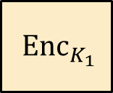









Generic composition: AE from Encryption + MAC
MAC-then-Encrypt (MtE)
Encrypt-and-MAC (E&M)
Encrypt-then-MAC (EtM)
$$M$$ | $${MAC}_{K_{2}}\left(M\right)$$
$$M$$
$$M$$
$${ Enc}_{K_{1}}$$
$${ Enc}_{K_{1}}$$
$${ Enc}_{K_{1}}$$
$$C$$
$$C$$
$${ MAC}_{K_{2}}\left(M\right)$$
$$C$$
$${MAC}_{K_{2}}\left(C\right)$$

Slide 58





Generic composition: secure?
Suppose $Enc$ is IND$-CPA secure and $MAC$ is PRF-secure*; which combination is secure?
MtE: $C←Enc\left(K_{1}, M || MAC\left(K_{2}, M\right)\right)$
  Used in TLS up to TLS 1.2
E&M: $C || T←Enc\left(K_{1}, M\right) || MAC\left(K_{2}, M\right)$
  Used in SSH
EtM: $C || T←Enc\left(K_{1}, M\right) || MAC\left(K_{2}, C\right)$
  Used in IPsec
  MAC must cover all of $C$ (including IVs)
  *which implies UF-CMA security
✗
$$\$\$\$\$ || Enc\left(K_{1}, M,MAC\left(K_{2}, M\right)\right)$$
$$C$$
✗
$$Enc\left(K_{1}, M\right) || M || {MAC}^{′}\left(K_{2}, M\right)$$
$$MAC\left(K_{2}, M\right)$$
✓

Slide 59
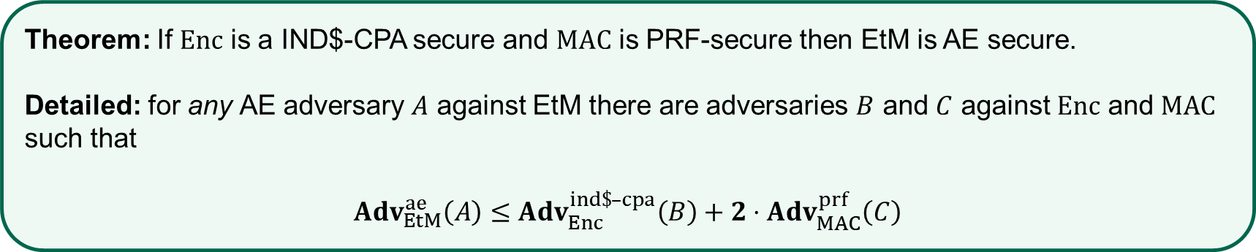

EtM – security
Proof intuition:
  If $A$ can forge a ciphertext for EtM $⟹$ a forgery against $MAC$ (and hence its PRF-security)
  Conditioning on $A$ not forging a ciphertext (hence the $𝒟or⊥$ oracle always returns $⊥$)
  then the AE game is equivalent to the IND$-CPA game
  $$\operatorname{Pr}\left[A wins\right]≤Pr\left[A wins | \overline{forge C}\right]+\operatorname{Pr}\left[forge C\right]≤\operatorname{Pr}\left[B wins\right]+Pr[C wins]$$
Theorem: If $Enc$ is a IND$-CPA secure and $MAC$ is PRF-secure then EtM is AE secure.
Detailed: for any AE adversary $A$ against EtM there are adversaries $B$ and $C$ against $Enc$ and $MAC$ such that
$Adv_{EtM}^{ae}\left(A\right)≤$ $Adv_{Enc}^{ind\$–cpa}\left(B\right)+2⋅Adv_{MAC}^{prf}\left(C\right)$

Slide 60
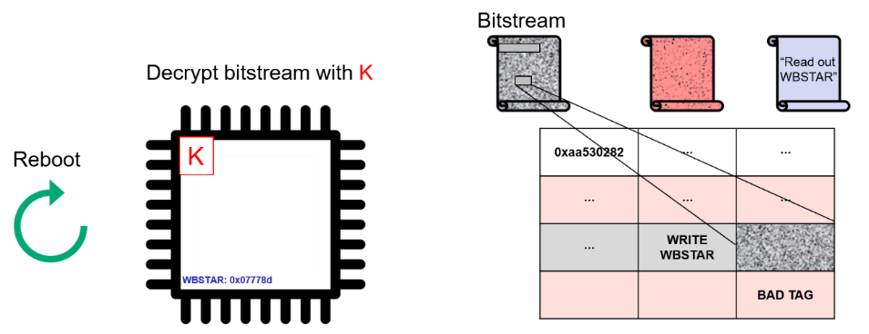
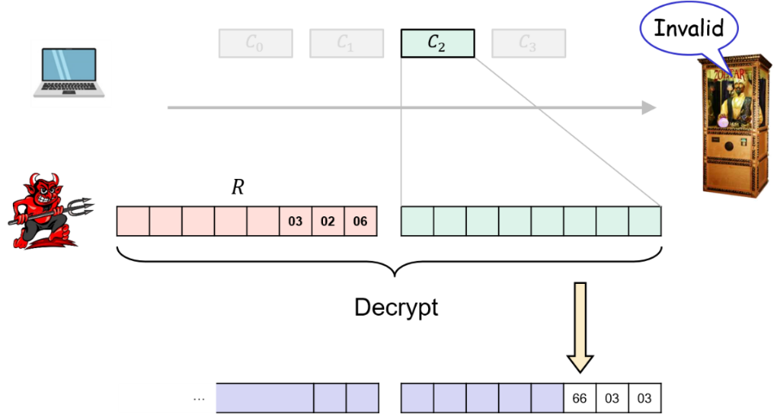
CCA-attacks – revisited
MtE used in both Starbleed attack
and in DTLS padding oracle attack
Gave rise to (partial) decryption oracles
Attacks would not have been possible
with an AE secure scheme

Slide 61
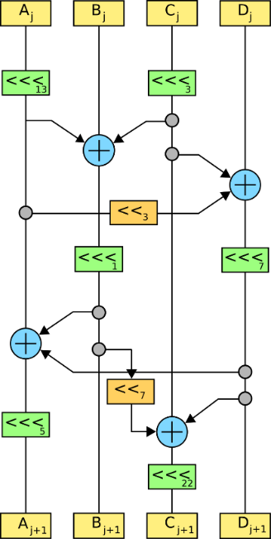

AEAD – Authenticated encryption with associated data

Slide 62
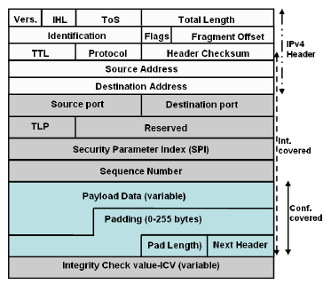


AEAD – AE with associated data (AD)
AD – data that can't be encrypted but still need integrity protection
  Headers in protocols
  Configuration data
  Metadata
Integrity protected
$$AD$$
$$M$$
Privacy protected
Notes:
Example: Filenames of (encrypted) files on disk

Slide 63

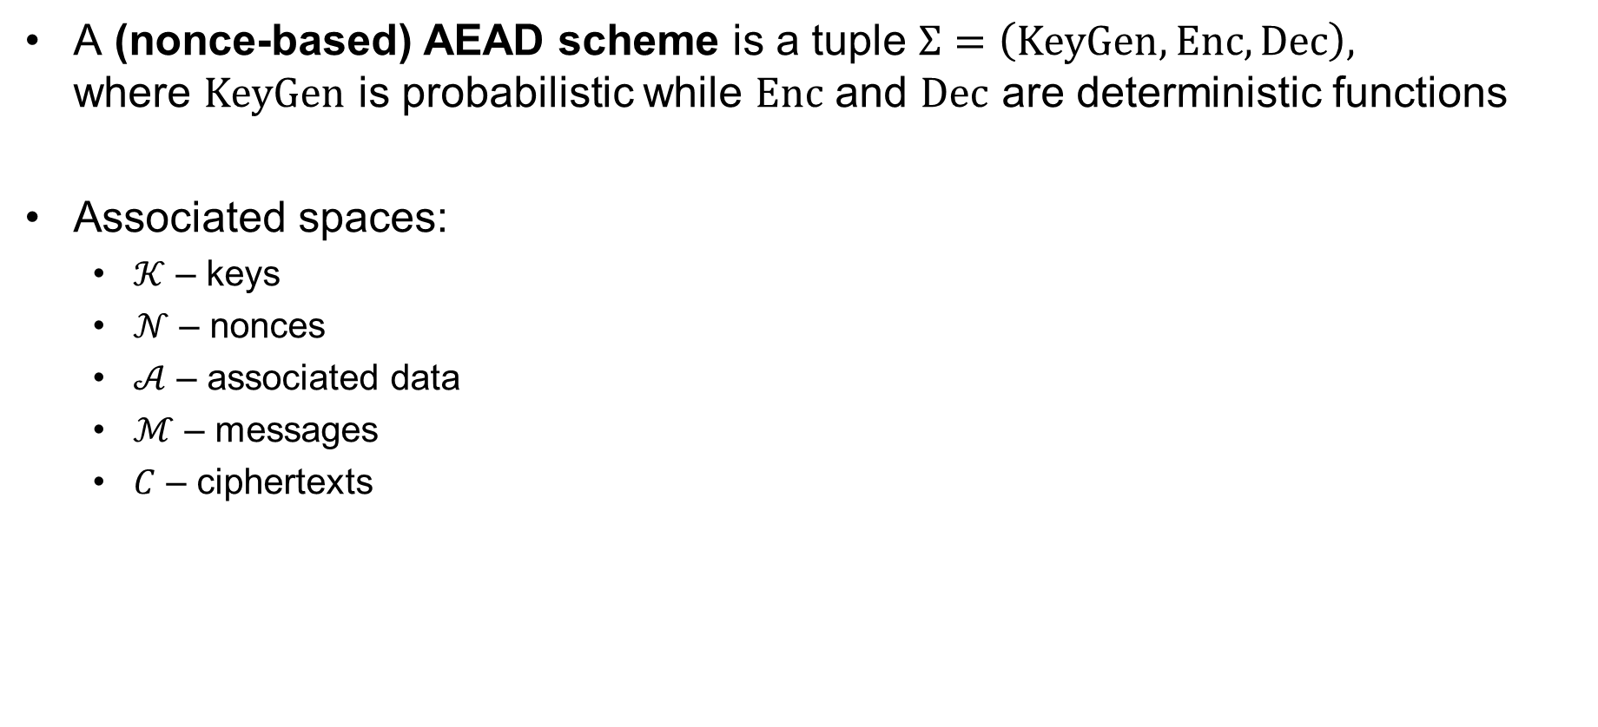
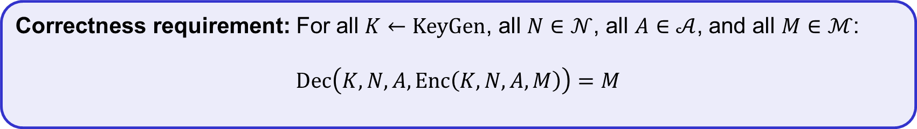
AEAD – syntax (nonce-based)
A (nonce-based) AEAD scheme is a tuple $Σ=\left(KeyGen, Enc, Dec\right),$
where $KeyGen$ is probabilistic while $Enc$ and $Dec$ are deterministic functions
Associated spaces:
  $𝒦$ – keys
  $𝒩$ – nonces
  $𝒜$ – associated data
  $ℳ$ – messages
  $C$ – ciphertexts
$$Enc :𝒦×𝒩×𝒜×ℳ→𝒞$$
$$Enc\left(K, N, A, M\right)={Enc}_{K}\left(N, A, M\right)={Enc}_{K}^{N}\left(A, M\right)={Enc}_{K}^{N, A}\left(M\right)$$
$$Dec :𝒦×𝒩×𝒜×𝒞→ℳ∪\left\{⊥\right\}$$
$$Dec\left(K, N, A, C\right)={Dec}_{K}\left(N, A, C\right)={Dec}_{K}^{N}\left(A, C\right)={Dec}_{K}^{N, A}\left(C\right)$$
Correctness requirement: For all $K←KeyGen$, all $N∈𝒩$, all $A∈𝒜$, and all $M∈ℳ$:
$$Dec\left(K, N, A, Enc\left(K, N, A, M\right)\right)=M$$

Slide 64
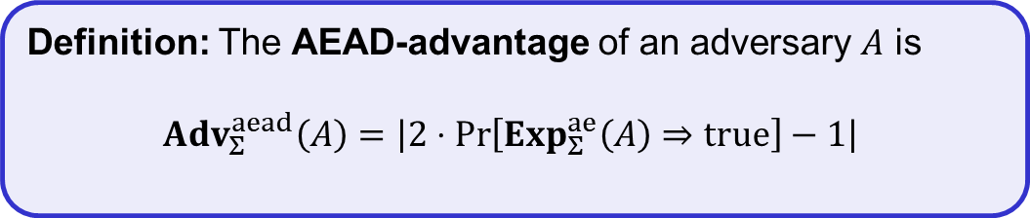

AEAD security (nonce-based)
$$Exp_{Σ}^{aead}\left(A\right)$$
$b\underset{←}{\$}\left\{0,1\right\}$ $Nonces←\left[ \right]$ $Ciphertexts←\left[ \right]$ $K\underset{←}{\$}Σ.KeyGen$ $b′←A^{ℰor\$\left(⋅,⋅,⋅\right), 𝒟or⊥ (⋅,⋅,⋅)}$ $return b^{′}\overset{?}{=}b$ $$ℰor\$\left(N, A,M\right)$$ --------------------------------- if $N∈Nonces$ then // cheating! return $⊥$ $C_{1}←Σ.Enc\left(K, N, A,M\right)$ $C_{0}\underset{←}{\$}{\left\{0,1\right\}}^{\left|C_{1}\right| }$ $Nonces.add(N)$ Ciphertexts$.add\left(C_{b}\right)$ return $C_{b}$ | $$𝒟or⊥\left(N, A, C\right)$$ --------------------------------- if $C∈Ciphertexts$ then // cheating! return $⊥$ $C_{1}←Σ.Dec\left(K, N, A,C\right)$ $C_{0}←⊥$ return $C_{b}$
Definition: The AEAD-advantage of an adversary $A$ is
$${Adv}_{Σ}^{aead}\left(A\right)=\left|2⋅\operatorname{Pr}\left[Exp_{Σ}^{ae}\left(A\right)⇒true\right]−1\right|$$

Slide 65



























GCM – Galois/Counter Mode
$N=96 bit nonce$
$$ctr=N||0^{31}1$$
$H=E_{K}\left(0^{128}\right)$
$$S=E_{K}(N||0^{31}1)$$
ctr+1
ctr+2
ctr+3
$${ E}_{K}$$
$${ E}_{K}$$
$${ E}_{K}$$
$${ M}_{1}$$
$${ M}_{2}$$
$${ M}_{3}$$
$${ A}_{1}$$
$${ A}_{2}$$
$${ C}_{1}$$
$${ C}_{2}$$
$${ C}_{3}$$
$$\left|A\right|+\left|C\right|$$
$$⋇$$
$$⋇$$
$$⋇$$
$$⋇$$
$$⋇$$
$$⋇$$
$$H$$
$$H$$
$$H$$
$$H$$
$$H$$
$$H$$
$$S$$
$$T$$

Slide 66

















GCM – Galois/Counter Mode
CTR-mode
$N=96 bit nonce$
$$ctr=N||0^{31}1$$
$H=E_{K}\left(0^{128}\right)$
$$S=E_{K}(N||0^{31}1)$$
ctr+1
ctr+2
ctr+3
$${ E}_{K}$$
$${ E}_{K}$$
$${ E}_{K}$$
$${ M}_{1}$$
$${ M}_{2}$$
$${ M}_{3}$$
$${ A}_{1}$$
$${ A}_{2}$$
$${ C}_{1}$$
$${ C}_{2}$$
$${ C}_{3}$$
$$\left|A\right|+\left|C\right|$$
$$⋇$$
$$⋇$$
$$⋇$$
$$⋇$$
$$⋇$$
$$⋇$$
$$H$$
$$H$$
$$H$$
$$H$$
$$H$$
$$H$$
$$S$$
$$T$$

Slide 67













GCM – Galois/Counter Mode
$N=96 bit nonce$
$$ctr=N||0^{31}1$$
$H=E_{K}\left(0^{128}\right)$
$$S=E_{K}(N||0^{31}1)$$
ctr+1
ctr+2
ctr+3
$${ E}_{K}$$
$${ E}_{K}$$
$${ E}_{K}$$
$${ M}_{1}$$
$${ M}_{2}$$
$${ M}_{3}$$
GMAC
$${ A}_{1}$$
$${ A}_{2}$$
$${ C}_{1}$$
$${ C}_{2}$$
$${ C}_{3}$$
$$\left|A\right|+\left|C\right|$$
$$⋇$$
$$⋇$$
$$⋇$$
$$⋇$$
$$⋇$$
$$⋇$$
$$H$$
$$H$$
$$H$$
$$H$$
$$H$$
$$H$$
$$A_{1}H$$
$$A_{1}H^{2}+A_{2}H$$
$$A_{1}H^{3}+A_{2}H^{2}+C_{1}H$$
$$S$$
$$A_{1}H^{4}+A_{2}H^{3}+C_{1}H^{2}+C_{2}H$$
$$T$$
$$A_{1}H^{5}+A_{2}H^{4}+C_{1}H^{3}+C_{2}H^{2}+C_{3}H$$

Slide 68

GCM – properties
Very fast
  Especially with AES-NI and
  Intel PCLMULQDQ instructions
Parallelizable and online
  Doesn't need to know the length of the
  message before it starts encrypting
Brittle
  Nonce-reuse is very bad (see Problem set 5)
  Tricky to implement correctly
Used everywhere

Slide 69


























OCBv3 – Offset Codebook Mode
$${ A}_{1}$$
$${ A}_{2}$$
$${ M}_{1}$$
$${ M}_{2}$$
$${ M}_{3}$$
Checksum
$$Δ_{1}$$
$$Δ_{2}$$
$$Δ_{3}$$
$$Δ_{4}$$
$$Δ_{5}$$
$$Δ_{6}$$
$${ E}_{K}$$
$${ E}_{K}$$
$${ E}_{K}$$
$${ E}_{K}$$
$${ E}_{K}$$
$${ E}_{K}$$
$$Δ_{3}$$
$$Δ_{4}$$
$$Δ_{5}$$
Auth
Auth
$${ C}_{1}$$
$${ C}_{2}$$
$${ C}_{3}$$
$$T$$
$Δ_{i}$ - derived from 96-bit nonce $N$
Checksum $=M_{1}⊕M_{2}⊕M_{3}$

Slide 70


OCB – properties
The fastest AEAD algorithm
in the west
Fully parallelizable and online
Incremental
Patented by Rogaway
  Not used much
‟ If OCB was your kid, he’d play three sports and be on his
way to Harvard. You’d brag about him to all your friends. ”
‟ Unfortunately OCB is not your kid. It belongs to Philip
Rogaway, who also happens to hold a patent on it.”
Matthew Green

Slide 71




















CCM – Counter Mode with CBC-MAC
$${ E}_{K}$$
$${ E}_{K}$$
$${ E}_{K}$$
$${ E}_{K}$$
$${ E}_{K}$$
$$T$$
$$IV$$
$${ A}_{1}$$
$${ M}_{1}$$
$${ M}_{2}$$
$${ M}_{3}$$
ctr+1
$${ E}_{K}$$
ctr+2
$${ E}_{K}$$
ctr+3
$${ E}_{K}$$
ctr
$${ E}_{K}$$
$${ C}_{1}$$
$${ C}_{2}$$
$${ C}_{3}$$
$${ C}_{T}$$
$$N =104 bit nonce$$
$$IV=0^{8}||N|| {len}_{16}\left(AD+M\right)$$
ctr $=1^{8}||N|| 0^{16}$

Slide 72









CCM – Counter Mode with CBC-MAC
$${ E}_{K}$$
$${ E}_{K}$$
$${ E}_{K}$$
$${ E}_{K}$$
$${ E}_{K}$$
$$T$$
CTR-mode
$$IV$$
$${ A}_{1}$$
$${ M}_{1}$$
$${ M}_{2}$$
$${ M}_{3}$$
ctr+1
$${ E}_{K}$$
ctr+2
$${ E}_{K}$$
ctr+3
$${ E}_{K}$$
ctr
$${ E}_{K}$$
$${ C}_{1}$$
$${ C}_{2}$$
$${ C}_{3}$$
$${ C}_{T}$$
$$N =104 bit nonce$$
$$IV=0^{8}||N|| {len}_{16}\left(AD+M\right)$$
ctr $=1^{8}||N|| 0^{16}$

Slide 73







CCM – Counter Mode with CBC-MAC
$\left|M\right|$-CBC-MAC
$${ E}_{K}$$
$${ E}_{K}$$
$${ E}_{K}$$
$${ E}_{K}$$
$${ E}_{K}$$
$$T$$
$$IV$$
$${ A}_{1}$$
$${ M}_{1}$$
$${ M}_{2}$$
$${ M}_{3}$$
ctr+1
$${ E}_{K}$$
ctr+2
$${ E}_{K}$$
ctr+3
$${ E}_{K}$$
ctr
$${ E}_{K}$$
$${ C}_{1}$$
$${ C}_{2}$$
$${ C}_{3}$$
$${ C}_{T}$$
$$N =104 bit nonce$$
$$IV=0^{8}||N|| {len}_{16}\left(AD+M\right)$$
ctr $=1^{8}||N|| 0^{16}$

Slide 74

CCM – Counter Mode with CBC-MAC
≈ XCBC-MAC
$${ E}_{K}$$
$${ E}_{K}$$
$${ E}_{K}$$
$${ E}_{K}$$
$${ E}_{K}$$
$$T$$
$$IV$$
$${ A}_{1}$$
$${ M}_{1}$$
$${ M}_{2}$$
$${ M}_{3}$$
ctr+1
$${ E}_{K}$$
ctr+2
$${ E}_{K}$$
ctr+3
$${ E}_{K}$$
ctr
$${ E}_{K}$$
$${ C}_{1}$$
$${ C}_{2}$$
$${ C}_{3}$$
$${ C}_{T}$$
$$N =104 bit nonce$$
$$IV=0^{8}||N|| {len}_{16}\left(AD+M\right)$$
ctr $=1^{8}||N|| 0^{16}$

Slide 75


CCM – properties
Slow; needs 2 block cipher
calls per message block
Sequential; not online
Clunky message encoding
Royalty-free
  Designed specifically as an alternative
  to OCB for use in WiFi (WPA/2)
Widely used
  Default encryption algorithm in WPA2
‟ CCM is the 1989 Volvo station wagon of AEAD modes.
It’ll get you to your destination reliably, just not in a hurry. ”
Matthew Green

Slide 76
Summary
Authenticated encryption: privacy and intergrity in one primitive
AEAD: authenticated encryption with associated data: additional data that gets integrity protection, but not privacy protection (think protocol headers)
AEAD examples:
  GCM
  CCM
  OCB
Next week: hash functions

