Slide 1
Lecture 10 – Public-key encryption, IND-CPA/CCA, ElGamal, RSA
TEK4500
27.10.2021
Håkon Jacobsen
hakon.jacobsen@its.uio.no

Slide 2
Basic goals of cryptography
 | Message privacy | Message integrity / authentication
Symmetric keys | Symmetric encryption | Message authentication codes (MAC)
Asymmetric keys | Asymmetric encryption (a.k.a. public-key encryption) | Digital signatures
(Key exchange)

Slide 3
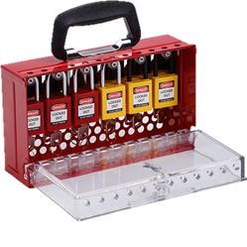
Public-key encryption

Slide 4
Public-key encryption – syntax
A public-key encryption scheme is a tuple $Σ=\left(KeyGen, Enc, Dec\right)$ of algorithms
$$KeyGen :\left\{ \right\}→𝒮𝒦×𝒫𝒦$$
$$Enc :𝒫𝒦×ℳ→𝒞$$
$$Dec :𝒮𝒦×𝒞→ℳ∪\left\{⊥\right\}$$
$$\left(sk, pk\right)\underset{←}{\$}KeyGen$$
$$Enc\left(pk, M\right)={Enc}_{pk}\left(M\right)=C$$
$$Dec\left(sk, C\right)={Dec}_{sk}\left(C\right)=M/⊥$$
Correctness: for all $\left(sk,pk\right)\underset{←}{\$}KeyGen$:
$$Dec\left(sk, Enc\left(pk, M\right)\right)=M$$
$$\$$$
$$KeyGen$$
$𝒮𝒦$ – private key space
$𝒫𝒦$ – public key space
$ℳ$ – message space
$𝒞$ – ciphertext space
$pk$
$sk$
$\left(sk,pk\right)$
$$Enc$$
$$C$$
$$Dec$$
$$\$$$
$$M$$
$$M / \left\{⊥\right\}$$
Adversary

Slide 5
Public-key encryption – security: IND-CPA
$$Exp_{Σ}^{ind­­–cpa}\left(A\right)$$
$b\underset{←}{\$}\left\{0,1\right\}$ $\left(sk,pk\right)\underset{←}{\$}Σ.KeyGen$ $b′←A^{ℰ\left(⋅\right)}\left(pk\right)$ $return b^{′}\overset{?}{=}b$ $$ℰ\left(M\right)$$ --------------------------------- $R\underset{←}{\$}{\left\{0,1\right\}}^{\left|M\right|}$ $C_{0}←Σ.Enc\left(pk, R\right)$ $C_{1}←Σ.Enc\left(pk M\right)$ return $C_{b}$
World 1
Input $M$: return $Σ.Enc\left(pk, M\right)$
World 0
Input $M$: return $Σ.Enc\left(pk, \$^{\left|M\right|}\right)$
$b$
I’m in World $b′$
$$pk$$
Definition: The IND-CPA advantage of $A$ is
$${Adv}_{Σ}^{ind­–cpa}\left(A\right)\overset{def}{=}\left|2⋅Pr\left[b^{′}=b\right]−1\right|$$

Slide 6
Public-key encryption – security: IND-CCA
$$Exp_{Σ}^{ind­­–cca}\left(A\right)$$
$b\underset{←}{\$}\left\{0,1\right\}$ Ciphertexts $←\left[ \right]$ // bookkeeping $\left(sk,pk\right)\underset{←}{\$}Σ.KeyGen$ $b′←A^{ℰ\left(⋅\right),𝒟\left(⋅\right)}\left(pk\right)$ $return b^{′}\overset{?}{=}b$ $$ℰ\left(M\right)$$ --------------------------------- $R\underset{←}{\$}{\left\{0,1\right\}}^{\left|M\right|}$ $C_{0}←Σ.Enc\left(pk, R\right)$ $C_{1}←Σ.Enc\left(pk M\right)$ Ciphertexts.add$\left(C_{b}\right)$ return $C_{b}$ $$𝒟\left(C\right)$$ --------------------------------- if $C∈$ Ciphertexts: return $⊥$ return $Σ.Dec\left(sk,C\right)$
World 1
Input $M$: return $Σ.Enc\left(pk, M\right)$ Input $C$: return $Σ.Dec\left(sk,C\right)$
World 0
Input $M$: return $Σ.Enc\left(pk, \$^{\left|M\right|}\right)$ Input $C$: return $Σ.Dec\left(sk,C\right)$
$b$
I’m in World $b′$
Restriction: not allowed to ask for decryption of previous $Enc$ call
$$pk$$
Definition: The IND-CCA advantage of $A$ is
$${Adv}_{Σ}^{ind­–cca}\left(A\right)\overset{def}{=}\left|2⋅Pr\left[b^{′}=b\right]−1\right|$$

Slide 7
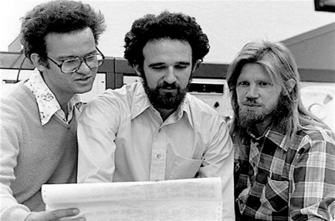
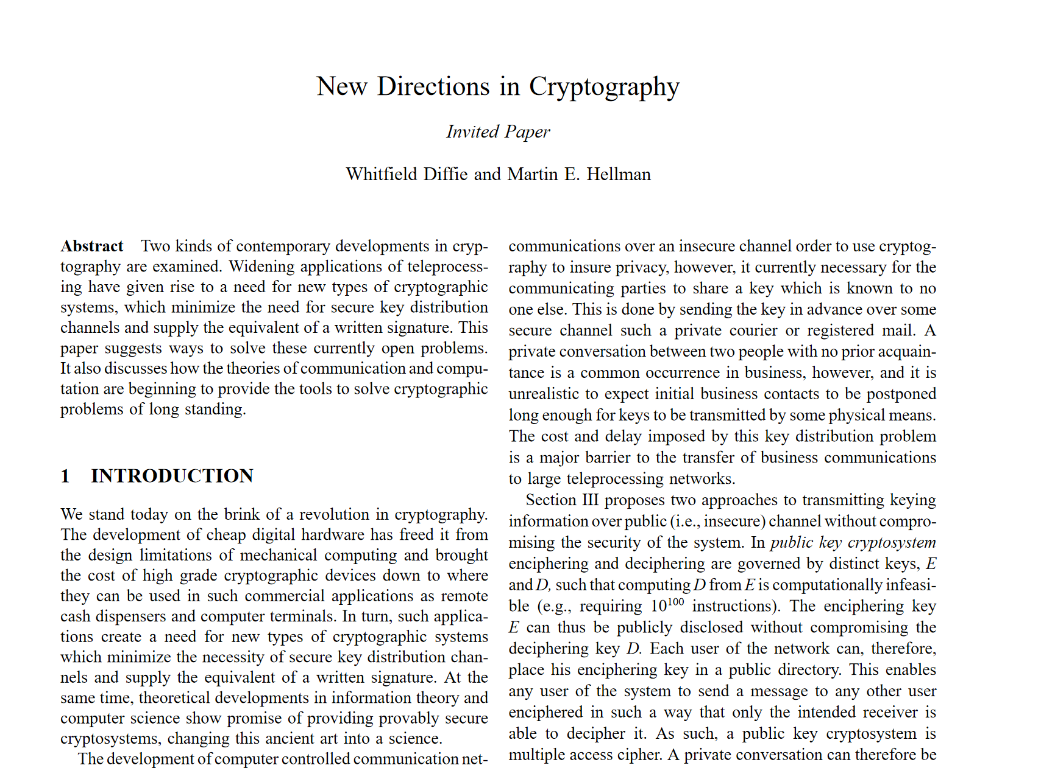
Diffie-Hellman key exchange
Discovered in the 1970's
Allows two parties to establish a shared secret without ever having met
Diffie & Hellman paper also introduced the idea of:
Public-key encryption
But didn't figure out how to do it
1984: ElGamal encryption scheme
Digital signatures
But didn't figure out how to do it
Ralph Merkle
Whitfield Diffie
Martin Hellman

Slide 8
Public-key encryption: ElGamal
$$G=〈g〉$$
$$M$$
$$A$$
$$B$$
$$a\underset{←}{\$}\left\{1, …, \left|G\right|\right\}$$
$$b\underset{←}{\$}\left\{1, …, \left|G\right|\right\}$$
$$A←g^{a}$$
$$C$$
$$B←g^{b}$$
$$Z←B^{a}=H\left(g^{ab}\right)$$
$$Z←A^{b}=H\left(g^{ab}\right)$$
$$C←Σ.Enc\left(Z, M\right)$$
$$M←Σ. Dec\left(Z, C\right)$$
Symmetric encryption scheme

Slide 9
Public-key encryption: ElGamal
$$KeyGen$$
$$G=〈g〉$$
$$sk=$$
$$b\underset{←}{\$}\left\{1, …, \left|G\right|\right\}$$
$$M$$
$$B$$
$$pk=$$
$$B←g^{b}$$
return $\left(sk,pk\right)$
$$,C$$
$$A$$
$$Enc\left(pk, M\right)$$
$$a\underset{←}{\$}\left\{1, …, \left|G\right|\right\}$$
$$C$$
$$Dec\left(sk, C\right)$$
$$A←g^{a}$$
ElGamal IND-CPA security:
DLOG + DH must be hard
$Σ$ must be IND-CPA secure
Is this enough?
No: $Σ$ only guarantees security if the key $Z$ is independent and uniformly distributed in the group $G$ …but ${Z=g}^{ab}$ isn't uniformly distributed in $G$!
$$Z←B^{a}=H\left(g^{ab}\right)$$
$$Z←A^{b}=H\left(g^{ab}\right)$$
$$C←Σ.Enc\left(Z, M\right)$$
$$M←Σ. Dec\left(Z, C\right)$$
return $\left(A,C\right)$
return $M$
$$Σ. Enc :G×ℳ→𝒞$$
Actually want $Σ. Enc :{\left\{0,1\right\}}^{k}×ℳ→𝒞$

Slide 10
Public-key encryption: Hashed-ElGamal
$$KeyGen$$
$$H :G→{\left\{0,1\right\}}^{k}$$
$$G=〈g〉$$
$$sk=$$
$$b\underset{←}{\$}\left\{1, …, \left|G\right|\right\}$$
$$M$$
$$B$$
$$pk=$$
$$B←g^{b}$$
return $\left(sk,pk\right)$
$$,C$$
$$A$$
$$Enc\left(pk, M\right)$$
$$a\underset{←}{\$}\left\{1, …, \left|G\right|\right\}$$
$$Dec\left(sk, C\right)$$
$$A←g^{a}$$
$$Z←H\left(B^{a}\right)=H\left(g^{ab}\right)$$
$$Z←H\left(A^{b}\right)=H\left(g^{ab}\right)$$
$$C←Σ.Enc\left(Z, M\right)$$
$$M←Σ. Dec\left(Z, C\right)$$
return $\left(A,C\right)$
return $M$
Theorem: Hashed-ElGamal is IND-CPA secure if:
DH-problem is hard in $G$
$Σ$ is IND-CPA secure
$H$ is “perfect” (i.e., a random oracle)

Slide 11
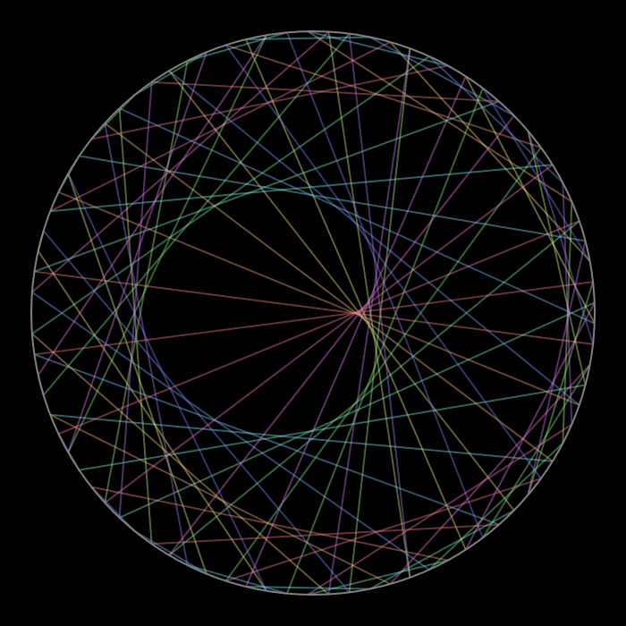
$$C=M^{e} \left(\operatorname{mod}{n}\right)$$
The RSA encryption scheme
Notes:
https://www.redblobgames.com/x/1847-mathologer-modulo-circle/#N=85&M=22&color=angle

Slide 12
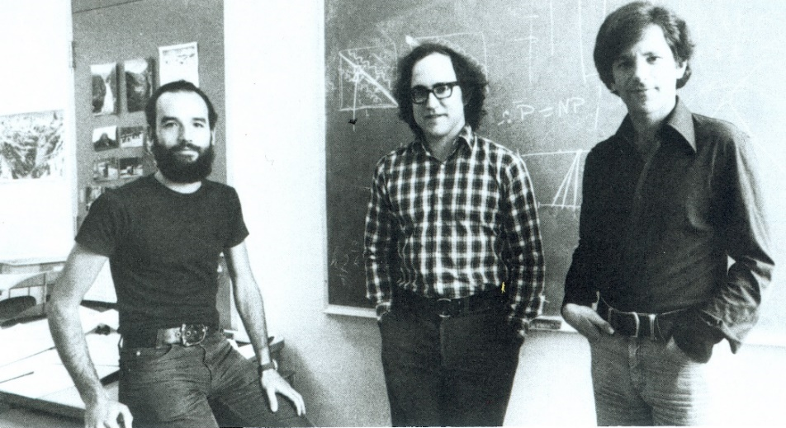
RSA
Designed by Rivest, Shamir and Adleman in 1977
One year before ElGamal
Used both for public-key encryption and digital signatures
Adi Shamir
Ron Rivest
Leonard Adleman

Slide 13
RSA encryption
$$31$$
$$32$$
$$0$$
$$1$$
$$2$$
$$30$$
$$3$$
$$29$$
$$4$$
$$e=3$$
$$28$$
$$5$$
$$d=7$$
$$27$$
$$6$$
$$26$$
$$7$$
$$25$$
$$8$$
$$24$$
$$9$$
$$23$$
$$10$$
$$22$$
$$11$$
$$21$$
$$12$$
$$20$$
$$13$$
$$M$$
$$19$$
$$14$$
$$C$$
$$18$$
$$17$$
$$16$$
$$15$$

Slide 14
The group $\left(Z_{n}^{∗},⋅\right)$
$$Z_{p}=\left\{0, 1, …, p−1\right\}$$
$\left(Z_{p}, ⋅\right)$ is not a group!
Not invertible | Invertible
$$2, 4, 5, 6, 8$$ | $$1, 3, 7, 9$$
$$Z_{p}^{∗}=\left\{1, …, p−1\right\}$$
$\left(Z_{p}^{∗}, ⋅\right)$ is a group!
$$Z_{10}^{+}=\left\{1, 2, 3, 4, 5, 6, 7, 8, 9\right\}$$
$$2⋅1=2 \operatorname{mod}{10}$$
$$Z_{n}=\left\{0, 1, …, n−1\right\}$$
$\left(Z_{n}, ⋅\right)$ is not a group!
$$2⋅2=4 \operatorname{mod}{10}$$
$$2⋅3=6 \operatorname{mod}{10}$$
$$1⋅1=1 \operatorname{mod}{10}$$
$$Z_{n}^{∗}≠\left\{1, …, n−1\right\}$$
$\left(Z_{n}^{+}, ⋅\right)$ is also not a group!
$$2⋅4=8 \operatorname{mod}{10}$$
$$3⋅7=21=1 \operatorname{mod}{10}$$
$$2⋅5=0 \operatorname{mod}{10}$$
$$Z_{n}^{+}$$
$$2⋅6=2 \operatorname{mod}{10}$$
$$9⋅9=81=1 \operatorname{mod}{10}$$
$$\overset{theorem}{=} \left\{a∈Z_{n} ∣ \gcd\left(a,n\right)=1\right\}$$
$$2⋅7=4 \operatorname{mod}{10}$$
$$Z_{n}^{∗}=invertible elements in Z_{n}$$
$$2⋅8=6 \operatorname{mod}{10}$$
$$2=2$$
$$2⋅9=8 \operatorname{mod}{10}$$
$$4=2⋅2$$
$\left(Z_{n}^{∗}, ⋅\right)$ is a group!
$$5=5$$
$$10=2⋅5$$
$$6=2⋅3$$
Proof: let $d=\gcd\left(a,n\right)$
$a$ invertible
$d=1$
$$8=2⋅2⋅2$$
$⟹$ $∃b∈Z_{n}$ such that $ab=1\operatorname{mod}{n}$
$⟹$ $∃k:$ $ab=1+kn$
$⟹$ $ab−kn=1$
$⟹$ $d\left(a^{′}b−kn′\right)=1$
$⟹$ $d=1$
$⟹$ Claim: $∃s,t∈Z$ such that $sa+tn=d=1$
$⟹$ $sa=1−tn$
$⟹$ $sa=1\operatorname{mod}{n}$
$⟹$ $a$ is invertible

Slide 15
Euler's $φ\left(n\right)$ function
$$q$$
$φ\left(n\right)\overset{def}{=}\left|Z_{n}^{∗}\right|$
$φ\left(p\right)=p−1$
$φ\left(p⋅q\right)=$
Note: $φ\left(n\right)≈n−2\sqrt{n}≈n$
almost all integers are invertible for large $p$, $q$
$$= \left|\left\{a∈Z_{n} ∣ \gcd\left(a,n\right)=1\right\}\right|$$
$$1⋅p$$
$$2⋅p$$
$$3⋅p$$
$$⋯ q⋅p$$
$$1⋅q$$
$$2⋅q$$
$$3⋅q$$
$$⋯ p⋅q$$
$$p$$
$$\left(p−1\right)⋅\left(q−1\right)$$
$$φ\left(pq\right)=$$
$$pq$$
$$− \#numbers with gcd\left(x,pq\right)≠1$$
$$q − p$$
$$= pq −$$
$$+ 1$$
$$p⋅q$$
$$=\left(p−1\right)⋅\left(q−1\right)$$
$$n$$ | $$1$$ | 2 | 3 | 4 | 5 | 6 | 7 | 8 | 9 | 10 | 11 | 12 | 13 | 14 | 15 | 16 | 17 | 18 | 19 | 20
$$φ\left(n\right)$$ | $$1$$ | 1 | 2 | 2 | 4 | 2 | 6 | 4 | 6 | 4 | 10 | 4 | 12 | 6 | 8 | 8 | 16 | 6 | 18 | 8

Slide 16
Textbook RSA
$$𝒫𝒦$$
$$ℳ$$
$$𝒞$$
$$KeyGen$$
$p,q\underset{←}{\$}$ two random prime numbers $n←p⋅q$ $φ\left(n\right)=\left(p−1\right)\left(q−1\right)$ choose $e$ such that $\gcd\left(e, φ\left(n\right)\right)=1$ $d←e^{−1} \operatorname{mod}{φ\left(n\right)}$ $sk←\left(n,d\right)$ $pk←\left(n,e\right)$ return $(sk, pk)$
$$RSA.Enc :$$
$$Z^{+}×Z_{φ\left(n\right)}^{∗}×Z_{n}^{∗}→Z_{n}^{∗}$$
$$RSA.Dec:$$
$${Z^{+}×Z}_{φ\left(n\right)}^{∗}×Z_{n}^{∗}→Z_{n}^{∗}$$
$$𝒞$$
$$ℳ$$
$$𝒮𝒦$$
$$pk$$
$$Enc\left(pk=\left(n,e\right), M∈Z_{n}^{∗}\right)$$
$C←M^{e} \operatorname{mod}{n}$ return $C$
$$C$$
$$Dec\left(sk=\left(n,d\right), C∈Z_{n}^{∗}\right)$$
$M←C^{d} \operatorname{mod}{n}$ return $M$
Common choices of $e$: $3$ $17$ $65 537$
${11}_{2}$ ${10001}_{2}$ $1 0000 0000 0000 {0001}_{2}$

Slide 17
RSA example
$$Z_{33}^{∗ }$$
$$31$$
$$32$$
$$0$$
$$1$$
$$2$$
$$30$$
$$3$$
$$n=33=3⋅11$$
$$29$$
$$4$$
$$e=3$$
// need to find $d=e^{−1}\operatorname{mod}{φ\left(n\right)}$
$$28$$
$$5$$
$$φ\left(n\right)=\left(3−1\right)\left(11−1\right)=20$$
$$27$$
$$6$$
$$7$$
$$26$$
$$7$$
$$3⋅7=21=1\operatorname{mod}{20}$$
$$d=7$$
$$25$$
$$8$$
$$24$$
$$9$$
$$M=13$$
$$23$$
$$10$$
$$C←{13}^{3}=2197=19\operatorname{mod}{33}$$
$$22$$
$$11$$
$$21$$
$$12$$
$$C^{7}={19}^{7}=893871739=13\operatorname{mod}{33}$$
$$20$$
$$13$$
$$19$$
$$14$$
$$M$$
$$C$$
$$18$$
$$17$$
$$16$$
$$15$$

Slide 18
Euler’s Theorem
$\left(Z_{p}^{∗},⋅\right)$: $\left|Z_{p}^{∗}\right|=p−1$
$\left(Z_{n}^{∗},⋅\right)$: $\left|Z_{n}^{∗}\right|=φ\left(n\right)$
Theorem: if $\left(G,∘\right)$ is a finite group, then for all $g∈G$:
$$g^{\left|G\right|}=e$$
Fermat’s theorem: if $p$ is prime, then for all $a≠0 \left(\operatorname{mod}{p}\right)$:
$a^{p−1}≡1 \left(\operatorname{mod}{p}\right)$
Euler’s theorem: for all positive integers $n$, if $\gcd\left(a,n\right)=1$ then
$a^{φ\left(n\right)}≡1 \left(\operatorname{mod}{n}\right)$

Slide 19
Textbook RSA – correctness
$$RSA.Dec\left(sk, RSA.Enc\left(pk, M\right)\right)=M$$
$$KeyGen$$
$p,q\underset{←}{\$}$ two random prime numbers $n←p⋅q$ $φ\left(n\right)=\left(p−1\right)\left(q−1\right)$ choose $e$ such that $\gcd\left(e, φ\left(n\right)\right)=1$ $d←e^{−1} \operatorname{mod}{φ\left(n\right)}$ $sk←\left(n,d\right)$ $pk←\left(n,e\right)$ return $(sk, pk)$
Euler’s theorem: for all $a∈Z_{n}^{∗}$
$a^{φ\left(n\right)}≡1 \left(\operatorname{mod}{n}\right)$
$$=M^{1+φ\left(n\right)k}$$
$$=M^{1}⋅M^{φ\left(n\right)k}$$
$$C^{d}=M^{ed}$$
$$=M\operatorname{mod}{n}$$
$$Enc\left(pk=\left(n,e\right), M∈Z_{n}^{∗}\right)$$
$C←M^{e} \operatorname{mod}{n}$ return $C$
$$d=e^{−1}\operatorname{mod}{φ\left(n\right) ⟺} ed=1\operatorname{mod}{φ\left(n\right)} ⇔ ed=1+φ\left(n\right)k$$
$$Dec\left(sk=\left(n,d\right), C∈Z_{n}^{∗}\right)$$
$M←C^{d} \operatorname{mod}{n}$ return $M$
Fact: RSA also works for $M∈Z_{n}$
Notes:
p = 11
q = 17
n = p * q
Zn = Integers(n)
phi = euler_phi(n)
Zphi = Integers(phi)
e = Zphi(3)
d = e^-1
mod(e * d, phi)
M = Zn(123)
C = M^e
C^d

Slide 20
Textbook RSA – security
$$KeyGen$$
$p,q\underset{←}{\$}$ two random prime numbers $n←p⋅q$ $φ\left(n\right)=\left(p−1\right)\left(q−1\right)$ choose $e$ such that $\gcd\left(e, φ\left(n\right)\right)=1$ $d←e^{−1} \operatorname{mod}{φ\left(n\right)}$ $sk←\left(n,d\right)$ $pk←\left(n,e\right)$ return $(sk, pk)$
$$RSA.Enc :$$
$$Z^{+}×Z_{φ\left(n\right)}^{∗}×Z_{n}^{∗}→Z_{n}^{∗}$$
$$RSA.Enc : n, e,M↦M^{e} \operatorname{mod}{n}$$
$$pk$$
$$pk=(n,e)$$
$$C$$
$$sk=d$$
$$Enc\left(pk=\left(n,e\right), M∈Z_{n}^{∗}\right)$$
$C←M^{e} \operatorname{mod}{n}$ return $C$
$$Dec\left(sk=\left(n,d\right), C∈Z_{n}^{∗}\right)$$
$M←C^{d} \operatorname{mod}{n}$ return $M$

Slide 21
Textbook RSA – security
$$RSA.{Enc}_{pk} :$$
$$Z_{n}^{∗}→Z_{n}^{∗}$$
$$RSA.{Enc}_{pk} : M↦M^{e} \operatorname{mod}{n}$$
$$pq$$
$$pk=(n,e)$$
$$C$$
$${=M}^{e}\operatorname{mod}{n}$$
$$sk=d$$
$$=e^{−1} \operatorname{mod}{φ\left(n\right)}$$
$$Enc\left(pk=\left(n,e\right), M∈Z_{n}^{∗}\right)$$
$C←M^{e} \operatorname{mod}{n}$ return $C$
$$\left(p−1\right)\left(q−1\right)$$
Security:
Must be hard to compute $M$ given $pk$, $M^{e}\operatorname{mod}{n}$
Must be hard to find $d$ given $n$, $e$
Must be hard to find $φ\left(n\right)$ given $n$, $e$
Must be hard to find $p$, $q$ given $n$
(RSA assumption)
equivalent!
(Factoring assumption)

Slide 22
How hard is factoring?
In practice factoring is only known way to break RSA
Naïve $Factor\left(n\right)$:
$3$ divides $n?$ return $3$
$5$ divides $n?$ return $5$
$7$ divides $n?$ return $7$
$⋮$
$\left\lfloor \sqrt{n}\right\rfloor$ divides $n?$ return $\left\lfloor \sqrt{n}\right\rfloor$
return $n$
Much faster algorithms known
Quadratic sieve
Rational sieve
General number field sieve
Current record: 829 bits
Very inefficient: $n≈2^{k} ⟹ π\left(n\right)≈\frac{2^{k}}{\ln{2^{k}}}≈\frac{2^{k}}{k}$
 | Time to factor $n$ for $p≈q≈2^{k/2}$ | Size of $k$
 |  | 128 bit security | 256 bit security
 | $$≈𝒪\left(e^{1.93k^{1/3}{\left(\log{k}\right)}^{2/3}+c}\right)$$ | 3072 | 15,360
DH group | Time to solve DLOG for $p≈2^{k}$
$$Z_{p}^{∗}$$ | $$≈𝒪\left(e^{1.93k^{1/3}{\left(\log{k}\right)}^{2/3}+c}\right)$$ | 3072 | 15,360
$$E\left(F_{p}\right)$$ | $$≈𝒪\left(2^{k/2}\right)$$ | 256 | 512

Slide 23
Textbook RSA – security
Textbook RSA is not IND-CPA secure!
Deterministic
Malleable
Many other attacks as well*
Textbook RSA is not an encryption scheme!
So what is it? Answer: a one-way trapdoor permutation
* https://crypto.stackexchange.com/questions/20085/which-attacks-are-possible-against-raw-textbook-rsa
$$KeyGen$$
$p,q\underset{←}{\$}$ two random prime numbers $n←p⋅q$ $φ\left(n\right)=\left(p−1\right)\left(q−1\right)$ choose $e$ such that $\gcd\left(e, φ\left(n\right)\right)=1$ $d←e^{−1} \operatorname{mod}{φ\left(n\right)}$ $sk←\left(n,d\right)$ $pk←\left(n,e\right)$ return $(sk, pk)$
$$Enc\left(pk=\left(n,e\right), M∈Z_{n}^{∗}\right)$$
$C←M^{e} \operatorname{mod}{n}$ return $C$
$$pk$$
$$C$$
$$Dec\left(sk=\left(n,d\right), C∈Z_{n}^{∗}\right)$$
$M←C^{d} \operatorname{mod}{n}$ return $M$

Slide 24
Shoup's RSA variant
$$KeyGen$$
$\left(sk, pk\right)←RSA.KeyGen$ return $(sk, pk)$
$$Enc\left(pk=\left(n,e\right), M\right)$$
$K←Z_{n}^{∗}$ $C_{1}←K^{e} \operatorname{mod}{n}$ $C_{2}←Σ.Enc\left(K,M\right)$ return $C_{1},C_{2}$
$$pk$$
$$C_{1},C_{2}$$
$$Dec\left(sk=d, C=\left(C_{1}, C_{2}\right)\right)$$
$K←C_{1}^{d} \operatorname{mod}{n}$ $M←Σ.Dec\left(K,C_{2}\right)$ return $M$
$$H :Z_{n}^{∗}→{\left\{0,1\right\}}^{k}$$
Symmetric encryption scheme
$$Σ. Enc :Z_{n}^{∗}×ℳ→𝒞$$
Actually want: $Σ. Enc :{\left\{0,1\right\}}^{k}×ℳ→𝒞$

Slide 25
Shoup's RSA variant
$$KeyGen$$
$\left(sk, pk\right)←RSA.KeyGen$ return $(sk, pk)$
$$Enc\left(pk=\left(n,e\right), M\right)$$
$R←Z_{n}^{∗}$ $C_{1}←R^{e} \operatorname{mod}{n}$ $K←H(R)$ $C_{2}←Σ.Enc\left(K,M\right)$ return $C_{1},C_{2}$
$$pk$$
$$C_{1},C_{2}$$
$$Dec\left(sk=d, C=\left(C_{1}, C_{2}\right)\right)$$
$R←C_{1}^{d} \operatorname{mod}{n}$ $K←H\left(R\right)$ $M←Σ.Dec\left(K,C_{2}\right)$ return $M$
$$H :Z_{n}^{∗}→{\left\{0,1\right\}}^{k}$$
Theorem: Shoup-RSA is IND-CPA (IND-CCA) secure if:
RSA-problem is hard in $Z_{n}^{∗}$
$Σ$ is IND-CPA (IND-CCA) secure
$H$ is “perfect” (i.e., a random oracle)

Slide 26
RSA in practice I
Textbook RSA is deterministic $⟹$ cannot be IND-CPA/IND-CCA secure
How to achieve IND-CPA/IND-CCA?
Pad message with random data before applying RSA function
PKCS#1v1.5 (no existing security proof; many impl. attacks)
RSA-OAEP (complicated security proof; first proof buggy)
RSA encryption not used much in practice anymore
Mostly key transport of (short) symmetric key
RSA digital signatures still very common
Covered next week
256 bits
$$M$$
$$Pad$$
$$r || M$$
$$r||M↦{\left(r||M\right)}^{e}\operatorname{mod}{n}$$
$$C$$
2048 bits

Slide 27
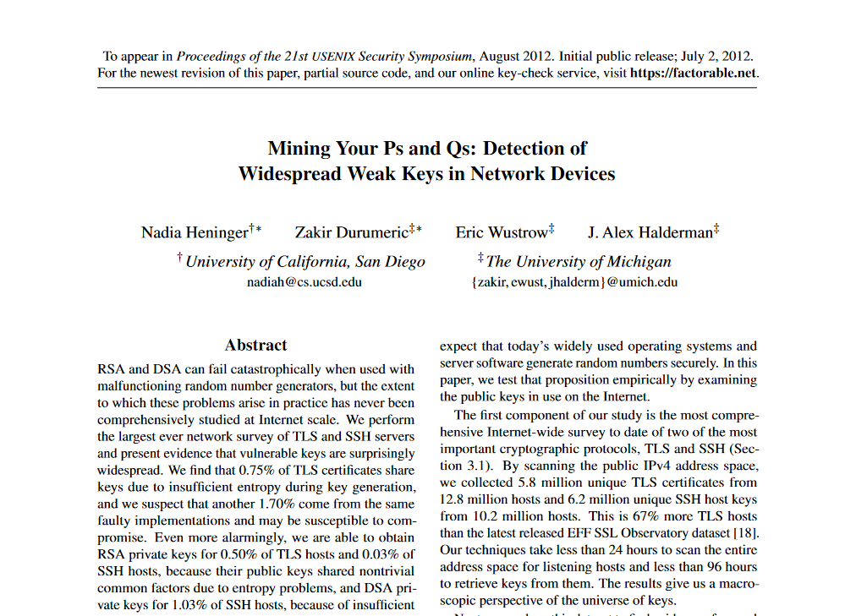
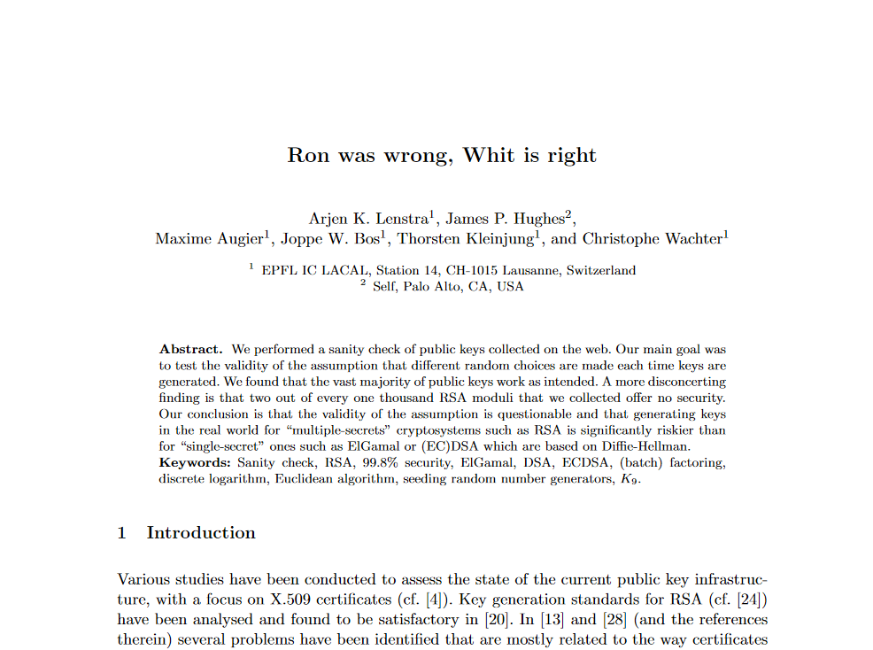
RSA in practice II
Multiple RSA modulus $n$ sharing a common prime
https://factorable.net/weakkeys12.extended.pdf
https://eprint.iacr.org/2012/064

Slide 28
Summary
Public-key encryption security goals: IND-CPA and IND-CCA
ElGamal
Public-key encryption from Diffie-Hellman key exchange + symmetric encryption scheme
Hashed-ElGamal: hash DH key to obtain a symmetric key $K$
RSA
Textbook-RSA: not a public-key encryption scheme directly (not IND-CPA secure!)
Shoup's RSA: encrypt random number with Textbook-RSA and derive symmetric key from hash function
IND-CPA / IND-CCA secure (depending on symmetric scheme)
Not much used in practice
In practice: pad message before encrypting with Textbook-RSA (PKCS#1v1.5, RSA-OAEP)
Must be hard: RSA-problem and factoring problem

