Slide 1
Lecture 12 – Quantum computers,
Shor’s algorithm, post-quantum cryptography
TEK4500
10.11.2021
Håkon Jacobsen
hakon.jacobsen@its.uio.no

Slide 2
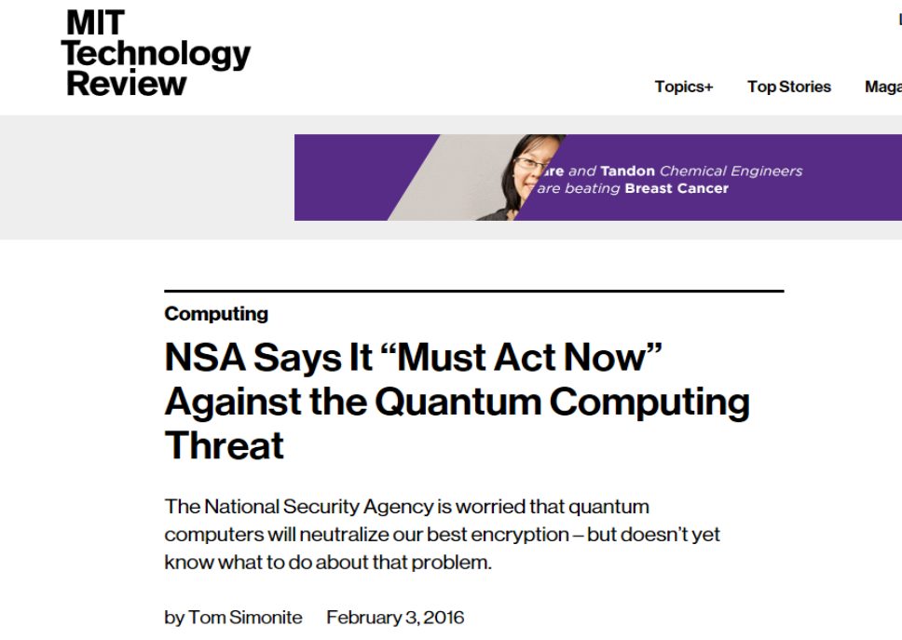

Slide 3
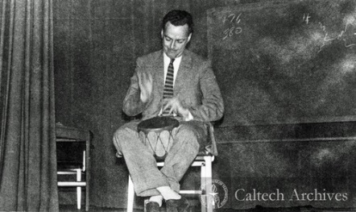
Quantum computing – the starting point

Slide 4
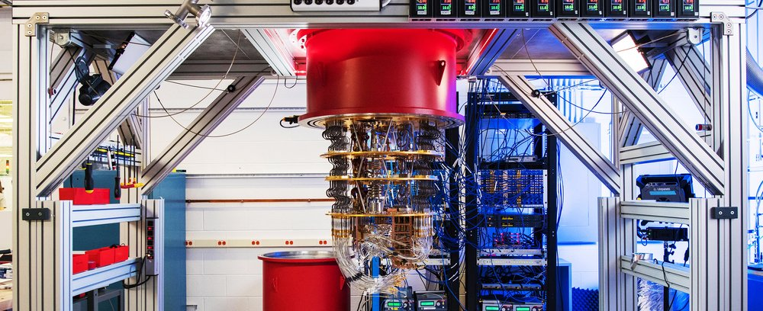
Elements of (quantum) computing
Three elements of all computations: data, operations, results
Quantum computation
  Data = qubit
  Operation = quantum gate
  Results = measurements

Slide 5
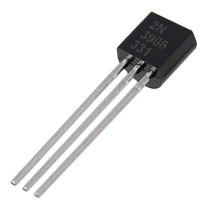

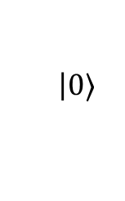







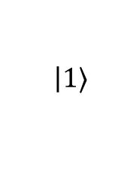


Qubits
Classical bit:
Qubit:
  Can be in a superposition of two basic states $|0〉$ and $|1〉$
  But we can never observe $α$ and $β$ directly!
  Must measure $|ψ〉$ to obtain its value $⟹$ state randomly collapses to either $|0〉$ or $|1〉$
  What's the probability of observing $|0〉$ or $|1〉$?
$$0$$
$$1$$
$$|ψ〉=$$
$$α$$
$$\left|0\right.〉$$
$$+ β$$
$$\left|1\right.〉$$
$$α,β∈C$$
$${\left|α\right|}^{2}+{\left|β\right|}^{2}=1$$
$$\operatorname{Pr}\left[measure |ψ〉⇒|0〉\right]={\left|α\right|}^{2}$$
$$\operatorname{Pr}\left[measure |ψ〉⇒|1〉\right]={\left|β\right|}^{2}$$

Slide 6










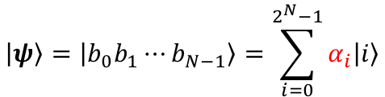


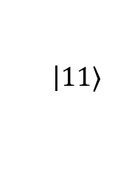

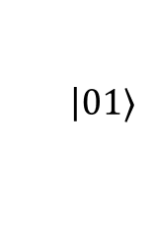


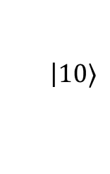

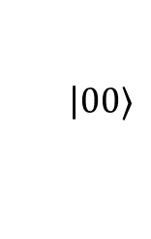



Quantum states – multiple qubits
A quantum computer consists of multiple qubits
  $N$-qubit system: $2^{N}$ basis states
  Representable by a $2^{N}$ element vector
$$α,β,γ,δ∈C$$
$$|ψ_{0}ψ_{1}〉=$$
$$α$$
$$\left|00\right.〉$$
$$+ β$$
$$\left|01\right.〉$$
$$+ γ$$
$$\left|10\right.〉$$
$$+ δ$$
$$\left|11\right.〉$$
$${\left|α\right|}^{2}+{\left|β\right|}^{2}+{\left|γ\right|}^{2}+{\left|δ\right|}^{2}=1$$
$$|ψ〉=|b_{0}b_{1}⋯b_{N−1}〉=\sum_{i=0}^{2^{N}−1}{α_{i}|i〉}$$
$$0.8|000〉−0.6i|101〉=\left(\begin{matrix}\begin{matrix}\begin{matrix}0.8 \\ 0\end{matrix} \\ 0\end{matrix} \\ \begin{matrix}\begin{matrix}0 \\ 0\end{matrix} \\ \begin{matrix}−0.6i \\ \begin{matrix}0 \\ 0\end{matrix}\end{matrix}\end{matrix}\end{matrix}\right)$$
$${\left|α_{0}\right|}^{2}+{\left|α_{1}\right|}^{2}+⋯+{\left|α_{111}\right|}^{2}=1$$
$$2^{N}−1$$
$$|ψ〉=\left(\begin{matrix}α_{0} \\ α_{1} \\ \begin{matrix}⋮ \\ α_{N−1}\end{matrix}\end{matrix}\right)$$
$$|000〉=\left(\begin{matrix}\begin{matrix}\begin{matrix}1 \\ 0\end{matrix} \\ 0\end{matrix} \\ \begin{matrix}\begin{matrix}0 \\ 0\end{matrix} \\ \begin{matrix}0 \\ \begin{matrix}0 \\ 0\end{matrix}\end{matrix}\end{matrix}\end{matrix}\right)$$
$$|001〉=\left(\begin{matrix}\begin{matrix}\begin{matrix}0 \\ 1\end{matrix} \\ 0\end{matrix} \\ \begin{matrix}\begin{matrix}0 \\ 0\end{matrix} \\ \begin{matrix}0 \\ \begin{matrix}0 \\ 0\end{matrix}\end{matrix}\end{matrix}\end{matrix}\right)$$
$$|010〉=\left(\begin{matrix}\begin{matrix}\begin{matrix}0 \\ 0\end{matrix} \\ 1\end{matrix} \\ \begin{matrix}\begin{matrix}0 \\ 0\end{matrix} \\ \begin{matrix}0 \\ \begin{matrix}0 \\ 0\end{matrix}\end{matrix}\end{matrix}\end{matrix}\right)$$
$$|011〉=\left(\begin{matrix}\begin{matrix}\begin{matrix}0 \\ 0\end{matrix} \\ 0\end{matrix} \\ \begin{matrix}\begin{matrix}1 \\ 0\end{matrix} \\ \begin{matrix}0 \\ \begin{matrix}0 \\ 0\end{matrix}\end{matrix}\end{matrix}\end{matrix}\right)$$
$$|100〉=\left(\begin{matrix}\begin{matrix}\begin{matrix}0 \\ 0\end{matrix} \\ 0\end{matrix} \\ \begin{matrix}\begin{matrix}0 \\ 1\end{matrix} \\ \begin{matrix}0 \\ \begin{matrix}0 \\ 0\end{matrix}\end{matrix}\end{matrix}\end{matrix}\right)$$
$$|101〉=\left(\begin{matrix}\begin{matrix}\begin{matrix}0 \\ 0\end{matrix} \\ 0\end{matrix} \\ \begin{matrix}\begin{matrix}0 \\ 0\end{matrix} \\ \begin{matrix}1 \\ \begin{matrix}0 \\ 0\end{matrix}\end{matrix}\end{matrix}\end{matrix}\right)$$
$$|110〉=\left(\begin{matrix}\begin{matrix}\begin{matrix}0 \\ 0\end{matrix} \\ 0\end{matrix} \\ \begin{matrix}\begin{matrix}0 \\ 0\end{matrix} \\ \begin{matrix}0 \\ \begin{matrix}1 \\ 0\end{matrix}\end{matrix}\end{matrix}\end{matrix}\right)$$
$$|111〉=\left(\begin{matrix}\begin{matrix}\begin{matrix}0 \\ 0\end{matrix} \\ 0\end{matrix} \\ \begin{matrix}\begin{matrix}0 \\ 0\end{matrix} \\ \begin{matrix}0 \\ \begin{matrix}0 \\ 1\end{matrix}\end{matrix}\end{matrix}\end{matrix}\right)$$

Slide 7
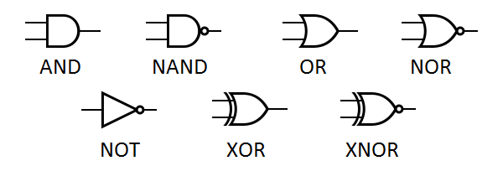
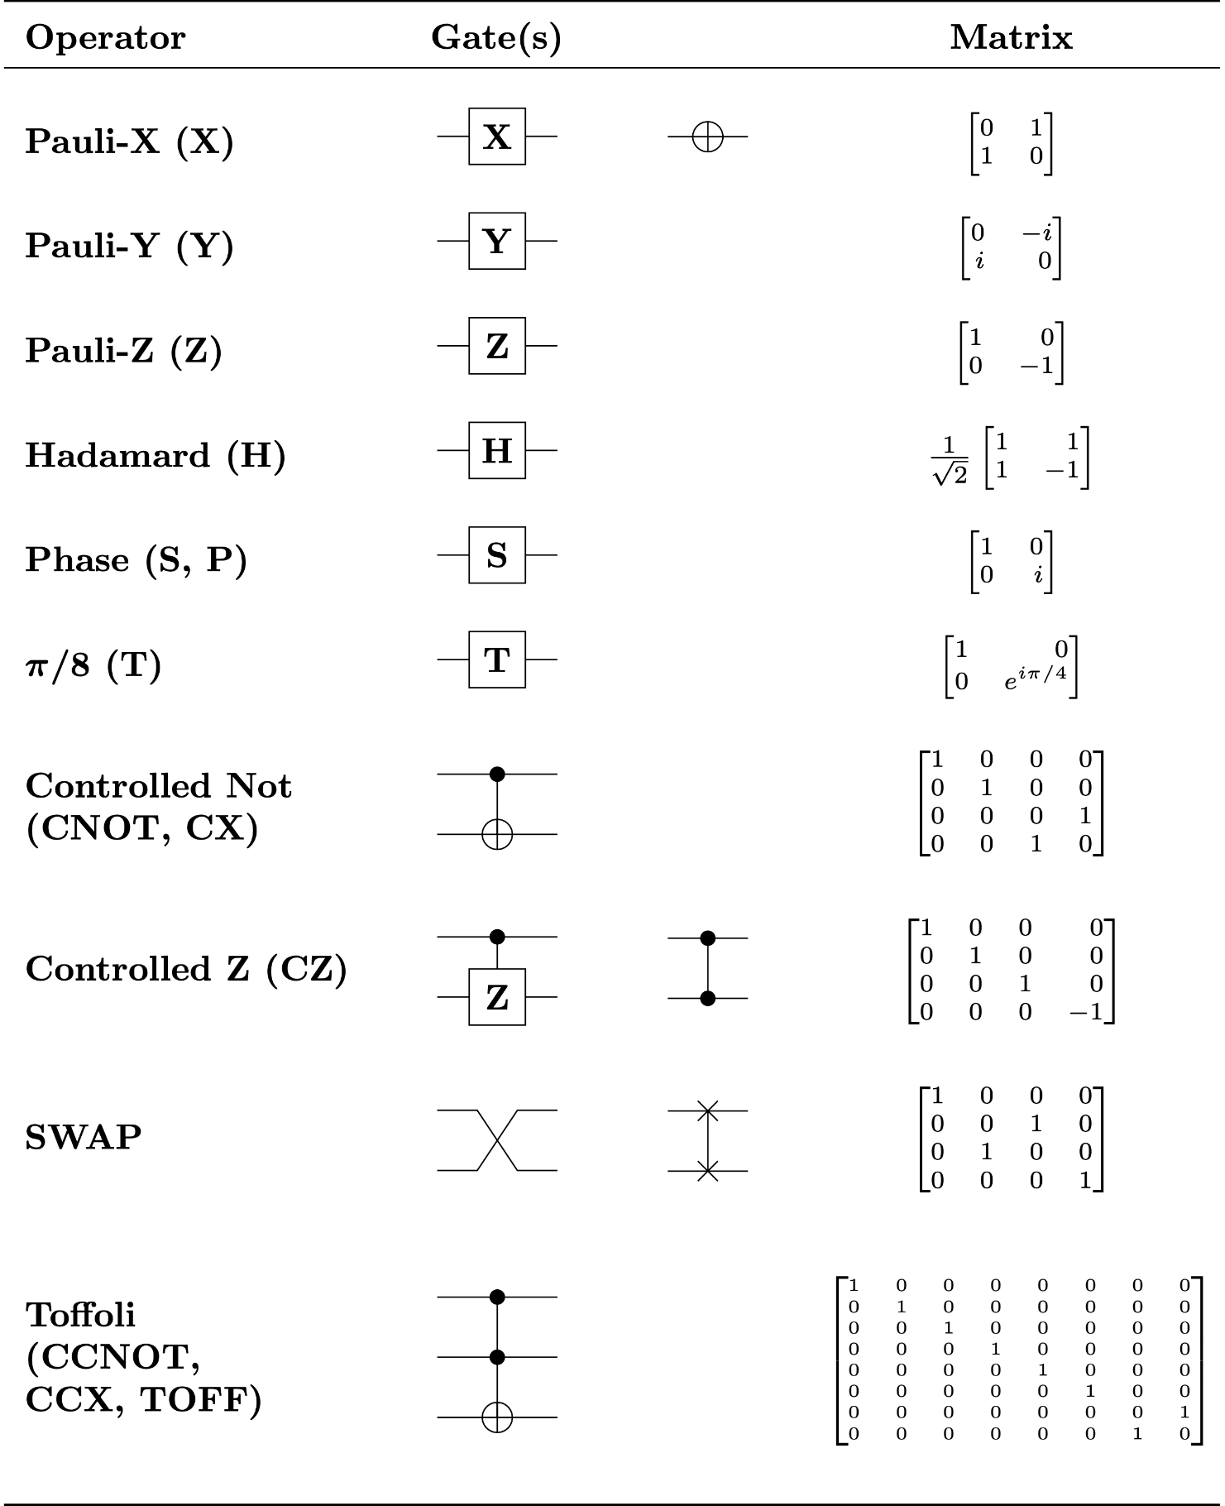
Quantum computation – quantum gates
Classic bits are transformed using logical gates
Qubits are transformed using
quantum gates
$$|ψ〉=α|0〉+β|1〉 ↦ |ψ′〉=α′|0〉+β′|1〉$$

Slide 8









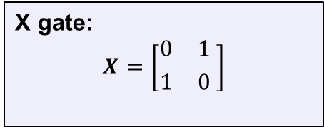




(Quantum) NOT-gate (or X gate)
$$|0〉 \underset{↦}{X} |1〉$$
$$|ψ〉=α|0〉+β|1〉$$
$$|1〉 \underset{↦}{X} |0〉$$
X gate:
$$X=\left[{0 \atop 1}{ 1 \atop 0 }\right]$$
$$|0〉=\left({1 \atop 0}\right)$$
$$|ψ〉=\left({α \atop β}\right)$$
$$α|0〉+β|1〉 \underset{↦}{X} β|0〉+α|1〉$$
$$|1〉=\left({0 \atop 1}\right)$$
$$X|0〉=X\left({1 \atop 0}\right)=\left({0 \atop 1}\right)$$
$$X|1〉=X\left({0 \atop 1}\right)=\left({1 \atop 0}\right)$$
$$X|ψ〉=X\left({α \atop β}\right)= ?$$
$$\left[{0 \atop 1}{ 1 \atop 0}\right]\left({1 \atop 0}\right)=\left({0 \atop 1}\right)$$
$$\left[{0 \atop 1}{ 1 \atop 0}\right]\left({0 \atop 1}\right)=\left({1 \atop 0}\right)$$
$$\left[{0 \atop 1}{ 1 \atop 0}\right]\left({α \atop β }\right)=\left({β \atop α}\right)$$

Slide 9
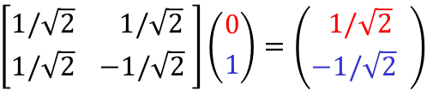

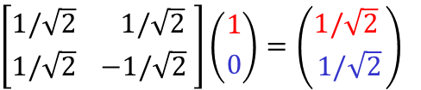

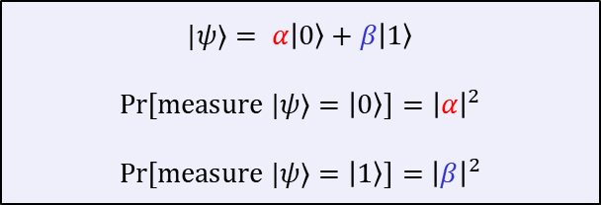
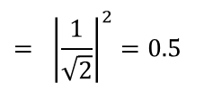

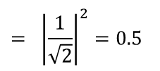

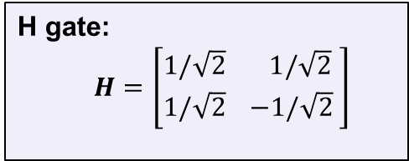
The Hadamard gate
$$|0〉 \underset{↦}{H} \frac{|0〉+|1〉}{\sqrt{2} }$$
$$|ψ⟩= α|0〉+β|1〉$$
$$\operatorname{Pr}\left[measure |ψ⟩=|0〉\right]={\left|α\right|}^{2}$$
$$\operatorname{Pr}\left[measure |ψ⟩=|1〉\right]={\left|β\right|}^{2}$$
$$|1〉 \underset{↦}{H} \frac{|0〉−|1〉}{\sqrt{2} }$$
$$= {\left|\frac{1}{\sqrt{2}}\right|}^{2}=0.5$$
H gate:
$$H=\left[{1/\sqrt{2} \atop 1/\sqrt{2}}{ 1/\sqrt{2} \atop −1/\sqrt{2} }\right]$$
$$\operatorname{Pr}\left[measure H|0〉⇒|0〉\right]$$
$$= {\left|\frac{1}{\sqrt{2}}\right|}^{2}=0.5$$
$$\operatorname{Pr}\left[measure H|1〉⇒|1〉\right]$$
The Hadamard gate allows us to create random bits!
$$\left[{1/\sqrt{2} \atop 1/\sqrt{2}}{ 1/\sqrt{2} \atop −1/\sqrt{2} }\right]\left({1 \atop 0}\right)=\left({1/\sqrt{2} \atop 1/\sqrt{2}}\right)$$
$$\left[{1/\sqrt{2} \atop 1/\sqrt{2}}{ 1/\sqrt{2} \atop −1/\sqrt{2} }\right]\left({0 \atop 1}\right)=\left({ 1/\sqrt{2} \atop −1/\sqrt{2} }\right)$$

Slide 10
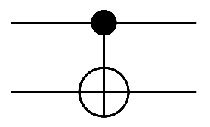


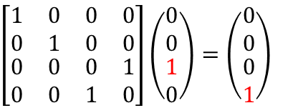






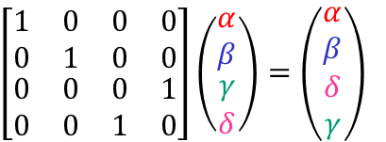
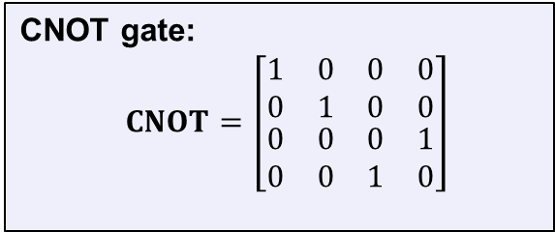


Controlled-NOT gate (CNOT)
CNOT
$$|00〉↦|00〉$$
$$|01〉↦|01〉$$
CNOT gate:
$$CNOT=\left[\begin{matrix}\begin{matrix}1 & 0 \\ 0 & 1\end{matrix} & \begin{matrix}0 & 0 \\ 0 & 0\end{matrix} \\ \begin{matrix}0 & 0 \\ 0 & 0\end{matrix} & \begin{matrix}0 & 1 \\ 1 & 0\end{matrix}\end{matrix}\right]$$
$$|10〉↦|11〉$$
$$|x〉$$
$$|x〉$$
$$|11〉↦|10〉$$
$$|y〉$$
$$|x⊕y〉$$
$$|10〉$$
$$|11〉$$
$$\left[\begin{matrix}\begin{matrix}1 & 0 \\ 0 & 1\end{matrix} & \begin{matrix}0 & 0 \\ 0 & 0\end{matrix} \\ \begin{matrix}0 & 0 \\ 0 & 0\end{matrix} & \begin{matrix}0 & 1 \\ 1 & 0\end{matrix}\end{matrix}\right]\left(\begin{matrix}\begin{matrix}0 \\ 0\end{matrix} \\ \begin{matrix}1 \\ 0\end{matrix}\end{matrix}\right)=\left(\begin{matrix}\begin{matrix}0 \\ 0\end{matrix} \\ \begin{matrix}0 \\ 1\end{matrix}\end{matrix}\right)$$
$$\left[\begin{matrix}\begin{matrix}1 & 0 \\ 0 & 1\end{matrix} & \begin{matrix}0 & 0 \\ 0 & 0\end{matrix} \\ \begin{matrix}0 & 0 \\ 0 & 0\end{matrix} & \begin{matrix}0 & 1 \\ 1 & 0\end{matrix}\end{matrix}\right]\left(\begin{matrix}\begin{matrix}α \\ β\end{matrix} \\ \begin{matrix}γ \\ δ\end{matrix}\end{matrix}\right)=\left(\begin{matrix}\begin{matrix}α \\ β\end{matrix} \\ \begin{matrix}δ \\ γ\end{matrix}\end{matrix}\right)$$

Slide 11

Many other gates…
Universal for classical logic!

Slide 12

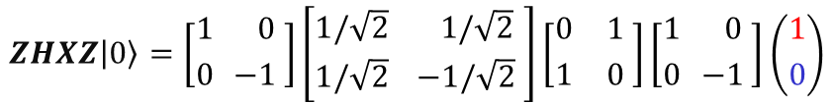










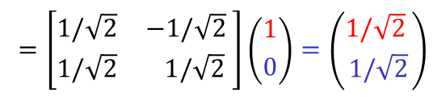
Quantum gates
Turns out that all quantum gates can be described by matrices
  In fact, very special matrices: unitary matrices
  … and only unitary matrices! (fact of nature)
Quantum operations are linear and can be combined
$$|0〉 \underset{↦}{X} |1〉$$
$$X=\left[{0 \atop 1}{ 1 \atop 0 }\right]$$
$$|1〉 \underset{↦}{X} |0〉$$
$$|0〉 \underset{↦}{Z} |0〉$$
$$Z=\left[{1 \atop 0}{ 0 \atop −1 }\right]$$
$$|ψ_{0}〉 \underset{↦}{Z} |ψ_{1}〉\underset{↦}{X} |ψ_{2}〉\underset{↦}{H} |ψ_{3}〉\underset{↦}{Z} |ψ_{4}〉$$
$$|1〉 \underset{↦}{Z} −|1〉$$
$$ZHXZ|ψ_{0}〉=|ψ_{4}〉$$
$$ZHXZ|0〉=\left[{1 \atop 0}{ 0 \atop −1 }\right]\left[{1/\sqrt{2} \atop 1/\sqrt{2}}{ 1/\sqrt{2} \atop −1/\sqrt{2} }\right]\left[{0 \atop 1}{ 1 \atop 0 }\right]\left[{1 \atop 0}{ 0 \atop −1 }\right]\left({1 \atop 0}\right)$$
$$|0〉 \underset{↦}{H} \frac{|0〉+|1〉}{\sqrt{2} }$$
$$H=\left[{1/\sqrt{2} \atop 1/\sqrt{2}}{ 1/\sqrt{2} \atop −1/\sqrt{2} }\right]$$
$$|1〉 \underset{↦}{H} \frac{|0〉−|1〉}{\sqrt{2} }$$
$$=\left[{1/\sqrt{2} \atop 1/\sqrt{2}}{ −1/\sqrt{2} \atop 1/\sqrt{2} }\right]\left({1 \atop 0}\right)=\left({1/\sqrt{2} \atop 1/\sqrt{2}}\right)$$

Slide 13
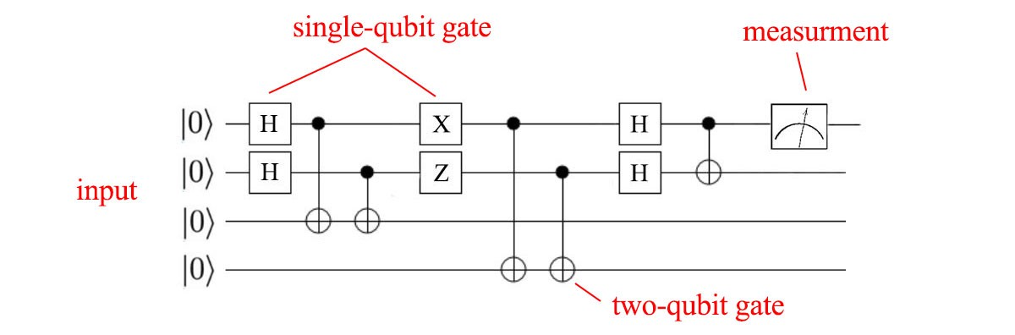

Quantum computer
A quantum computer consists of:
  $N$ input qubits
  a sequence of quantum gates
  $N$ output qubits
  result = measurement of final quantum state (output qubits)

Slide 14
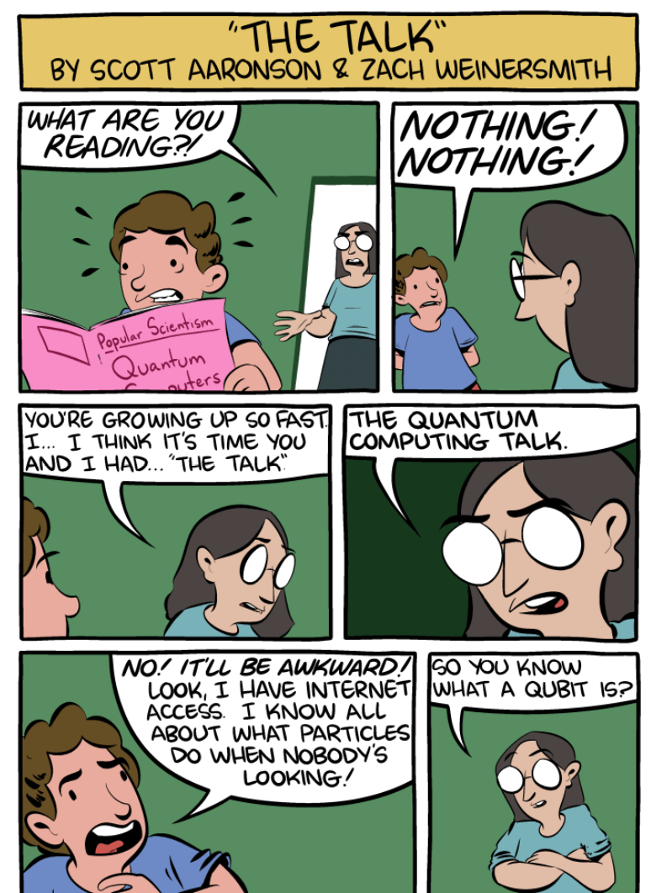
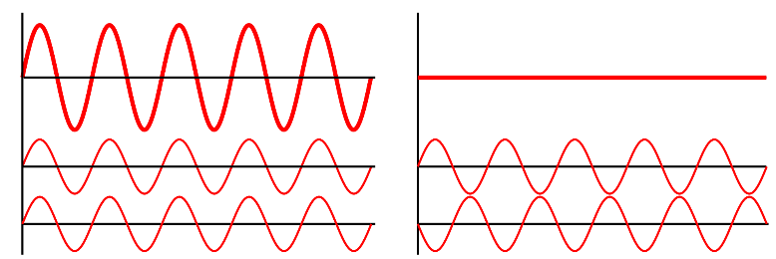


What makes quantum computation special?
Warning: a quantum computer does not simply
"try out all solutions in parallel"
The magic comes from allowing complex amplitudes
(or even just negative reals)
Quantum interference: can carefully choreograph
computations so wrong answers "cancel out" their amplitudes,
while correct answers "combine"
  increases probability of measuring correct result
  only a few special problems allow this choreography
$$|ψ〉=α|0〉+β|1〉$$
$$α,β∈C$$
https://www.smbc-comics.com/comic/the-talk-3

Slide 15





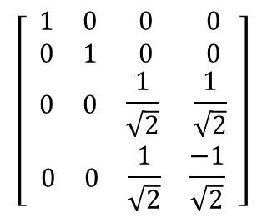
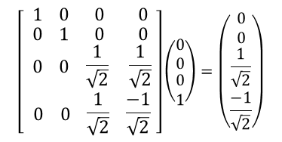

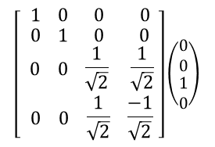



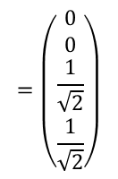
Example (interference)
$$\left[\begin{aligned}\begin{aligned}\begin{matrix}\begin{matrix} 1 & 0 \end{matrix} & \begin{matrix}0 & 0 \end{matrix}\end{matrix} \\ \begin{matrix}\begin{matrix} 0 & 1 \end{matrix} & \begin{matrix}0 & 0 \end{matrix}\end{matrix}\end{aligned} \\ \begin{matrix}\begin{matrix} 0 & 0\end{matrix} & \begin{matrix}\frac{1}{\sqrt{2}} & \frac{1}{\sqrt{2}}\end{matrix}\end{matrix} \\ \begin{matrix} \begin{matrix}0 & 0\end{matrix} & \begin{matrix}\frac{1}{\sqrt{2}} & \frac{−1}{\sqrt{2}}\end{matrix}\end{matrix}\end{aligned} \right]$$
$$G =$$
$$\frac{1}{\sqrt{2}}|10〉+\frac{1}{\sqrt{2}}|11〉$$
$$\frac{1}{\sqrt{2}}|10〉−\frac{1}{\sqrt{2}}|11〉$$
$$G\left(\frac{1}{\sqrt{2}}|10〉−\frac{1}{\sqrt{2}}|11〉\right)$$
$$= \frac{1}{\sqrt{2}}\left(G|10〉−G|11〉\right)$$
$$G|10〉$$
$$G|11〉$$
$$\left[\begin{aligned}\begin{aligned}\begin{matrix}\begin{matrix} 1 & 0 \end{matrix} & \begin{matrix}0 & 0 \end{matrix}\end{matrix} \\ \begin{matrix}\begin{matrix} 0 & 1 \end{matrix} & \begin{matrix}0 & 0 \end{matrix}\end{matrix}\end{aligned} \\ \begin{matrix}\begin{matrix} 0 & 0\end{matrix} & \begin{matrix}\frac{1}{\sqrt{2}} & \frac{1}{\sqrt{2}}\end{matrix}\end{matrix} \\ \begin{matrix} \begin{matrix}0 & 0\end{matrix} & \begin{matrix}\frac{1}{\sqrt{2}} & \frac{−1}{\sqrt{2}}\end{matrix}\end{matrix}\end{aligned}\right]\left(\begin{matrix}\begin{matrix}0 \\ 0\end{matrix} \\ \begin{matrix}1 \\ 0\end{matrix}\end{matrix}\right)$$
$$=\left(\begin{matrix}\begin{matrix}0 \\ 0\end{matrix} \\ \begin{matrix}\frac{1}{\sqrt{2}} \\ \frac{1}{\sqrt{2}}\end{matrix}\end{matrix}\right)$$
$$\left[\begin{aligned}\begin{aligned}\begin{matrix}\begin{matrix} 1 & 0 \end{matrix} & \begin{matrix}0 & 0 \end{matrix}\end{matrix} \\ \begin{matrix}\begin{matrix} 0 & 1 \end{matrix} & \begin{matrix}0 & 0 \end{matrix}\end{matrix}\end{aligned} \\ \begin{matrix}\begin{matrix} 0 & 0\end{matrix} & \begin{matrix}\frac{1}{\sqrt{2}} & \frac{1}{\sqrt{2}}\end{matrix}\end{matrix} \\ \begin{matrix} \begin{matrix}0 & 0\end{matrix} & \begin{matrix}\frac{1}{\sqrt{2}} & \frac{−1}{\sqrt{2}}\end{matrix}\end{matrix}\end{aligned}\right]\left(\begin{matrix}\begin{matrix}0 \\ 0\end{matrix} \\ \begin{matrix}0 \\ 1\end{matrix}\end{matrix}\right)=\left(\begin{matrix}\begin{matrix}0 \\ 0\end{matrix} \\ \begin{matrix}\frac{1}{\sqrt{2}} \\ \frac{−1}{\sqrt{2}}\end{matrix}\end{matrix}\right)$$
$$= \frac{1}{\sqrt{2}}\left(\frac{1}{\sqrt{2}}|10〉+\frac{1}{\sqrt{2}}|11〉−\frac{1}{\sqrt{2}}|10〉+\frac{1}{\sqrt{2}}|11〉 \right)$$
$$= |11〉$$

Slide 16
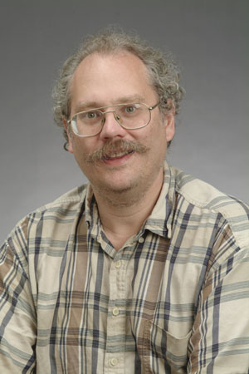
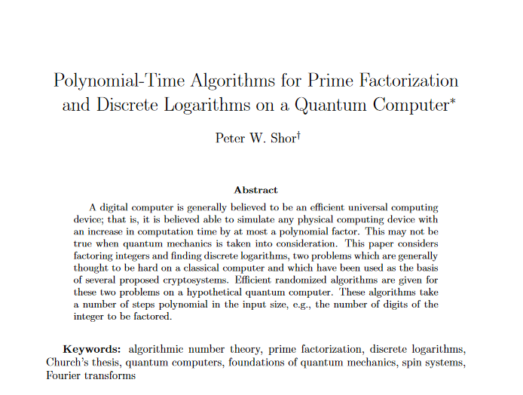
Shor's algorithm
1994

Slide 17



First: something completely different
$$2, 4, 8, 16, 32, 64, 128, 256, 512, 1024, …$$
$$2, 4, 8, 1, 2, 4, 8, 1, 2, 4, 8, 1, 2…$$
$$\operatorname{mod}{15}$$
$$2, 4, 8, 16, 11, 1, 2, 4, 8, 16, 11, 1, 2…$$
$$\operatorname{mod}{21}$$
sequences are periodic

Slide 18
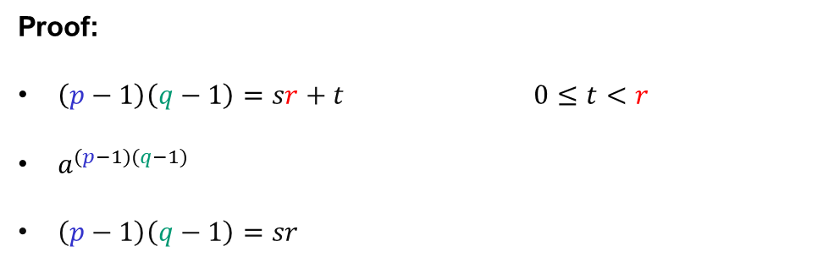














Factoring to order-finding
$$N=pq$$
$$\left| \right|=$$
$$=1$$
$$\left\langle a\right\rangle$$
$$r$$
$a^{1},a^{2},$ $a^{3}, …,a^{r},a^{1},a^{2}…$
$$\left(\operatorname{mod}{N}\right)$$
order of $a$
$=$ the smallest positive $r$ such that $a^{r}=1 \left(\operatorname{mod}{N}\right)$
Euler’s theorem: for all $a∈Z_{N}^{∗}$
$$a^{φ\left(N\right)}=a^{\left(p−1\right)(q−1)}=1 \left(\operatorname{mod}{N}\right)$$
Fact: $r$ must divide $\left(p−1\right)\left(q−1\right)$
Proof:
$\left(p−1\right)\left(q−1\right)=sr+t$ $0≤t<r$
$a^{(p−1)(q−1)}$
$\left(p−1\right)\left(q−1\right)=sr$
$$=a^{sr+t}=a^{sr}a^{t}$$
$$={\left(a^{r}\right)}^{s}a^{t}$$
$$=1⋅a^{t}$$
$$=1\operatorname{mod}{N}$$
$⟹ t=0$ (since $r$ is the smallest)
QED
Conclusion: learn $r$ $⟹$ we learn a factor of $(p−1)(q−1)$
repeat with a different $a$ $⟹$ learn another factor of $\left(p−1\right)\left(q−1\right)$ (with high prob.)
eventually we can learn full $\left(p−1\right)\left(q−1\right)$ $⟹$ can find $p$ and $q$ (Problem set 10)

Slide 19


Shor's algorithm
Where the quantum magic happens!
Shor's algorithm
Input: $N=pq$ Output: $p$ and $q$ $a\underset{←}{\$}Z_{N}$ $r←{Order}_{N}\left(a\right)$ use $r$ to find $φ\left(N\right)$ compute $p$ and $q$ from $N$ and $φ\left(N\right)$
// but how to find $r$?

Slide 20


Shor’s algorithm
To factor $N$: find order of $a$ in $Z_{N}^{∗}$
Problem: $r$ can be very large
  Classical solutions take exponential time
Note: the function $f\left(i\right)=a^{i}\operatorname{mod}{N}$ is periodic:
$f\left(i+kr\right)=a^{i+kr}=a^{i}\operatorname{mod}{N}=f(i)$
  finding signal frequencies $⟺$ finding signal period
Key ingredient of Shor's algorithm:
quantum Fourier transform (QFT)
Fourier transform
Notes:
How to find period classically?
Brute-force: takes 2^n time
Create random a^r, a^r' and look for collisions: time 2^n/2

Slide 21



Shor’s algorithm

Slide 22


Consequences of Shor’s algorithm
Cryptosystems broken by Shors' algorithm:
  RSA
  Diffie-Hellman
  Schnorr
  ElGamal
  ECDSA
…public-key crypto is dead
Shor's algorithm
Input: $N=pq$ Output: $p$ and $q$ $a\underset{←}{\$}Z_{N}$ $r←{Order}_{N}\left(a\right)$ // QFT++ use $r$ to find $φ\left(N\right)$ compute $p$ and $q$ from $N$ and $φ\left(N\right)$
both $Z_{p}^{∗}$ and $E\left(F_{p}\right)$
Notes:
Dlog: periodic function: $f\left(a,b\right)=g^{a}h^{−b}$; period: $(x,1)$ where $h=g^{x}$; for any period $\left(\tilde{x },\tilde{y }\right)$ we have $x=\frac{−\tilde{x}}{\tilde{y}} mod⁡q$

Slide 23


The quantum menace
How far away is a quantum computer?
  Nobody knows
Building large-scale quantum computers a huge
engineering challenge
  very susceptible to noise (decoherence)
  requires quantum error correction (is it even possible?)
  many physical qubits needed to simulate a single logical qubit
    $≈1000$ physical qubits needed for $1$ logical qubit
    $≈1000$ logical qubits needed for Shor's algorithm
    largest (known) quantum computers:
    $≈65$ physical qubits (IBM; 2020) (no error correction)
    $≈53$ physical qubits (Google; 2019) (no error correction; demonstrated quantum supremacy)

Slide 24

The quantum menace
Source: JP Aumasson; https://www.aumasson.jp/data/talks/quantum-cyberpeace-2021.pdf

Slide 25

The quantum menace
Source: JP Aumasson; https://www.aumasson.jp/data/talks/quantum-cyberpeace-2021.pdf

Slide 26

Dealing with quantum computers
Symmetric cryptography
  Grover's algorithm: solves $𝒪\left(2^{n}\right)$ problems in $𝒪\left(2^{n/2}\right)$ quantum steps
  Solution: double key-lengths ($128→256)$
Quantum cryptography
  Use quantum mechanics to build cryptography
Post-quantum cryptography
  Classical algorithms believed to withstand quantum attacks

Slide 27





















Post-quantum cryptography
Lattice-based cryptography
Code-based encryption
$$c=Gx+e∈F_{2}^{n}$$
$$pk$$
$$H$$
$$H$$
$$H$$
$$H$$
$$H$$
$$H$$
$$H$$
$$pk_{\text{ots}}^{1}$$
$$pk_{\text{ots}}^{2}$$
$$pk_{\text{ots}}^{3}$$
$$pk_{\text{ots}}^{4}$$
$$pk_{\text{ots}}^{5}$$
$$pk_{\text{ots}}^{6}$$
$$pk_{\text{ots}}^{7}$$
$$pk_{\text{ots}}^{8}$$
$${sk}_{\text{ots}}^{1}$$
$$sk_{\text{ots}}^{2}$$
$$sk_{\text{ots}}^{3}$$
$${sk}_{\text{ots}}^{4}$$
$$sk_{\text{ots}}^{5}$$
$$sk_{\text{ots}}^{6}$$
$$sk_{\text{ots}}^{7}$$
$${sk}_{\text{ots}}^{8}$$
Hash-based signatures
Supersingular isogeny key exchange

Slide 28

The NIST post-quantum competition
Public competition to standardize
post-quantum schemes
  Public-key encryption
  Digital signatures
Started in 2017
  Round 1: 69 submissions
  Round 2: 26 candidates selected
  Round 3: 15 candidates selected (current)
Winner(s) expected in about a year
Algorithm (public-key encryption) | Problem
Classic McEliece | Code-based
CRYSTALS-KYBER | Lattice-based
NTRU | Lattice-based
SABER | Lattice-based
BIKE | Code-based
FrodoKEM | Lattice-based
HQC | Code-based
NTRU Prime | Lattice-based
SIKE | Isogeny-based
Algorithm (digital signatures) | Problem
CRYSTALS-DILITHIUM | Lattice-based
FALCON | Lattice-based
Rainbow | Multivariate-based
GeMSS | Multivariate-based
Picnic | ZKP
SPHINCS+ | Hash-based

Slide 29


Lattice-based cryptography
Very versatile computational problems
  Public-key encryption
  Digital signatures
  Hash functions
  Fully homomorphic encryption
  Key exchange
Leads to efficient and compact schemes
Based on hardness of problems in algebraic number theory
  Believed to be hard also for quantum computers
Shortest vector problem
Closest vector problem

Slide 30
Lattice-based cryptography
https://cr.yp.to/talks/2017.12.28/slides-dan+nadia+tanja-20171228-latticehacks-16x9.pdf

Slide 31
Learn more about post-quantum cryptography?
Want to learn more about post-quantum cryptography?
Sign up for TEK5550 - Advanced Topics in Cryptology next spring!

Slide 32
Next week
Guest lecture
Martin Strand, PhD, Norwegian Defence Research Establishment (FFI)
Topic: blind signatures and anonymous authentication

