Slide 1
Lecture 7 – Randomness, entropy, TRNG/PRNGs, stream ciphers, conspiracy theories
TEK4500
06.10.2021
Håkon Jacobsen
hakon.jacobsen@its.uio.no

Slide 2

Randomness

Slide 3
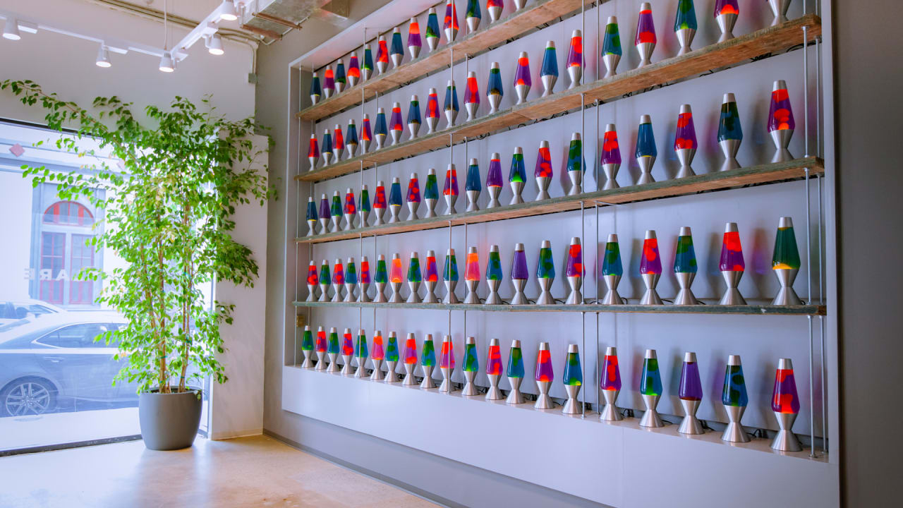
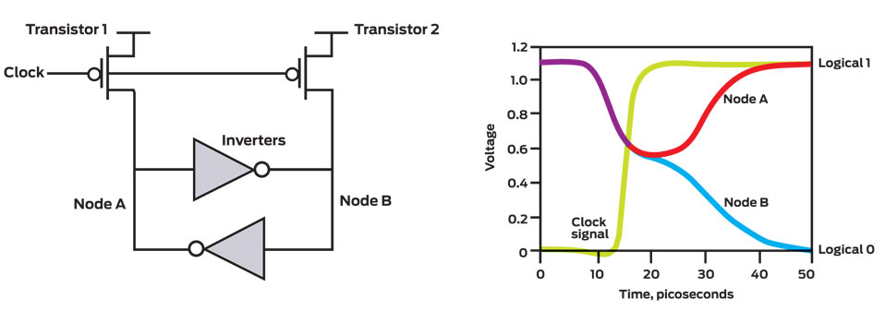
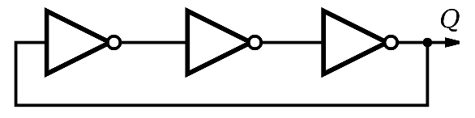
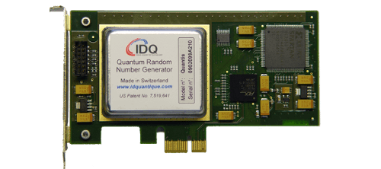

TRNG
Thermal noise
Entropy sources
https://www.cloudflare.com/learning/ssl/lava-lamp-encryption/
Ring oscillators
Quantum magic
(radioactive decay, quantum tunneling, etc…)

Slide 4

Ring-oscillators
Shot noise
Thermal agitation
Clock
sample
sample

Slide 5
Ring-oscillators
Clock
sample
sample

Slide 6
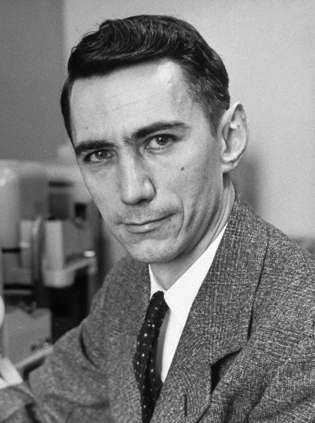


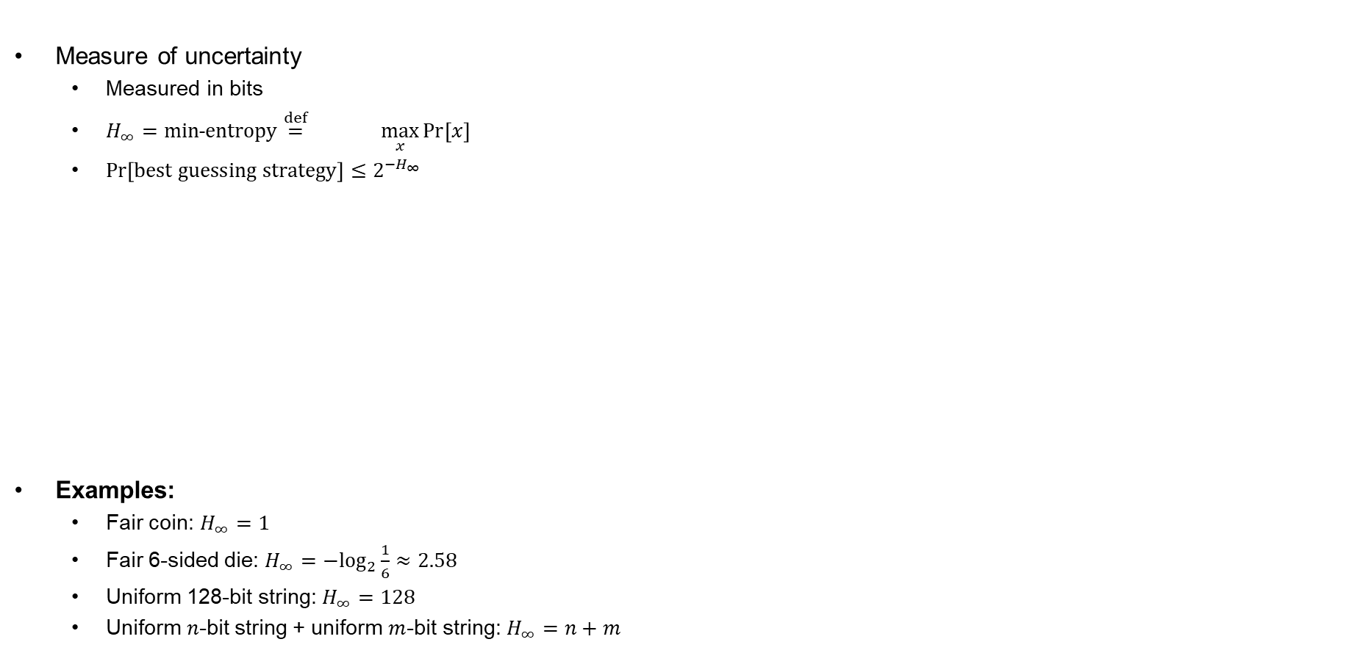



Entropy
Measure of uncertainty
  Measured in bits
  $H_{∞}=min˗entropy\overset{def}{=} \max_{x}{\operatorname{Pr}\left[x\right]}$
  $\operatorname{Pr}\left[best guessing strategy\right]≤2^{−H_{∞}}$
Examples:
  Fair coin: $H_{∞}=1$
  Fair 6-sided die: $H_{∞}={−log}_{2}{\frac{1}{6}}≈2.58$
  Uniform 128-bit string: $H_{∞}=128$
  Uniform $n$-bit string + uniform $m$-bit string: $H_{∞}=n+m$
$$\log_{2}\left(\max_{x}{\operatorname{Pr}{[x]}}\right)$$
$$−$$
$$H_{∞}=−\log_{2}{\frac{1}{4}=2}$$
$$H_{∞}=−\log_{2}{\frac{1}{2}=1}$$
$$H_{∞}=−\log_{2}{1=0}$$
Claude Shannon

Slide 7
TRNG
Thermal noise
Entropy sources
https://www.cloudflare.com/learning/ssl/lava-lamp-encryption/
Ring oscillators
Quantum magic
(radioactive decay, quantum tunneling, etc…)

Slide 8
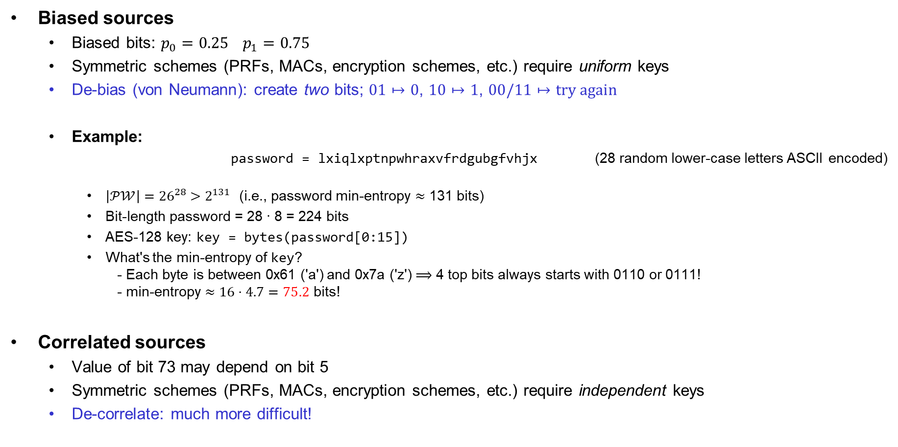
Problems with TRNGs
…and slow!
Biased sources
  Biased bits: $p_{0}=0.25$ $p_{1}=0.75$
  Symmetric schemes (PRFs, MACs, encryption schemes, etc.) require uniform keys
  De-bias (von Neumann): create two bits; $01↦0$, $10↦1$, $00/11↦try again$
  Example:
    password = lxiqlxptnpwhraxvfrdgubgfvhjx (28 random lower-case letters ASCII encoded)
    $\left|𝒫𝒲\right|{=26}^{28} >2^{131}$ (i.e., password min-entropy $≈$ 131 bits)
    Bit-length password = 28 ∙ 8 = 224 bits
    AES-128 key: key = bytes(password[0:15])
    What's the min-entropy of key?
    - Each byte is between 0x61 ('a') and 0x7a ('z') $⟹$ 4 top bits always starts with 0110 or 0111!
    - min-entropy $≈16⋅4.7=75.2$ bits!
Correlated sources
  Value of bit 73 may depend on bit 5
  Symmetric schemes (PRFs, MACs, encryption schemes, etc.) require independent keys
  De-correlate: much more difficult!
(in practice: hash with SHA2-256)
(in practice: hash with SHA2-256)

Slide 9



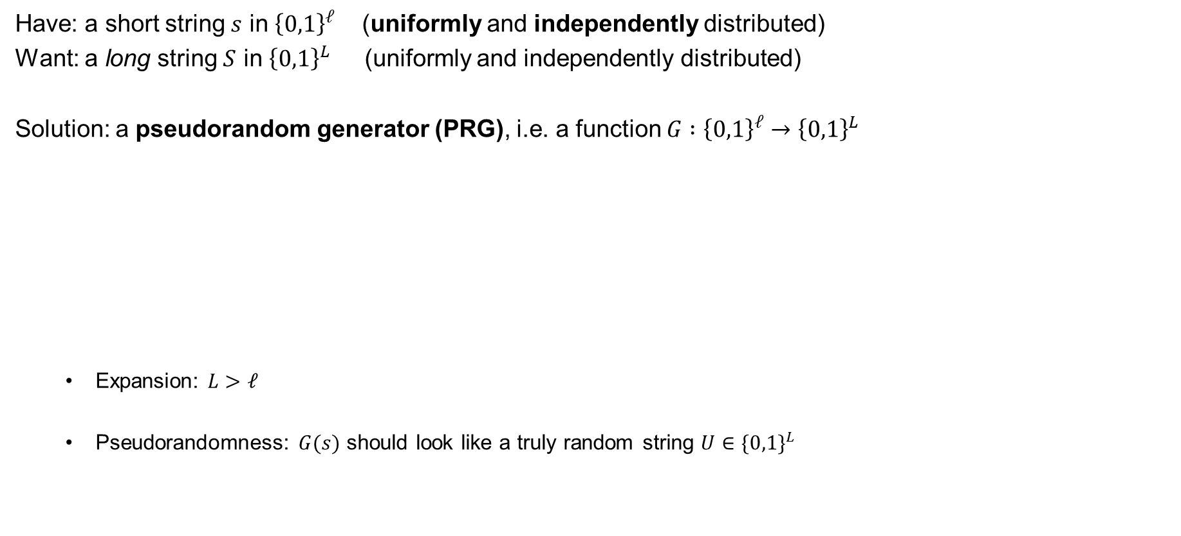


Pseudorandom generators (PRG) – syntax
Have: a short string $s$ in ${\left\{0,1\right\}}^{ℓ}$ (uniformly and independently distributed)
Want: a long string $S$ in ${\left\{0,1\right\}}^{L}$ (uniformly and independently distributed)
Solution: a pseudorandom generator (PRG), i.e. a function $G :{\left\{0,1\right\}}^{ℓ}→{\left\{0,1\right\}}^{L}$
  Expansion: $L>ℓ$
  Pseudorandomness: $G(s)$ should look like a truly random string $U∈\{0,1\}^{L}$
$$ℓ$$
$$L$$
$$G$$
$$s$$
$$G\left(s\right)$$
$$≫$$

Slide 10
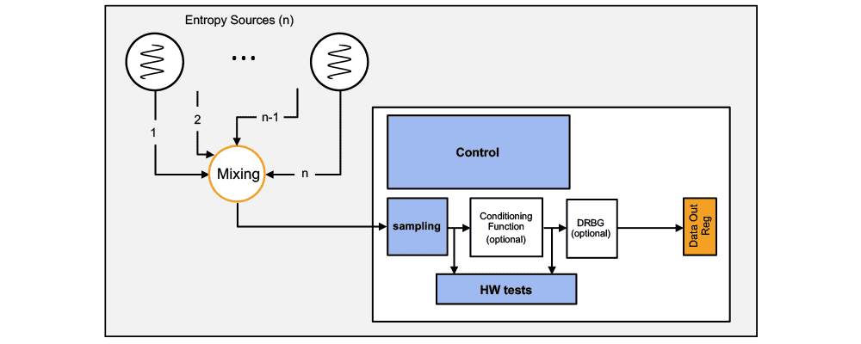
Random generators
Common design:
  TRNG generates short random seed
  PRNG expands seed to “infinite” length
Examples:
  /dev/urandom
  CryptGenRandom
  Intel RDRAND
Debian OpenSSL RNG bug
  // MD_Update(&m,buf,j);
  Only 32,767 possibilities for seed ≈ 15 bits of entropy

Slide 11
Statistical tests
Is this a random string?
What does that even mean?
Suggestions:
  A random string should have roughly 50% zeros and ones (how much can you deviate?)
  A continuous run of zeros (or ones) shouldn't be too long (how long?)
  ≈ 25% of 2-bit substrings should be 00, 25% should be 01, …
  ≈ 12.5% of 3-bit substrings should be 000, 12.5% should be 001, ….
  A random string should not be compressible (related to Kolmogorov-complexity)
  …
101010011101011000100100011111000010101000000001010011111
Our answer: question not valid!

Slide 12

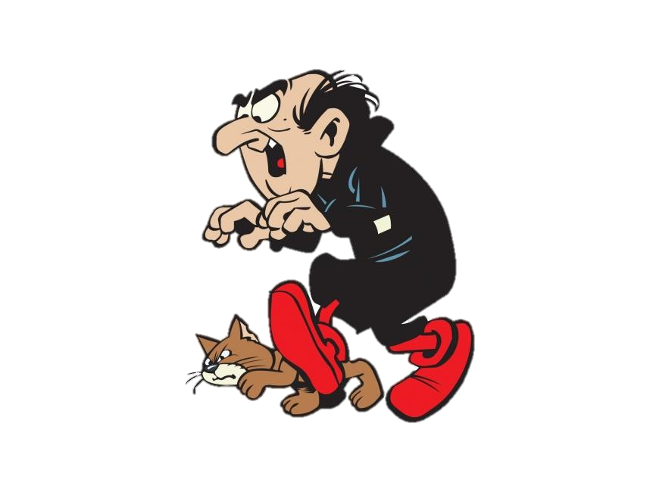
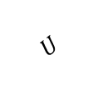
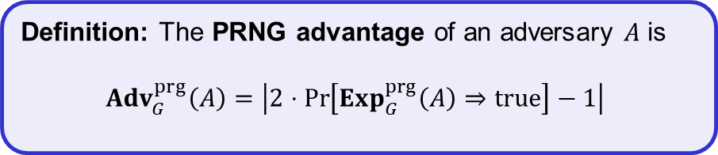
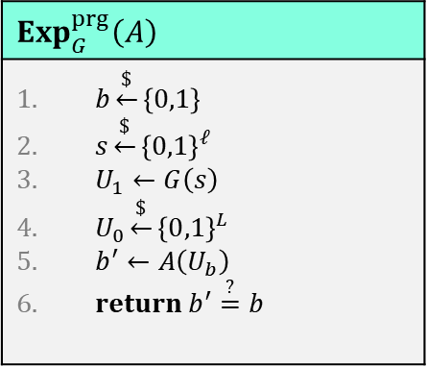
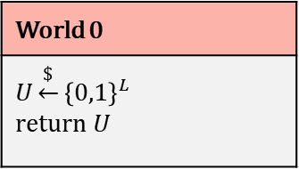
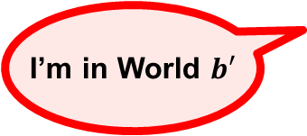
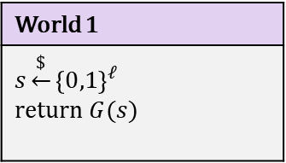
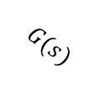
PRNG – security definition
$$Exp_{G}^{prg}\left(A\right)$$
$b\underset{←}{\$}\left\{0,1\right\}$ $s\underset{←}{\$}{\left\{0,1\right\}}^{ℓ}$ $U_{1}←G\left(s\right)$ $U_{0}\underset{←}{\$}{\left\{0,1\right\}}^{L}$ $b^{′}←A\left(U_{b}\right)$ $return b^{′}\overset{?}{=}b$
World 1
$$s\underset{←}{\$}{\left\{0,1\right\}}^{ℓ}$$ return $G(s)$
World 0
$$U\underset{←}{\$}{\left\{0,1\right\}}^{L}$$ return $U$
$$G(s)$$
$$U$$
I’m in World $b′$
Definition: The PRNG advantage of an adversary $A$ is
$${Adv}_{G}^{prg}\left(A\right)=\left|2⋅\operatorname{Pr}\left[Exp_{G}^{prg}\left(A\right)⇒true\right]−1\right|$$
$$2⋅\operatorname{Pr}\left[b^{′}=b\right]−1=\operatorname{Pr}\left[b^{′}=1 ∣ b=1\right]+\operatorname{Pr}\left[b^{′}=0 ∣ b=0\right]−1$$
$$=\operatorname{Pr}\left[b^{′}=1 ∣ b=1\right]−\operatorname{Pr}\left[b^{′}=1 ∣ b=0\right]$$
$$=\operatorname{Pr}\left[A\left(G\left(s\right)\right)⇒1\right]−\operatorname{Pr}\left[A\left(U\right)⇒1\right]$$

Slide 13






Pseudorandomness
$${s∈\left\{0,1\right\}}^{ℓ}$$
PRNG sec.
$$≈$$
$$G(s)$$
$${\left\{0,1\right\}}^{L}$$
$${\left\{0,1\right\}}^{L}$$

Slide 14








Creating PRNGs – CTR-mode
pick randomly
ctr
ctr+1
ctr+2
ctr+3
ctr+4
ctr+5
$${ E}_{K}$$
$${ E}_{K}$$
$${ E}_{K}$$
$${ E}_{K}$$
$${ E}_{K}$$
$$⋯$$
keystream
$$M$$
=
$$C_{0}$$
$$C$$

Slide 15
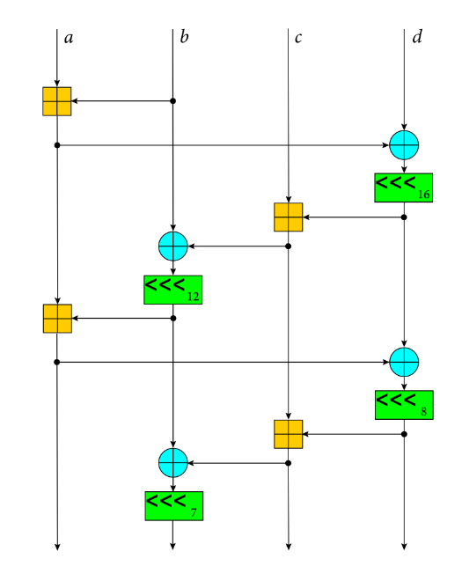
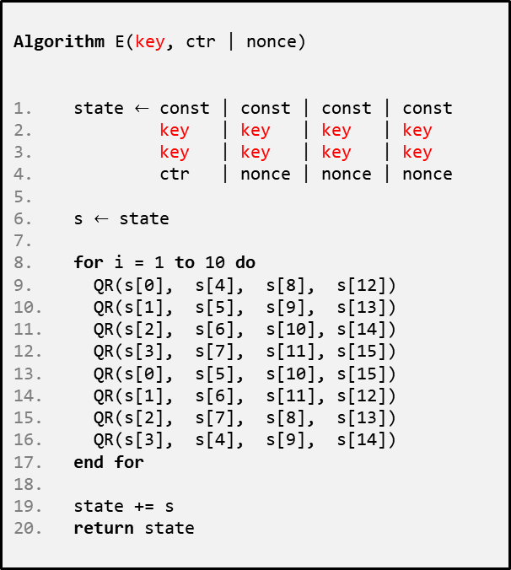



ChaCha20
$$E :{\left\{0,1\right\}}^{256}×{\left\{0,1\right\}}^{128}→{\left\{0,1\right\}}^{512}$$
Algorithm E(key, ctr | nonce)
state $←$ const | const | const | const
$←$ key | key | key | key
$←$ key | key | key | key
$←$ ctr | nonce | nonce | nonce
s $←$ state
for i = 1 to 10 do
QR(s[0], s[4], s[8], s[12])
QR(s[1], s[5], s[9], s[13])
QR(s[2], s[6], s[10], s[14])
QR(s[3], s[7], s[11], s[15])
QR(s[0], s[5], s[10], s[15])
QR(s[1], s[6], s[11], s[12])
QR(s[2], s[7], s[8], s[13])
QR(s[3], s[4], s[9], s[14])
end for
state += s
return state
Algorithm QR(a, b, c , d)
a += b; d ^= a; d <<<= 16;
c += d; b ^= c; b <<<= 12;
a += b; d ^= a; d <<<= 8;
c += d; b ^= c; b <<<= 7;
ChaCha20:
1|nonce
2|nonce
3|nonce
4|nonce
$${ E}_{K}$$
$${ E}_{K}$$
$${ E}_{K}$$
$${ E}_{K}$$
$$⋯$$
keystream
0
1
2
3
s =
4
5
6
7
8
9
10
11
12
13
14
15

Slide 16
ChaCha20
Extremely simple
  only ARX operations (add-rotate-xor)
Very fast in SW
  no HW support required
  faster than AES(-CTR) without AES-NI instructions
Constant time – no tables
No key-setup, no subkeys
Designed by Daniel J. Bernstein

Slide 17






Stream ciphers
Security requirement: For all $N$ the function $G(⋅,N)$ is a secure PRG
$$N$$
$$ℓ$$
$$L$$
$$G$$
$$s$$
$$G\left(s\right)$$
$$,N)$$
not IND-CPA secure!
$$Enc_{K}\left(M\right)={truncate}_{\left|M\right|}(G\left(K\right))⊕M$$
$$Enc :𝒦×𝒩×ℳ→𝒞$$
$$Enc_{K}^{N}\left(M\right)=N || {truncate}_{\left|M\right|}(G\left(K, N\right))⊕M$$
Stream cipher

Slide 18




Stream ciphers – CTR-mode
ctr
ctr+1
ctr+2
ctr+3
ctr+4
ctr+5
$${ E}_{K}$$
$${ E}_{K}$$
$${ E}_{K}$$
$${ E}_{K}$$
$${ E}_{K}$$
$$⋯$$
keystream
$$M$$
=
$$C_{0}$$
$$C$$

Slide 19

AFTER THE BREAK…

Slide 20

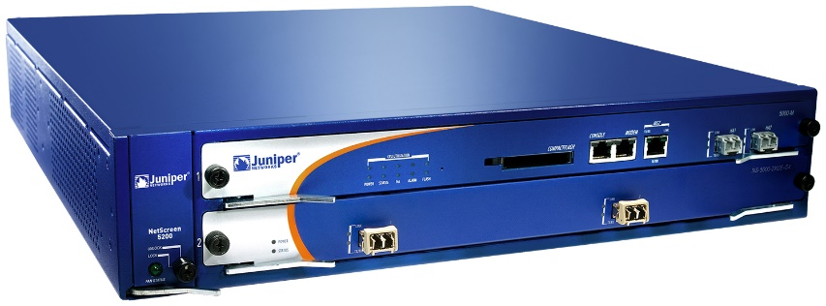
Juniper Networks
Juniper Networks: big manufacturer of network equipment (routers, VPNs, firewalls, etc.)
  Major customers: telcos, banks, US DoD
2015:
Hackers had obtained access to source code repository
Only change:
--- Qx = 2c55e5e45edf713dc43475effe8813a60326a64d9ba3d2e39cb639b0f3b0ad10
+++ Qx = 9585320eeaf81044f20d55030a035b11bece81c785e6c933e4a8a131f6578107
IMPORTANT JUNIPER SECURITY ANNOUNCEMENT
During a recent internal code review, Juniper discovered unauthorized code in ScreenOS that could allow a knowledgeable attacker to gain administrative access to NetScreen® devices and to decrypt VPN connections.

Slide 21
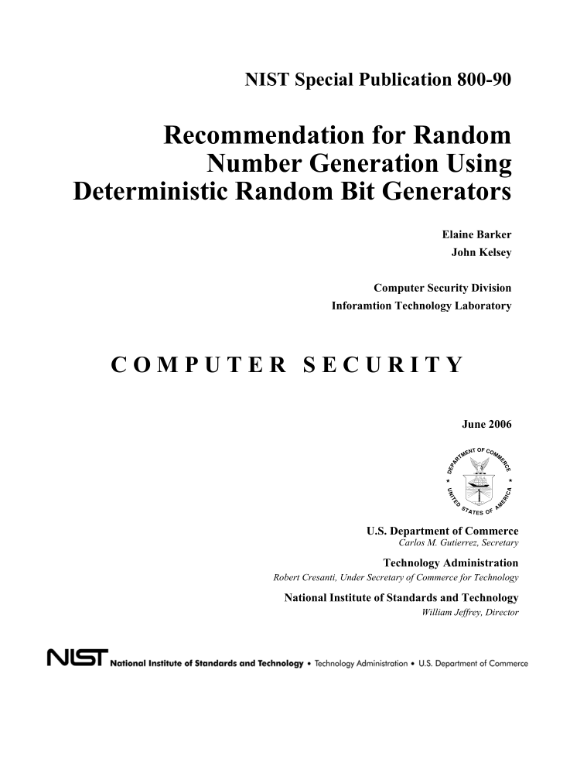
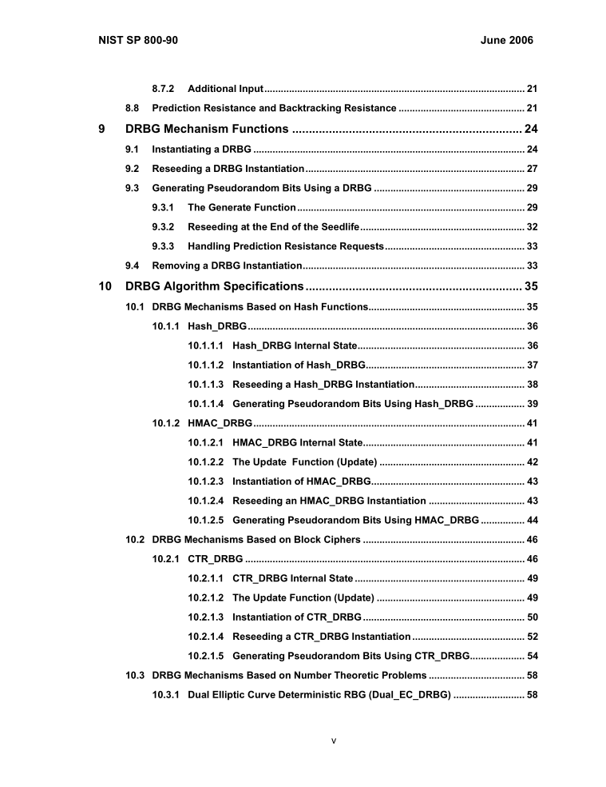
PRNG standardization

Slide 22














PRNG
$$f\left(s_{0}\right)$$
$$f\left(s_{1}\right)$$
$$f\left(s_{2}\right)$$
$${ s}_{0}$$
$${ s}_{1}$$
$${ s}_{2}$$
$${ s}_{3}$$
$$g\left(s_{0}\right)$$
$$g\left(s_{1}\right)$$
$$g\left(s_{2}\right)$$
$$⋯$$
$${ R}_{0}$$
$${ R}_{1}$$
$${ R}_{2}$$

Slide 23
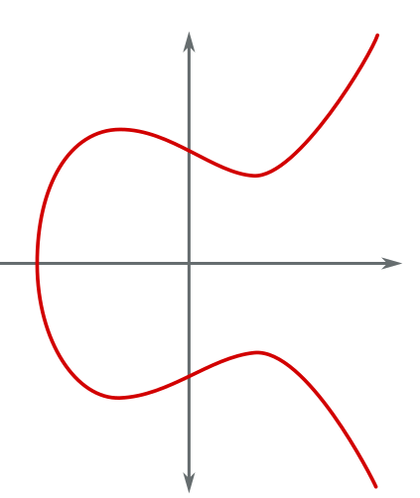
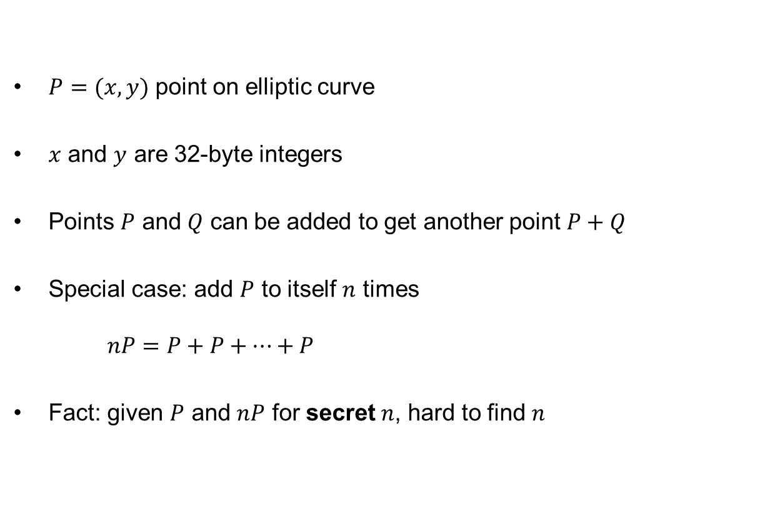



Elliptic curves 101
$P=(x,y)$ point on elliptic curve
$x$ and $y$ are 32-byte integers
Points $P$ and $Q$ can be added to get another point $P+Q$
Special case: add $P$ to itself $n$ times
$nP=P+P+…+P$
Fact: given $P$ and $nP$ for secret $n$, hard to find $n$
$$y$$
$$P$$
$$x$$

Slide 24


















Dual EC DRBG
$P,Q:$public points on an elliptic curve
$x\left(⋅\right) :$x-coordinate (32 bytes)
$$x\left(s_{0}P\right)$$
$$x\left(s_{1}P\right)$$
$$x\left(s_{2}P\right)$$
32-byte state
$${ s}_{0}$$
$${ s}_{1}$$
$${ s}_{2}$$
$$s_{0}Q$$
$$x\left(s_{1}Q\right)$$
$$x\left(s_{2}Q\right)$$
$$⋯$$
$$x\left(s_{0}Q\right)$$
$$r_{0}$$
$$r_{1}$$
$$r_{2}$$
keep 30 bytes
Output

Slide 25
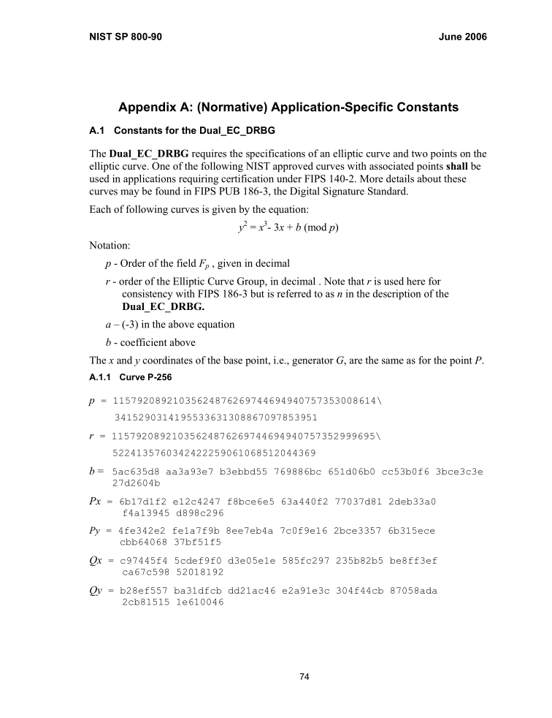
Where does $Q$ (and $P$) come from?
Subject: RE: Minding our Ps and Qs in Dual_EC
From: "Don Johnson" <DJohnson@cygnacom.com>
Date: Wed, October 27, 2004 11:42 am
To: "John Kelsey" <john.kelsey@nist.gov>
John,
P=G.
Q is (in essence) the public key for some random private key.
It could also be generated like a(nother) canonical G, but NSA kyboshed
this idea, and I was not allowed to publicly discuss it, just in case you
may think of going there.
Don B. Johnson
-----Original Message-----
From: John Kelsey [mailto:john.kelsey@nist.gov]
Sent: Wednesday, October 27, 2004 11:17 AM
To: Don Johnson
Subject: Minding our Ps and Qs in Dual_EC
Do you know where Q comes from in Dual_EC_DRBG?
Thanks,
-Joh

Slide 26




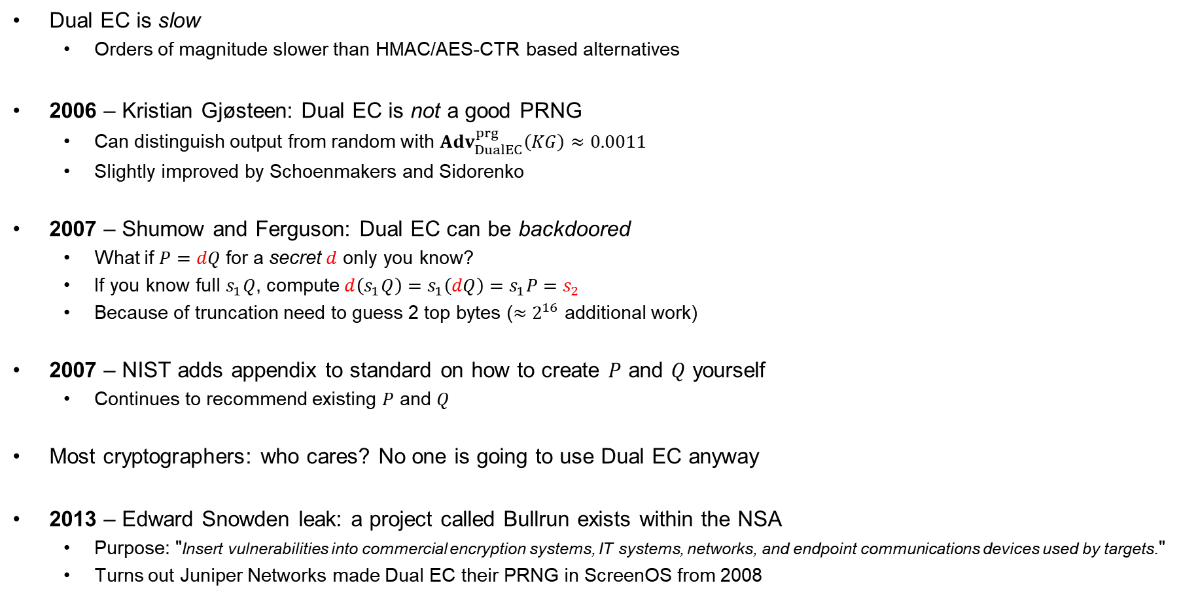






Dual EC DBRG – something's fishy
Dual EC is slow
  Orders of magnitude slower than HMAC/AES-CTR based alternatives
2006 – Kristian Gjøsteen: Dual EC is not a good PRNG
  Can distinguish output from random with ${Adv}_{DualEC}^{prg}\left(KG\right)≈0.0011$
  Slightly improved by Schoenmakers and Sidorenko
2007 – Shumow and Ferguson: Dual EC can be backdoored
  What if $P=dQ$ for a secret $d$ only you know?
  If you know full $s_{1}Q$, compute $d\left(s_{1}Q\right)=s_{1}\left(dQ\right)=s_{1}P=s_{2}$
  Because of truncation need to guess 2 top bytes (${≈2}^{16}$ additional work)
2007 – NIST adds appendix to standard on how to create $P$ and $Q$ yourself
  Continues to recommend existing $P$ and $Q$
Most cryptographers: who cares? No one is going to use Dual EC anyway
2013 – Edward Snowden leak: a project called Bullrun exists within the NSA
  Purpose: "Insert vulnerabilities into commercial encryption systems, IT systems, networks, and endpoint communications devices used by targets."
  Turns out Juniper Networks made Dual EC their PRNG in ScreenOS from 2008
$$x\left(s_{0}P\right)$$
$$x\left(s_{1}P\right)$$
$$x\left(s_{2}P\right)$$
$${ s}_{0}$$
$${ s}_{1}$$
$${ s}_{2}$$
$$x\left(s_{0}Q\right)$$
$$x\left(s_{1}Q\right)$$
$$x\left(s_{2}Q\right)$$
$$⋯$$
$$r_{0}$$
$$r_{1}$$
$$r_{2}$$
Output
…

Slide 27
Juniper PRNG
ScreenOS does make use of the Dual_EC_DRBG standard,
but is designed to not use Dual_EC_DBRG as its primary random number generator. ScreenOS uses it in a way that should not be vulnerable to the possible issue that has been brought to light. Instead of using the NIST recommended curve points it uses self-generated basis points and then takes the output as an input to FIPS/ANSI X.9.31 PRNG, which is the random number generator used in ScreenOS cryptographic operations.
Juniper Knowledge Base Article KB28205

Slide 28
Juniper PRNG
ScreenOS v.6.1
ScreenOS v.6.2
char block[8], seed[8], key[24]; // X9.31 vars
unsigned int index, calls_since_reseed;
void prng_reseed(void) {
// same as v6.2
}
void prng_generate(char *output) {
unsigned int index = 0;
calls_since_reseed++;
if (calls_since_reseed > 10 000)
prng_reseed();
for (; index < 20; index += 8) {
...
x9_31_generate_block(seed, key, block);
...
memcpy(&output[index], block, 8);
}
}
char block[8], seed[8], key[24]; // X9.31 vars
char output[32]; // prng_generate output
unsigned int index;
void prng_reseed(void) {
dual_ec_generate(output, 32);
memcpy(seed, output, 8);
index = 8;
memcpy(key, &output[index], 24);
index = 32;
}
void prng_generate(void) {
index = 0;
prng_reseed();
for (; index < 32; index += 8) {
...
x9_31_generate_block(seed, key, block);
...
memcpy(&output[index], block, 8);
}
}
global variable
caller-supplied buffer
private variable
only 20 bytes
global shared buffer
Source: Where did I leave my keys? Lessons from the Juniper Dual EC incident https://dl.acm.org/doi/10.1145/3266291

Slide 29


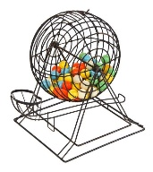
IKEv2 / IPsec
Knowledge of any of these allows deriving traffic encryption key
client nonce,
xG
IKE: 8–256 bytes
yG
server nonce,
client authentication
Juniper: 32 bytes
server authentication
Dual EC
Created by Juniper PRNG

Slide 30

Juniper Networks backdoor
Juniper Networks: big manufacturer of network equipment (routers, VPNs, firewalls, etc.)
  Major customers: telcos, banks, US DoD
2015:
Hackers had obtained access to source code repository
Only change:
--- Qx = 2c55e5e45edf713dc43475effe8813a60326a64d9ba3d2e39cb639b0f3b0ad10
+++ Qx = 9585320eeaf81044f20d55030a035b11bece81c785e6c933e4a8a131f6578107
IMPORTANT JUNIPER SECURITY ANNOUNCEMENT
During a recent internal code review, Juniper discovered unauthorized code in ScreenOS that could allow a knowledgeable attacker to gain administrative access to NetScreen® devices and to decrypt VPN connections.
Juniper created $Q$ (yay! No NSA)
Who dis?

Slide 31

Juniper Networks backdoor
2008 – Juniper starts using Dual EC in ScreenOS
2012 – Someone hacks into Juniper's code repositories
  Changes $Q$ point in Dual EC
2015 – Juniper discovers intrusion
  Changes $Q$ back to its original value

Slide 32
TLS
Only 28 bytes ☹
client random
server random, yG
xG
Dual EC

Slide 33
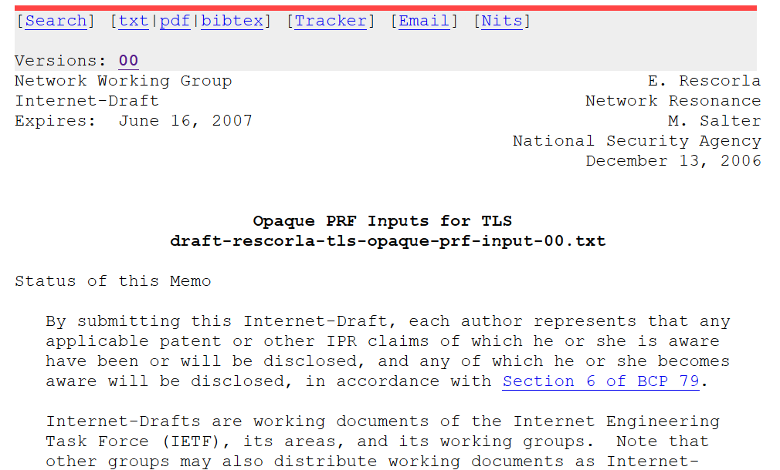
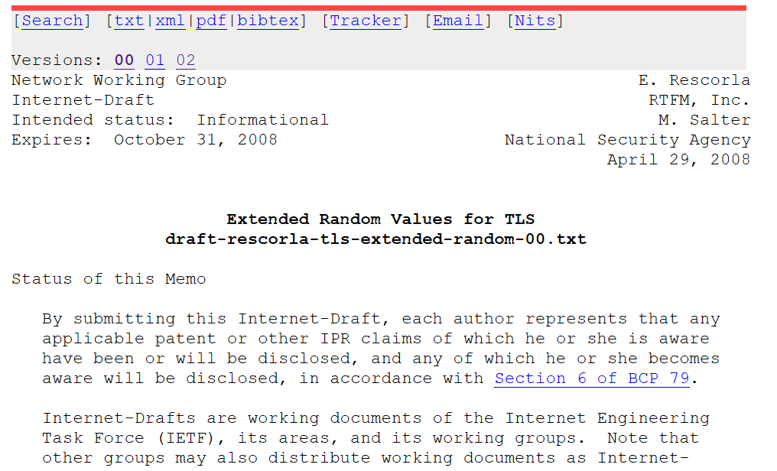
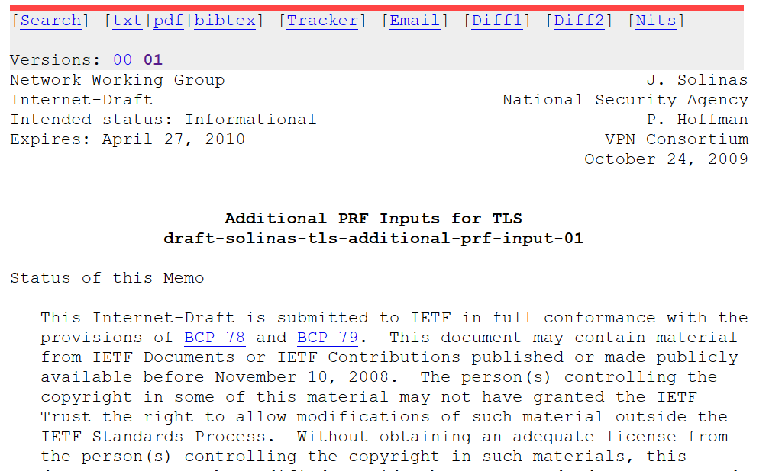
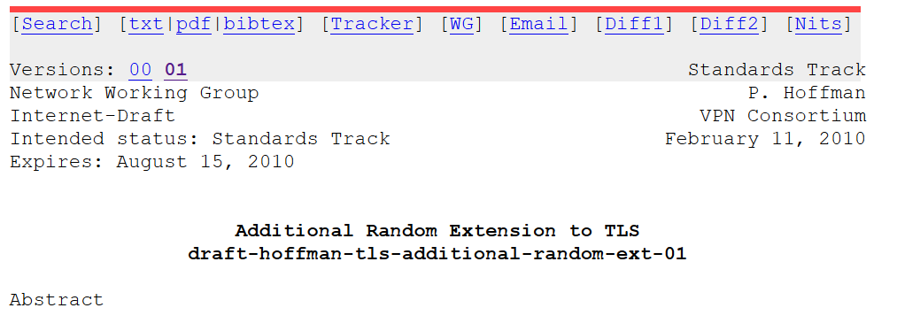
Extended Random
NSA: please make the TLS nonces bigger…for reasons ;-)
Implementing Extended Random makes
exploiting Dual EC 10,000 times easier
No real cryptographic justification exists
for making them longer

Slide 34

RSA Security – BSAFE
Turns out Juniper weren't the only one using Dual EC
RSA Security
  Big computer and network security company
  Creator of BSAFE cryptographic library
2004 – accepted $10 million from the NSA in order to make Dual EC the default in BSAFE
2014 – adapted the TLS Extended Random extension

Slide 35


Slide 36
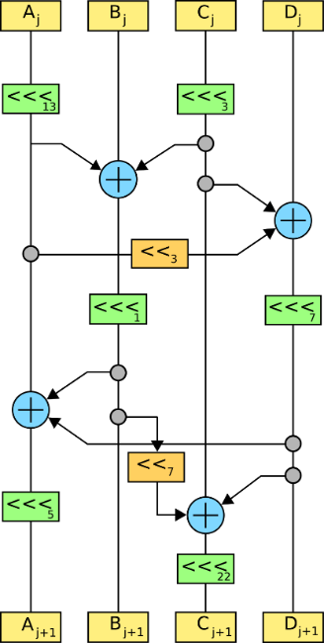
End of PART 1
(symmetric Crypto)

Slide 37
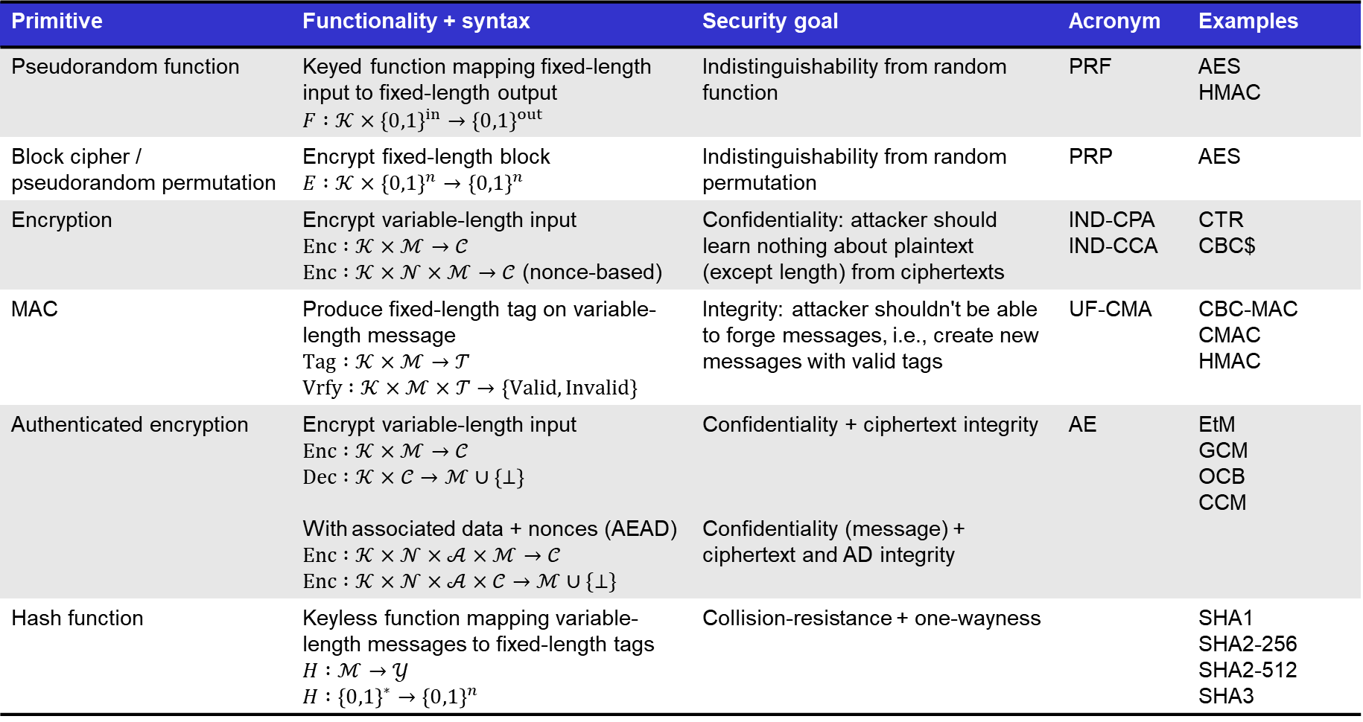
Summary of symmetric cryptography
Primitive | Functionality + syntax | Security goal | Acronym | Examples
Pseudorandom function | Keyed function mapping fixed-length input to fixed-length output $$F :𝒦×{\left\{0,1\right\}}^{in}→{\left\{0,1\right\}}^{out}$$ | Indistinguishability from random function | PRF | AES HMAC
Block cipher / pseudorandom permutation | Encrypt fixed-length block $$E :𝒦×{\left\{0,1\right\}}^{n}→{\left\{0,1\right\}}^{n}$$ | Indistinguishability from random permutation | PRP | AES
Encryption | Encrypt variable-length input $$Enc :𝒦×ℳ→𝒞$$ $Enc :𝒦×𝒩×ℳ→𝒞$ (nonce-based) | Confidentiality: attacker should learn nothing about plaintext (except length) from ciphertexts | IND-CPA IND-CCA | CTR CBC$
MAC | Produce fixed-length tag on variable-length message $$Tag :𝒦×ℳ→𝒯$$ $$Vrfy :𝒦×ℳ×𝒯→\left\{Valid, Invalid\right\}$$ | Integrity: attacker shouldn't be able to forge messages, i.e., create new messages with valid tags | UF-CMA | CBC-MAC CMAC HMAC
Authenticated encryption | Encrypt variable-length input $Enc :𝒦×ℳ→𝒞$ $$Dec :𝒦×𝒞→ℳ∪\left\{⊥\right\}$$ With associated data + nonces (AEAD) $$Enc :𝒦×𝒩×𝒜×ℳ→𝒞$$ $$Enc :𝒦×𝒩×𝒜×𝒞→ℳ∪\{⊥\}$$ | Confidentiality + ciphertext integrity Confidentiality (message) + ciphertext and AD integrity | AE | EtM GCM OCB CCM
Hash function | Keyless function mapping variable-length messages to fixed-length tags $H :ℳ→𝒴$ $$H :{\left\{0,1\right\}}^{∗}→{\left\{0,1\right\}}^{n}$$ | Collision-resistance + one-wayness |  | SHA1 SHA2-256 SHA2-512 SHA3

Slide 38
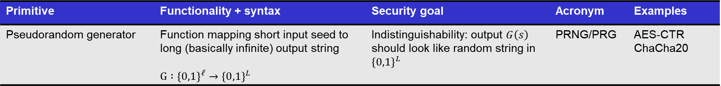
Summary of symmetric cryptography
Primitive | Functionality + syntax | Security goal | Acronym | Examples
Pseudorandom generator | Function mapping short input seed to long (basically infinite) output string $$G :{\left\{0,1\right\}}^{ℓ}→{\left\{0,1\right\}}^{L}$$ | Indistinguishability: output $G\left(s\right)$ should look like random string in ${\left\{0,1\right\}}^{L}$ | PRNG/PRG | AES-CTR ChaCha20

