Slide 1
Lecture 13 – Quantum computers,
Shor’s algorithm, post-quantum cryptography
TEK4500
16.11.2022
Håkon Jacobsen
hakon.jacobsen@its.uio.no

Slide 2
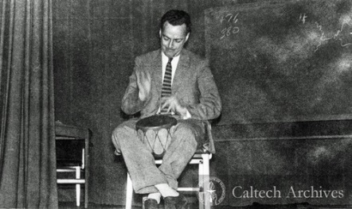
Quantum computing – the starting point

Slide 3
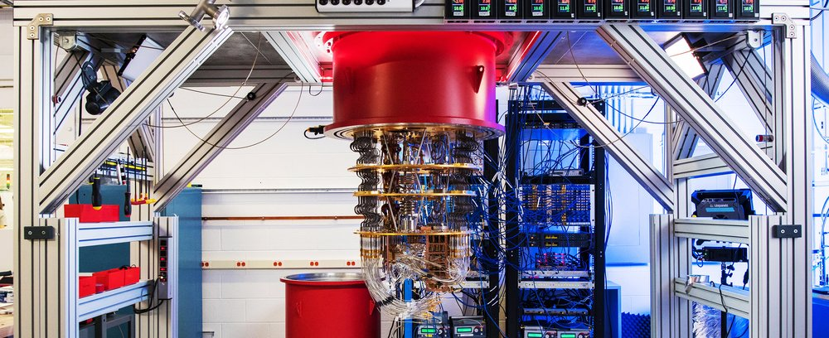
Elements of (quantum) computing
Three elements of all computations: data, operations, results
Quantum computation
  Data = qubit
  Operation = quantum gate
  Results = measurements

Slide 4

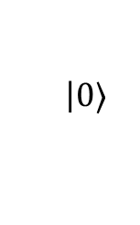







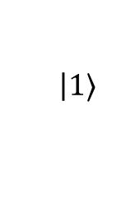


Qubits
Classical bit:
Qubit:
  Can be in a superposition of two basic states $|0〉$ and $|1〉$
  But we can never observe $α$ and $β$ directly!
  Must measure $|ψ〉$ to obtain its value $⟹$ state randomly collapses to either $|0〉$ or $|1〉$
  What's the probability of observing $|0〉$ or $|1〉$?
$$0$$
$$1$$
$$|ψ〉=$$
$$α$$
$$\left|0\right.〉$$
$$+ β$$
$$\left|1\right.〉$$
$$α,β∈C$$
$${\left|α\right|}^{2}+{\left|β\right|}^{2}=1$$
$$\operatorname{Pr}\left[observe |0〉\right]={\left|α\right|}^{2}$$
$$\operatorname{Pr}\left[observe |1〉\right]={\left|β\right|}^{2}$$

Slide 5














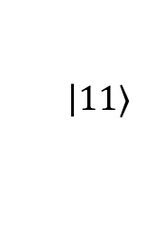

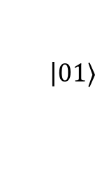


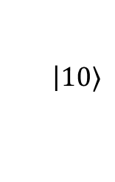

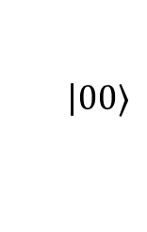



Multiple qubits
2-qubit system
$N$-qubit system: $2^{N}$ basis states
  Representable by a $2^{N}$ element vector:
$$α,β,γ,δ∈C$$
$$|ψ〉 =$$
$$α$$
$$\left|00\right.〉$$
$$+ β$$
$$\left|01\right.〉$$
$$+ γ$$
$$\left|10\right.〉$$
$$+ δ$$
$$\left|11\right.〉$$
$${\left|α\right|}^{2}+{\left|β\right|}^{2}+{\left|γ\right|}^{2}+{\left|δ\right|}^{2}=1$$
$$0.8|001〉−0.6i|101〉=\left(\begin{matrix}\begin{matrix}\begin{matrix}0 \\ 0.8\end{matrix} \\ 0\end{matrix} \\ \begin{matrix}\begin{matrix}0 \\ 0\end{matrix} \\ \begin{matrix}−0.6i \\ \begin{matrix}0 \\ 0\end{matrix}\end{matrix}\end{matrix}\end{matrix}\right)$$
$$|ψ〉=\sum_{i=0}^{2^{N}−1}{α_{i}|i〉}$$
$${\left|α_{0}\right|}^{2}+{\left|α_{1}\right|}^{2}+⋯+{\left|α_{2^{N}−1}\right|}^{2}=1$$
$$\operatorname{Pr}\left[observe |001〉\right]={\left|0.8\right|}^{2}=0.64$$
$$\operatorname{Pr}\left[observe |101〉\right]={\left|−0.6i\right|}^{2}$$
$$={\sqrt{{\left(−0.6\right)}^{2}}}^{2}=0.36$$
$$|ψ〉=\left(\begin{matrix}α_{0} \\ α_{1} \\ \begin{matrix}⋮ \\ α_{2^{N}−1}\end{matrix}\end{matrix}\right)$$
$$|000〉=\left(\begin{matrix}\begin{matrix}\begin{matrix}1 \\ 0\end{matrix} \\ 0\end{matrix} \\ \begin{matrix}\begin{matrix}0 \\ 0\end{matrix} \\ \begin{matrix}0 \\ \begin{matrix}0 \\ 0\end{matrix}\end{matrix}\end{matrix}\end{matrix}\right)$$
$$|001〉=\left(\begin{matrix}\begin{matrix}\begin{matrix}0 \\ 1\end{matrix} \\ 0\end{matrix} \\ \begin{matrix}\begin{matrix}0 \\ 0\end{matrix} \\ \begin{matrix}0 \\ \begin{matrix}0 \\ 0\end{matrix}\end{matrix}\end{matrix}\end{matrix}\right)$$
$$|010〉=\left(\begin{matrix}\begin{matrix}\begin{matrix}0 \\ 0\end{matrix} \\ 1\end{matrix} \\ \begin{matrix}\begin{matrix}0 \\ 0\end{matrix} \\ \begin{matrix}0 \\ \begin{matrix}0 \\ 0\end{matrix}\end{matrix}\end{matrix}\end{matrix}\right)$$
$$|011〉=\left(\begin{matrix}\begin{matrix}\begin{matrix}0 \\ 0\end{matrix} \\ 0\end{matrix} \\ \begin{matrix}\begin{matrix}1 \\ 0\end{matrix} \\ \begin{matrix}0 \\ \begin{matrix}0 \\ 0\end{matrix}\end{matrix}\end{matrix}\end{matrix}\right)$$
$$|100〉=\left(\begin{matrix}\begin{matrix}\begin{matrix}0 \\ 0\end{matrix} \\ 0\end{matrix} \\ \begin{matrix}\begin{matrix}0 \\ 1\end{matrix} \\ \begin{matrix}0 \\ \begin{matrix}0 \\ 0\end{matrix}\end{matrix}\end{matrix}\end{matrix}\right)$$
$$|101〉=\left(\begin{matrix}\begin{matrix}\begin{matrix}0 \\ 0\end{matrix} \\ 0\end{matrix} \\ \begin{matrix}\begin{matrix}0 \\ 0\end{matrix} \\ \begin{matrix}1 \\ \begin{matrix}0 \\ 0\end{matrix}\end{matrix}\end{matrix}\end{matrix}\right)$$
$$|110〉=\left(\begin{matrix}\begin{matrix}\begin{matrix}0 \\ 0\end{matrix} \\ 0\end{matrix} \\ \begin{matrix}\begin{matrix}0 \\ 0\end{matrix} \\ \begin{matrix}0 \\ \begin{matrix}1 \\ 0\end{matrix}\end{matrix}\end{matrix}\end{matrix}\right)$$
$$|111〉=\left(\begin{matrix}\begin{matrix}\begin{matrix}0 \\ 0\end{matrix} \\ 0\end{matrix} \\ \begin{matrix}\begin{matrix}0 \\ 0\end{matrix} \\ \begin{matrix}0 \\ \begin{matrix}0 \\ 1\end{matrix}\end{matrix}\end{matrix}\end{matrix}\right)$$

Slide 6
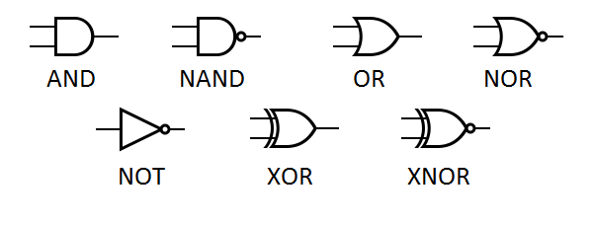
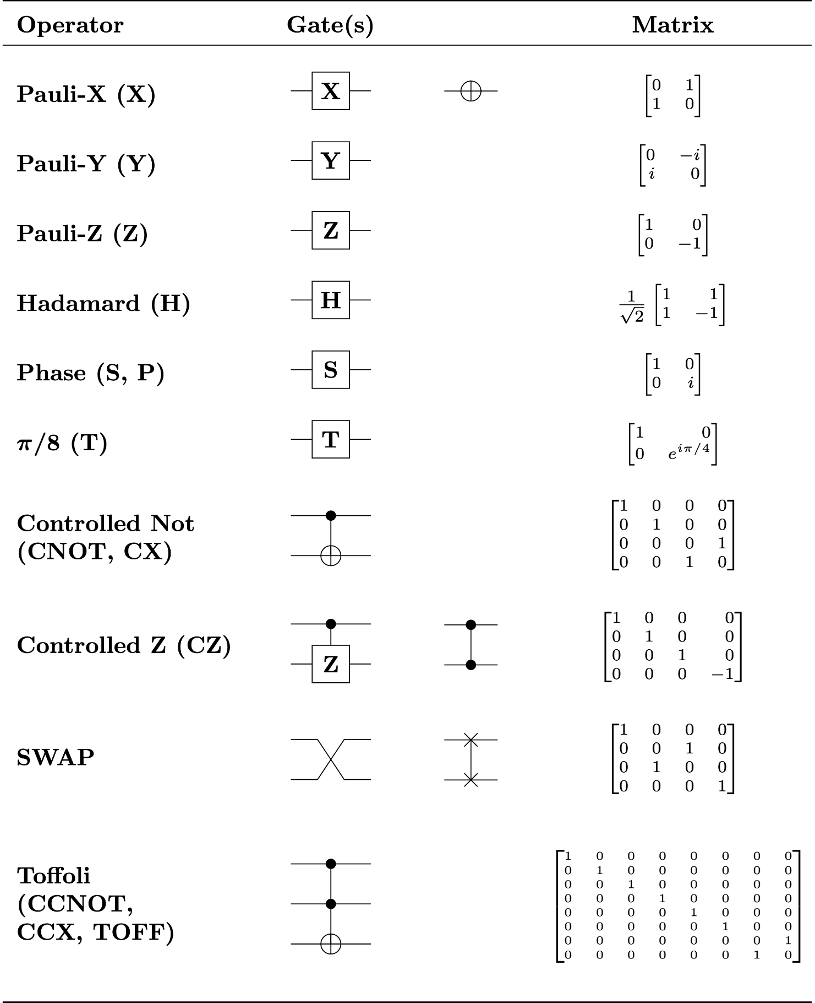
Quantum computation – quantum gates
Classic bits are transformed using logical gates
Qubits are transformed using
quantum gates
$$|ψ〉=α|0〉+β|1〉 \underset{↦}{G} |ψ′〉=α′|0〉+β′|1〉$$

Slide 7








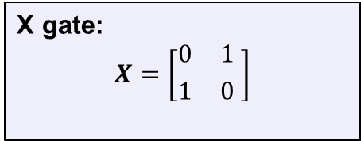



(Quantum) NOT-gate (or X gate)
$$|0〉 \underset{↦}{X} |1〉$$
$$|ψ〉=α|0〉+β|1〉$$
$$|1〉 \underset{↦}{X} |0〉$$
X gate:
$$X=\left[{0 \atop 1}{ 1 \atop 0 }\right]$$
$$|ψ〉=\left({α \atop β}\right)$$
$$α|0〉+β|1〉 \underset{↦}{X} β|0〉+α|1〉$$
$$X|0〉=X\left({1 \atop 0}\right)=\left({0 \atop 1}\right)=|1〉$$
$$X|1〉=X\left({0 \atop 1}\right)=\left({1 \atop 0}\right)=|0〉$$
$$X|ψ〉=X\left({α \atop β}\right)= ?$$
$$\left[{0 \atop 1}{ 1 \atop 0}\right]\left({1 \atop 0}\right)=\left({0 \atop 1}\right)$$
$$\left[{0 \atop 1}{ 1 \atop 0}\right]\left({0 \atop 1}\right)=\left({1 \atop 0}\right)$$
$$\left[{0 \atop 1}{ 1 \atop 0}\right]\left({α \atop β }\right)=\left({β \atop α}\right)$$

Slide 8
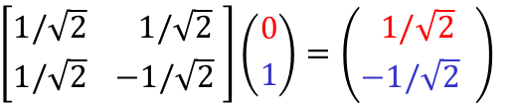

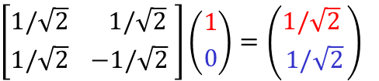

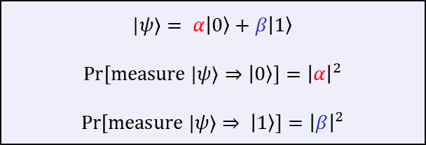
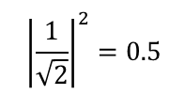

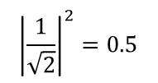

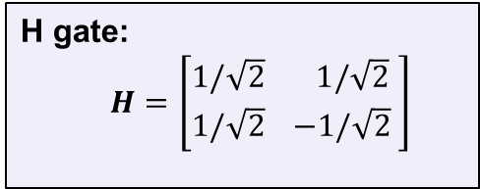
The Hadamard gate
$$|0〉 \underset{↦}{H} \frac{1}{\sqrt{2} }|0〉+\frac{1}{\sqrt{2} }|1〉$$
$$|ψ⟩= α|0〉+β|1〉$$
$$\operatorname{Pr}\left[measure |ψ⟩⇒|0〉\right]={\left|α\right|}^{2}$$
$$\operatorname{Pr}\left[measure |ψ⟩⇒ |1〉\right]={\left|β\right|}^{2}$$
$$|1〉 \underset{↦}{H} \frac{1}{\sqrt{2} }|0〉−\frac{1}{\sqrt{2} }|1〉$$
$${\left|\frac{1}{\sqrt{2}}\right|}^{2}=0.5$$
H gate:
$$H=\left[{1/\sqrt{2} \atop 1/\sqrt{2}}{ 1/\sqrt{2} \atop −1/\sqrt{2} }\right]$$
$$\operatorname{Pr}\left[measure H|0〉⇒|0〉\right]=$$
$${\left|\frac{1}{\sqrt{2}}\right|}^{2}=0.5$$
$$\operatorname{Pr}\left[measure H|1〉⇒|1〉\right]=$$
The Hadamard gate allows us to create random bits!
$$\left[{1/\sqrt{2} \atop 1/\sqrt{2}}{ 1/\sqrt{2} \atop −1/\sqrt{2} }\right]\left({1 \atop 0}\right)=\left({1/\sqrt{2} \atop 1/\sqrt{2}}\right)$$
$$\left[{1/\sqrt{2} \atop 1/\sqrt{2}}{ 1/\sqrt{2} \atop −1/\sqrt{2} }\right]\left({0 \atop 1}\right)=\left({ 1/\sqrt{2} \atop −1/\sqrt{2} }\right)$$

Slide 9
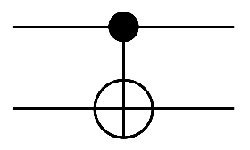


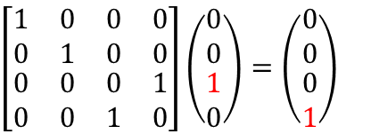






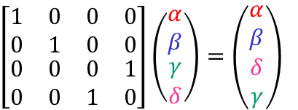
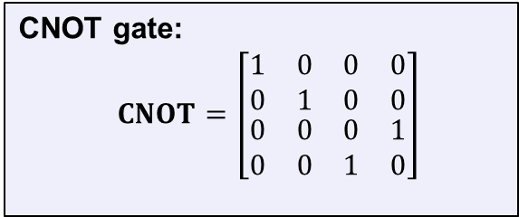


Controlled-NOT gate (CNOT)
CNOT
$$|00〉↦|00〉$$
$$|01〉↦|01〉$$
CNOT gate:
$$CNOT=\left[\begin{matrix}\begin{matrix}1 & 0 \\ 0 & 1\end{matrix} & \begin{matrix}0 & 0 \\ 0 & 0\end{matrix} \\ \begin{matrix}0 & 0 \\ 0 & 0\end{matrix} & \begin{matrix}0 & 1 \\ 1 & 0\end{matrix}\end{matrix}\right]$$
$$|10〉↦|11〉$$
$$|x〉$$
$$|x〉$$
$$|11〉↦|10〉$$
$$|y〉$$
$$|x⊕y〉$$
$$|10〉$$
$$|11〉$$
$$\left[\begin{matrix}\begin{matrix}1 & 0 \\ 0 & 1\end{matrix} & \begin{matrix}0 & 0 \\ 0 & 0\end{matrix} \\ \begin{matrix}0 & 0 \\ 0 & 0\end{matrix} & \begin{matrix}0 & 1 \\ 1 & 0\end{matrix}\end{matrix}\right]\left(\begin{matrix}\begin{matrix}0 \\ 0\end{matrix} \\ \begin{matrix}1 \\ 0\end{matrix}\end{matrix}\right)=\left(\begin{matrix}\begin{matrix}0 \\ 0\end{matrix} \\ \begin{matrix}0 \\ 1\end{matrix}\end{matrix}\right)$$
$$\left[\begin{matrix}\begin{matrix}1 & 0 \\ 0 & 1\end{matrix} & \begin{matrix}0 & 0 \\ 0 & 0\end{matrix} \\ \begin{matrix}0 & 0 \\ 0 & 0\end{matrix} & \begin{matrix}0 & 1 \\ 1 & 0\end{matrix}\end{matrix}\right]\left(\begin{matrix}\begin{matrix}α \\ β\end{matrix} \\ \begin{matrix}γ \\ δ\end{matrix}\end{matrix}\right)=\left(\begin{matrix}\begin{matrix}α \\ β\end{matrix} \\ \begin{matrix}δ \\ γ\end{matrix}\end{matrix}\right)$$

Slide 10

Many other gates…
Universal for classical logic!

Slide 11

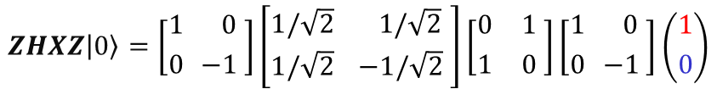










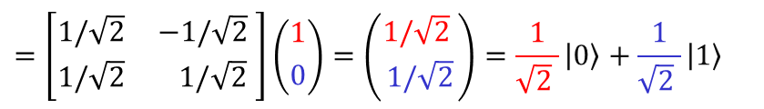
Quantum gates
Turns out that all quantum gates can be described by matrices
  In fact, very special matrices: unitary matrices
  … and only unitary matrices! (fact of nature)
Quantum operations are linear and can be combined
$$|0〉↦ |1〉$$
$$X=\left[{0 \atop 1}{ 1 \atop 0 }\right]$$
$$|1〉↦|0〉$$
$$|ψ_{0}〉 \underset{↦}{Z} |ψ_{1}〉\underset{↦}{X} |ψ_{2}〉\underset{↦}{H} |ψ_{3}〉\underset{↦}{Z} |ψ_{4}〉$$
$$Z=\left[{1 \atop 0}{ 0 \atop −1 }\right]$$
$$|0〉↦|0〉$$
$$|1〉↦−|1〉$$
$$ZHXZ|ψ_{0}〉=|ψ_{4}〉$$
$$ZHXZ|0〉=\left[{1 \atop 0}{ 0 \atop −1 }\right]\left[{1/\sqrt{2} \atop 1/\sqrt{2}}{ 1/\sqrt{2} \atop −1/\sqrt{2} }\right]\left[{0 \atop 1}{ 1 \atop 0 }\right]\left[{1 \atop 0}{ 0 \atop −1 }\right]\left({1 \atop 0}\right)$$
$$|0〉↦\frac{1}{\sqrt{2} }|0〉+\frac{1}{\sqrt{2} }|1〉$$
$$H=\left[{1/\sqrt{2} \atop 1/\sqrt{2}}{ 1/\sqrt{2} \atop −1/\sqrt{2} }\right]$$
$$|1〉↦\frac{1}{\sqrt{2} }|0〉−\frac{1}{\sqrt{2} }|1〉$$
$$=\left[{1/\sqrt{2} \atop 1/\sqrt{2}}{ −1/\sqrt{2} \atop 1/\sqrt{2} }\right]\left({1 \atop 0}\right)=\left({1/\sqrt{2} \atop 1/\sqrt{2}}\right)=\frac{1}{\sqrt{2} }|0〉+\frac{1}{\sqrt{2} }|1〉$$

Slide 12
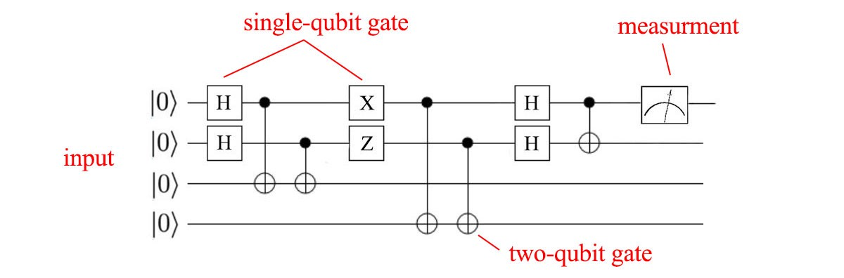

Quantum computer
A quantum computer consists of:
  $N$ input qubits
  a sequence of quantum gates
  $N$ output qubits
  result = measurement of final quantum state (output qubits)

Slide 13
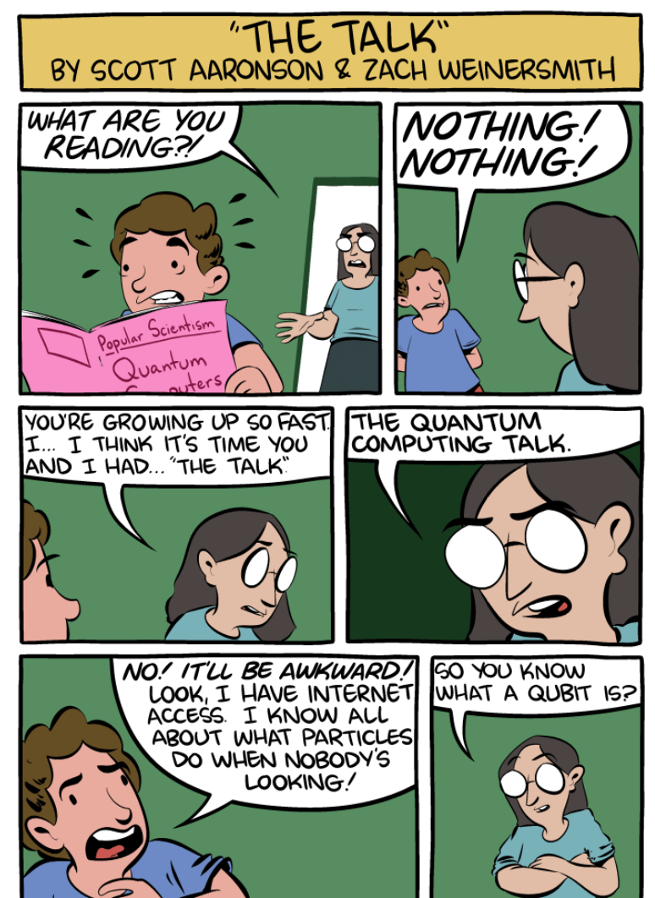
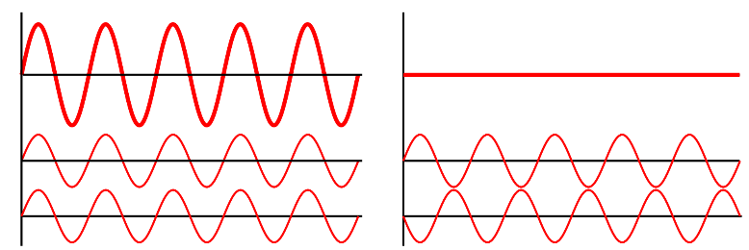


What makes quantum computation special?
Warning: a quantum computer does not simply
"try out all solutions in parallel"
The magic comes from allowing complex amplitudes
(or even just negative reals)
Quantum interference: can carefully choreograph
computations so wrong answers "cancel out" their amplitudes,
while correct answers "combine"
  increases probability of measuring correct result
  only a few special problems allow this choreography
$$|ψ〉=α|0〉+β|1〉$$
$$α,β∈C$$
https://www.smbc-comics.com/comic/the-talk-3

Slide 14
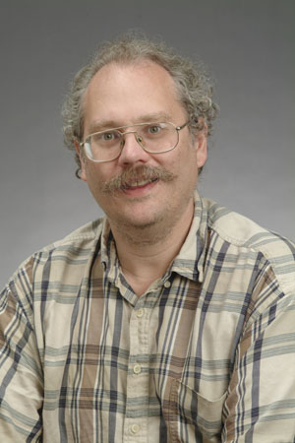
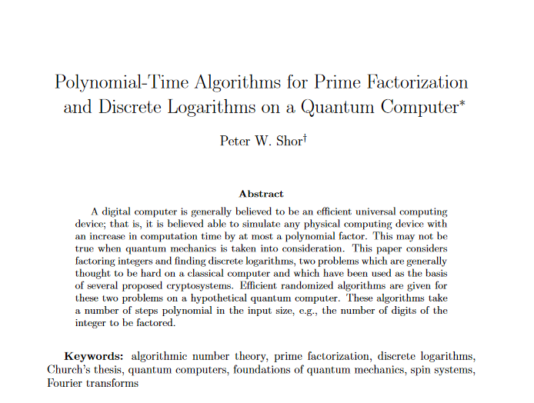
Shor's algorithm
1994

Slide 15



First: something completely different
$$2, 4, 8, 16, 32, 64, 128, 256, 512, 1024, …$$
$$2, 4, 8, 1, 2, 4, 8, 1, 2, 4, 8, 1, 2…$$
$$\operatorname{mod}{15}$$
$$2, 4, 8, 16, 11, 1, 2, 4, 8, 16, 11, 1, 2…$$
$$\operatorname{mod}{21}$$
sequences are periodic

Slide 16
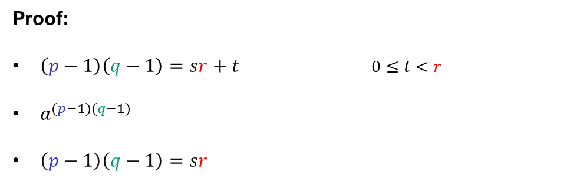









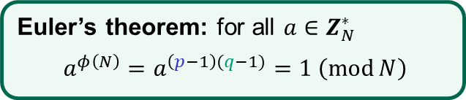



Factoring to order-finding
$$N=pq$$
$$=1$$
$a^{1},a^{2},$ $a^{3}, …,a^{r},a^{1},a^{2}…$
$$\left(\operatorname{mod}{N}\right)$$
order of $a$
$=$ the smallest positive $r$ such that $a^{r}=1 \left(\operatorname{mod}{N}\right)$
Euler’s theorem: for all $a∈Z_{N}^{∗}$
$$a^{φ\left(N\right)}=a^{\left(p−1\right)(q−1)}=1 \left(\operatorname{mod}{N}\right)$$
Fact: $r$ must divide $\left(p−1\right)\left(q−1\right)$
Proof:
$\left(p−1\right)\left(q−1\right)=sr+t$ $0≤t<r$
$a^{(p−1)(q−1)}$
$\left(p−1\right)\left(q−1\right)=sr$
$$=a^{sr+t}=a^{sr}a^{t}$$
$$={\left(a^{r}\right)}^{s}a^{t}$$
$$=1⋅a^{t}$$
$$={ a}^{t}$$
$$=1\operatorname{mod}{N}$$
$⟹ t=0$ (since $r$ is the smallest)
QED
Conclusion: learn $r$ $⟹$ we learn a factor of $(p−1)(q−1)$
repeat with a different $a$ $⟹$ learn another factor of $\left(p−1\right)\left(q−1\right)$ (with high prob.)
eventually we can learn full $\left(p−1\right)\left(q−1\right)$ $⟹$ can find $p$ and $q$ (Problem set 9)

Slide 17

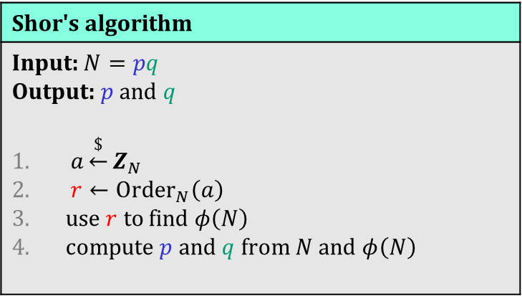
Shor's algorithm
Where the quantum magic happens!
Shor's algorithm
Input: $N=pq$ Output: $p$ and $q$ $a\underset{←}{\$}Z_{N}$ $r←{Order}_{N}\left(a\right)$ use $r$ to find $φ\left(N\right)$ compute $p$ and $q$ from $N$ and $φ\left(N\right)$
// but how to find $r$?

Slide 18
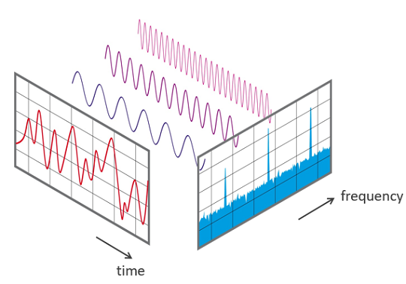

Shor’s algorithm
To factor $N$: find order $r$ of $a$ in $Z_{N}^{∗}$
Problem: $r$ can be very large
  Classical solutions take exponential time
Note: the function $f\left(i\right)=a^{i}\operatorname{mod}{N}$ is periodic:
$f\left(i+kr\right)=a^{i+kr}=a^{i}\operatorname{mod}{N}=f(i)$
  finding signal frequencies $⟺$ finding signal period
Key ingredient of Shor's algorithm:
quantum Fourier transform (QFT)
Fourier transform
Notes:
How to find period classically?
Brute-force: takes 2^n time
Create random a^r, a^r' and look for collisions: time 2^n/2

Slide 19
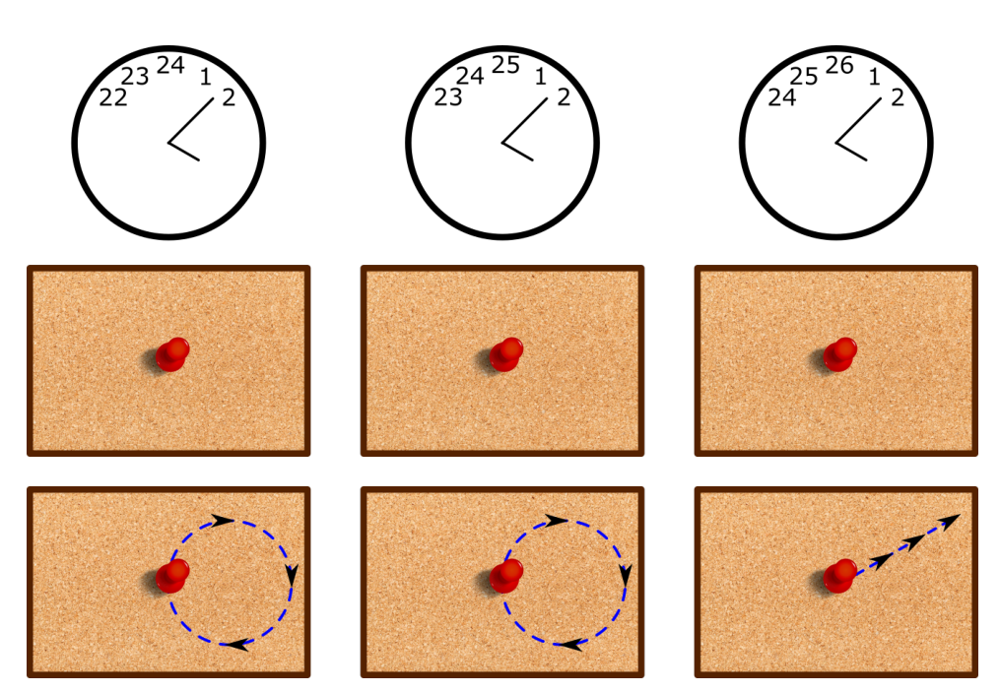
Fourier transform
Source: https://www.scottaaronson.com/qclec.pdf
More on the Fourier transform:
(3Blue1Brown) https://www.3blue1brown.com/lessons/fourier-transforms
(Veritasium) https://youtu.be/nmgFG7PUHfo

Slide 20
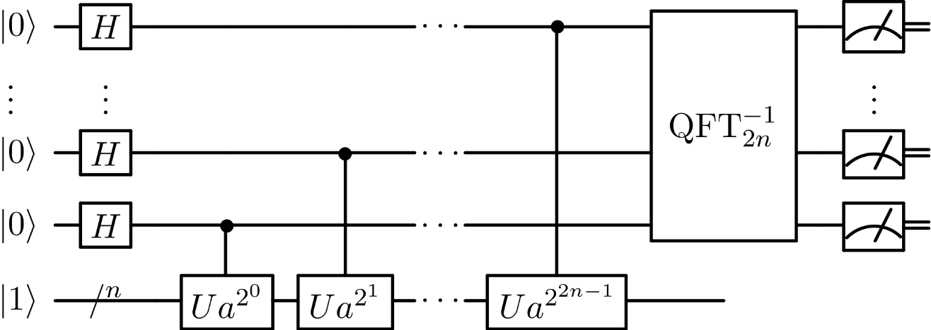


Shor’s algorithm

Slide 21


Consequences of Shor’s algorithm
Cryptosystems broken by Shors' algorithm:
  RSA
  Diffie-Hellman
  Schnorr
  ElGamal
  ECDSA
…public-key crypto is dead
Shor's algorithm
Input: $N=pq$ Output: $p$ and $q$ $a\underset{←}{\$}Z_{N}$ $r←{Order}_{N}\left(a\right)$ // QFT++ use $r$ to find $φ\left(N\right)$ compute $p$ and $q$ from $N$ and $φ\left(N\right)$
both $Z_{p}^{∗}$ and $E\left(F_{p}\right)$
Notes:
Dlog: periodic function: $f\left(a,b\right)=g^{a}h^{−b}$; period: $(x,1)$ where $h=g^{x}$; for any period $\left(\tilde{x },\tilde{y }\right)$ we have $x=\frac{−\tilde{x}}{\tilde{y}} mod⁡q$

Slide 22


The quantum menace
How far away is a quantum computer?
  Nobody knows
Building a large-scale quantum computer is a huge
engineering challenge
  very susceptible to noise (decoherence)
  requires quantum error correction (is it even possible?)
  many physical qubits needed to simulate a single logical qubit
    $≥1000$ logical qubits needed for Shor's algorithm
    largest (known) quantum computers:
    $≈53$ physical qubits (Google; 2019) (no error correction)
    $≈65$ physical qubits (IBM; 2020) (no error correction)
    $≈127$ physical qubits (IBM; 2021) (no error correction)
    $≈433$ physical qubits (IBM; 2022) (no error correction)

Slide 23

The quantum menace
Source: JP Aumasson; https://www.aumasson.jp/data/talks/quantum-cyberpeace-2021.pdf

Slide 24

The quantum menace
Source: JP Aumasson; https://www.aumasson.jp/data/talks/quantum-cyberpeace-2021.pdf

Slide 25


Slide 26

Dealing with quantum computers
Symmetric cryptography
  Grover's algorithm: solves $𝒪\left(2^{n}\right)$ problems in $𝒪\left(2^{n/2}\right)$ quantum steps
  Inherently serial + huge constants
  AES-128 is most likely safe
Quantum cryptography
  Use quantum mechanics to build cryptography
Post-quantum cryptography
  Classical algorithms believed to withstand quantum attacks

Slide 27





















Post-quantum cryptography
Lattice-based cryptography
Code-based encryption
$$c=Gx+e∈F_{2}^{n}$$
https://eprint.iacr.org/2022/975
Broken this year!
$$pk$$
$$H$$
$$H$$
$$H$$
$$H$$
$$H$$
$$H$$
$$H$$
$$pk_{\text{ots}}^{1}$$
$$pk_{\text{ots}}^{2}$$
$$pk_{\text{ots}}^{3}$$
$$pk_{\text{ots}}^{4}$$
$$pk_{\text{ots}}^{5}$$
$$pk_{\text{ots}}^{6}$$
$$pk_{\text{ots}}^{7}$$
$$pk_{\text{ots}}^{8}$$
$${sk}_{\text{ots}}^{1}$$
$$sk_{\text{ots}}^{2}$$
$$sk_{\text{ots}}^{3}$$
$${sk}_{\text{ots}}^{4}$$
$$sk_{\text{ots}}^{5}$$
$$sk_{\text{ots}}^{6}$$
$$sk_{\text{ots}}^{7}$$
$${sk}_{\text{ots}}^{8}$$
Hash-based signatures
Supersingular isogeny key exchange

Slide 28

The NIST post-quantum competition
Public competition to standardize
post-quantum schemes
  Public-key encryption
  Digital signatures
Started in 2017
  Round 1: 69 submissions
  Round 2: 26 candidates selected
  Round 3: 15 candidates selected
  Round 4: alternative candidates
Winners:
  CRYSTALS-KYBER (PKE)
  CRYSTALS-DILITHIUM (Signature)
  Falcon (Signature)
  SPHINCS+ (Signature)
Algorithm (public-key encryption) | Problem
Classic McEliece | Code-based
CRYSTALS-KYBER | Lattice-based
NTRU | Lattice-based
SABER | Lattice-based
BIKE | Code-based
FrodoKEM | Lattice-based
HQC | Code-based
NTRU Prime | Lattice-based
SIKE | Isogeny-based
Algorithm (digital signatures) | Problem
CRYSTALS-DILITHIUM | Lattice-based
Falcon | Lattice-based
Rainbow | Multivariate-based
GeMSS | Multivariate-based
Picnic | ZKP
SPHINCS+ | Hash-based

Slide 29
The NIST post-quantum competition
Public competition to standardize
post-quantum schemes
  Public-key encryption
  Digital signatures
Started in 2017
  Round 1: 69 submissions
  Round 2: 26 candidates selected
  Round 3: 15 candidates selected
  Round 4: alternative candidates
Winners:
  CRYSTALS-KYBER (PKE)
  CRYSTALS-DILITHIUM (Signature)
  Falcon (Signature)
  SPHINCS+ (Signature)
Algorithm (public-key encryption) | Problem
Classic McEliece | Code-based
CRYSTALS-KYBER | Lattice-based
NTRU | Lattice-based
SABER | Lattice-based
BIKE | Code-based
FrodoKEM | Lattice-based
HQC | Code-based
NTRU Prime | Lattice-based
SIKE | Isogeny-based
Algorithm (digital signatures) | Problem
CRYSTALS-DILITHIUM | Lattice-based
Falcon | Lattice-based
Rainbow | Multivariate-based
GeMSS | Multivariate-based
Picnic | ZKP
SPHINCS+ | Hash-based

Slide 30
The NIST post-quantum competition
Public competition to standardize
post-quantum schemes
  Public-key encryption
  Digital signatures
Started in 2017
  Round 1: 69 submissions
  Round 2: 26 candidates selected
  Round 3: 15 candidates selected
  Round 4: alternative candidates
Winners:
  CRYSTALS-KYBER (PKE)
  CRYSTALS-DILITHIUM (Signature)
  Falcon (Signature)
  SPHINCS+ (Signature)
Algorithm (public-key encryption) | Problem
Classic McEliece | Code-based
CRYSTALS-KYBER | Lattice-based
NTRU | Lattice-based
SABER | Lattice-based
BIKE | Code-based
FrodoKEM | Lattice-based
HQC | Code-based
NTRU Prime | Lattice-based
SIKE | Isogeny-based
Algorithm (digital signatures) | Problem
CRYSTALS-DILITHIUM | Lattice-based
Falcon | Lattice-based
Rainbow | Multivariate-based
GeMSS | Multivariate-based
Picnic | ZKP
SPHINCS+ | Hash-based

Slide 31


Lattice-based cryptography
Very versatile computational problems
  Public-key encryption
  Digital signatures
  Hash functions
  Fully homomorphic encryption
  Key exchange
Leads to efficient and compact schemes
Based on hardness of problems in algebraic number theory
  Believed to be hard also for quantum computers
Shortest vector problem
Closest vector problem

Slide 32
Lattice-based cryptography
https://cr.yp.to/talks/2017.12.28/slides-dan+nadia+tanja-20171228-latticehacks-16x9.pdf

Slide 33
Post-quantum cryptography
Want to learn more about post-quantum cryptography?
Sign up for TEK5550 - Advanced Topics in Cryptology next spring!

Slide 34
Next week
Summary lecture
  If there's anything in particular you want me to repeat, let me know!
Ask me anything session

