Slide 1
Lecture 14 – Course recap
TEK4500
23.11.2022
Håkon Jacobsen
hakon.jacobsen@its.uio.no

Slide 2
What is cryptography?
Alice
Bob
M
Adversary
Security goals:
Data privacy: adversary should not be able to read message M

Slide 3
What is cryptography?
Alice
Bob
M
M'
Adversary
Security goals:
Data privacy: adversary should not be able to read message M
Data integrity: adversary should not be able to modify message M
Data authenticity: message M really originated from Alice

Slide 4
Ideal solution: secure channels
But how to build?
Alice
Bob
M
Adversary
Security goals:
Data privacy: adversary should not be able to read message M ✓
Data integrity: adversary should not be able to modify message M ✓
Data authenticity: message M really originated from Alice ✓

Slide 5
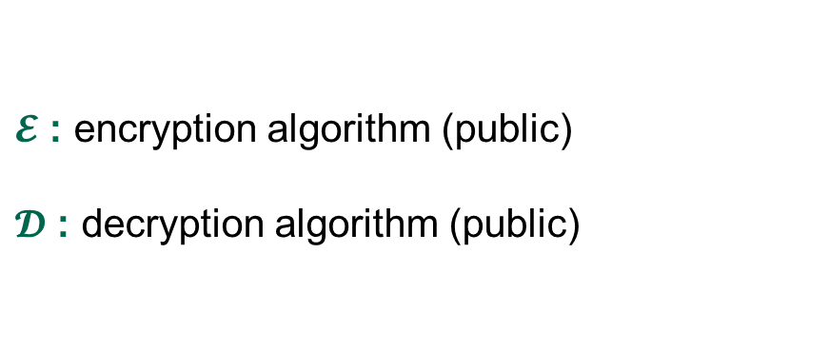
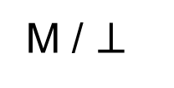
Creating secure channels: encryption schemes
Alice
Bob
K
K
$$ℰ$$
C
$$𝒟$$
M
M / $⊥$
Adversary
$𝓔$ : encryption algorithm (public)
$𝓓$ : decryption algorithm (public)
K : encryption / decryption key (secret)

Slide 6
Creating secure channels: encryption schemes
Alice
Bob
K_{e}
K_{d}
$$ℰ$$
C
$$𝒟$$
M
M / $⊥$
Adversary
$𝓔$ : encryption algorithm (public)
$𝓓$ : decryption algorithm (public)
K_{e} : encryption key (public)
K_{d} : decryption key (secret)

Slide 7
Basic goals of cryptography
IND-CPA, IND-CCA
UF-CMA
AE
 | Message privacy | Message integrity / authentication
Symmetric keys | Symmetric encryption | Message authentication codes (MAC)
Asymmetric keys | Asymmetric encryption (public-key encryption) | Digital signatures
PRNG
PRNG
Key exchange
IND-CPA, IND-CCA
UF-CMA
Unkeyed primitives
Hash functions
TRNG
Collision resistance, one-wayness
Enough min-entropy

Slide 8
Basic goals of cryptography
Encrypt-then-MAC
AES-GCM
AES-CCM
AES-OCB
AES-CTR, AES-CTR$
AES-CBC$
CBC-MAC, CMAC,
HMAC
 | Message privacy | Message integrity / authentication
Symmetric keys | Symmetric encryption | Message authentication codes (MAC)
Asymmetric keys | Asymmetric encryption (public-key encryption) | Digital signatures
CTR mode
PRNG
Key exchange
Diffie-Hellman
ElGamal, Padded RSA
Schnorr, ECDSA, Hashed RSA
Unkeyed primitives
Hash functions
TRNG
SHA2-256, SHA2-512
SHA3-256, SHA3-512
Ring-oscillators, lava lamps
quantum effects, mouse wiggling…

Slide 9
Constructions and relations
TRNG
PRG
GCM++, CCM, OCB++
CTR
CTR
Symmetric-key encryption
PRF
AE
AEAD
CBC$
EtM
AES
Feistel
Thm.
PRP
MAC schemes
CBC-MAC, CMAC, PMAC
Protocols
TLS, SSH, IPsec, What's App
Davies-Mayer
HMAC
SHA2
Hash functions
Public-key encryption
Merkle- Damgård
Lamport
Key exchange
ElGamal
Schnorr, ECDSA
Diffie-Hellman
$$\left(Z_{p}^{∗} , .⋅.\right)$$
$$\left(E\left(F_{p}\right),+\right)$$
Digital signatures
One-Way Trapdoor functions
$$\left(Z_{N}^{∗} , ⋅\right)$$
RSA

Slide 10
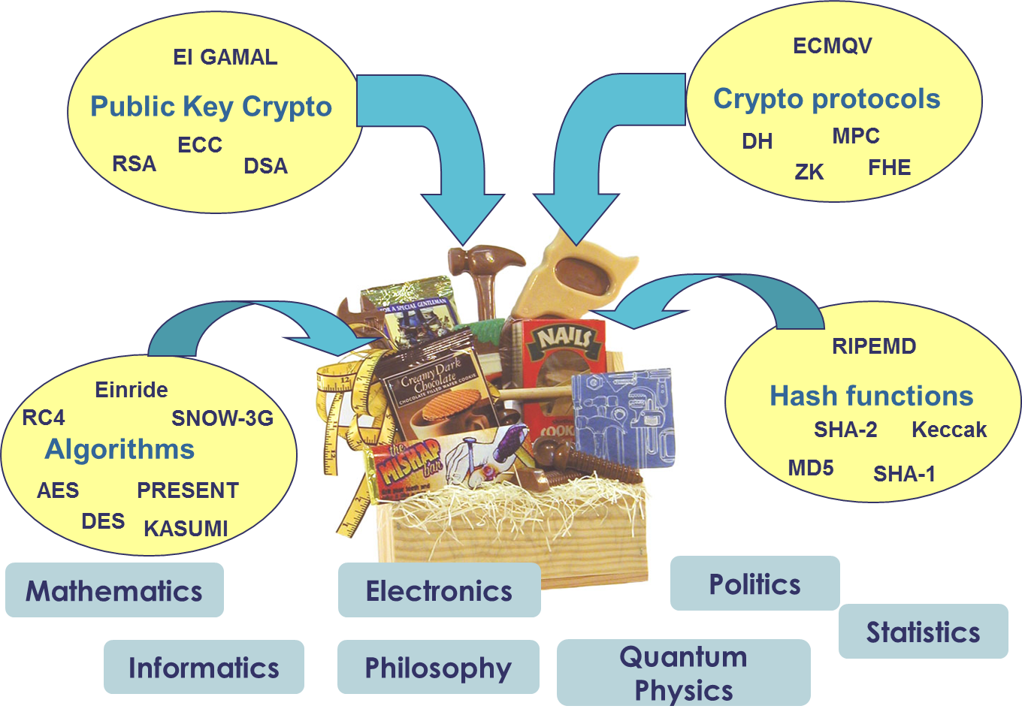
The crypto toolbox

Slide 11
Exam
Tuesday December 06, 15:00-19:00 (4 hours)
Digital, on-campus (Silurveien 2, Sal 3B+3D)
Closed-book

