Slide 1
Course information
TEK4500
30.08.2023
Håkon Jacobsen
hakon.jacobsen@its.uio.no

Slide 2
TEK 4500
Lecture times:
Wednesdays 12:15 – 14:00 in Simula, Ole Johan Dahls hus
Note: the first lecture is in a different lecture hall than the others!
Recitation:
Wednesdays 14:15 – 15:00 in Black Box, Ole Johan Dahls hus
Recordings (sound + slides) made available on course web page (or Canvas)

Slide 3
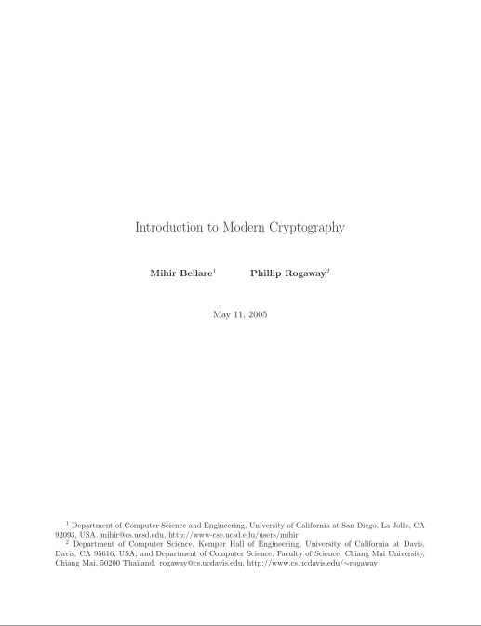
Curriculum
No mandatory text, but one primary source:
[BR]: Bellare and Rogaway Introduction to Modern Cryptography (free) https://web.cs.ucdavis.edu/~rogaway/classes/227/spring05/book/main.pdf
Additional material linked on the semester page

Slide 4
Course tools
https://canvas.uio.no/
Only used for delivery and distribution of home work solutions and as a discussion forum (recorded lectures may also end up here); everything else I will try to make available on the semester page of the course

Slide 5
Exam
Wednesday December 19, 15:00-19:00 (4 hours)
Digital on-campus exam
Closed-book exam
Requirements to take exam:
Pass midterm exam (pass/fail)
Get (at least) two of the weekly problem sets approved (pass/fail)

