Slide 1
Lecture 13 – Quantum computers, Shor’s algorithm, post-quantum cryptography
TEK4500
22.11.2023
Håkon Jacobsen
hakon.jacobsen@its.uio.no

Slide 2
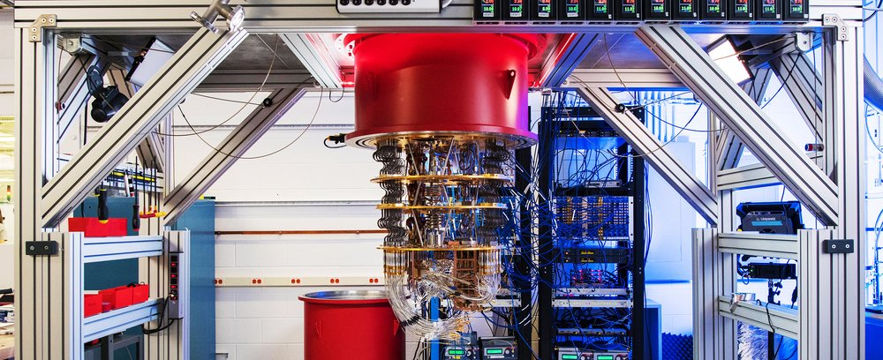
Elements of (quantum) computing
Three elements of all computations: data, operations, results
Quantum computation
Data = qubit
Operation = quantum gate
Results = measurements

Slide 3
Qubits
Classical bit:
Qubit:
Can be in a superposition of two basic states $|0〉$ and $|1〉$
But we can never observe $α$ and $β$ directly!
Must measure $|ψ〉$ to obtain its value $⟹$ state randomly collapses to either $|0〉$ or $|1〉$
What's the probability of observing $|0〉$ or $|1〉$?
$$0$$
$$1$$
$$|ψ〉=$$
$$α$$
$$\left|0\right.〉$$
$$+ β$$
$$\left|1\right.〉$$
$$α,β∈C$$
$${\left|α\right|}^{2}+{\left|β\right|}^{2}=1$$
$$\operatorname{Pr}\left[observe |0〉\right]={\left|α\right|}^{2}$$
$$\operatorname{Pr}\left[observe |1〉\right]={\left|β\right|}^{2}$$

Slide 4
Multiple qubits
2-qubit system
$N$-qubit system: $2^{N}$ basis states
Representable by a $2^{N}$ element vector:
$$α,β,γ,δ∈C$$
$$|ψ〉 =$$
$$α$$
$$\left|00\right.〉$$
$$+ β$$
$$\left|01\right.〉$$
$$+ γ$$
$$\left|10\right.〉$$
$$+ δ$$
$$\left|11\right.〉$$
$${\left|α\right|}^{2}+{\left|β\right|}^{2}+{\left|γ\right|}^{2}+{\left|δ\right|}^{2}=1$$
$$|ψ〉=α_{0}\left|0…00\right\rangle +α_{1}\left|0…01\right\rangle +α_{2}\left|0…10\right\rangle +…+α_{2^{N}−1} \left|1…11\right\rangle$$
$${\left|α_{0}\right|}^{2}+{\left|α_{1}\right|}^{2}+⋯+{\left|α_{2^{N}−1}\right|}^{2}=1$$
$$0.8|001〉−0.6i|101〉=\left(\begin{matrix}\begin{matrix}\begin{matrix}0 \\ 0.8\end{matrix} \\ 0\end{matrix} \\ \begin{matrix}\begin{matrix}0 \\ 0\end{matrix} \\ \begin{matrix}−0.6i \\ \begin{matrix}0 \\ 0\end{matrix}\end{matrix}\end{matrix}\end{matrix}\right)$$
$$\operatorname{Pr}\left[observe |001〉\right]={\left|0.8\right|}^{2}=0.64$$
$$\operatorname{Pr}\left[observe |101〉\right]={\left|−0.6i\right|}^{2}$$
$$={\sqrt{{\left(−0.6\right)}^{2}}}^{2}=0.36$$
$$|ψ〉=\left(\begin{matrix}α_{0} \\ α_{1} \\ \begin{matrix}⋮ \\ α_{2^{N}−1}\end{matrix}\end{matrix}\right)$$
$$|000〉=\left(\begin{matrix}\begin{matrix}\begin{matrix}1 \\ 0\end{matrix} \\ 0\end{matrix} \\ \begin{matrix}\begin{matrix}0 \\ 0\end{matrix} \\ \begin{matrix}0 \\ \begin{matrix}0 \\ 0\end{matrix}\end{matrix}\end{matrix}\end{matrix}\right)$$
$$|001〉=\left(\begin{matrix}\begin{matrix}\begin{matrix}0 \\ 1\end{matrix} \\ 0\end{matrix} \\ \begin{matrix}\begin{matrix}0 \\ 0\end{matrix} \\ \begin{matrix}0 \\ \begin{matrix}0 \\ 0\end{matrix}\end{matrix}\end{matrix}\end{matrix}\right)$$
$$|010〉=\left(\begin{matrix}\begin{matrix}\begin{matrix}0 \\ 0\end{matrix} \\ 1\end{matrix} \\ \begin{matrix}\begin{matrix}0 \\ 0\end{matrix} \\ \begin{matrix}0 \\ \begin{matrix}0 \\ 0\end{matrix}\end{matrix}\end{matrix}\end{matrix}\right)$$
$$|011〉=\left(\begin{matrix}\begin{matrix}\begin{matrix}0 \\ 0\end{matrix} \\ 0\end{matrix} \\ \begin{matrix}\begin{matrix}1 \\ 0\end{matrix} \\ \begin{matrix}0 \\ \begin{matrix}0 \\ 0\end{matrix}\end{matrix}\end{matrix}\end{matrix}\right)$$
$$|100〉=\left(\begin{matrix}\begin{matrix}\begin{matrix}0 \\ 0\end{matrix} \\ 0\end{matrix} \\ \begin{matrix}\begin{matrix}0 \\ 1\end{matrix} \\ \begin{matrix}0 \\ \begin{matrix}0 \\ 0\end{matrix}\end{matrix}\end{matrix}\end{matrix}\right)$$
$$|101〉=\left(\begin{matrix}\begin{matrix}\begin{matrix}0 \\ 0\end{matrix} \\ 0\end{matrix} \\ \begin{matrix}\begin{matrix}0 \\ 0\end{matrix} \\ \begin{matrix}1 \\ \begin{matrix}0 \\ 0\end{matrix}\end{matrix}\end{matrix}\end{matrix}\right)$$
$$|110〉=\left(\begin{matrix}\begin{matrix}\begin{matrix}0 \\ 0\end{matrix} \\ 0\end{matrix} \\ \begin{matrix}\begin{matrix}0 \\ 0\end{matrix} \\ \begin{matrix}0 \\ \begin{matrix}1 \\ 0\end{matrix}\end{matrix}\end{matrix}\end{matrix}\right)$$
$$|111〉=\left(\begin{matrix}\begin{matrix}\begin{matrix}0 \\ 0\end{matrix} \\ 0\end{matrix} \\ \begin{matrix}\begin{matrix}0 \\ 0\end{matrix} \\ \begin{matrix}0 \\ \begin{matrix}0 \\ 1\end{matrix}\end{matrix}\end{matrix}\end{matrix}\right)$$

Slide 5
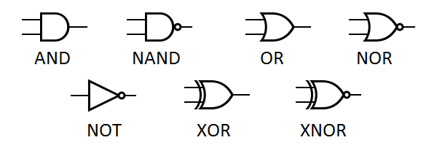
Quantum computation – quantum gates
Classic bits are transformed using logical gates
Qubits are transformed using quantum gates
$$|ψ〉 \underset{↦}{G} |ψ′〉$$
$$α|0〉+β|1〉 \underset{↦}{G} α′|0〉+β′|1〉$$

Slide 6
(Quantum) NOT-gate (or X gate)
$$|0〉 \underset{↦}{X} |1〉$$
$$|ψ〉=α|0〉+β|1〉$$
$$|1〉 \underset{↦}{X} |0〉$$
X gate:
$$X=\left[{0 \atop 1}{ 1 \atop 0 }\right]$$
$$|ψ〉=\left({α \atop β}\right)$$
$$α|0〉+β|1〉 \underset{↦}{X} β|0〉+α|1〉$$
$$X|0〉=X\left({1 \atop 0}\right)=\left({0 \atop 1}\right)=|1〉$$
$$X|1〉=X\left({0 \atop 1}\right)=\left({1 \atop 0}\right)=|0〉$$
$$X|ψ〉=X\left({α \atop β}\right)= ?$$
$$\left[{0 \atop 1}{ 1 \atop 0}\right]\left({1 \atop 0}\right)=\left({0 \atop 1}\right)$$
$$\left[{0 \atop 1}{ 1 \atop 0}\right]\left({0 \atop 1}\right)=\left({1 \atop 0}\right)$$
$$\left[{0 \atop 1}{ 1 \atop 0}\right]\left({α \atop β }\right)=\left({β \atop α}\right)$$

Slide 7
The Hadamard gate
$$|0〉 \underset{↦}{H} \frac{1}{\sqrt{2} }|0〉+\frac{1}{\sqrt{2} }|1〉$$
$$|ψ⟩= α|0〉+β|1〉$$
$$\operatorname{Pr}\left[measure |ψ⟩⇒|0〉\right]={\left|α\right|}^{2}$$
$$\operatorname{Pr}\left[measure |ψ⟩⇒ |1〉\right]={\left|β\right|}^{2}$$
$$|1〉 \underset{↦}{H} \frac{1}{\sqrt{2} }|0〉−\frac{1}{\sqrt{2} }|1〉$$
$${\left|\frac{1}{\sqrt{2}}\right|}^{2}=0.5$$
H gate:
$$H=\left[{1/\sqrt{2} \atop 1/\sqrt{2}}{ 1/\sqrt{2} \atop −1/\sqrt{2} }\right]$$
$$\operatorname{Pr}\left[measure H|1〉⇒|0〉\right]=$$
$${\left|\frac{−1}{\sqrt{2}}\right|}^{2}=0.5$$
$$\operatorname{Pr}\left[measure H|1〉⇒|1〉\right]=$$
The Hadamard gate allows us to create random bits!
$$\left[{1/\sqrt{2} \atop 1/\sqrt{2}}{ 1/\sqrt{2} \atop −1/\sqrt{2} }\right]\left({1 \atop 0}\right)=\left({1/\sqrt{2} \atop 1/\sqrt{2}}\right)$$
$$\left[{1/\sqrt{2} \atop 1/\sqrt{2}}{ 1/\sqrt{2} \atop −1/\sqrt{2} }\right]\left({0 \atop 1}\right)=\left({ 1/\sqrt{2} \atop −1/\sqrt{2} }\right)$$

Slide 8
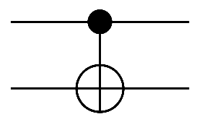
Controlled-NOT gate (CNOT)
CNOT
$$|00〉↦|00〉$$
$$|01〉↦|01〉$$
CNOT gate:
$$CNOT=\left[\begin{matrix}\begin{matrix}1 & 0 \\ 0 & 1\end{matrix} & \begin{matrix}0 & 0 \\ 0 & 0\end{matrix} \\ \begin{matrix}0 & 0 \\ 0 & 0\end{matrix} & \begin{matrix}0 & 1 \\ 1 & 0\end{matrix}\end{matrix}\right]$$
$$|10〉↦|11〉$$
$$|x〉$$
$$|x〉$$
$$|11〉↦|10〉$$
$$|y〉$$
$$|x⊕y〉$$
$$|10〉$$
$$|11〉$$
$$\left[\begin{matrix}\begin{matrix}1 & 0 \\ 0 & 1\end{matrix} & \begin{matrix}0 & 0 \\ 0 & 0\end{matrix} \\ \begin{matrix}0 & 0 \\ 0 & 0\end{matrix} & \begin{matrix}0 & 1 \\ 1 & 0\end{matrix}\end{matrix}\right]\left(\begin{matrix}\begin{matrix}0 \\ 0\end{matrix} \\ \begin{matrix}1 \\ 0\end{matrix}\end{matrix}\right)=\left(\begin{matrix}\begin{matrix}0 \\ 0\end{matrix} \\ \begin{matrix}0 \\ 1\end{matrix}\end{matrix}\right)$$
$$\left[\begin{matrix}\begin{matrix}1 & 0 \\ 0 & 1\end{matrix} & \begin{matrix}0 & 0 \\ 0 & 0\end{matrix} \\ \begin{matrix}0 & 0 \\ 0 & 0\end{matrix} & \begin{matrix}0 & 1 \\ 1 & 0\end{matrix}\end{matrix}\right]\left(\begin{matrix}\begin{matrix}α \\ β\end{matrix} \\ \begin{matrix}γ \\ δ\end{matrix}\end{matrix}\right)=\left(\begin{matrix}\begin{matrix}α \\ β\end{matrix} \\ \begin{matrix}δ \\ γ\end{matrix}\end{matrix}\right)$$

Slide 9
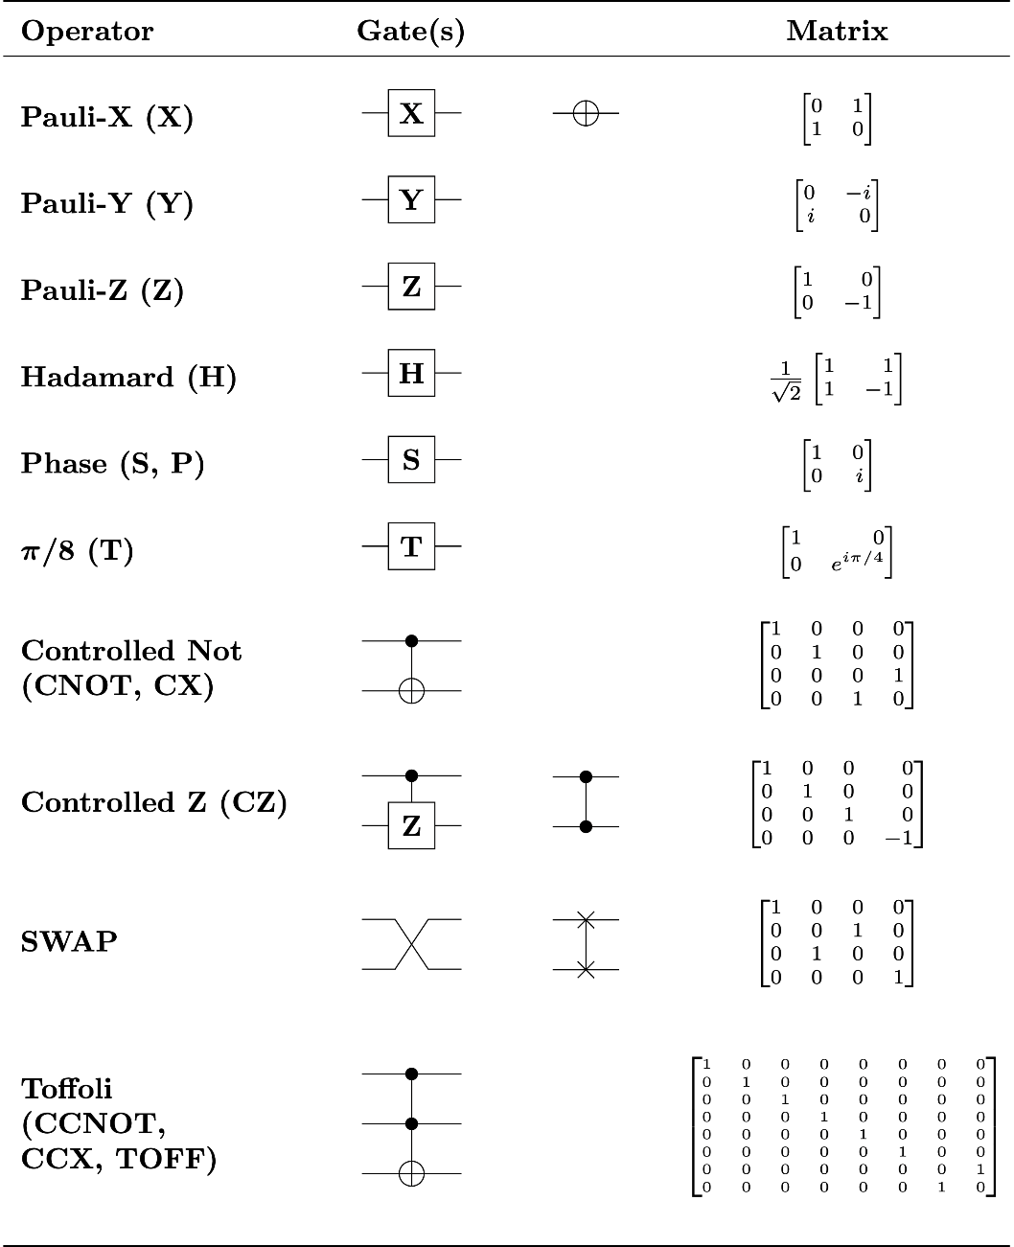
Many other gates…
Universal for classical logic!

Slide 10
Quantum gates
Turns out that all quantum gates can be described by matrices
In fact, very special matrices: unitary matrices
… and only unitary matrices! (fact of nature)
Quantum operations are linear and can be combined
$$|0〉↦ |1〉$$
$$X=\left[{0 \atop 1}{ 1 \atop 0 }\right]$$
$$|1〉↦|0〉$$
$$|ψ_{0}〉 \underset{↦}{Z} |ψ_{1}〉\underset{↦}{X} |ψ_{2}〉\underset{↦}{H} |ψ_{3}〉\underset{↦}{Z} |ψ_{4}〉$$
$$Z=\left[{1 \atop 0}{ 0 \atop −1 }\right]$$
$$|0〉↦|0〉$$
$$|1〉↦−|1〉$$
$$ZHXZ|ψ_{0}〉=|ψ_{4}〉$$
$$ZHXZ|0〉=\left[{1 \atop 0}{ 0 \atop −1 }\right]\left[{1/\sqrt{2} \atop 1/\sqrt{2}}{ 1/\sqrt{2} \atop −1/\sqrt{2} }\right]\left[{0 \atop 1}{ 1 \atop 0 }\right]\left[{1 \atop 0}{ 0 \atop −1 }\right]\left({1 \atop 0}\right)$$
$$|0〉↦\frac{1}{\sqrt{2} }|0〉+\frac{1}{\sqrt{2} }|1〉$$
$$H=\left[{1/\sqrt{2} \atop 1/\sqrt{2}}{ 1/\sqrt{2} \atop −1/\sqrt{2} }\right]$$
$$|1〉↦\frac{1}{\sqrt{2} }|0〉−\frac{1}{\sqrt{2} }|1〉$$
$$=\left[{1/\sqrt{2} \atop 1/\sqrt{2}}{ −1/\sqrt{2} \atop 1/\sqrt{2} }\right]\left({1 \atop 0}\right)=\left({1/\sqrt{2} \atop 1/\sqrt{2}}\right)=\frac{1}{\sqrt{2} }|0〉+\frac{1}{\sqrt{2} }|1〉$$

Slide 11
Quantum computer
A quantum computer consists of:
$N$ input qubits
a sequence of quantum gates
$N$ output qubits
result = measurement of final quantum state (output qubits)

Slide 12
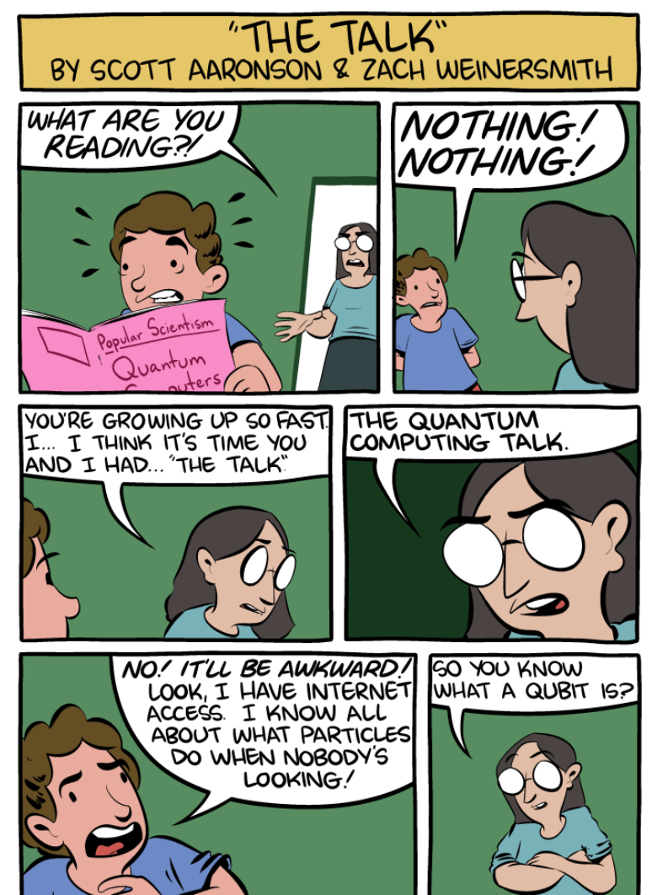
What makes quantum computation special?
Warning: a quantum computer does not simply "try out all solutions in parallel"
The magic comes from allowing complex amplitudes (or even just negative reals)
Quantum interference: can carefully choreograph computations so wrong answers "cancel out" their amplitudes, while correct answers "combine"
increases probability of measuring correct result
only a few special problems allow this choreography
$$|ψ〉=α|0〉+β|1〉$$
$$α,β∈C$$
https://www.smbc-comics.com/comic/the-talk-3

Slide 13
Example (interference)
$$G$$
$$\left[\begin{aligned}\begin{aligned}\begin{matrix}\begin{matrix} 1 & 0 \end{matrix} & \begin{matrix}0 & 0 \end{matrix}\end{matrix} \\ \begin{matrix}\begin{matrix} 0 & 1 \end{matrix} & \begin{matrix}0 & 0 \end{matrix}\end{matrix}\end{aligned} \\ \begin{matrix}\begin{matrix} 0 & 0\end{matrix} & \begin{matrix}\frac{1}{\sqrt{2}} & \frac{1}{\sqrt{2}}\end{matrix}\end{matrix} \\ \begin{matrix} \begin{matrix}0 & 0\end{matrix} & \begin{matrix}\frac{1}{\sqrt{2}} & \frac{−1}{\sqrt{2}}\end{matrix}\end{matrix}\end{aligned} \right]$$
$$|b_{0}〉$$
$$|b_{0}〉$$
$$G =$$
$$|b_{1}〉$$
$$H$$
$$|b_{1}〉$$
$$G|10〉$$
$$=$$
$$\frac{1}{\sqrt{2}}|10〉+\frac{1}{\sqrt{2}}|11〉$$
$$G|11〉$$
$$=$$
$$\frac{1}{\sqrt{2}}|10〉−\frac{1}{\sqrt{2}}|11〉$$
$$G\left(\frac{1}{\sqrt{2}}|10〉−\frac{1}{\sqrt{2}}|11〉\right)$$
$$= \frac{1}{\sqrt{2}}\left(G|10〉−G|11〉\right)$$
$$\left[\begin{aligned}\begin{aligned}\begin{matrix}\begin{matrix} 1 & 0 \end{matrix} & \begin{matrix}0 & 0 \end{matrix}\end{matrix} \\ \begin{matrix}\begin{matrix} 0 & 1 \end{matrix} & \begin{matrix}0 & 0 \end{matrix}\end{matrix}\end{aligned} \\ \begin{matrix}\begin{matrix} 0 & 0\end{matrix} & \begin{matrix}\frac{1}{\sqrt{2}} & \frac{1}{\sqrt{2}}\end{matrix}\end{matrix} \\ \begin{matrix} \begin{matrix}0 & 0\end{matrix} & \begin{matrix}\frac{1}{\sqrt{2}} & \frac{−1}{\sqrt{2}}\end{matrix}\end{matrix}\end{aligned}\right]\left(\begin{matrix}\begin{matrix}0 \\ 0\end{matrix} \\ \begin{matrix}1 \\ 0\end{matrix}\end{matrix}\right)$$
$$=\left(\begin{matrix}\begin{matrix}0 \\ 0\end{matrix} \\ \begin{matrix}\frac{1}{\sqrt{2}} \\ \frac{1}{\sqrt{2}}\end{matrix}\end{matrix}\right)$$
$$\left[\begin{aligned}\begin{aligned}\begin{matrix}\begin{matrix} 1 & 0 \end{matrix} & \begin{matrix}0 & 0 \end{matrix}\end{matrix} \\ \begin{matrix}\begin{matrix} 0 & 1 \end{matrix} & \begin{matrix}0 & 0 \end{matrix}\end{matrix}\end{aligned} \\ \begin{matrix}\begin{matrix} 0 & 0\end{matrix} & \begin{matrix}\frac{1}{\sqrt{2}} & \frac{1}{\sqrt{2}}\end{matrix}\end{matrix} \\ \begin{matrix} \begin{matrix}0 & 0\end{matrix} & \begin{matrix}\frac{1}{\sqrt{2}} & \frac{−1}{\sqrt{2}}\end{matrix}\end{matrix}\end{aligned}\right]\left(\begin{matrix}\begin{matrix}0 \\ 0\end{matrix} \\ \begin{matrix}0 \\ 1\end{matrix}\end{matrix}\right)=\left(\begin{matrix}\begin{matrix}0 \\ 0\end{matrix} \\ \begin{matrix}\frac{1}{\sqrt{2}} \\ \frac{−1}{\sqrt{2}}\end{matrix}\end{matrix}\right)$$
$$=\frac{1}{\sqrt{2}}\left(\frac{1}{\sqrt{2}}|10〉+\frac{1}{\sqrt{2}}|11〉−\frac{1}{\sqrt{2}}|10〉+\frac{1}{\sqrt{2}}|11〉 \right)$$
$$=\frac{1}{\sqrt{2}}\left(\frac{2}{\sqrt{2}}|11〉\right)$$
$$=|11〉$$

Slide 14
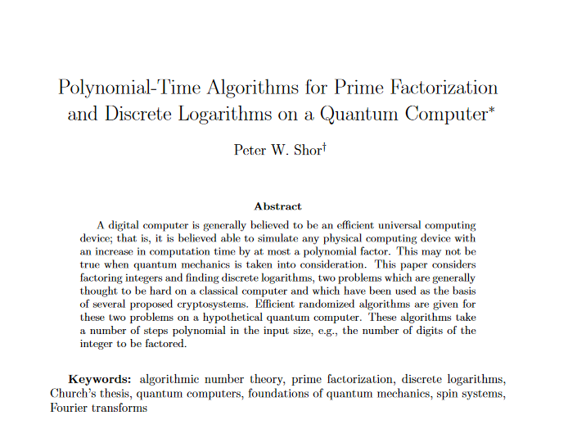
Shor's algorithm
1994

Slide 15
First: something completely different
$$2, 4, 8, 16, 32, 64, 128, 256, 512, 1024, …$$
$$2, 4, 8, 1, 2, 4, 8, 1, 2, 4, 8, 1, 2…$$
$$\operatorname{mod}{15}$$
$$2, 4, 8, 16, 11, 1, 2, 4, 8, 16, 11, 1, 2…$$
$$\operatorname{mod}{21}$$
sequences are periodic

Slide 16
Factoring to order-finding
$$N=pq$$
$$=1$$
$a^{1},a^{2},$ $a^{3}, …,a^{r},a^{1},a^{2}…$
$$\left(\operatorname{mod}{N}\right)$$
order of $a$
$=$ the smallest positive $r$ such that $a^{r}=1 \left(\operatorname{mod}{N}\right)$
Euler’s theorem: for all $a∈Z_{N}^{∗}$
$$a^{φ\left(N\right)}=a^{\left(p−1\right)(q−1)}=1 \left(\operatorname{mod}{N}\right)$$
Fact: $r$ must divide $\left(p−1\right)\left(q−1\right)=φ(N)$
Proof:
$\left(p−1\right)\left(q−1\right)=sr+t$ $0≤t<r$
$a^{(p−1)(q−1)}$
$\left(p−1\right)\left(q−1\right)=sr$
$$=a^{sr+t}=a^{sr}a^{t}$$
$$={\left(a^{r}\right)}^{s}a^{t}$$
$$=1⋅a^{t}$$
$$={ a}^{t}$$
$$=1\operatorname{mod}{N}$$
$⟹ t=0$ (since $r$ is the smallest)
QED
Conclusion: learn $r$ $⟹$ we learn a factor of $(p−1)(q−1)$
repeat with a different $a$ $⟹$ learn another factor of $\left(p−1\right)\left(q−1\right)$ (with high prob.)
eventually we can learn full $φ\left(N\right)=\left(p−1\right)\left(q−1\right)$ $⟹$ can find $p$ and $q$ (Problem set 9)

Slide 17
Shor's algorithm
Where the quantum magic happens!
Shor's algorithm
Input: $N=pq$ Output: $p$ and $q$ repeat until $φ(N)$ is factored: $a\underset{←}{\$}Z_{N}$ $r←{Order}_{N}\left(a\right)$ use $r$ to find factor of $φ\left(N\right)$ compute $p$ and $q$ from $N$ and $φ\left(N\right)$
// but how to find $r$?

Slide 18
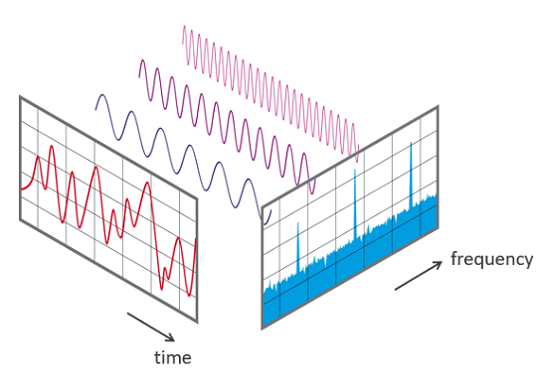
Shor’s algorithm
To factor $N$: find order $r$ of $a$ in $Z_{N}^{∗}$
Problem: $r$ can be very large
Classical solutions take exponential time
Note: the function $f\left(i\right)=a^{i}\operatorname{mod}{N}$ is periodic: $f\left(i+kr\right)=a^{i+kr}=a^{i}\operatorname{mod}{N}=f(i)$
finding signal frequencies $⟺$ finding signal period
Key ingredient of Shor's algorithm: quantum Fourier transform (QFT)
Fourier transform
Notes:
How to find period classically?
Brute-force: takes 2^n time
Create random a^r, a^r' and look for collisions: time 2^n/2

Slide 19
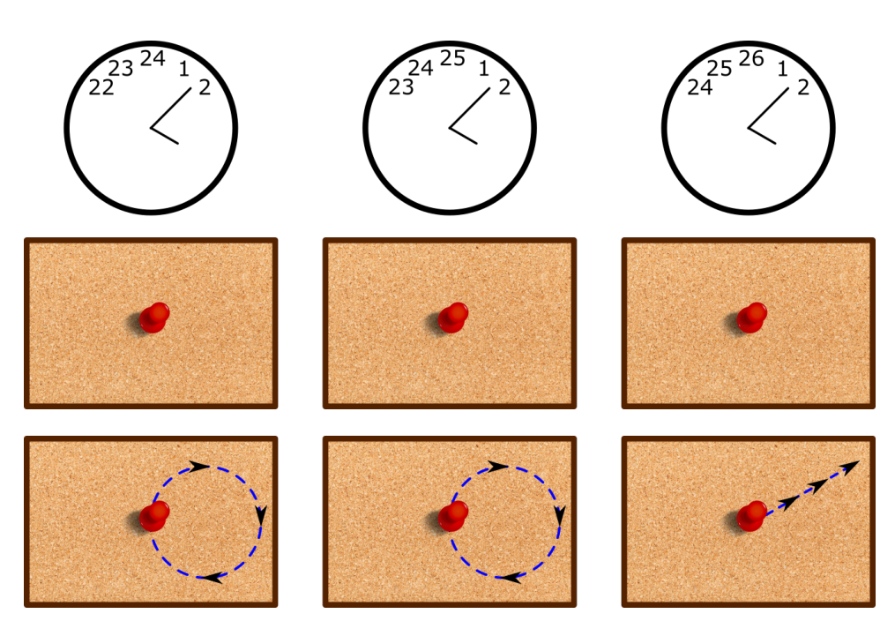
Fourier transform
Source: https://www.scottaaronson.com/qclec.pdf
More on the Fourier transform:
(3Blue1Brown) https://www.3blue1brown.com/lessons/fourier-transforms (Veritasium) https://youtu.be/nmgFG7PUHfo

Slide 20
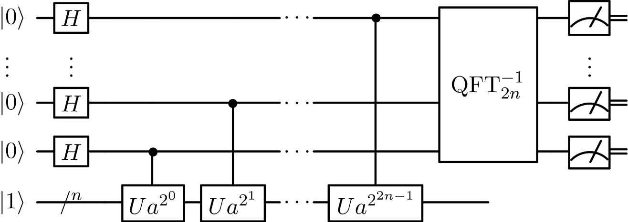
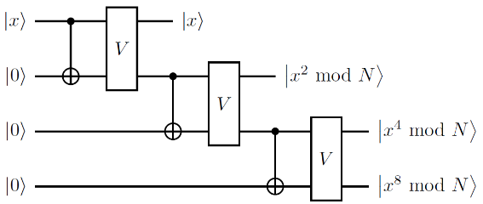
Shor’s algorithm

Slide 21
Consequences of Shor’s algorithm
Cryptosystems broken by Shors' algorithm:
RSA
Diffie-Hellman
Schnorr
ElGamal
ECDSA
…public-key crypto is dead
Shor's algorithm
Input: $N=pq$ Output: $p$ and $q$ repeat until $φ(N)$ is factored: $a\underset{←}{\$}Z_{N}$ $r←{Order}_{N}\left(a\right)$ use $r$ to find factor of $φ\left(N\right)$ compute $p$ and $q$ from $N$ and $φ\left(N\right)$
both $Z_{p}^{∗}$ and $E\left(F_{p}\right)$
Notes:
Dlog: periodic function: $f\left(a,b\right)=g^{a}h^{−b}$; period: $(x,1)$ where $h=g^{x}$; for any period $\left(\tilde{x },\tilde{y }\right)$ we have $x=\frac{−\tilde{x}}{\tilde{y}} mod⁡q$

Slide 22
The quantum menace
How far away is a quantum computer?
Nobody knows
Building a large-scale quantum computer is a huge engineering challenge
very susceptible to noise (decoherence)
requires quantum error correction (is it even possible?)
many physical qubits needed to simulate a single logical qubit
$≥1000$ logical qubits needed for Shor's algorithm
largest (known) quantum computers: $≈53$ physical qubits (Google; 2019) (no error correction) $≈65$ physical qubits (IBM; 2020) (no error correction) $≈127$ physical qubits (IBM; 2021) (no error correction) $≈433$ physical qubits (IBM; 2022) (no error correction)

Slide 23
The quantum menace
Source: JP Aumasson; https://www.aumasson.jp/data/talks/quantum-cyberpeace-2021.pdf

Slide 24
The quantum menace
Source: JP Aumasson; https://www.aumasson.jp/data/talks/quantum-cyberpeace-2021.pdf

Slide 25
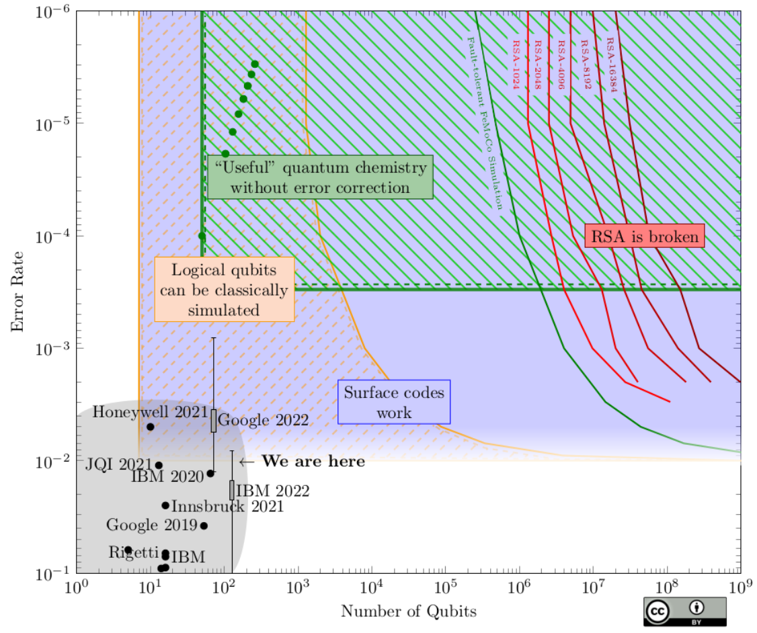
The quantum menace
http://sam-jaques.appspot.com/quantum_landscape_2022

Slide 26
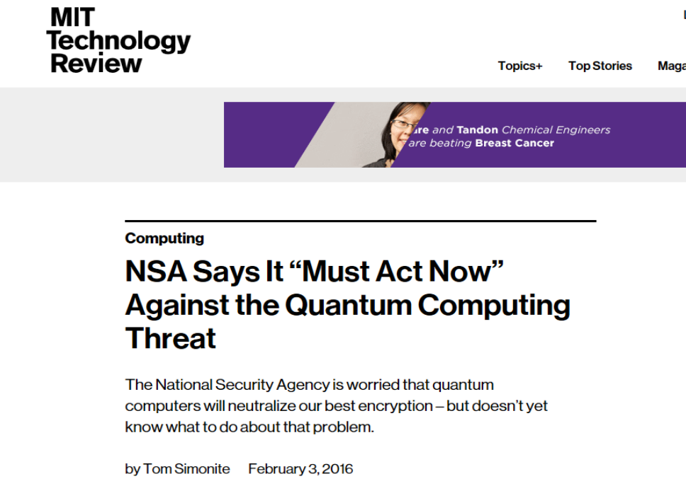

Slide 27
Dealing with quantum computers
Symmetric cryptography
Grover's algorithm: solves $𝒪\left(2^{n}\right)$ problems in $𝒪\left(2^{n/2}\right)$ quantum steps
Inherently serial + huge constants
AES-128 is most likely safe; using AES-256 removes any doubts
Quantum cryptography
Use quantum mechanics to build cryptography
Requires specialized equipment
Only used for key distribution; does not solve authentication problem
Quantum-resistant cryptography (a.k.a. post-quantum cryptography)
Classical (asymmetric) algorithms believed to withstand quantum attacks

Slide 28
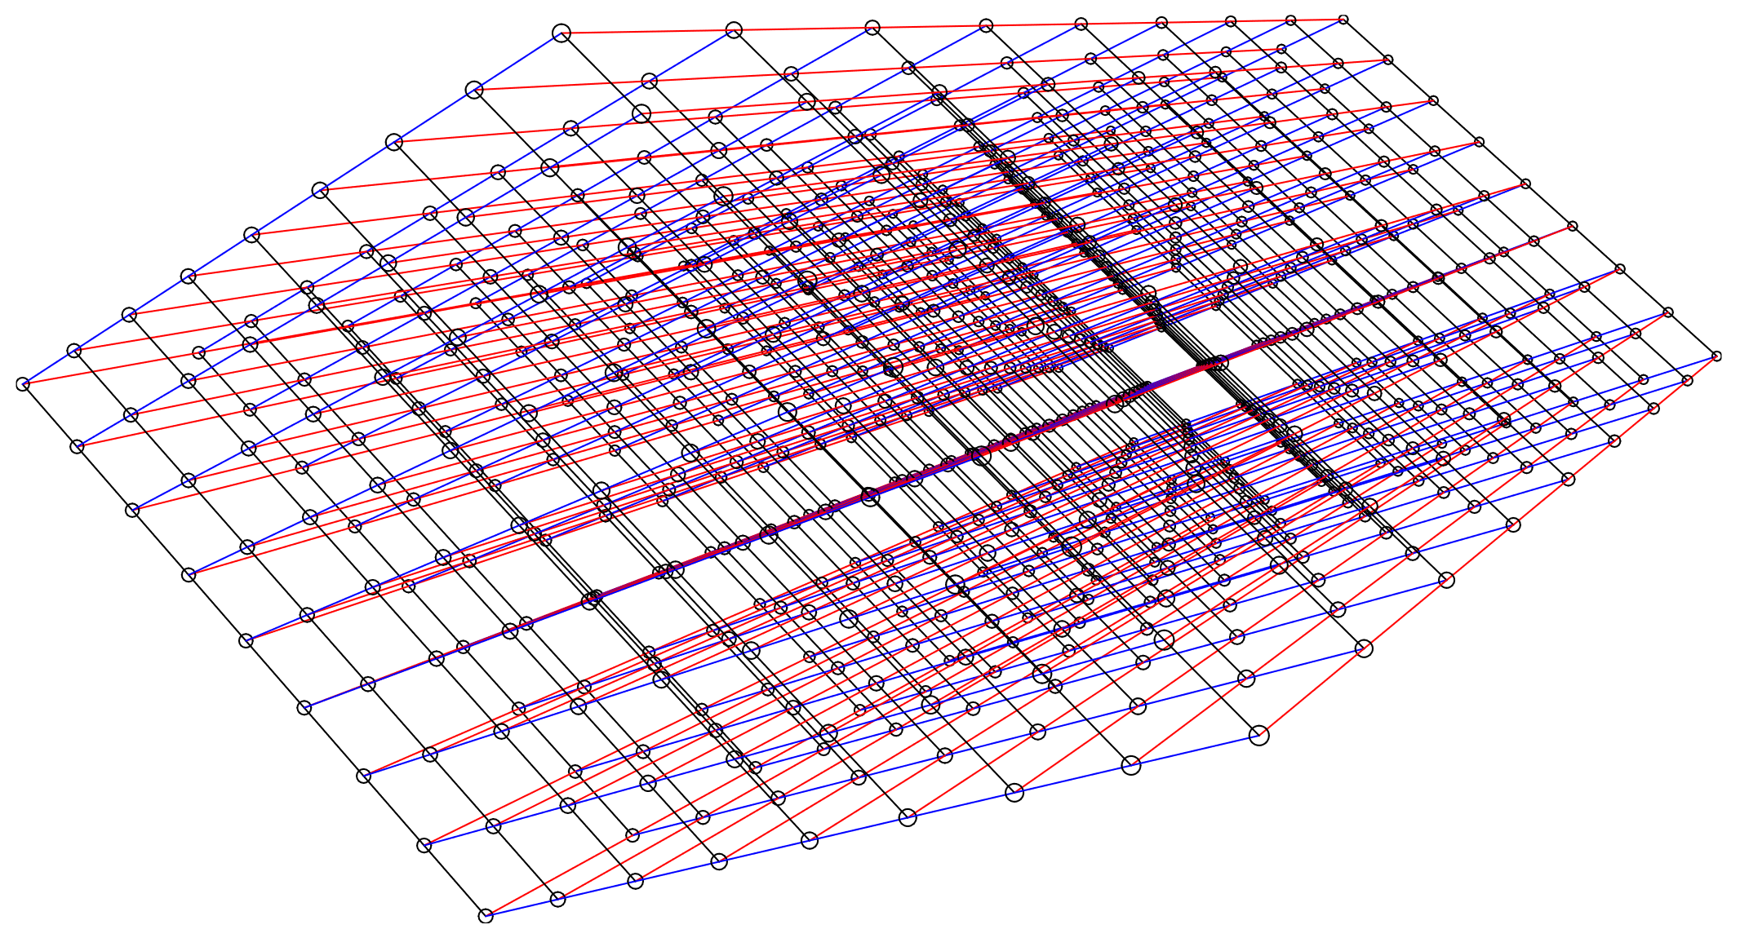
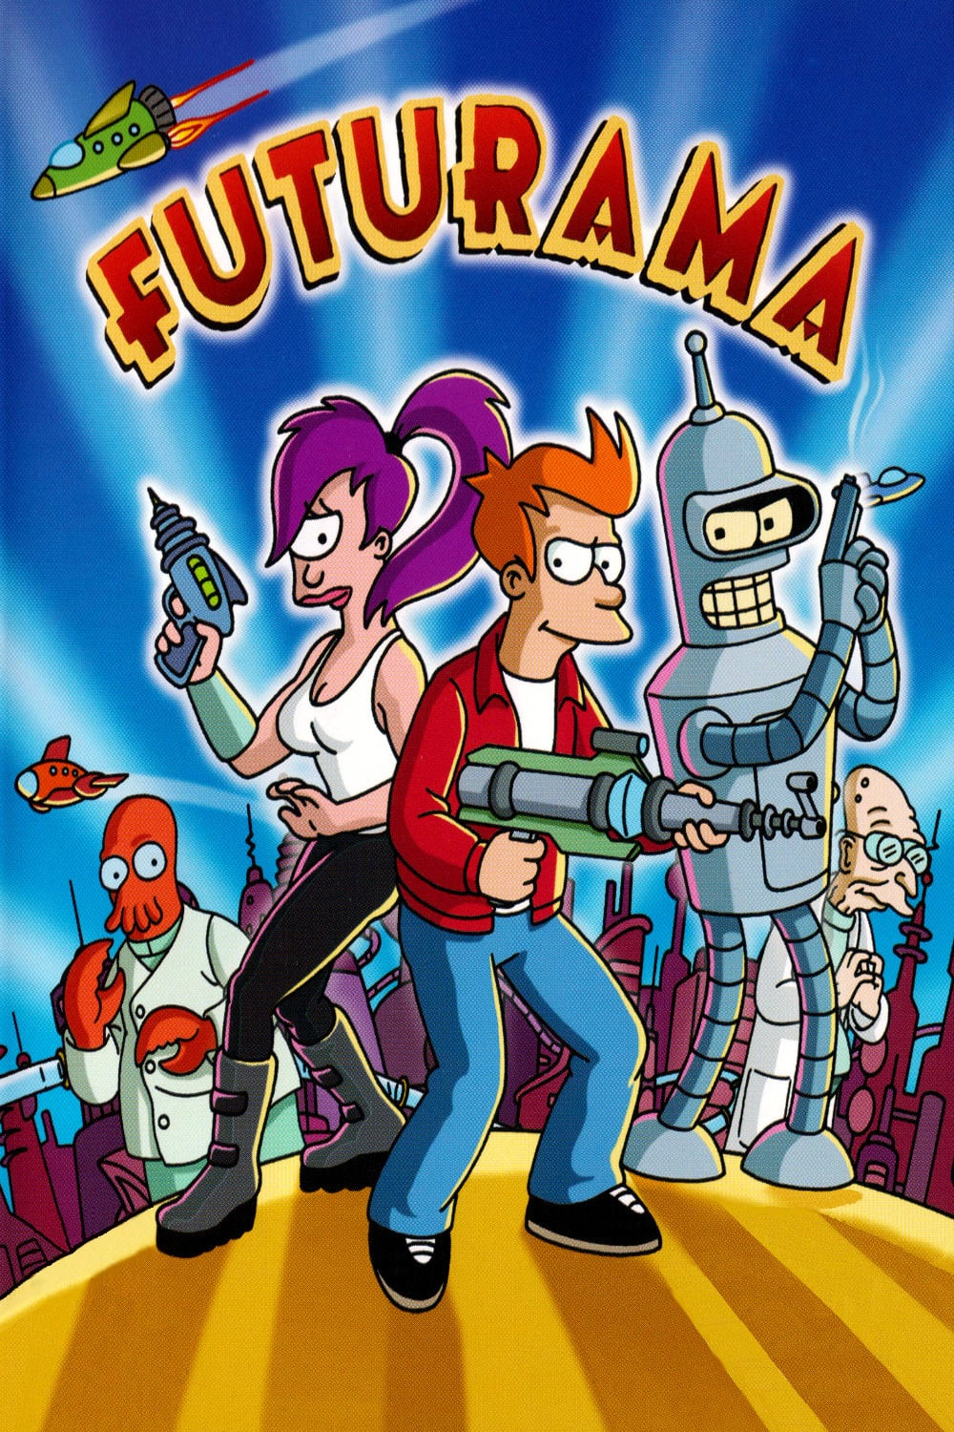
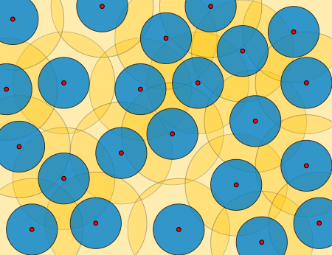
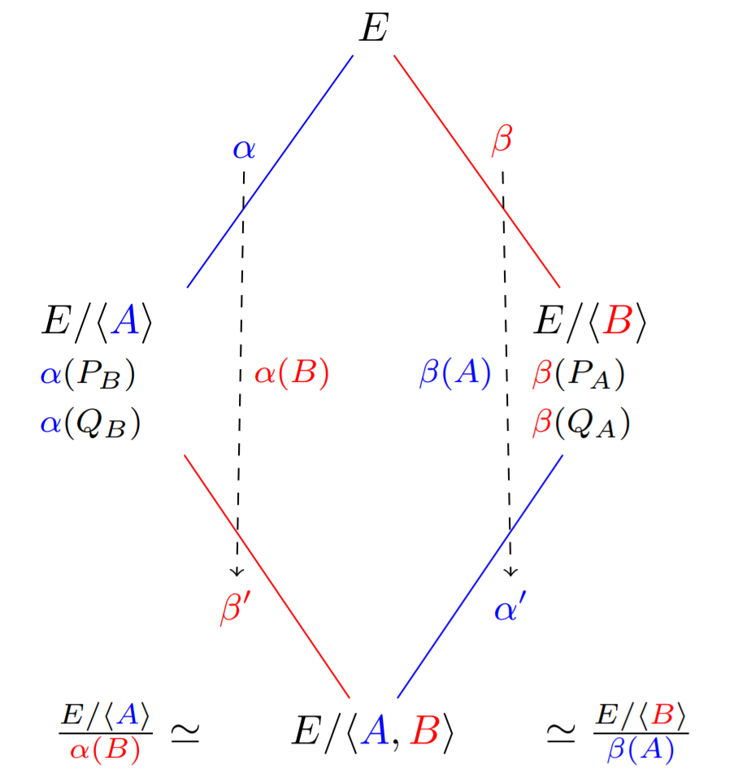
Post-quantum cryptography
Lattice-based cryptography
Code-based encryption
https://eprint.iacr.org/2022/975
Broken last year!
$$pk$$
$$H$$
$$H$$
$$H$$
$$H$$
$$H$$
$$H$$
$$H$$
$$pk_{\text{ots}}^{1}$$
$$pk_{\text{ots}}^{2}$$
$$pk_{\text{ots}}^{3}$$
$$pk_{\text{ots}}^{4}$$
$$pk_{\text{ots}}^{5}$$
$$pk_{\text{ots}}^{6}$$
$$pk_{\text{ots}}^{7}$$
$$pk_{\text{ots}}^{8}$$
$${sk}_{\text{ots}}^{1}$$
$$sk_{\text{ots}}^{2}$$
$$sk_{\text{ots}}^{3}$$
$${sk}_{\text{ots}}^{4}$$
$$sk_{\text{ots}}^{5}$$
$$sk_{\text{ots}}^{6}$$
$$sk_{\text{ots}}^{7}$$
$${sk}_{\text{ots}}^{8}$$
Hash-based signatures
Supersingular isogeny key exchange

Slide 29
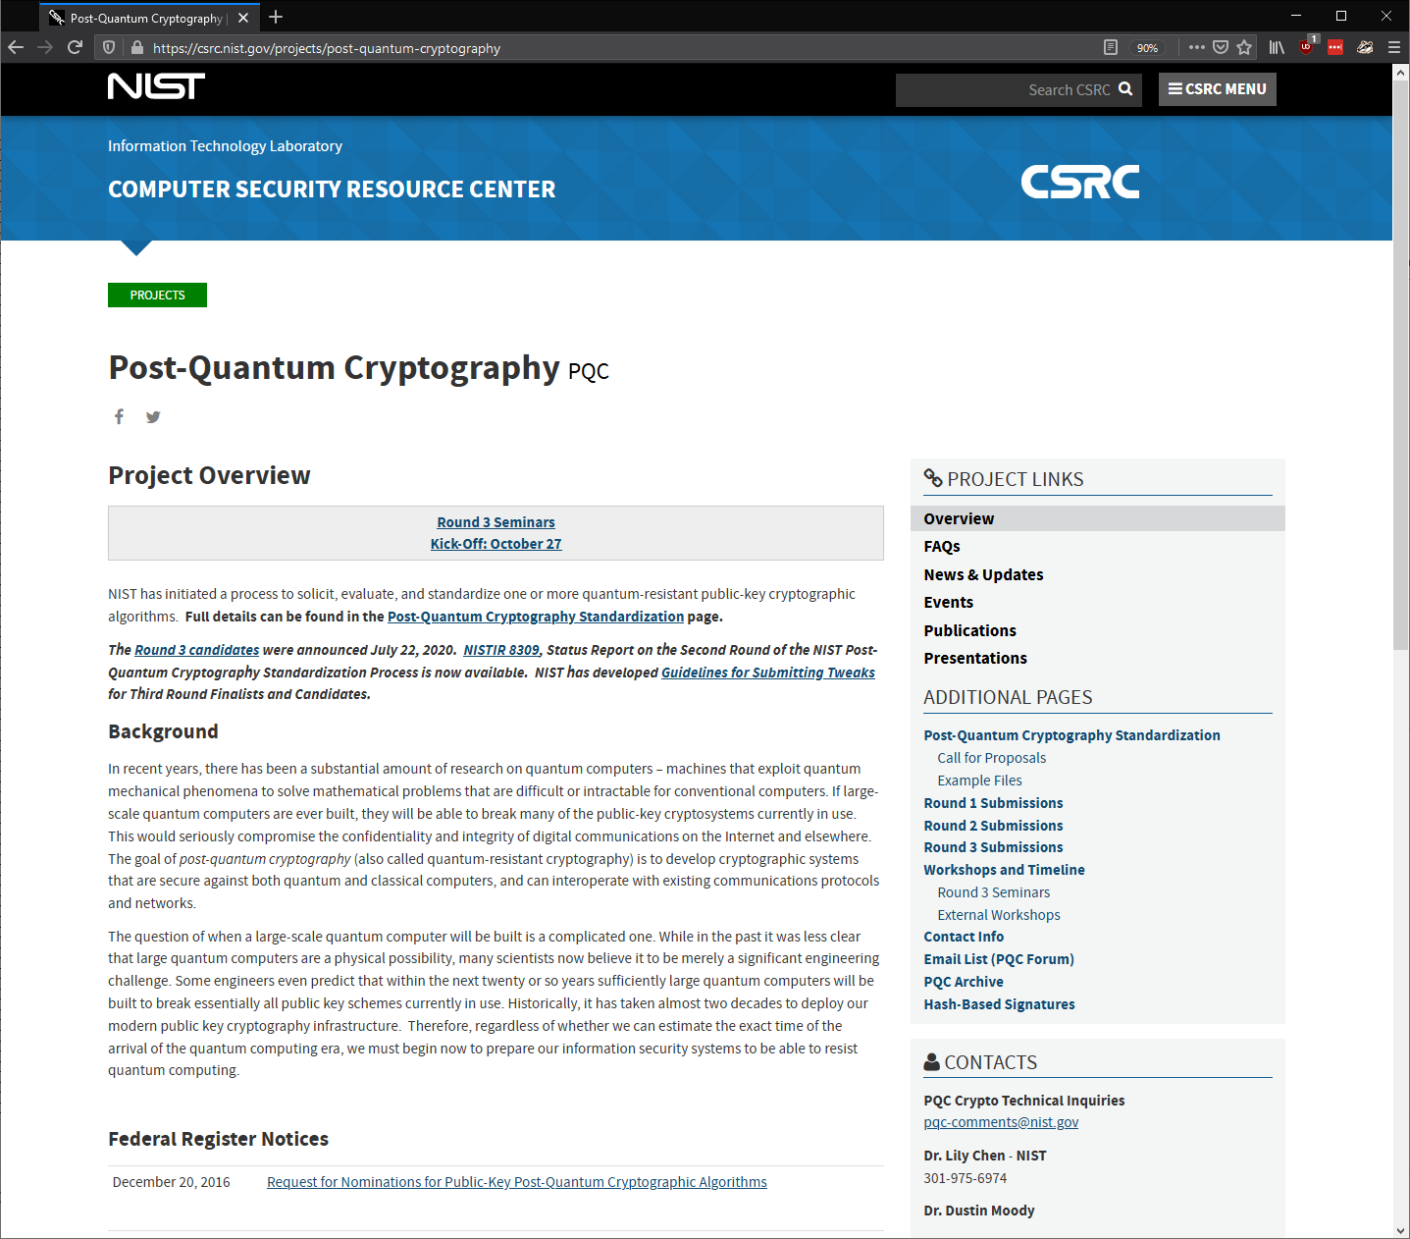
The NIST post-quantum competition
Public competition to standardize post-quantum schemes
Public-key encryption
Digital signatures
Started in 2017
Round 1: 69 submissions
Round 2: 26 candidates selected
Round 3: 15 candidates selected
Round 4: alternative candidates
Winners:
CRYSTALS-KYBER (PKE)
CRYSTALS-DILITHIUM (Signature)
Falcon (Signature)
SPHINCS+ (Signature)
Algorithm (public-key encryption) | Problem
Classic McEliece | Code-based
CRYSTALS-KYBER | Lattice-based
NTRU | Lattice-based
SABER | Lattice-based
BIKE | Code-based
FrodoKEM | Lattice-based
HQC | Code-based
NTRU Prime | Lattice-based
SIKE | Isogeny-based
Algorithm (digital signatures) | Problem
CRYSTALS-DILITHIUM | Lattice-based
Falcon | Lattice-based
Rainbow | Multivariate-based
GeMSS | Multivariate-based
Picnic | ZKP
SPHINCS+ | Hash-based

Slide 30
The NIST post-quantum competition
Public competition to standardize post-quantum schemes
Public-key encryption
Digital signatures
Started in 2017
Round 1: 69 submissions
Round 2: 26 candidates selected
Round 3: 15 candidates selected
Round 4: alternative candidates
Winners:
CRYSTALS-KYBER (PKE)
CRYSTALS-DILITHIUM (Signature)
Falcon (Signature)
SPHINCS+ (Signature)
Algorithm (public-key encryption) | Problem
Classic McEliece | Code-based
CRYSTALS-KYBER | Lattice-based
NTRU | Lattice-based
SABER | Lattice-based
BIKE | Code-based
FrodoKEM | Lattice-based
HQC | Code-based
NTRU Prime | Lattice-based
SIKE | Isogeny-based
Algorithm (digital signatures) | Problem
CRYSTALS-DILITHIUM | Lattice-based
Falcon | Lattice-based
Rainbow | Multivariate-based
GeMSS | Multivariate-based
Picnic | ZKP
SPHINCS+ | Hash-based

Slide 31
The NIST post-quantum competition
Public competition to standardize post-quantum schemes
Public-key encryption
Digital signatures
Started in 2017
Round 1: 69 submissions
Round 2: 26 candidates selected
Round 3: 15 candidates selected
Round 4: alternative candidates
Winners:
CRYSTALS-KYBER (PKE)
CRYSTALS-DILITHIUM (Signature)
Falcon (Signature)
SPHINCS+ (Signature)
Algorithm (public-key encryption) | Problem
Classic McEliece | Code-based
CRYSTALS-KYBER | Lattice-based
NTRU | Lattice-based
SABER | Lattice-based
BIKE | Code-based
FrodoKEM | Lattice-based
HQC | Code-based
NTRU Prime | Lattice-based
SIKE | Isogeny-based
Algorithm (digital signatures) | Problem
CRYSTALS-DILITHIUM | Lattice-based
Falcon | Lattice-based
Rainbow | Multivariate-based
GeMSS | Multivariate-based
Picnic | ZKP
SPHINCS+ | Hash-based

Slide 32
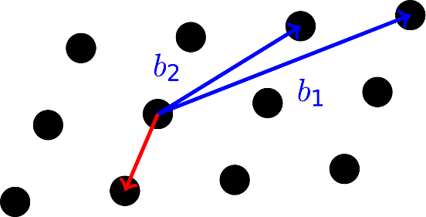
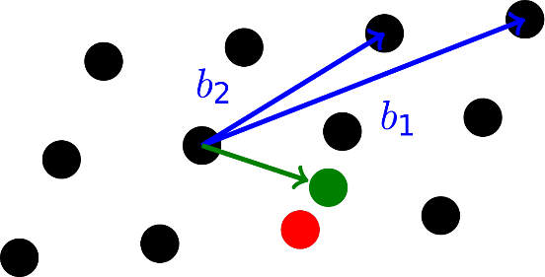
Lattice-based cryptography
Very versatile computational problems
Public-key encryption
Digital signatures
Hash functions
Fully homomorphic encryption
Key exchange
Leads to efficient and compact schemes
Based on hardness of problems in algebraic number theory
Believed to be hard also for quantum computers
Shortest vector problem
Closest vector problem

Slide 33
Lattice-based cryptography
https://cr.yp.to/talks/2017.12.28/slides-dan+nadia+tanja-20171228-latticehacks-16x9.pdf

Slide 34
Next week – guest lecture!

Slide 35
Post-quantum cryptography
Want to learn more about post-quantum cryptography?
Sign up for TEK5550 - Advanced Topics in Cryptology next spring!

