Slide 1
Lecture 2 – Block ciphers, PRFs/PRPs, AES
TEK4500
06.09.2023
Håkon Jacobsen
hakon.jacobsen@its.uio.no

Slide 2
Announcement
Recitation hours
Today: 14:15-15:00 in Black Box (room 3271 on the 3rd floor of Ole Johan Dahls hus)
Next week (and onwards): 11:15-12:00.

Slide 3
Ideal solution: secure channels
Internet
But how to build?
Alice
Bob
M
Adversary
Security goals:
Data privacy: adversary should not be able to read message M ✓
Data integrity: adversary should not be able to modify message M ✓
Data authenticity: message M really originated from Alice ✓

Slide 4
Basic goals of cryptography
 | Message privacy | Message integrity / authentication
Symmetric keys | Symmetric encryption | Message authentication codes (MAC)
Asymmetric keys | Asymmetric encryption (a.k.a. public-key encryption) | Digital signatures

Slide 5
Encryption schemes
Plaintext
$$ℳ$$
$$\$$$
$$ℰ$$
$$𝒦$$
Key
Ciphertext
$$𝒞$$

Slide 6
Block ciphers
Plaintext
$${\left\{0,1\right\}}^{n}$$
$$128$$
$$ℰ$$
$${\left\{0,1\right\}}^{k}$$
Key
AES
$$128$$
Ciphertext
$${\left\{0,1\right\}}^{n}$$
Examples:
AES-128: $k=128$, $n=128$
AES-192: $k=192$, $n=128$
AES-256: $k=256$, $n=128$

Slide 7
Block cipher applications
Encryption of messages of 128 bits (block length)
However: actually want to encrypt messages of arbitrary length!
Splitting the message into multiple 128 bit blocks (like above) is not secure!
A mode-of-operation is needed (covered later in the course)
Correct viewpoint: block ciphers are not encryption schemes!
Block ciphers are primitives used to construct other things
$$K$$
$$K$$
$$Y_{1}, { Y}_{2},…, { Y}_{t}$$
$$Y_{i}←E_{K}(X_{i})$$
$$X_{i}←E_{K}^{−1}(Y_{i})$$

Slide 8
Block cipher applications
The “work horse” of crypto
Can be used to build:
Encryption of arbitrary length messages (including stream ciphers)
Message authentication codes
Authenticated encryption
Hash functions
(Cryptographically secure) pseudorandom generators
Key derivation functions

Slide 9
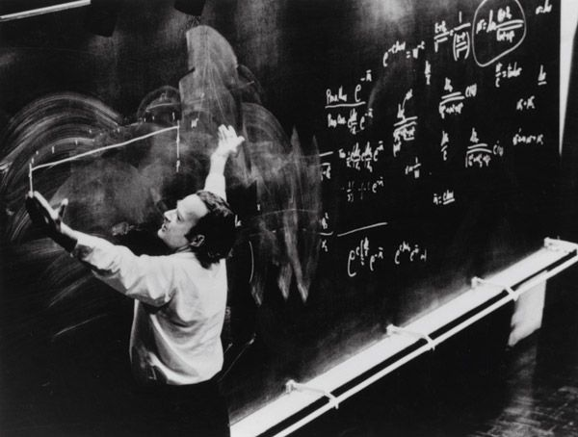
Defining block ciphers

Slide 10
Pseudorandom functions (PRFs) and permutations (PRP)
$k, in, out$ are called the key-length, input-length, and output-length of $F$
Think of a PRF as a family of functions:
For each $K∈{\left\{0,1\right\}}^{k}$ we get a function $F_{K} :{\left\{0,1\right\}}^{in}→{\left\{0,1\right\}}^{out}$ defined by $F_{K}\left(X\right)=F(K, X)$
Definition: A pseudorandom function (PRF) is a function
$$F :{\left\{0,1\right\}}^{k}×{\left\{0,1\right\}}^{in}→{\left\{0,1\right\}}^{out}$$
Definition: A pseudorandom permutation (PRP) is a function
$$E :{\left\{0,1\right\}}^{k}×{\left\{0,1\right\}}^{n}→{\left\{0,1\right\}}^{n}$$
such that $E_{K} :{\left\{0,1\right\}}^{n}→{\left\{0,1\right\}}^{n}$ is a permutation for all $K∈{\left\{0,1\right\}}^{k}$
PRP = block cipher
note: all PRPs are PRFs (but not all PRFs are PRPs!)

Slide 11
Permutations vs. functions
$$E_{K}$$
$$F_{K}$$
$$00 \\ 01 \\ 10 \\ 11$$
$$00 \\ 01 \\ 10 \\ 11$$
$$00 \\ 01 \\ 10 \\ 11$$
$$00 \\ 01 \\ 10 \\ 11$$
Permutation
Not a permutation

Slide 12
Permutations vs. functions
$$E_{K}^{−1}$$
$$F_{K}$$
$$00 \\ 01 \\ 10 \\ 11$$
$$00 \\ 01 \\ 10 \\ 11$$
$$00 \\ 01 \\ 10 \\ 11$$
$$00 \\ 01 \\ 10 \\ 11$$
Permutation
Not a permutation
Important:
${E : \left\{0,1\right\}}^{k}×{\left\{0,1\right\}}^{n}→{\left\{0,1\right\}}^{n}$ is not a permutation (but a block cipher)
$E_{K} :{\left\{0,1\right\}}^{n}→{\left\{0,1\right\}}^{n}$ is a permutation

Slide 13
Block cipher security
What should the security definition of a block cipher look like?
Which security properties should a block cipher satisfy?
Some suggestions:
P1: Should be hard to obtain $K$ from $E_{K}(X)$ for secret $K$
P2: Should be hard to obtain $K$ from $E_{K}\left(X_{1}\right),E_{K}\left(X_{2}\right),E_{K}\left(X_{3}\right)…$
P3: Should be hard to obtain $X$ from $E_{K}(X)$
P4: Should be hard to obtain any $X_{i}$ from $E_{K}\left(X_{1}\right),E_{K}\left(X_{2}\right),E_{K}\left(X_{3}\right)…$
P5: Should be hard to learn any bit of $X$ from $E_{K}(X)$
P6: Should be hard to detect repetitions among $X_{1},X_{2},…$ from $E_{K}\left(X_{1}\right),E_{K}\left(X_{2}\right), …$
P7: …
Not good enough!
Impossible!

Slide 14
PRF – security; formal definition
World 0
$$K\underset{←}{\$}{\left\{0,1\right\}}^{k}$$ Input $X$: return $F_{K}\left(X\right)$
$b$
World 1
?
$$b=0$$
$$b=1$$
$$X_{1}, X_{2}, ⋯$$
$$X_{1}, X_{2}, ⋯$$
$$Y_{1}, Y_{2}, ⋯$$
$$Y_{1}, Y_{2}, ⋯$$

Slide 15
Random functions
$$\tilde{F }:{\left\{0,1\right\}}^{in}→{\left\{0,1\right\}}^{out}$$
$$X$$ | $$\tilde{F}(X)$$
$$000…000$$ | $$101…111$$
$$000…001$$ | $$001…001$$
$$000…010$$ | $$111…100$$
$$⋮$$ | $$⋮$$
$$111…111$$ | $$001…001$$
$$2^{in}$$
$$in$$
$$out$$

Slide 16
Random functions
$$\tilde{F }:{\left\{0,1\right\}}^{in}→{\left\{0,1\right\}}^{out}$$
$$X$$ | $$\tilde{F}(X)$$
$$000…000$$ | $$101…111$$
$$000…001$$ | $$001…001$$
$$000…010$$ | $$111…100$$
$$⋮$$ | $$⋮$$
$$111…111$$ | $$001…001$$
$T←[ ]$ $\tilde{F}\left(X\right):$ if $T\left[X\right]= ⊥$: $T\left[X\right]\underset{←}{\$}{\left\{0,1\right\}}^{out}$ return $T[X]$
Notes:
If $\tilde{F}$ has not been evaluated on $X$ then $\tilde{F}(X)$ is completely undetermined (even if you know $\tilde{F}\left(X+1\right),\tilde{F}\left(X−1\right),\tilde{F}\left(X+2\right),\tilde{F}\left(X−2\right)$ etc.)

Slide 17
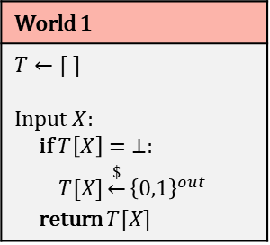
PRF – security; formal definition
World 0
$$K\underset{←}{\$}{\left\{0,1\right\}}^{k}$$ Input $X$: return $F_{K}\left(X\right)$
$b$
World 1
$$T←[ ]$$ Input $X$: if $T\left[X\right]= ⊥:$ $T[X]\underset{←}{\$}{\left\{0,1\right\}}^{out}$ return $T[X]$
$$X_{1}, X_{2}, ⋯$$
${Adv}_{F}^{prf}\left(A\right)≈1/2$ $⟹$ adversary is doing well
${Adv}_{F}^{prf}\left(A\right)≈0$ $⟹$ adversary is doing poorly
$$Y_{1}, Y_{2}, ⋯$$
I’m in World $b′$
Definition: The PRF-advantage of an adversary $A$ is
$${Adv}_{F}^{prf}\left(A\right)=\left|\operatorname{Pr}\left[b^{′}=b\right]−1/2\right|$$

Slide 18
PRF – security; formal definition
World 0
$$K\underset{←}{\$}{\left\{0,1\right\}}^{k}$$ Input $X$: return $F_{K}\left(X\right)$
$b$
World 1
$$T←[ ]$$ Input $X$: if $T\left[X\right]= ⊥:$ $T[X]\underset{←}{\$}{\left\{0,1\right\}}^{out}$ return $T[X]$
Intuitive idea: $F$ is a secure PRF if ${Adv}_{F}^{prf}\left(A\right)$ is “small” for all “reasonable” $A$
${Adv}_{F}^{prf}\left(A\right)≈1$ $⟹$ adversary is doing well
${Adv}_{F}^{prf}\left(A\right)≈0$ $⟹$ adversary is doing poorly
I’m in World $b′$
Definition: The PRF-advantage of an adversary $A$ is
$${Adv}_{F}^{prf}\left(A\right)=\left|2⋅Pr\left[b^{′}=b\right]−1\right|$$

Slide 19
Understanding "advantage"
$F$ is a secure PRF if ${Adv}_{F}^{prf}\left(A\right)$ is "small" for all adversaries $A$ using a "reasonable" amount of resources
PRF security depends on the adversaries':
Available resources: running time, number of oracle calls (calls to $\tilde{F} / F$), memory…
Not on the adversary strategy! (since we consider all possible $A$)
What does small and reasonable mean?
Example: 128-bit security: ${Adv}_{F}^{prf}\left(A\right)≤\frac{1}{2^{128}}$
for all adversaries $A$ that run in time $≤t$
Example: a PRF is insecure if we can come up with one efficient adversary with good advantage
$$t$$
$$2^{80}$$
$$≈2^{80}$$

Slide 20
Example
Define $F :{\left\{0,1\right\}}^{n}×{\left\{0,1\right\}}^{n}→{\left\{0,1\right\}}^{n}$ by $F\left(K, X\right)=K⊕X$
Claim: $F$ is not a secure PRF
World 0
$$K\underset{←}{\$}{\left\{0,1\right\}}^{k}$$ Input $X$: return $K⊕X$
World 1
$$T←[ ]$$ Input $X$: if $T\left[X\right]= ⊥:$ $T[X]\underset{←}{\$}{\left\{0,1\right\}}^{n}$ return $T[X]$
$b$
$$A$$
Query $X=0^{n}$ // receive back $Y←K⊕0^{n}$ or $Y\underset{←}{\$}{\left\{0,1\right\}}^{n}$ Query $X^{′}=1^{n}$ // receive back $Y^{′}←K⊕1^{n}$ or $Y′\underset{←}{\$}{\left\{0,1\right\}}^{n}$ Output $b^{′}=\left\{\begin{aligned}0, if Y⊕Y^{′}=1^{n} \\ &1, otherwise \end{aligned}\right.$
I’m in World $b′$
Definition: The PRF-advantage of an adversary $A$ is
$${Adv}_{F}^{prf}\left(A\right)=\left|2⋅Pr\left[b^{′}=b\right]−1\right|$$
$$\operatorname{Pr}\left[b^{′}=b\right] =$$
$$= \operatorname{Pr}\left[b^{′}=0 ∣ b=0\right]⋅\operatorname{Pr}\left[ b=0\right]+\operatorname{Pr}\left[b^{′}=1 ∣ b=1\right]⋅\operatorname{Pr}\left[ b=1\right]$$
$$= \operatorname{Pr}\left[b^{′}=0 ∣ b=0\right]⋅1/2 +\operatorname{Pr}\left[b^{′}=1 ∣ b=1\right]⋅1/ 2$$
$$= Pr\left[Y⊕Y′=1^{n}∣b=0\right]{⋅1/2} + ⋯$$
$$= 1⋅1/2 + ⋯$$
Notes:
0^n = 0000…0 (n bits)
1^n = 1111…1 (n bits)

Slide 21
Example
Define $F :{\left\{0,1\right\}}^{n}×{\left\{0,1\right\}}^{n}→{\left\{0,1\right\}}^{n}$ by $F\left(K, X\right)=K⊕X$
Claim: $F$ is not a secure PRF
World 0
$$K\underset{←}{\$}{\left\{0,1\right\}}^{k}$$ Input $X$: return $K⊕X$
World 1
$$T←[ ]$$ Input $X$: if $T\left[X\right]= ⊥:$ $T[X]\underset{←}{\$}{\left\{0,1\right\}}^{n}$ return $T[X]$
$b$
$$A$$
Query $X=0^{n}$ // receive back $Y←K⊕0^{n}$ or $Y\underset{←}{\$}{\left\{0,1\right\}}^{n}$ Query $X^{′}=1^{n}$ // receive back $Y^{′}←K⊕1^{n}$ or $Y′\underset{←}{\$}{\left\{0,1\right\}}^{n}$ Output $b^{′}=\left\{\begin{aligned}0, if Y⊕Y^{′}=1^{n} \\ &1, otherwise \end{aligned}\right.$
I’m in World $b′$
Definition: The PRF-advantage of an adversary $A$ is
$${Adv}_{F}^{prf}\left(A\right)=\left|2⋅Pr\left[b^{′}=b\right]−1\right|$$
$$\operatorname{Pr}\left[b^{′}=b\right] =$$
$$= \operatorname{Pr}\left[b^{′}=0 ∣ b=0\right]⋅\operatorname{Pr}\left[ b=0\right]+\operatorname{Pr}\left[b^{′}=1 ∣ b=1\right]⋅\operatorname{Pr}\left[ b=1\right]$$
$$= \operatorname{Pr}\left[b^{′}=0 ∣ b=0\right]⋅1/2 +\operatorname{Pr}\left[b^{′}=1 ∣ b=1\right]⋅1/ 2$$
$$= Pr\left[Y⊕Y′=1^{n}∣b=0\right]{⋅1/2} +\left(1−Pr\left[b^{′}=0 ∣ b=1\right]\right)⋅1/2$$
$$= 1⋅1/2 + ⋯$$
$$\left(1−Pr\left[Y⊕Y′=1^{n} ∣ b=1\right]\right)⋅1/2$$

Slide 22
Example
Define $F :{\left\{0,1\right\}}^{n}×{\left\{0,1\right\}}^{n}→{\left\{0,1\right\}}^{n}$ by $F\left(K, X\right)=K⊕X$
Claim: $F$ is not a secure PRF
World 0
$$K\underset{←}{\$}{\left\{0,1\right\}}^{k}$$ Input $X$: return $K⊕X$
World 1
$$T←[ ]$$ Input $X$: if $T\left[X\right]= ⊥:$ $T[X]\underset{←}{\$}{\left\{0,1\right\}}^{n}$ return $T[X]$
$b$
$$A$$
Query $X=0^{n}$ // receive back $Y←K⊕0^{n}$ or $Y\underset{←}{\$}{\left\{0,1\right\}}^{n}$ Query $X^{′}=1^{n}$ // receive back $Y^{′}←K⊕1^{n}$ or $Y′\underset{←}{\$}{\left\{0,1\right\}}^{n}$ Output $b^{′}=\left\{\begin{aligned}0, if Y⊕Y^{′}=1^{n} \\ &1, otherwise \end{aligned}\right.$
I’m in World $b′$
Definition: The PRF-advantage of an adversary $A$ is
$${Adv}_{F}^{prf}\left(A\right)=\left|2⋅Pr\left[b^{′}=b\right]−1\right|$$
$$\operatorname{Pr}\left[b^{′}=b\right] =$$
$$= \operatorname{Pr}\left[b^{′}=0 ∣ b=0\right]⋅\operatorname{Pr}\left[ b=0\right]+\operatorname{Pr}\left[b^{′}=1 ∣ b=1\right]⋅\operatorname{Pr}\left[ b=1\right]$$
$$= \operatorname{Pr}\left[b^{′}=0 ∣ b=0\right]⋅1/2 +\operatorname{Pr}\left[b^{′}=1 ∣ b=1\right]⋅1/ 2$$
$$= Pr\left[Y⊕Y′=1^{n}∣b=0\right]{⋅1/2} +\left(1−Pr\left[b^{′}=0 ∣ b=1\right]\right)⋅1/2$$
$$= 1⋅1/2 + ⋯$$
$$\left(1−Pr\left[Z=1^{n} ∣ b=1\right]\right)⋅1/2$$
$$= 1/2 +\left(1−\frac{1}{2^{n}}\right)⋅1/2$$
$$= 1−\frac{1}{2^{n+1}}$$

Slide 23
Example
Define $F :{\left\{0,1\right\}}^{n}×{\left\{0,1\right\}}^{n}→{\left\{0,1\right\}}^{n}$ by $F\left(K, X\right)=K⊕X$
Claim: $F$ is not a secure PRF
World 0
$$K\underset{←}{\$}{\left\{0,1\right\}}^{k}$$ Input $X$: return $K⊕X$
World 1
$$T←[ ]$$ Input $X$: if $T\left[X\right]= ⊥:$ $T[X]\underset{←}{\$}{\left\{0,1\right\}}^{n}$ return $T[X]$
$b$
$$A$$
Query $X=0^{n}$ // receive back $Y←K⊕0^{n}$ or $Y\underset{←}{\$}{\left\{0,1\right\}}^{n}$ Query $X^{′}=1^{n}$ // receive back $Y^{′}←K⊕1^{n}$ or $Y′\underset{←}{\$}{\left\{0,1\right\}}^{n}$ Output $b^{′}=\left\{\begin{aligned}0, if Y⊕Y^{′}=1^{n} \\ &1, otherwise \end{aligned}\right.$
I’m in World $b′$
Definition: The PRF-advantage of an adversary $A$ is
$${Adv}_{F}^{prf}\left(A\right)=\left|2⋅Pr\left[b^{′}=b\right]−1\right|$$
$$\operatorname{Pr}\left[b^{′}=b\right] =$$
$$1−\frac{1}{2^{n+1}}$$
$${Adv}_{F}^{prf}\left(A\right)=\left|2⋅Pr\left[b^{′}=b\right]−1\right|$$
$$= \left|2⋅\left(1−\frac{1}{2^{n+1}}\right)−1\right|$$
$$=1−2^{−n}$$

Slide 24
Why is the PRF definition good?
World 0
$$K\underset{←}{\$}{\left\{0,1\right\}}^{k}$$ Input $X$: return $F_{K}\left(X\right)$
World 1
$$T←[ ]$$ Input $X$: if $T\left[X\right]= ⊥:$ $T[X]\underset{←}{\$}{\left\{0,1\right\}}^{n}$ return $T[X]$
$b$
P1: Should be hard to obtain $K$ from $F_{K}(X)$ for secret $K$
P2: Should be hard to obtain $K$ from $F_{K}\left(X_{1}\right),F_{K}\left(X_{2}\right),F_{K}\left(X_{3}\right)…$
P3: Should be hard to obtain $X$ from $F_{K}(X)$
P4: Should be hard to obtain any $X_{i}$ from $F_{K}\left(X_{1}\right),F_{K}\left(X_{2}\right),F_{K}\left(X_{3}\right)…$
P5: Should be hard to learn any bit of $X$ from $F_{K}(X)$
P6: …
Logic 101
$$A⇒B$$
is equivalent to:
$not A⇐not B$
I’m in World $b′$
Definition: The PRF-advantage of an adversary $A$ is
$${Adv}_{F}^{prf}\left(A\right)=\left|2⋅Pr\left[b^{′}=b\right]−1\right|$$
$F$ is PRF secure $⟹$ $F$ has properties P1, P2, P3, …
$F$ is not PRF secure $⟸$ $F$ does not have one (or more) of properties P1, P2, P3, …

Slide 25
Why is the PRF definition good?
World 0
$$K\underset{←}{\$}{\left\{0,1\right\}}^{k}$$ Input $X$: return $F_{K}\left(X\right)$
World 1
$$T←[ ]$$ Input $X$: if $T\left[X\right]= ⊥:$ $T[X]\underset{←}{\$}{\left\{0,1\right\}}^{n}$ return $T[X]$
$b$
P1: Should be hard to obtain $K$ from $F_{K}(X)$ for secret $K$
$$A$$
Query $X$ // receive back $Y←F_{K}\left(X\right)$ or $Y\underset{←}{\$}{\left\{0,1\right\}}^{out}$ Obtain $K^{′}$ from $Y$ // by "not P1" asssumption Calculate $Y^{′}←F_{K^{′}}\left(X\right)$ Output $b^{′}=\left\{\begin{aligned}0, if Y^{′}=Y \\ &1, otherwise \end{aligned}\right.$
Logic 101
$$A⇒B$$
is equivalent to:
$not A⇐not B$
I’m in World $b′$
Definition: The PRF-advantage of an adversary $A$ is
$${Adv}_{F}^{prf}\left(A\right)=\left|2⋅Pr\left[b^{′}=b\right]−1\right|$$
$F$ is PRF secure $⟹$ $F$ has property P1
$$\operatorname{Pr}\left[b^{′}=0 ∣ b=0\right]=$$
$$1$$
$$1−\frac{1}{2^{out}}$$
$F$ is not PRF secure $⟸$ $F$ does not have property P1
$$\operatorname{Pr}\left[b^{′}=1 ∣ b=1\right]=$$

Slide 26
PRF PRP – security
World 0
$$K\underset{←}{\$}{\left\{0,1\right\}}^{k}$$ Input $X$: return $F_{K}\left(X\right)$
$b$
World 1
$$T←[ ]$$ Input $X$: if $T\left[X\right]= ⊥:$ $T[X]\underset{←}{\$}{\left\{0,1\right\}}^{out}$ return $T[X]$
$$\backslash T.values$$
I’m in World $b′$
Definition: The PRF PRP-advantage of an adversary $A$ is
$${Adv}_{F}^{prp}\left(A\right)=\left|2⋅Pr\left[b^{′}=b\right]−1\right|$$

Slide 27
PRP security $⟹$ PRF security
Theorem: PRP security $⟹$PRF security. For all $A$ making at most $q$ oracle queries:
$${Adv}_{E}^{prf}\left(A\right)≤{Adv}_{E}^{prp}\left(A\right)+\frac{{2q}^{2}}{2^{n}}$$
Proof sketch:
$${Adv}_{E}^{prf}\left(A\right)$$
$$($$
$$)$$
$$=$$
$$2⋅$$
$$\operatorname{Pr}\left[b^{′}=b∧\overline{coll}\right]+\operatorname{Pr}\left[b^{′}=b∧coll\right]$$
$$\operatorname{Pr}\left[b^{′}=b\right]$$
$$− 1$$
$$=$$
$$2⋅$$
$$− 1$$
$$($$
$$)$$
$$≤$$
$$2⋅$$
$$\operatorname{Pr}\left[b^{′}=b∧\overline{coll}\right]+\operatorname{Pr}\left[coll\right]$$
$$− 1$$
$$\operatorname{Pr}\left[b^{′}=b∧\overline{coll}\right] + \frac{q^{2}}{2^{n}}$$
$$≤$$
$$2⋅$$
$$2⋅$$
$$− 1$$
$${Adv}_{E}^{prp}\left(A\right) + \frac{{2q}^{2}}{2^{n}}$$
$$=$$

Slide 28
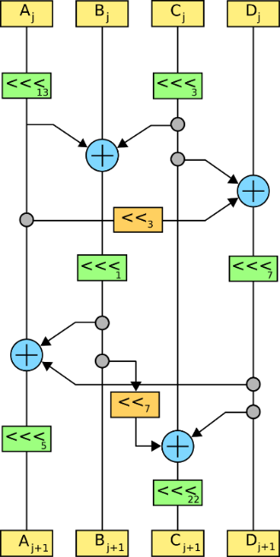
Constructing block ciphers

Slide 29
Principles for designing block ciphers
Claude Shannon, “Communication Theory of Secrecy Systems”(1949):
Diffusion: plaintext spread over large parts of the ciphertext
Confusion: a complex relation between plaintext, key and ciphertext

Slide 30
Block ciphers
$K$
$$ℰ$$
$$M$$
Key expansion
$$C$$
$n$ bits
$$K_{1}$$
$$K_{2}$$
$$K_{3}$$
$$K_{R}$$
$n$ bits
$$Rnd$$
$$Rnd$$
$$Rnd$$
$$Rnd$$
$$⋯$$
$Rnd(K_{i}, M)$ is called a round function
AES-128/192/256 $R=10/12/14$

Slide 31
Advanced Encryption Standard

Slide 32
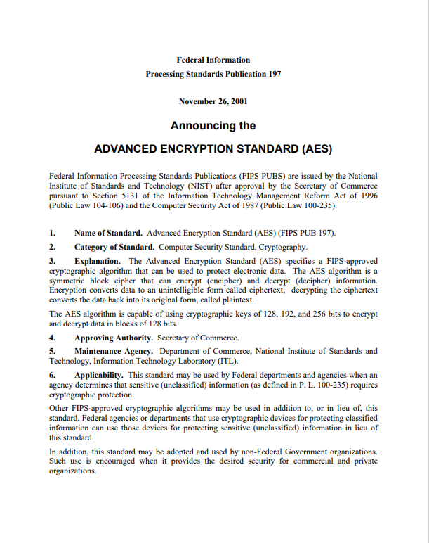
AES
History
Date Encryption Standard (DES) used since the 70's
Key length too short (56 bits)
Block length too short (64 bits)
Too slow in software
1997: NIST hosts a competition to find a new block cipher
2001: Rijndael is announced the winner → renamed AES
If you remember nothing else:
$AES˗128 :{\left\{0,1\right\}}^{128}×{\left\{0,1\right\}}^{128}→{\left\{0,1\right\}}^{128}$
$AES˗192 :{\left\{0,1\right\}}^{192}×{\left\{0,1\right\}}^{128}→{\left\{0,1\right\}}^{128}$
$AES˗256 :{\left\{0,1\right\}}^{256}×{\left\{0,1\right\}}^{128}→{\left\{0,1\right\}}^{128}$

Slide 33
AES-128
128
$$K$$
128
128
128
128
128
$${ K}_{0}$$
$${ K}_{1}$$
$${ K}_{2}$$
$$⋯$$
$$K_{9}$$
$$K_{10}$$
input
SubBytes
ShiftRow
MixColumn
SubBytes
ShiftRow
MixColumn
SubBytes
ShiftRow
output
$$⊕$$
$$⊕$$
$$⊕$$
$$⋯$$
$$⊕$$
$$⊕$$
10 rounds

Slide 34
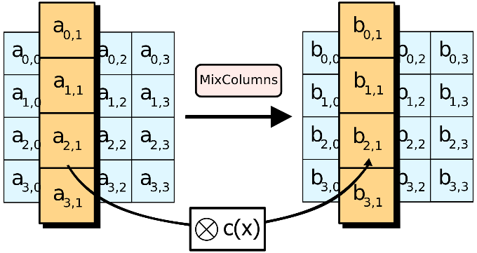
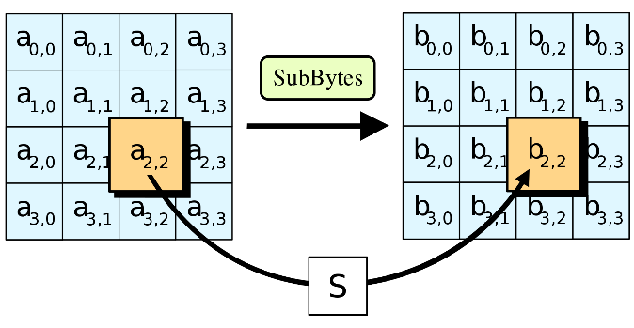
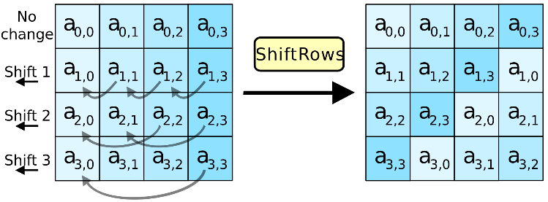
AES round function
SubBytes
ShiftRow
MixColumn

Slide 35
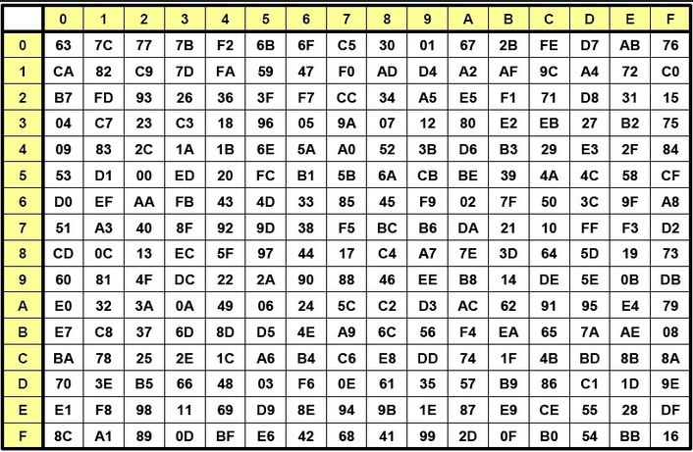
AES round function - SubBytes
SubBytes
ShiftRow
MixColumn
$a_{2,2}=$ 8A
$b_{2,2}=$ 7E

Slide 36
AES round function - ShiftRows
SubBytes
ShiftRow
MixColumn

Slide 37
AES round function - MixColumns
$$a_{1}$$
$$b_{1}$$
$$Ma_{1}=b_{1}$$
$$\left(\begin{matrix}\begin{matrix}02 & 03 \\ 01 & 02\end{matrix} & \begin{matrix}01 & 01 \\ 03 & 01\end{matrix} \\ \begin{matrix}01 & 01 \\ 03 & 01\end{matrix} & \begin{matrix}02 & 03 \\ 01 & 02\end{matrix}\end{matrix}\right)\left(\begin{matrix}a_{0,1} \\ a_{1,1} \\ \begin{matrix}a_{2,1} \\ a_{3,1}\end{matrix}\end{matrix}\right)=\left(\begin{matrix}b_{0,1} \\ b_{1,1} \\ \begin{matrix}b_{2,1} \\ b_{3,1}\end{matrix}\end{matrix}\right)$$
SubBytes
ShiftRow
MixColumn
$$1⋅a_{0,1}+2⋅a_{1,1}+3⋅a_{2,1}+1⋅a_{3,1}=b_{1,1}$$
$$a_{0,1}⊕2⋇a_{1,1}⊕3⋇a_{2,1}⊕a_{3,1}=b_{1,1}$$

Slide 38
AES-128
128
$$K$$
128
128
128
128
128
$$K_{0}$$
$$K_{1}$$
$$K_{2}$$
$$K_{9}$$
$$K_{10}$$
input
SubBytes
ShiftRow
MixColumn
SubBytes
ShiftRow
MixColumn
SubBytes
ShiftRow
output
$$⊕$$
$$⊕$$
$$⊕$$
$$⋯$$
$$⊕$$
$$⊕$$
10 rounds

Slide 39
AES round
$$a_{0,0}$$ | $$a_{0,1}$$ | $$a_{0,2}$$ | $$a_{0,3}$$
$$a_{1,0}$$ | $$a_{1,1}$$ | $$a_{1,2}$$ | $$a_{1,3}$$
$$a_{2,0}$$ | $$a_{2,1}$$ | $$a_{2,2}$$ | $$a_{2,3}$$
$$a_{3,0}$$ | $$a_{3,1}$$ | $$a_{3,2}$$ | $$a_{3,3}$$
SubBytes | $$b_{i,j}=S[a_{i,j}]$$
ShiftRows | $$\left[\begin{matrix}c_{0,j} \\ c_{1,j} \\ \begin{matrix}c_{2,j} \\ c_{3,j}\end{matrix}\end{matrix}\right]=\left[\begin{matrix}b_{0,j} \\ b_{1,j−1} \\ \begin{matrix}b_{2,j−2} \\ b_{3,j−3}\end{matrix}\end{matrix}\right]$$
MixColumns | $$\left[\begin{matrix}d_{0,j} \\ d_{1,j} \\ \begin{matrix}d_{2,j} \\ d_{3,j}\end{matrix}\end{matrix}\right]=\left[\begin{matrix}\begin{matrix}02 & 03 \\ 01 & 02\end{matrix} & \begin{matrix}01 & 01 \\ 03 & 01\end{matrix} \\ \begin{matrix}01 & 01 \\ 03 & 01\end{matrix} & \begin{matrix}02 & 03 \\ 01 & 02\end{matrix}\end{matrix}\right]\left[\begin{matrix}c_{0,j} \\ c_{1,j} \\ \begin{matrix}c_{2,j} \\ c_{3,j}\end{matrix}\end{matrix}\right]$$
AddRoundKey | $$\left[\begin{matrix}e_{0,j} \\ e_{1,j} \\ \begin{matrix}e_{2,j} \\ e_{3,j}\end{matrix}\end{matrix}\right]=\left[\begin{matrix}d_{0,j} \\ d_{1,j} \\ \begin{matrix}d_{2,j} \\ d_{3,j}\end{matrix}\end{matrix}\right]⊕\left[\begin{matrix}k_{0,j} \\ k_{1,j} \\ \begin{matrix}k_{2,j} \\ k_{3,j}\end{matrix}\end{matrix}\right]$$
$$\left[\begin{matrix}e_{0,j} \\ e_{1,j} \\ \begin{matrix}e_{2,j} \\ e_{3,j}\end{matrix}\end{matrix}\right]=\left[\begin{matrix}\begin{matrix}02 & 03 \\ 01 & 02\end{matrix} & \begin{matrix}01 & 01 \\ 03 & 01\end{matrix} \\ \begin{matrix}01 & 01 \\ 03 & 01\end{matrix} & \begin{matrix}02 & 03 \\ 01 & 02\end{matrix}\end{matrix}\right]\left[\begin{aligned}S[a_{0,j}] \\ S[a_{1,j−1}] \\ S[a_{2,j−2}] \\ S[a_{3,j−3}]\end{aligned}\right]⊕\left[\begin{matrix}k_{0,j} \\ k_{1,j} \\ \begin{matrix}k_{2,j} \\ k_{3,j}\end{matrix}\end{matrix}\right]$$
$$=\left(\left[\begin{aligned}02 \\ 01 \\ 01 \\ 03\end{aligned}\right]∙S[a_{0,j}]\right)⊕\left(\left[\begin{aligned}03 \\ 02 \\ 01 \\ 01\end{aligned}\right]∙S\left[a_{1,j−1}\right]\right)$$
$$⊕\left(\left[\begin{aligned}01 \\ 03 \\ 02 \\ 01\end{aligned}\right]∙S[a_{2,j−2}]\right)⊕\left(\left[\begin{aligned}01 \\ 01 \\ 03 \\ 02\end{aligned}\right]∙S[a_{3,j−3}]\right)⊕\left[\begin{matrix}k_{0,j} \\ k_{1,j} \\ \begin{matrix}k_{2,j} \\ k_{3,j}\end{matrix}\end{matrix}\right]$$
$$T_{0}\left[x\right]=\left(\left[\begin{aligned}02 \\ 01 \\ 01 \\ 03\end{aligned}\right]∙S\left[x\right]\right)$$ | $$T_{1}\left[x\right]=\left(\left[\begin{aligned}03 \\ 02 \\ 01 \\ 01\end{aligned}\right]∙S\left[x\right]\right)$$ | $$T_{2}\left[x\right]=\left(\left[\begin{aligned}01 \\ 03 \\ 02 \\ 01\end{aligned}\right]∙S\left[x\right]\right)$$ | $$T_{3}\left[x\right]=\left(\left[\begin{aligned}01 \\ 01 \\ 03 \\ 02\end{aligned}\right]∙S\left[x\right]\right)$$

Slide 40
AES round
$$a_{0,0}$$ | $$a_{0,1}$$ | $$a_{0,2}$$ | $$a_{0,3}$$
$$a_{1,0}$$ | $$a_{1,1}$$ | $$a_{1,2}$$ | $$a_{1,3}$$
$$a_{2,0}$$ | $$a_{2,1}$$ | $$a_{2,2}$$ | $$a_{2,3}$$
$$a_{3,0}$$ | $$a_{3,1}$$ | $$a_{3,2}$$ | $$a_{3,3}$$
SubBytes | $$b_{i,j}=S[a_{i,j}]$$
ShiftRows | $$\left[\begin{matrix}c_{0,j} \\ c_{1,j} \\ \begin{matrix}c_{2,j} \\ c_{3,j}\end{matrix}\end{matrix}\right]=\left[\begin{matrix}b_{0,j} \\ b_{1,j−1} \\ \begin{matrix}b_{2,j−2} \\ b_{3,j−3}\end{matrix}\end{matrix}\right]$$
MixColumns | $$\left[\begin{matrix}d_{0,j} \\ d_{1,j} \\ \begin{matrix}d_{2,j} \\ d_{3,j}\end{matrix}\end{matrix}\right]=\left[\begin{matrix}\begin{matrix}02 & 03 \\ 01 & 02\end{matrix} & \begin{matrix}01 & 01 \\ 03 & 01\end{matrix} \\ \begin{matrix}01 & 01 \\ 03 & 01\end{matrix} & \begin{matrix}02 & 03 \\ 01 & 02\end{matrix}\end{matrix}\right]\left[\begin{matrix}c_{0,j} \\ c_{1,j} \\ \begin{matrix}c_{2,j} \\ c_{3,j}\end{matrix}\end{matrix}\right]$$
AddRoundKey | $$\left[\begin{matrix}e_{0,j} \\ e_{1,j} \\ \begin{matrix}e_{2,j} \\ e_{3,j}\end{matrix}\end{matrix}\right]=\left[\begin{matrix}d_{0,j} \\ d_{1,j} \\ \begin{matrix}d_{2,j} \\ d_{3,j}\end{matrix}\end{matrix}\right]⊕\left[\begin{matrix}k_{0,j} \\ k_{1,j} \\ \begin{matrix}k_{2,j} \\ k_{3,j}\end{matrix}\end{matrix}\right]$$
$$\left[\begin{matrix}e_{0,j} \\ e_{1,j} \\ \begin{matrix}e_{2,j} \\ e_{3,j}\end{matrix}\end{matrix}\right]=T_{0}\left[a_{0,j}\right]⊕T_{1}\left[a_{1,j−1}\right]⊕T_{2}\left[a_{2,j−2}\right]⊕T_{3}\left[a_{3,j−3}\right]⊕\left[\begin{matrix}k_{0,j} \\ k_{1,j} \\ \begin{matrix}k_{2,j} \\ k_{3,j}\end{matrix}\end{matrix}\right]$$
$$T_{0}\left[x\right]=\left(\left[\begin{aligned}02 \\ 01 \\ 01 \\ 03\end{aligned}\right]∙S\left[x\right]\right)$$ | $$T_{1}\left[x\right]=\left(\left[\begin{aligned}03 \\ 02 \\ 01 \\ 01\end{aligned}\right]∙S\left[x\right]\right)$$ | $$T_{2}\left[x\right]=\left(\left[\begin{aligned}01 \\ 03 \\ 02 \\ 01\end{aligned}\right]∙S\left[x\right]\right)$$ | $$T_{3}\left[x\right]=\left(\left[\begin{aligned}01 \\ 01 \\ 03 \\ 02\end{aligned}\right]∙S\left[x\right]\right)$$

Slide 41
AES performance
AES is reasonably efficient in software
T-table implementation very fast (but not secure!)
Hard to implement fast and constant-time
Intel introduced dedicated AES instructions into their CPUs (AES-NI):
aesenc, aesenclast: do one round of AES in one cycle
aeskeygenassist: do AES key expansion
aesdec, aesdeclast: do one round of AES decryption in one cycle
aesimc: do AES inverser MixColumns
Now standard in all modern CPUs
 | Throughput (my laptop)
AES-128 (in software) | 0.27 GB/s
AES-128 (w/AES-NI) | 3.45 GB/s

Slide 42
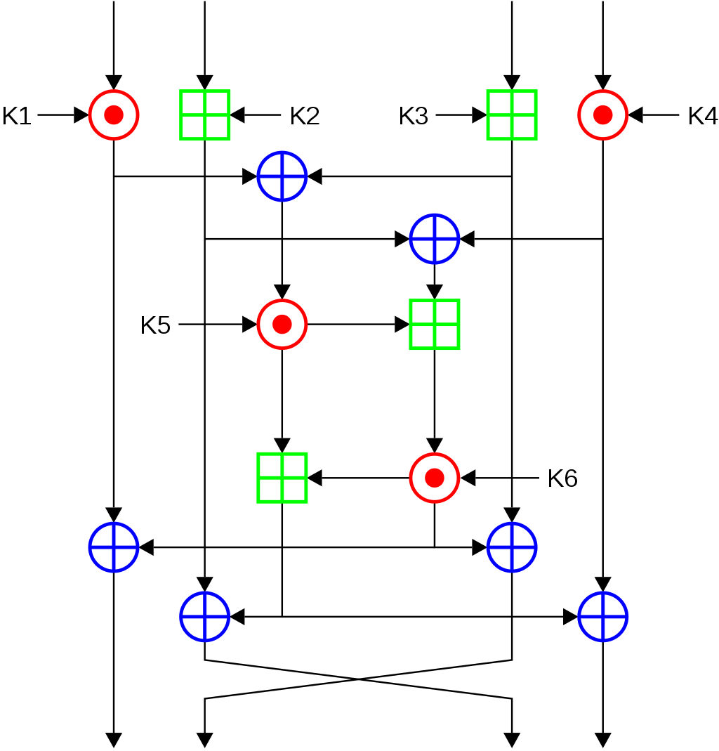
Attacking block ciphers

Slide 43
Attacks on block ciphers
Brute force attacks: search through every possible key in key space
Generic: works for all block ciphers
Not practical for large key spaces
Advanced attacks: try to exploit the concrete details of the block cipher
Differential cryptanalysis ('90, but known by the designers of DES + NSA since mid '70 )
Linear cryptanalysis ('92)
AES designed to resist both
Implementation attacks: vulnerabilities due to implementation characteristics
Power draw
Timing
Cache misses

Slide 44
PRF security – an equivalent view
$$\left|Func\left[in,out\right]\right|=$$
$$Func\left[in, out\right]$$
$$X$$ | $$\tilde{F}(X)$$
$$000…000$$ | $$101…111$$
$$000…001$$ | $$001…001$$
$$000…010$$ | $$111…100$$
$$000…011$$ | $$101…000$$
$$⋮$$ | $$⋮$$
$$111…111$$ | $$001…001$$
$$G\left(X\right)=\overline{X}$$
$$F\left(X\right)=X$$
$$2^{in}$$
$$V\left(X\right)=X⊕17$$
$$\tilde{F}$$
$$H\left(X\right)=00…0$$
$$out$$

Slide 45
PRF security – an equivalent view
$$Func\left[in, out\right]$$
$$\left|Func\left[in,out\right]\right|=$$
# bitstrings of length $2^{in}⋅out$
$$=2^{\left(2^{in}⋅out\right)}$$
$$\tilde{F}(X)$$
$$101…111$$
$$001…001$$
$$111…100$$
$$101…000$$
$$⋮$$
$$001…001$$
$$G\left(X\right)=\overline{X}$$
Example:
$$\left|Func\left[3,2\right]\right|=$$
$$2^{2^{3}⋅2}$$
$$F\left(X\right)=X$$
$$2^{in}$$
$$V\left(X\right)=X⊕17$$
$$=2^{16}$$
$$=65536$$
$$\tilde{F}$$
$$H\left(X\right)=00…0$$
$$out$$
- Bits needed to specify one function: $2^{in}⋅out$
- Each distinct bitstring of length $2^{in}⋅out$
represents a unique function

Slide 46
PRF security – an equivalent view
$$Func\left[128, 128\right]$$
$$\left|Func\left[in,out\right]\right|=$$
# bitstrings of length $2^{in}⋅out$
$$=2^{\left(2^{in}⋅out\right)}$$
$$\tilde{F}(X)$$
$$101…111$$
$$001…001$$
$$111…100$$
$$101…000$$
$$⋮$$
$$001…001$$
$$G\left(X\right)=\overline{X}$$
Example:
$$\left|Func\left[3,2\right]\right|=$$
$$2^{2^{3}⋅2}$$
$$F\left(X\right)=X$$
$$2^{in}$$
$$V\left(X\right)=X⊕17$$
$$=2^{16}$$
$$=65536$$
$$\tilde{F}$$
$$H\left(X\right)=00…0$$
$$out$$
$$AES$$
$$\left|Func\left[128,128\right]\right|=$$
$$2^{2^{128}⋅128}$$
$${AES}_{00…}\left(X\right)$$
$${AES}_{101…}\left(X\right)$$
- Bits needed to specify one function: $2^{in}⋅out$
$$\left|AES\right|=$$
$$2^{128}$$
$${AES}_{11…}\left(X\right)$$
- Each distinct bitstring of length $2^{in}⋅out$
represents a unique function

Slide 47
PRF security – an equivalent view
$$Func\left[128, 128\right]$$
$$\left|Func\left[in,out\right]\right|=$$
# bitstrings of length $2^{in}⋅out$
$$=2^{\left(2^{in}⋅out\right)}$$
$$\tilde{F}(X)$$
$$101…111$$
$$001…001$$
$$111…100$$
$$101…000$$
$$⋮$$
$$001…001$$
$$G\left(X\right)=\overline{X}$$
Example:
$$\left|Func\left[3,2\right]\right|=$$
$$2^{2^{3}⋅2}$$
$$F\left(X\right)=X$$
$$2^{in}$$
$$V\left(X\right)=X⊕17$$
$$=2^{16}$$
$$=65536$$
$$\tilde{F}$$
$$H\left(X\right)=00…0$$
$$out$$
$$\left|Func\left[128,128\right]\right|=$$
$$2^{2^{128}⋅128}$$
- Bits needed to specify one function: $2^{in}⋅out$
$$\left|AES\right|=$$
$$2^{128}$$
$$AES$$
- Each distinct bitstring of length $2^{in}⋅out$
represents a unique function

Slide 48
Block ciphers – security
$$\left|Func\left[128,128\right]\right|=$$
$$2^{2^{128}⋅128}$$
$$Func\left[128, 128\right]$$
$$G\left(X\right)=\overline{X}$$
$$F\left(X\right)=X$$
$$V\left(X\right)=X⊕17$$
$$H\left(X\right)=00…0$$
$$\left|AES\right|=$$
$$2^{128}$$
$$AES$$

Slide 49
Block ciphers – security
$$\left|Func\left[128,128\right]\right|=$$
$$2^{2^{128}⋅128}$$
$$Func\left[128, 128\right]$$
$$\left|Perm\left[128\right]\right|=$$
$$2^{128}!$$
$$Perm\left[128\right]$$
$$G\left(X\right)=\overline{X}$$
$$F\left(X\right)=X$$
$$V\left(X\right)=X⊕17$$
$$H\left(X\right)=00…0$$
$$\left|AES\right|=$$
$$2^{128}$$
$$AES$$

Slide 50
PRF – security
World 0
$$K\underset{←}{\$}{\left\{0,1\right\}}^{k}$$ Input $X$: return $F_{K}\left(X\right)$
$b$
World 1
$$T←[ ]$$ Input $X$: if $T\left[X\right]= ⊥:$ $T[X]\underset{←}{\$}{\left\{0,1\right\}}^{out}$ return $T[X]$
I’m in World $b′$

Slide 51
PRF – security; equivalent view
$$Exp_{F}^{prf}\left(A\right)$$
$b\underset{←}{\$}\left\{0,1\right\}$ $K\underset{←}{\$}{\left\{0,1\right\}}^{k}$ $F_{0}\underset{←}{}F_{K}$ // real $F$ $F_{1}\underset{←}{\$}Func\left[in, out\right]$ // random $\tilde{F}$ $b^{′}\underset{←}{}A^{F_{b}(⋅)}$ $return b^{′}\overset{?}{=}b$
$$A=$$
World 0
$$K\underset{←}{\$}{\left\{0,1\right\}}^{k}$$ Input $X$: return $F_{K}\left(X\right)$
$b$
World 1
$$\tilde{F}\underset{←}{\$}Func\left[in, out\right]$$ Input $X$: return $\tilde{F}\left(X\right)$
I’m in World $b′$
Definition: The PRF-advantage of an adversary $A$ is
$${Adv}_{F}^{prf}\left(A\right)=\left|2⋅Pr\left[b^{′}=b\right]−1\right|$$
Definition: The PRF-advantage of an adversary $A$ is
$${Adv}_{F}^{prf}\left(A\right)=\left|2⋅Pr\left[Exp_{F}^{prf}\left(A\right)⇒true\right]−1\right|$$

Slide 52
PRF PRP – security; equivalent view
$$Exp_{F}^{prfprp}\left(A\right)$$
$b\underset{←}{\$}\left\{0,1\right\}$ $K\underset{←}{\$}{\left\{0,1\right\}}^{k}$ $F_{0}\underset{←}{}F_{K}$ // real $F$ $F_{1}\underset{←}{\$}Func\left[in, out\right]$ // random $\tilde{F}$ $b^{′}\underset{←}{}A^{F_{b}(⋅)}$ $return b^{′}\overset{?}{=}b$
$$A=$$
World 1
$$K\underset{←}{\$}{\left\{0,1\right\}}^{k}$$ Input $X$: return $F_{K}\left(X\right)$
$b$
World 0
$$\tilde{F}\underset{←}{\$}Func\left[in, out\right]$$ Input $X$: return $\tilde{F}\left(X\right)$
$$Perm\left[n\right]$$
$$Perm\left[n\right]$$
I’m in World $b′$
Definition: The PRP-advantage of an adversary $A$ is
$${Adv}_{F}^{prp}\left(A\right)=\left|2⋅Pr\left[Exp_{F}^{prp}\left(A\right)⇒true\right]−1\right|$$

Slide 53
Summary
Block ciphers are very important primitives (building blocks) – not encryption schemes!
Correct abstraction: block ciphers = PRPs
Right security notion for PRFs/PRPs:
indistinguishability from random function/permutation
Concrete block cipher design: DES, AES, …

