Slide 1

Introduction to
Classification and labelling of mixtures
Wednesday 18. jan. 2017
09:15 – 12.00 and 13.15 – 15.00
Seminar room Curie, Chemistry building
Karoline Fægri og Svein Tveit, Skolelaboratoriet for kjemi

Slide 2
Competence aims
The aims of this course are to enable students to:
use the CLP-definitions in classification and labelling of mixtures
describe hazard communication in the form of labelling
produce labels for 3 % NaOH, 15 % HCl, 9 % NH₃ and 2 % CuSO₄
Notes:
Downstreams user?

Slide 3



HSE/HMS – authorities in Norway
 | Nature of hazards | Resposible authorities for HSE-laws and regulations
Health Helse | Health | Norwegian Labour Inspection Authority Arbeidstilsynet
Safety Sikkerhet | Physical | Norwegian Directorate for Civil Protection Direktoratet for samfunnssikkerhet og beredskap (DSB)
Environment Miljø | Environment | Norwegian Environment Agency Miljødirektoratet

Slide 4


About Regulation (EC) No 1272/2008 (CLP)
GHS | Global Harmonized System for classification and labelling of chemicals FNs globalt harmoniserte system for klassifisering og merking av kjemikalier
ECHA | European CHemicals Agency, responsible for implementing GHS in EU by establishing and updating an inventory for GHS substances Det europeiske kjemikaliebyrået ECHA har ansvar for å etablere og holde oppdatert et register over stoffers fareklassifisering og -merking.

Slide 5


About Regulation (EC) No 1272/2008 (CLP)
REACH | Regulation (EC) No 1907/2006 Registration, registrering Evaluation, vurdering Authorisation and Restriction, godkjenning og begrensning CHemicals, kjemikalier
CLP | Regulation (EC) No 1272/2008 Classification. klassifisering Labelling, merking Packaging of Substances and Mixtures, og emballering av stoffer og stoffblandinger

Slide 6

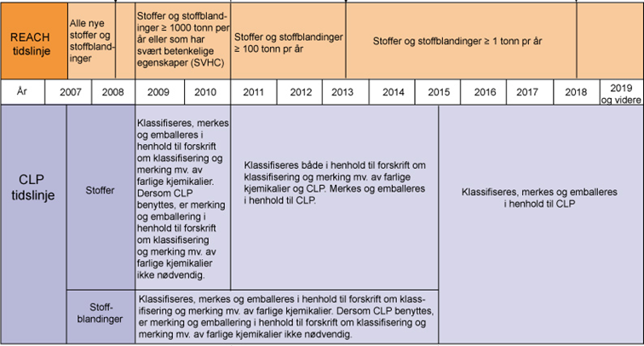
Timeline for implementing CLP
only CLP after
1. juni 2017
16. June 2012
CLP in Norway
1. December 2010
CLP in EU
Old labels and CLP until
1. June 2015
Kilde: http://www.miljodirektoratet.no/Global/dokumenter/tema/kjemikaler/reach_clp_tidslinje_800.jpg (august 2014)
Notes:
Forskrift om klassifisering, merking og emballering av stoffer og stoffblandinger (CLP) ble innført 16. juni 2012. Denne forskriften erstatter Forskrift om klassifisering, merking mv. av farlige kjemikalier (Merkeforskriften).
Skal sikre samme merking for lagring, omsetning og transport, over hele verden.

Slide 7
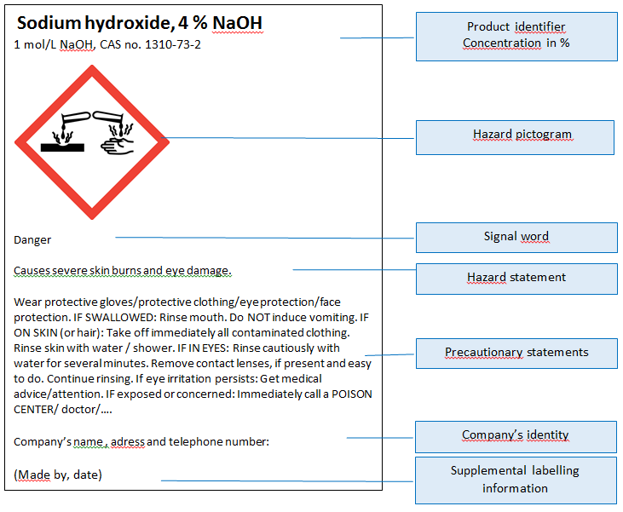
Hazard communication
Product identifier
Hazard pictogram
Signal word
Hazard statement
Precautionary
statement
Company identity

Slide 8
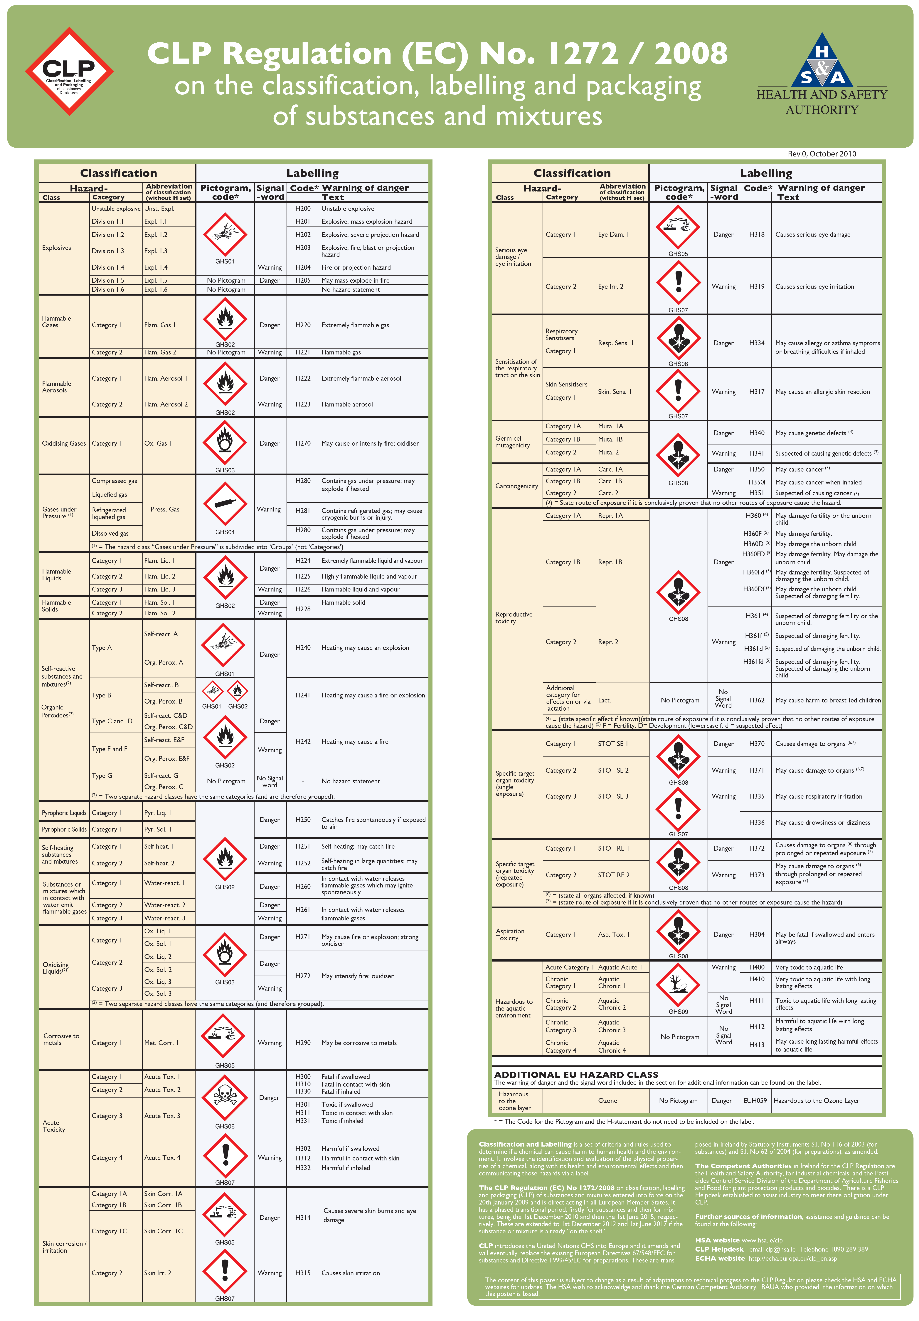
Guidance on Labelling and Packaging in accordance with Regulation (EC) No 1272/2008
The poster
English:
CLP Regulation
Norwegian:
Klassifisering og merking i CLP

Slide 9
Product identifier
Name and identification number given in the Classification and Labelling Inventory
if not included in C&L Inventory
CAS number and IUPAC name

Slide 10

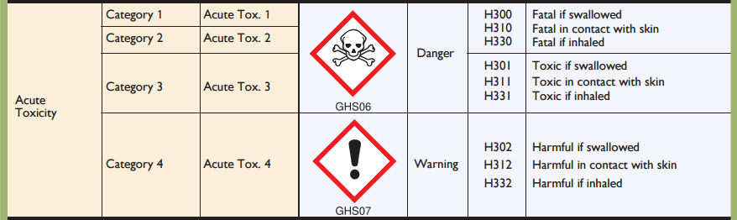
Hazard classes and categories

Slide 11
Hazard pictograms
Physical
Health
Environment

Slide 12
Signal words and hazard statements

Slide 13
Groups of hazard and precautionary statements
Code | hazard statements | Code | precautionary statements
H200-H299 | Physical | P100-P199 | General
H300-H399 | Health | P200-P299 | Prevention
H400-H499 | Environment | P300-P399 | Response
 |  | P400-P499 | Storage
 |  | P500-P599 | Disposal
EUH | only in the EU
Notes:
Egen fareklasse for EU/EØS: Fare for ozonlaget

Slide 14
Exercises - CLP
Label for 3 % NaOH in 1 L bottle

Slide 15

Natriumhydroksidløsning
3 % NaOH
Fare
Gir alvorlige etseskader på hud og øyne.
Benytt vernebriller. VED SVELGING: Skyll munnen. Ikke framkall brekning. VED HUDKONTAKT (eller håret): Skyll/dusj huden med vann. VED KONTAKT MED ØYNENE: Skyll forsiktig med vann i flere minutter. Fjern eventuelle kontaktlinser dersom dette enkelt lar seg gjøre. Fortsett skyllingen. Kontakt umiddelbart et GIFTINFORMASJONSSENTER eller lege.
Skole, adresse og telefonnummer:
(Laget av, dato)
Sodium hydroxide
3 % NaOH
Danger
Causes severe skin burns and eye damage
Wear eye protection. IF SWALLOWED: Rinse mouth. Do NOT
induce vomiting. IF ON SKIN (or hair): Remove / Take off
immediately all contaminated clothing. Rinse skin with water / shower. Wash contaminated clothing before reuse. IF IN EYES: Rinse cautiously with water for several minutes. Remove contact lenses, if present and easy to do. Continue rinsing. Immediately call a POISON Center or doctor/physician.
Company’s name , adress and telephone number:
(Made by, date)

Slide 16
Exercises - CLP
2. Label for 15 % HCl in 1 L bottle

Slide 17

Saltsyre
15 % HCl
Advarsel
Irriterer huden.
Gir alvorlig øyeirritasjon.
Kan forårsake irritasjon av luftveiene.
Benytt vernebriller. Unngå innånding av gass. VED HUDKONTAKT: Vask med mye såpe og vann. Ved hudirritasjon: Søk legehjelp. VED KONTAKT MED ØYNENE: Skyll forsiktig med vann i flere minutter. Fjern eventuelle kontaktlinser dersom dette enkelt lar seg gjøre. Fortsett skyllingen. Ved vedvarende øyeirritasjon: Søk legehjelp. Ved eksponering eller ubehag: Kontakt et GIFTINFORMASJONSSENTER eller lege.
Skole, adresse og telefonnummer:
(Laget av, dato)
Saltsyre
15 % HCl
Advarsel
Skole, adresse og telefonnummer:
(Laget av, dato)

Slide 18
Hydrochloric acid,
15 % HCl
Warning
Causes skin irritation.
Causes serious eye irritation.
May cause respiratory irritation.
Wear eye protection. Avoid breathing gas. IF ON SKIN: Wash with plenty of soap and water. If skin irritation occurs: Get medical advice / attention. IF IN EYES: Rinse cautiously with water for several minutes. Remove contact lenses, if present and easy to do. Continue rinsing. If eye irritation persists: Get medical advice/attention. Call a POISON CENTER or doctor/
physician if you feel unwell.
Company’s name , adress and telephone number:
(Made by, date)
Hydrochloric acid,
15 % HCl
Warning
Company’s name , adress and telephone number:
(Made by, date)

Slide 19
Concentration limits
Specific concentration limits and Generic concentration limits

Slide 20
Classification for acute or chronic aquatic hazard
L(E)C₅₀ from SDS
Product name Ammonia
SECTION 12: Ecological information
12.1. Toxicity
Acute aquatic, fish: Value: 0,89 mg/l, Method of testing: LC50 (Not ionized freshwater), Duration: 96h
Acute aquatic, Daphnia: Value: 101 mg/m³, Method of testing: LC50 (Freshwater), Duration: 96 h

Slide 21
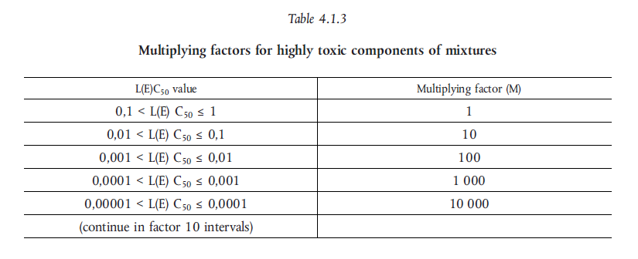
M - factor

Slide 22
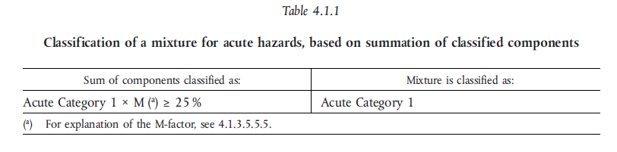
Classification – Aquatic acute

Slide 23
Exercises - CLP
3. Label for 9 % NH₃ in 1L bottle

Slide 24


Ammoniakkløsning,
9 % NH₃
Fare
Gir alvorlige etseskader på hud og øyne. Kan forårsake irritasjon av luftveiene.
Benytt vernebriller. Unngå innånding av gass. VED SVELGING: Skyll munnen. Ikke framkall brekning. VED HUDKONTAKT (eller håret): Tilsølte klær må fjernes straks. Skyll/dusj huden med vann. Tilsølte klær må vaskes før de brukes på nytt. VED KONTAKT MED ØYNENE: Skyll forsiktig med vann i flere minutter. Fjern eventuelle kontaktlinser dersom dette enkelt lar seg gjøre. Fortsett skyllingen. Kontakt umiddelbart et GIFTINFORMASJONSSENTER eller lege.
Skole, adresse og telefonnummer:
(Laget av, dato)
Ammonia,
9 % NH₃
Danger
Causes severe skin burns and eye damage. May cause respiratory irritation.
Wear eye protection. Avoid breathing gas. IF SWALLOWED: Rinse mouth. Do NOT induce vomiting. IF ON SKIN (or hair): Remove / Take off immediately all contaminated clothing. Rinse skin with water / shower. Wash contaminated clothing before reuse. IF IN EYES: Rinse cautiously with water for several minutes. Remove contact lenses, if present and easy to do. Continue rinsing. Immediately call a POISON Center or doctor/physician.
Company’s name , adress and telephone number:
(Made by, date)

Slide 25
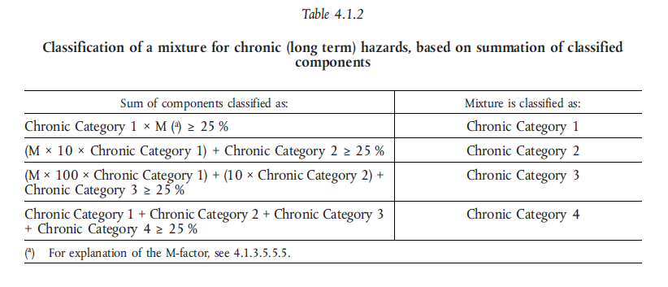
Classification – Aquatic chronic

Slide 26


Classification – Acute toxicity
ATE = Acute toxicity estimate

Slide 27
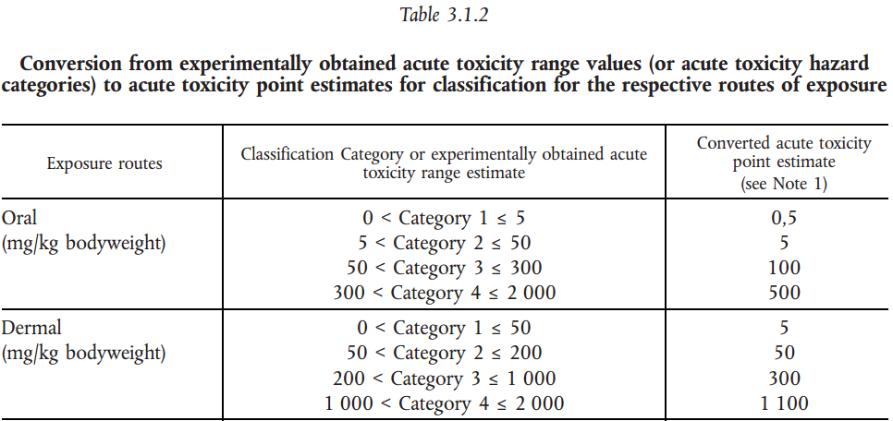

Acute toxicity
Example
A 5 % solution of a substance classified as acute tox. 3 – oral exposure
$${ATE}_{mix}=\frac{100∗{ATE}_{i}}{c_{i}}=\frac{100∗100}{5}=2000$$

Slide 28
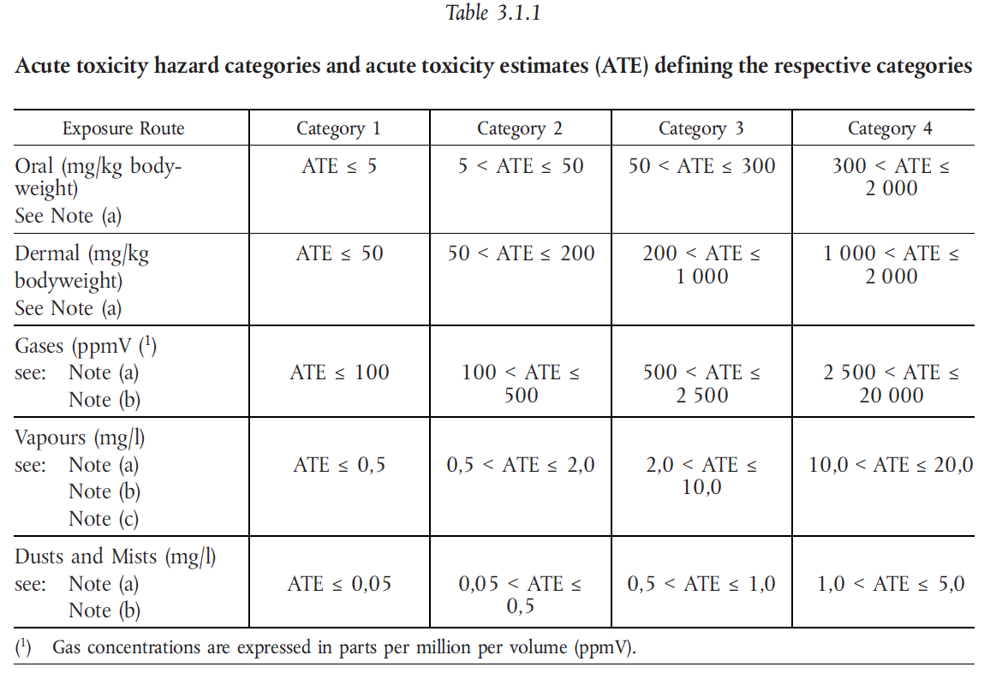

Slide 29
Acute toxicity
Example
A 5 % solution of a substance classified as acute tox. 3 – oral exposure
$${ATE}_{mix}=\frac{100∗{ATE}_{i}}{c_{i}}=\frac{100∗100}{5}=2000$$

Slide 30
Exercises - CLP
4. Label for 2 % CuSO₄ in 1 L bottle

Slide 31

Kobber(II)sulfatløsning,
2 % CuSO₄
Giftig, med langtidsvirkning, for liv i vann.
Unngå utslipp til miljøet. Samle opp spill
Skole, adresse og telefonnummer:
(Laget av, dato)
Kobber(II)sulfatløsning,
2 % CuSO₄
Skole, adresse og telefonnummer:
(Laget av, dato)

Slide 32
copper(II)sulphate
2 % CuSO₄
Toxic to aquatic life with long lasting effects.
Avoid release to the environment. Collect spillage.
Company’s name , adress and telephone number:
(Made by, date)
copper(II)sulphate
2 % CuSO₄
Company’s name , adress and telephone number:
(Made by, date)

Slide 33
Exercise - CLP (optional)
5. Can you make a nickel(II)sulfate solution that is not classified as hazardous under the CLP regulation?
(see next slide)

Slide 34
Hazard class | To determine the classification of the mixture | Concentration limit for the mixture to be classified as hazardous
Acute Tox. 4;H302 | Oral | 25 %
Skin irrit. 2;H315 | Specific concentration limit C ≥ 20 % | 20 %
Skin Sens. 1;H317 | Specific concentration limit C ≥ 0,01 % | 0,01 %
Acute Tox. 4;H332 | Dust/mist | 30 %
Resp. Sens. 1;H334 | Generic concentration limit C ≥ 1,0 % - table 3.4.3 in the CLP regulation | 1 %
Muta. 2;H341 | Generic concentration limit C ≥ 1,0 % - table 3.5.2 in the CLP regulation | 1 %
Carc. 1A;H350i | Generic concentration limit C ≥ 0,1 % - table 3.6.2 in the CLP regulation | 0,1 %
Repr. 1B;H360D | Generisk konsentrasjonsgrense C ≥ 0,3 % - table 3.7.2 in the CLP regulation | 0,3 %
STOT RE 1;H372 | Specific concentration limit C ≥ 1 % | 1 %
STOT RE 2;H373 | Specific concentration limit 0,1 % ≤ C ≤ 1% | 0,1 %
Aquatic Acute 1 | ˂ 25 % ∙ 1(M) ˂ 25 % | 25 %
Aquatic Chronic 1 | ˂ 0,25 % ∙ 1 (M) ∙ 100 ˂ 25 % | 0,25 %

Slide 35
Harmonised classification
Harmonised classification (as provided in Annex VI to CLP), must always be used by a manufacturer
Harmonised classification normally applies to those properties of the highest concern
Where some, but not all hazard classes or differentiations within hazard classes have been harmonised, the remainder should be self-classified to complete the classification
Guidance on the Application of the CLP Criteria

Slide 36
Leads to different classification for the same mixture
Ammonia 25 % (Avantor)
Skin corrosion 1B
Aquatic acute, 1
STOT, SE, 3
Serious eyedamage, 1
Aquatic chronic, 2
Ammonia 25 % (Merck)
Skin corrosion, 1B
Aquatic acute, 1
STOT, SE, 3
Corrosive to metals, 1

Slide 37
CLP in scientific research
This Regulation (CLP) shall not apply to the following:
substances and mixtures for scientific research and development, which are not placed on the market, provided they are used under controlled conditions in accordance with Community workplace and environmental legislation.
http://eur-lex.europa.eu/LexUriServ/LexUriServ.do?uri=OJ:L:2008:353:0001:1355:en:PDF
Title 1, Article 1, 2d

Slide 38
How to label mixtures in your science lab
Mixtures that are to be use the same day do not require any labelling
Mixtures that are left over night requires a minimum labelling of:
  Name and molar concentration
  Hazard pictograms
  Hazard statements
  (Highly relevant precautionairy statements)

