Slide 1
Species in natural freshwater
Central equilibriums in natural water samples
KJM MEF 4010
Module 19

Slide 2
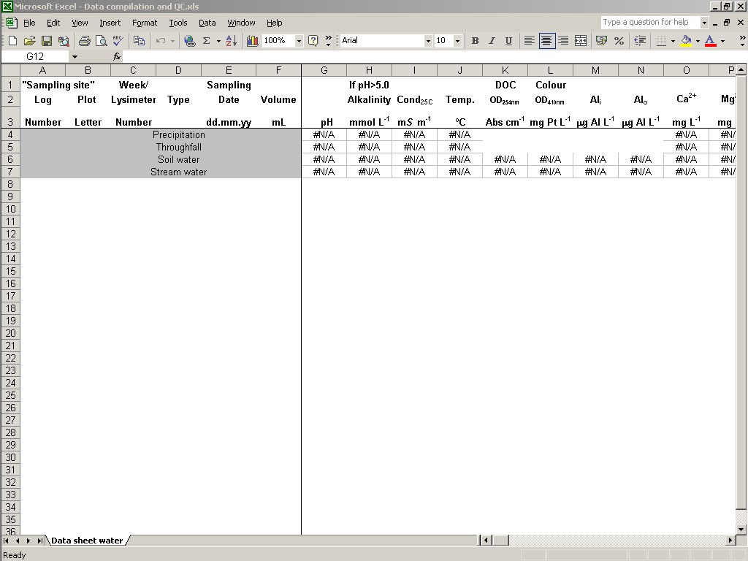
Compilation, calculations and QC of data
After the analysis
the data must be:
  compiled
  reckoned in terms of equivalent charge and
  quality controlled by ion balance and agreement between measured and calculated conductivity

Slide 3
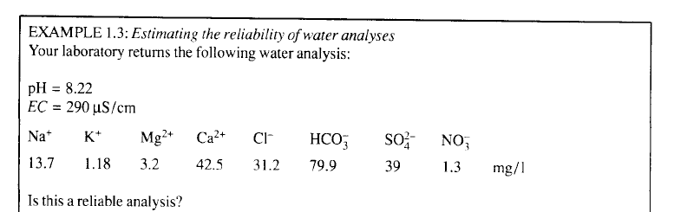
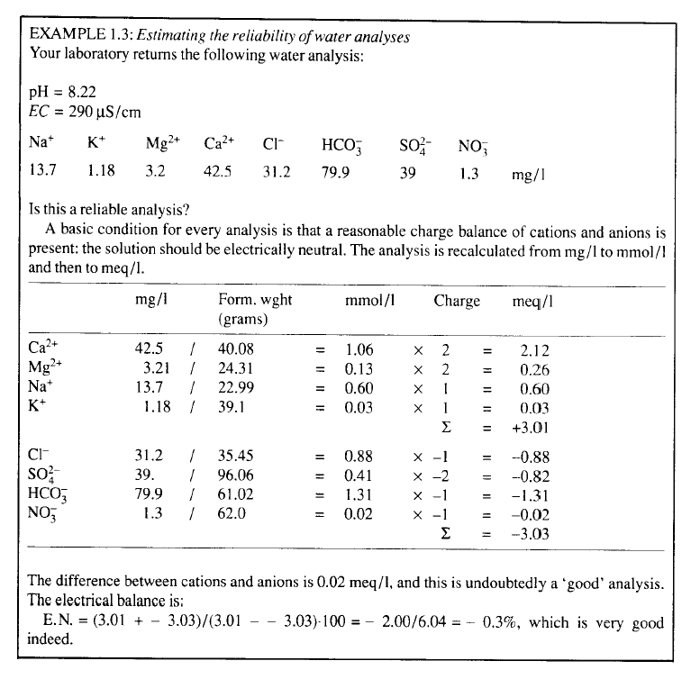

Slide 4
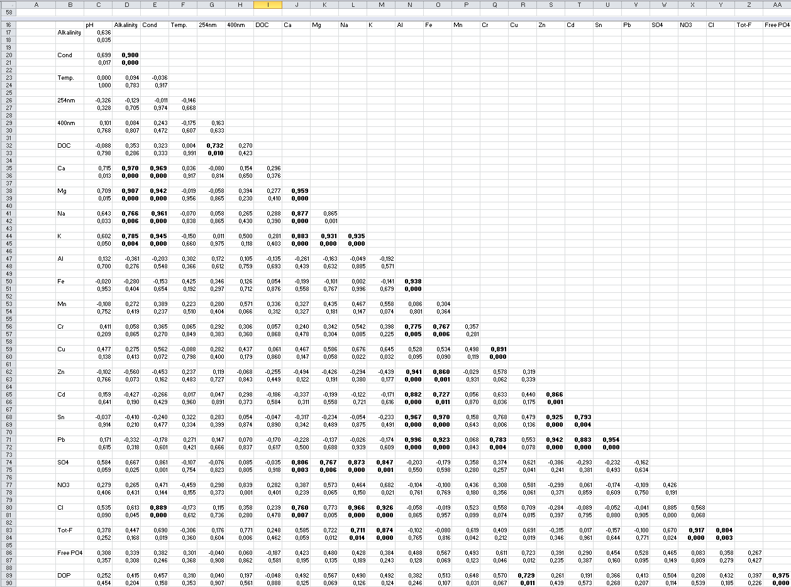
Statistical analysis
Correlation matrix
  Identify parameters that are directly correlated or
  co-variate

Slide 5
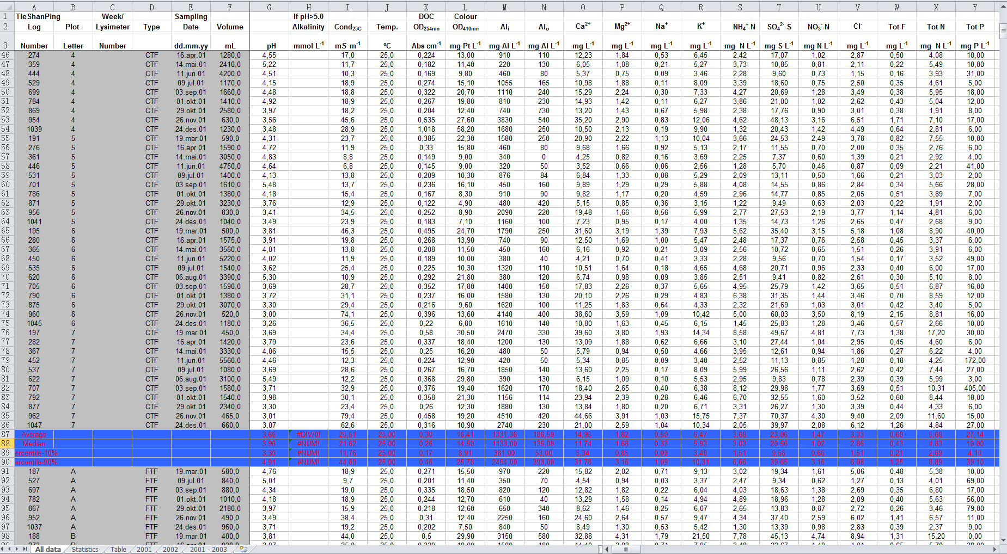
Multivariate statistics
How to interpret information in a data matrix of 1000 samples with typically 20 – 30 parameters

Slide 6
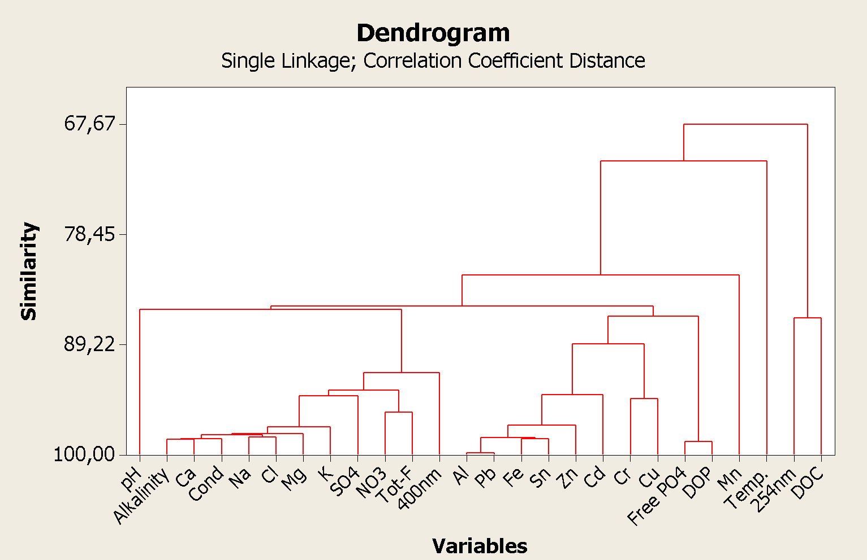
Cluster analysis
Organizing parameters that co-variate
in clusters
  Identify
    Links
    between groups
    of parameters
    Key
    variables
    General
    patterns
1
2
3

Slide 7
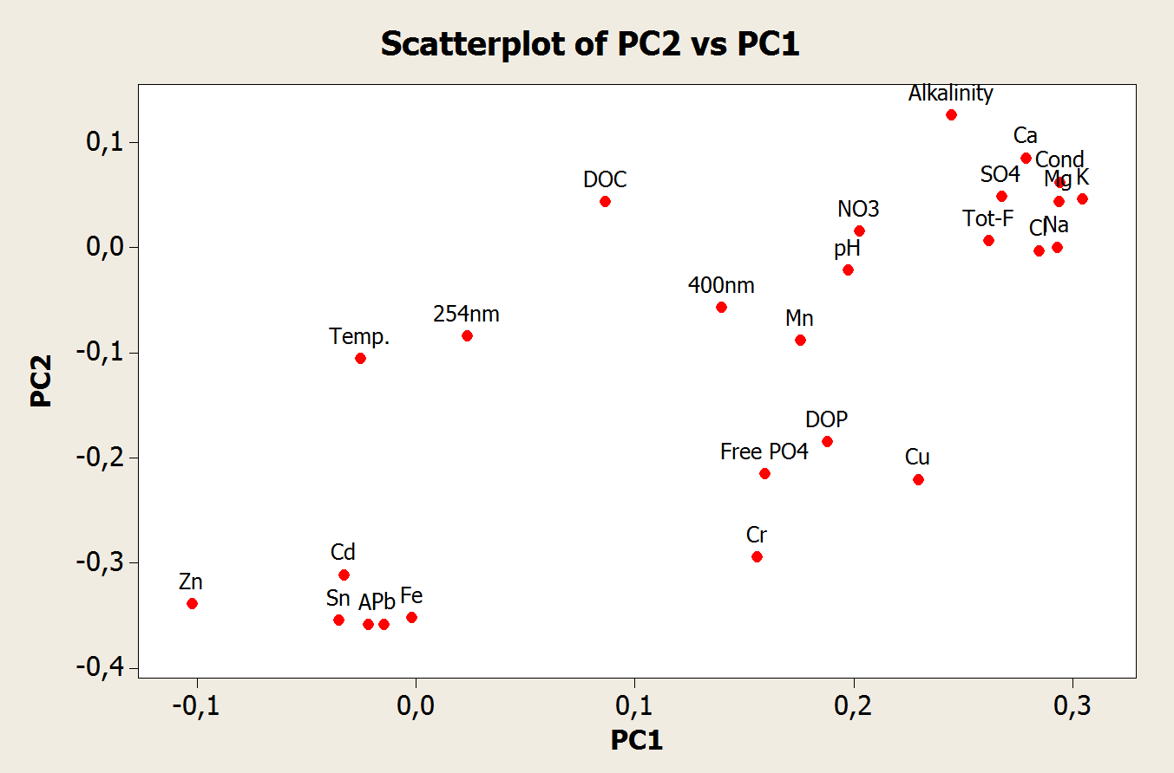
Principal Component Analysis
Makes an n-dimential graph of your
n parameters
Identifies the greatest variation in the swarm of data points and draws the PC1 through its axis.
Identifies the next PC perpendicular to the previous
Produce loading plots that are projections of the points to the PC plane
1
28.7%
3
2
40.0%

Slide 8
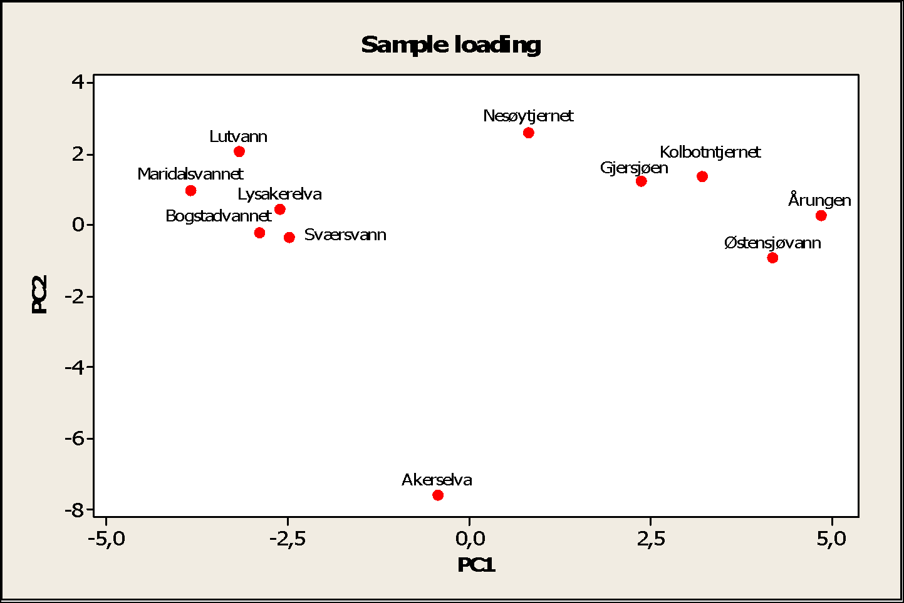
Degree of eutrophication
Degree of pollution

Slide 9
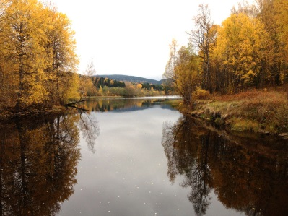
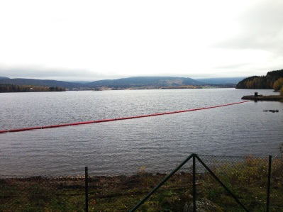
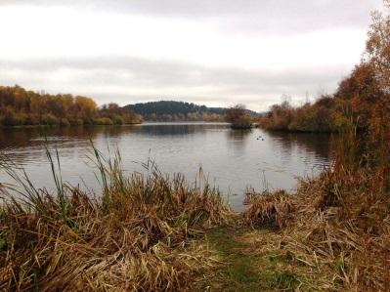
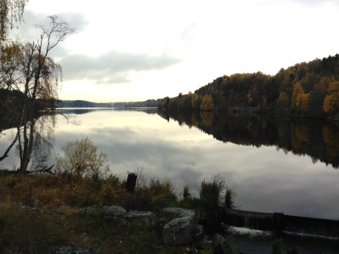
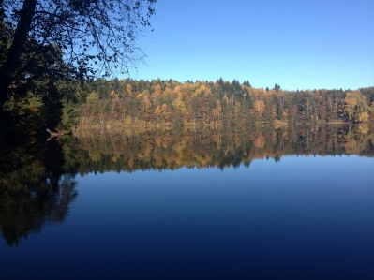
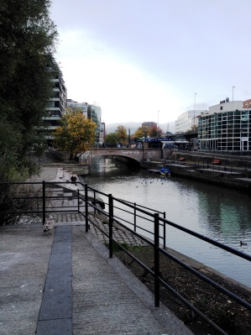
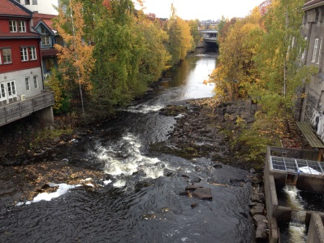
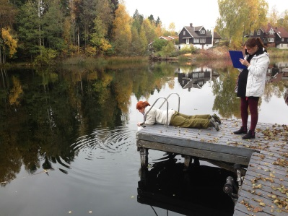
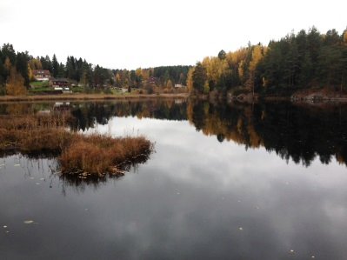
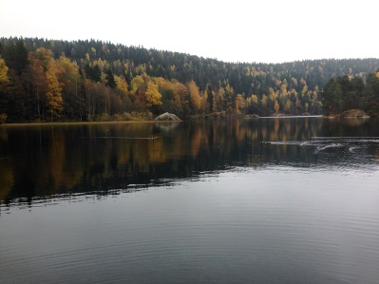

Slide 10
Challenges with simultaneous equilibrium
Speciation programs (MINEQL)

Slide 11
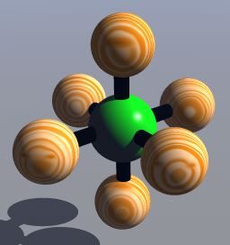
Inorganic complexes
Major cations in natural waters
  H⁺, Ca²⁺, Mg²⁺, Na⁺, K⁺
Common ligands in natural systems:
  OH⁻, HCO₃⁻, CO₃²⁻, Cl⁻, SO₄²⁻, F⁻ & organic anions
  In anoxic environment: HS⁻ & S²⁻
Dominating species in
aerobic freshwater
at pH 8 are:
Notes:
The table shows the % of the aqueous ligand relative to the sum of the M species
Free hydroxyl only at pH > 8 though cations of weak bases hydrolyse
Bicarbonate and carbonate only at pH>5
Significant amounts of F only where there is high conc. of Al

Slide 12
Hydrolysis
In aqueous systems, hydrolysis reactions are important
  Hydrolysis reactions are controlled by {H⁺}
    The higher the pH,
    the stronger the hydrolysis of metal cations
    E.g. Aluminium
        Al³⁺_{aq} denotes Al(H₂O)₆³⁺
Notes:
This is especially the case for amphoteric species
The hydrolysis is actually a removal of a proton as the more electronegative oxygen and central atom has taken the electron cloud.

Slide 13
Distribution of dissolved Fe³⁺ species
Two total Fe concentrations,
Fe_{T} = 10⁻⁴M and Fe_{T} = 10⁻²M
Distribution diagrams

Slide 14
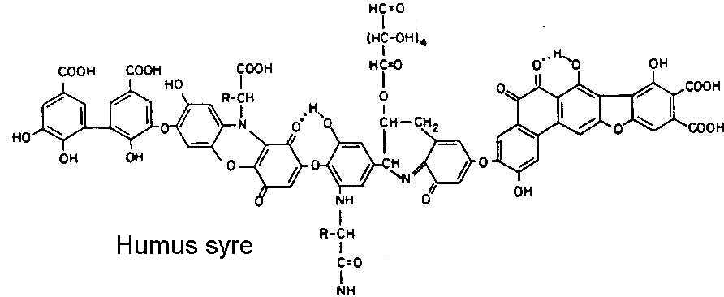
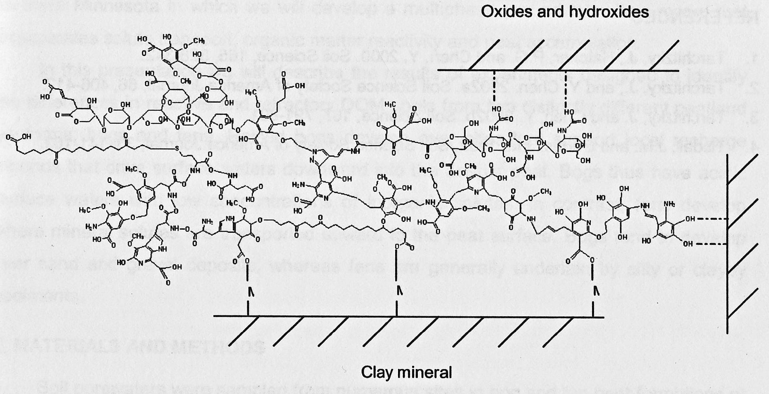
Dissolved Organic Matter
Low molecular weight (LMW)
  < 1000Da (e.g. C₃₂H₈₀O₃₃N₅P_{0.3})
  E.g.:
High molecular weight
  1000 - > 100 000Da
  Humic substance
    Very complex
    and coloured
    substances
Measured by
TOC/DOC
  Or by
  UV absorbency or
  colour
Notes:
Commonly 2-6 mg C/L
Secondary synthesis products of the decomposition of organic matter
No clear distinctions (boarders). Poorly defined
The colour is due to conjugated double bounds
Since the humic substances have multiple functional groups that may be used to complexbind metal ions . Such polydentate chelates are very stable (See Soil chemistry, slide 31).
Enhances the mobility of heavy (transition) metals (Cd, Ni, Co, Zn) and lipophilic micro pollutants
The amount of color increases in many parts of Northern Europe and North America

Slide 15
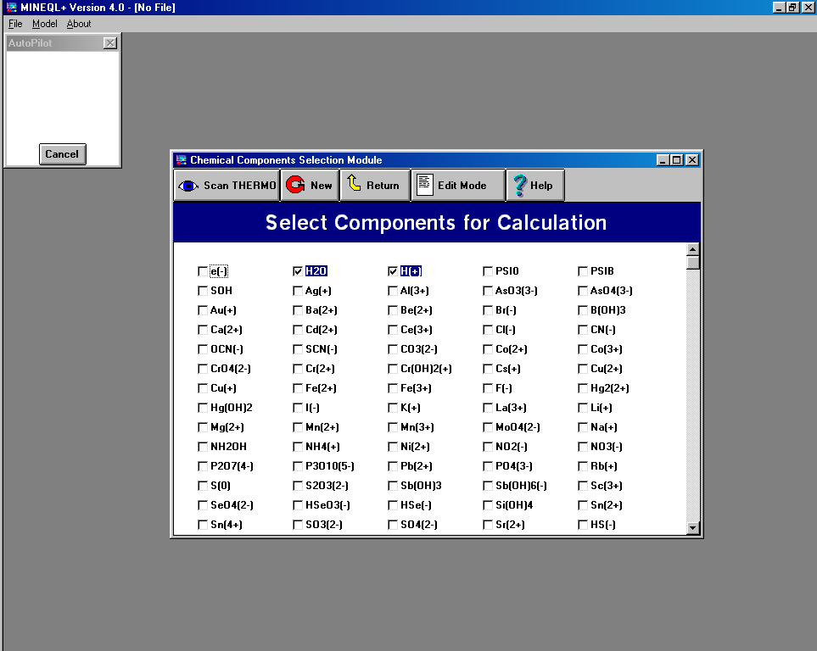
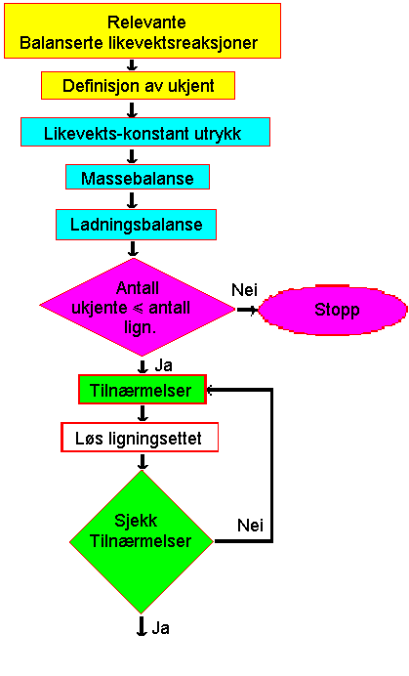
Speciation with different ligands present
In aqueous solution, containing a number of metal cations and
ligand anions, there are several simultaneous equilibriums
  Important ligands in natural water systems
    Basic: CO₃²⁻, OH⁻, Org⁻, Cl⁻
    Acid: F⁻, SO₄²⁻, Org⁻, Cl⁻
  The distribution of species will depend on factors such
  as ligand concentrations, temperature, pH and ionic strength
The calculations become very complex where a
metal cation have the opportunity to bind to more than
one type of ligands
  Multiple iterations of the calculations are necessary
For such calculations we apply computer programs as MINEQL+, ALCHEMI or PHREEQ-C
E.g. simple system with only Al³⁺ and F⁻
Notes:
In addition one needs to adjust the equilibrium constants for changes in temperature and ionic strength

Slide 16
Scheme for chemical equilibrium calculations
Relevant balanced equilibrium reactions
Definition of unknown
Equilibrium expressions
Mass balance
Charge balance
1
2 and 3
No of unknown <
No of equations
No
Stop
Approximations are commonly done by assuming the concentration of specific species are 0 Molar
  Only mass balance and charge balance equations can be simplified
Yes
Approximations
Solve equations
No
Are assumptions justified?
Yes

Slide 17
Set of expressions
Equilibrium expressions
  K_{W}, K_{SP}, K_{A}, K_{B}, β_{n}, K_{REDOX}, K_{d}
Mass (read: concentration) balance
  Set the equilibrium molarities (M_{X})
  up against each other (M_{X} vs. M_{Y}) and against the analytical molarity (M_{X} vs. c_{X})
    Analytical concentration is the concentration of a substance dumped into a solution. It includes all the forms of that substance in the solution.
Charge balance
  Σ eqv./L positive charge = Σ eqv./L negative charge

Slide 18
Equilibrium expressions
  K_{W}, K_{SP}, K_{A}, K_{B}, β_{n}, K_{REDOX}, K_{d}
Notes:
betta = Kompleksdannelses konstant
K_{d} = distribusjons konstant

Slide 19
2. Mass balance
Ex.1: BaSO₄ in HCl solution
  We see from the molecular formula
  that:
    So that:
    The hydroniumion (H⁺) has two sources:
    HCl (=c_{HCL}) and the auto-proteolysis of water (=[OH¯]):
Ex.2: Ag₂CrO₄ solution
  We see from the molecular formula that :
    So that :
Notes:
[X] = M_{x}= Likevektsmolaritet
c_{x} = Analytisk molaritet
[OH¯] tilsvarer mengden [H₃O⁺] fra vannets autoprotolyse
Det dannes 2 ganger så mange mol Ag⁺ som det dannes kromat slik at
2 x molariteten til kromat = molariteten til Ag⁺
Ikke bland aktivitet inn i massebalansen

Slide 20
3. Charge balance
The law of physics demand that
  Number of positive charge is
  equal to number of negative charge
    Charge contribution of a specie
    = Valens · Molar concentration
  Ex. 1:
        In neutral pH solutions one can disregard the
        H⁺ and OH⁻ ions
  Ex. 2:
  No new information
Notes:
Dette er noe annet enn å balansere ligningen
Eksemplene fra forrige side
I sure løsn. kan en se bort fra [OH¯]
I basiske løsn. kan en se bort fra [H⁺]
Ikke bland aktivitet inn i Ladningsbalansen

Slide 21
Metal hydrolysis
The hydrolysis is described by a set of equilibrium reactions
{Fe³⁺} is determined by replacing each of the other parts of the mass equation with their equilibrium expression with {Fe³⁺} :
  Then the other species can be determined from the {Fe³⁺} and β
  E.g.;
Notes:
Cations of weak bases hydrolyse in water
C= analytical conc.
In reality the Fe(OH)₃ would polymerize and precipitate

Slide 22

Speciation programmes
MINEQL+ is a chemical equilibrium model capable of calculating
  aqueous speciation
  solid phase saturation
  precipitation-dissolution
  adsorption.
An extensive thermodynamic database is included in the model

Slide 23
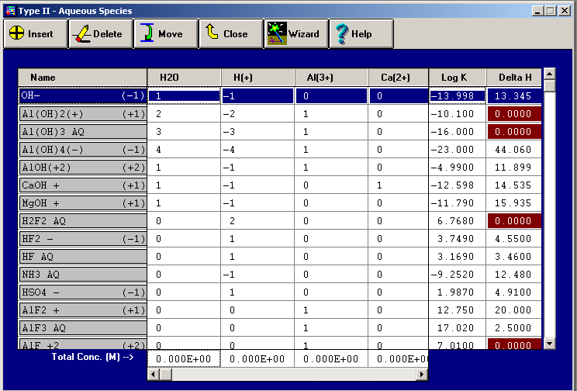
Speciation; Shortcomings
The equilibrium model is based on a choice of complexes and their stability constants,
which makes the results questionable

Slide 24
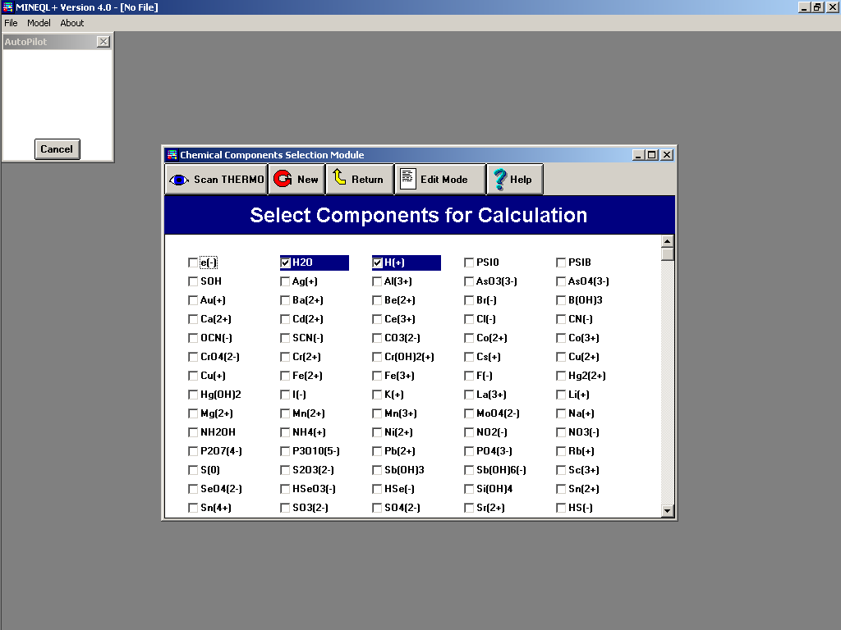
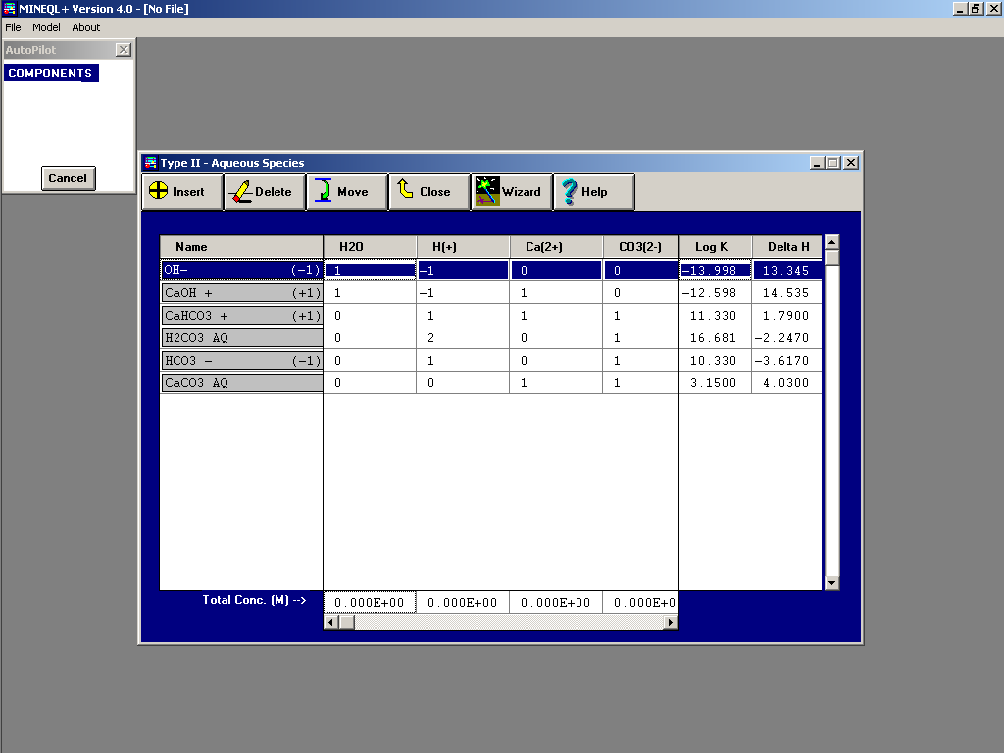
Tutorial
Start out by choosing components that define your system
Find thermodynamic constants in database in ”Scan Thermo”

Slide 25
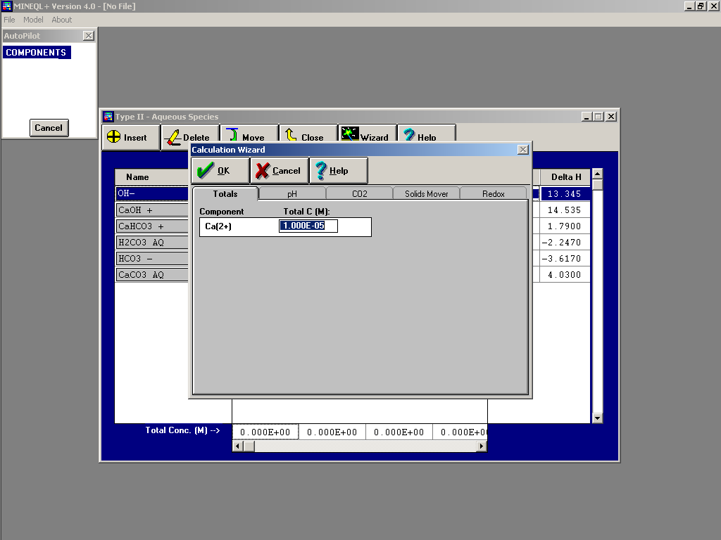
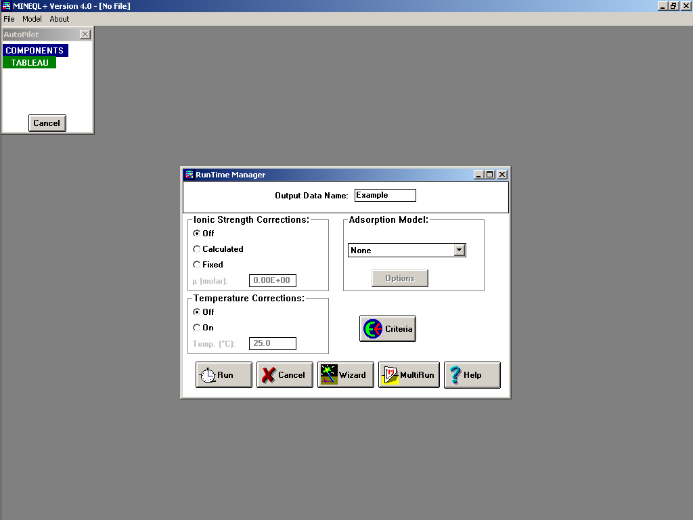
Tutorial
The Calculation Wizards Tool is a collection of 5 input options to describe the chemistry of the system
Running the calculation

Slide 26
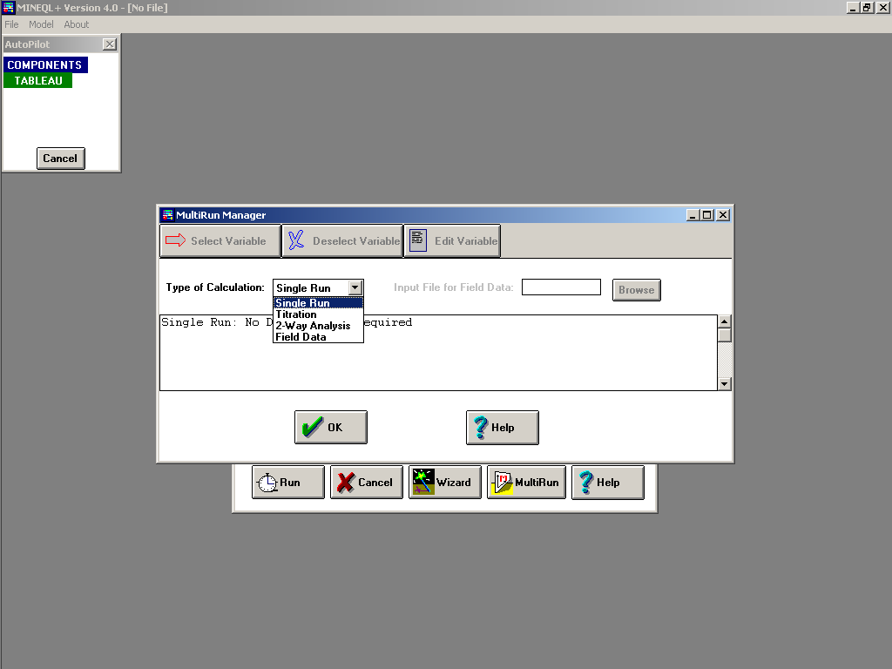
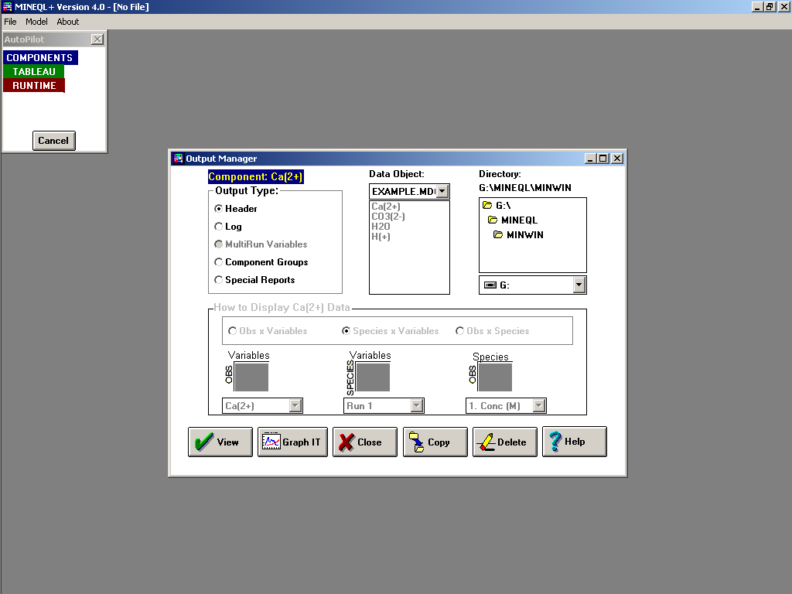
Tutorial
Multirun manager
  Titration
  2 way analysis
  Field data
Output manager
  Types of Output
    The Header
    The Log
    The MultiRun Table
    Component Groups
    Special Reports

Slide 27
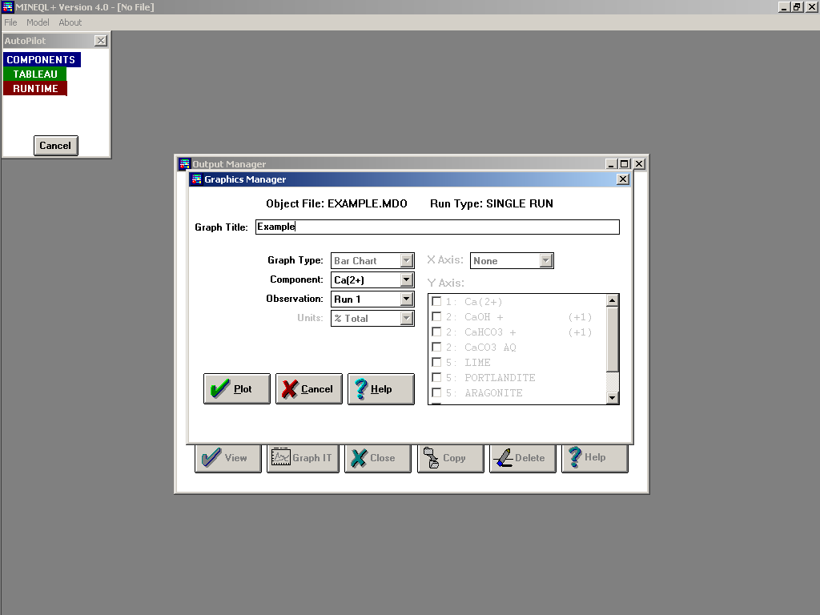
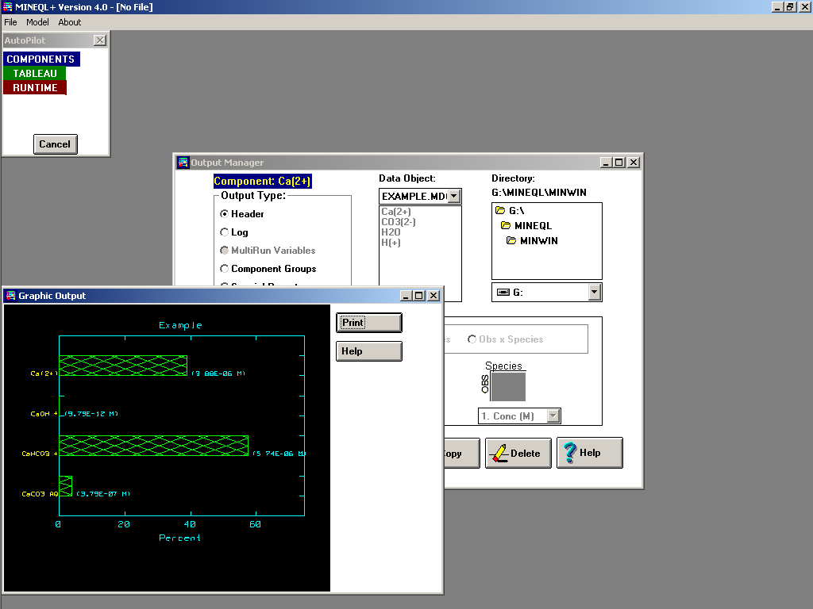
Tutorial
Graphics manager
  Bar and X-Y plots
Run through the 4 problems

Slide 28
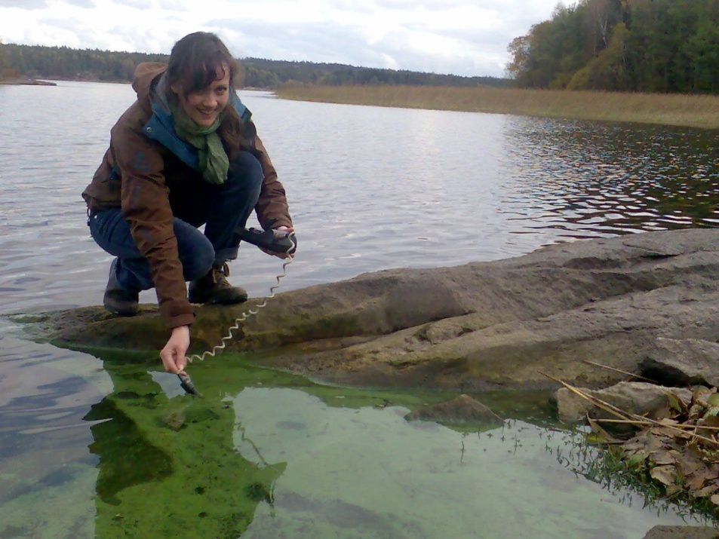
Report
The report (~ 3p) should include the following paragraphs
  Abstract
  Introduction
  Material and methods
  Results
  Discussion
  Conclusion

