Slide 1

Introduction to
Classification and labelling of mixtures
Tuesday 22. aug. 2017
09:15 – 12.00 and 13.15 – 15.00
Seminar room Berzelius, Chemistry building
Karoline Fægri og Svein Tveit, Skolelaboratoriet i kjemi

Slide 2
Competence aims
The aims of this course are to enable students to:
use the CLP-definitions in classification and labelling of mixtures
describe hazard communication in the form of labelling
produce labels for 3 % NaOH, 15 % HCl, 9 % NH₃ and 2 % CuSO₄
Notes:
Downstreams user?

Slide 3



HSE/HMS – authorities in Norway
 | Nature of hazards | Resposible authorities for HSE-laws and regulations
Health Helse | Health | Norwegian Labour Inspection Authority Arbeidstilsynet
Safety Sikkerhet | Physical | Norwegian Directorate for Civil Protection Direktoratet for samfunnssikkerhet og beredskap (DSB)
Environment Miljø | Environment | Norwegian Environment Agency Miljødirektoratet

Slide 4


About Regulation (EC) No 1272/2008 (CLP)
GHS | Global Harmonized System for classification and labelling of chemicals FNs globalt harmoniserte system for klassifisering og merking av kjemikalier
ECHA | European CHemicals Agency, responsible for implementing GHS in EU by establishing and updating an inventory for GHS substances Det europeiske kjemikaliebyrået ECHA har ansvar for å etablere og holde oppdatert et register over stoffers fareklassifisering og -merking.

Slide 5


About Regulation (EC) No 1272/2008 (CLP)
REACH | Regulation (EC) No 1907/2006 Registration, registrering Evaluation, vurdering Authorisation and Restriction, godkjenning og begrensning CHemicals, kjemikalier
CLP | Regulation (EC) No 1272/2008 Classification. klassifisering Labelling, merking Packaging of Substances and Mixtures, og emballering av stoffer og stoffblandinger

Slide 6

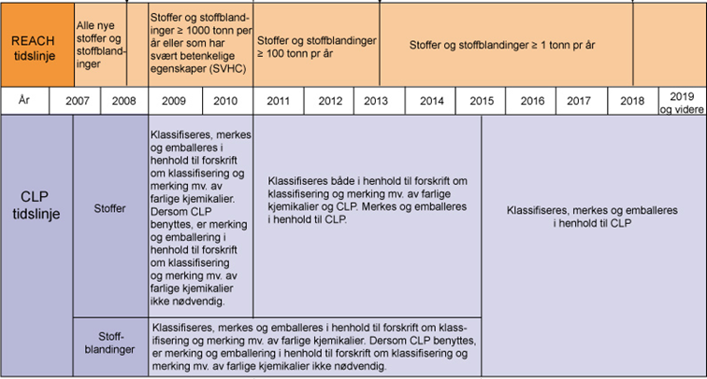
Timeline for implementing CLP
only CLP after
1. juni 2017
16. June 2012
CLP in Norway
1. December 2010
CLP in EU
Old labels and CLP until
1. June 2015
Kilde: http://www.miljodirektoratet.no/Global/dokumenter/tema/kjemikaler/reach_clp_tidslinje_800.jpg (august 2014)
Notes:
Forskrift om klassifisering, merking og emballering av stoffer og stoffblandinger (CLP) ble innført 16. juni 2012. Denne forskriften erstatter Forskrift om klassifisering, merking mv. av farlige kjemikalier (Merkeforskriften).
Skal sikre samme merking for lagring, omsetning og transport, over hele verden.

Slide 7
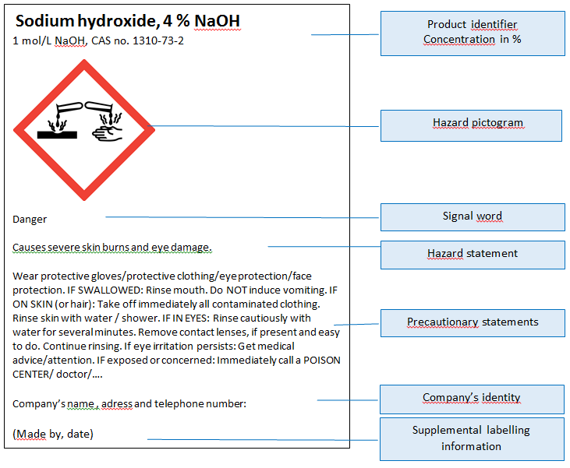
Hazard communication
Product identifier
Hazard pictogram
Signal word
Hazard statement
Precautionary
statement
Company identity

Slide 8
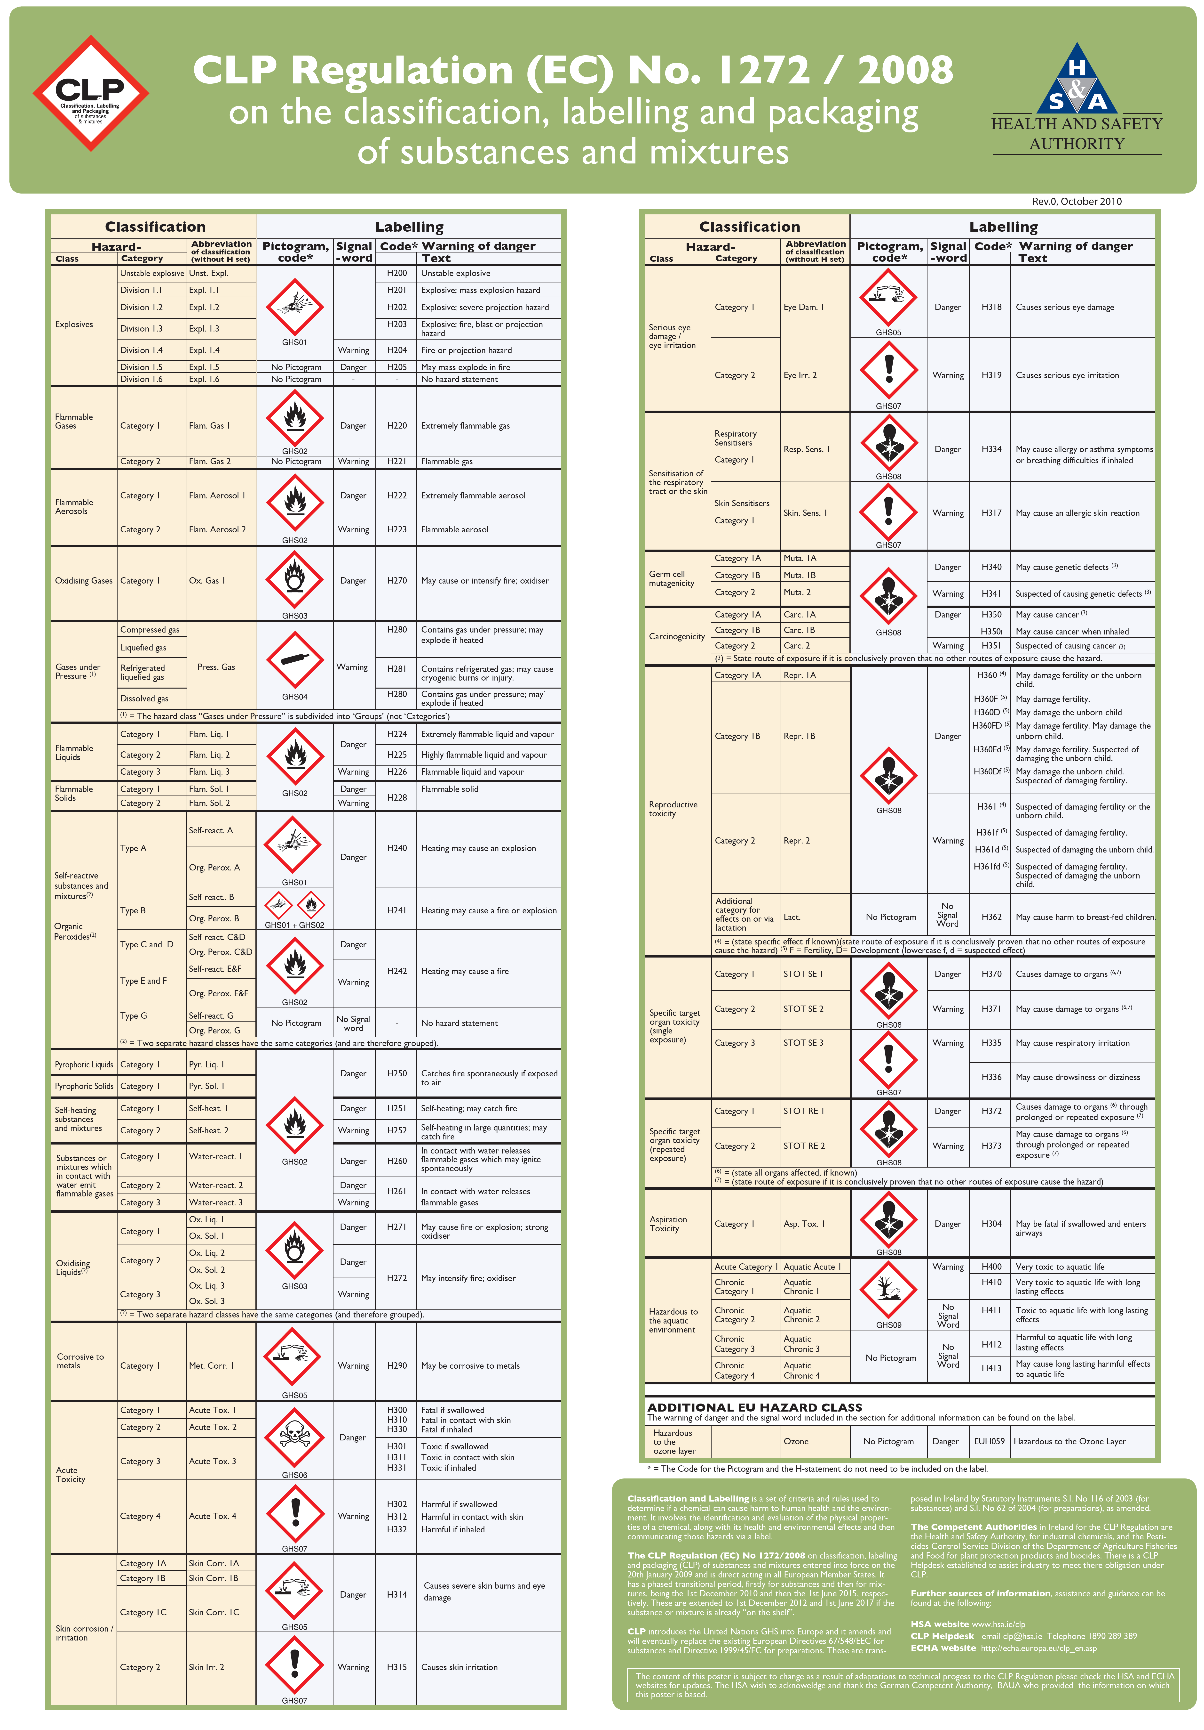
Guidance on Labelling and Packaging in accordance with Regulation (EC) No 1272/2008
The poster
English:
CLP Regulation
Norwegian:
Klassifisering og merking i CLP

Slide 9
Product identifier
Name and identification number given in the Classification and Labelling Inventory
if not included in C&L Inventory
CAS number and IUPAC name

Slide 10

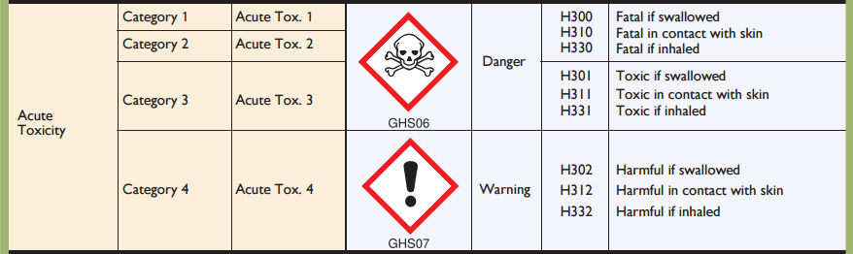
Hazard classes and categories

Slide 11
Hazard pictograms
Physical
Health
Environment

Slide 12
Signal words and hazard statements

Slide 13
Groups of hazard and precautionary statements
Code | hazard statements | Code | precautionary statements
H200-H299 | Physical | P100-P199 | General
H300-H399 | Health | P200-P299 | Prevention
H400-H499 | Environment | P300-P399 | Response
 |  | P400-P499 | Storage
 |  | P500-P599 | Disposal
EUH | only in the EU

Slide 14
Exercises - CLP
Label for 3 % NaOH in 1 L bottle

Slide 15
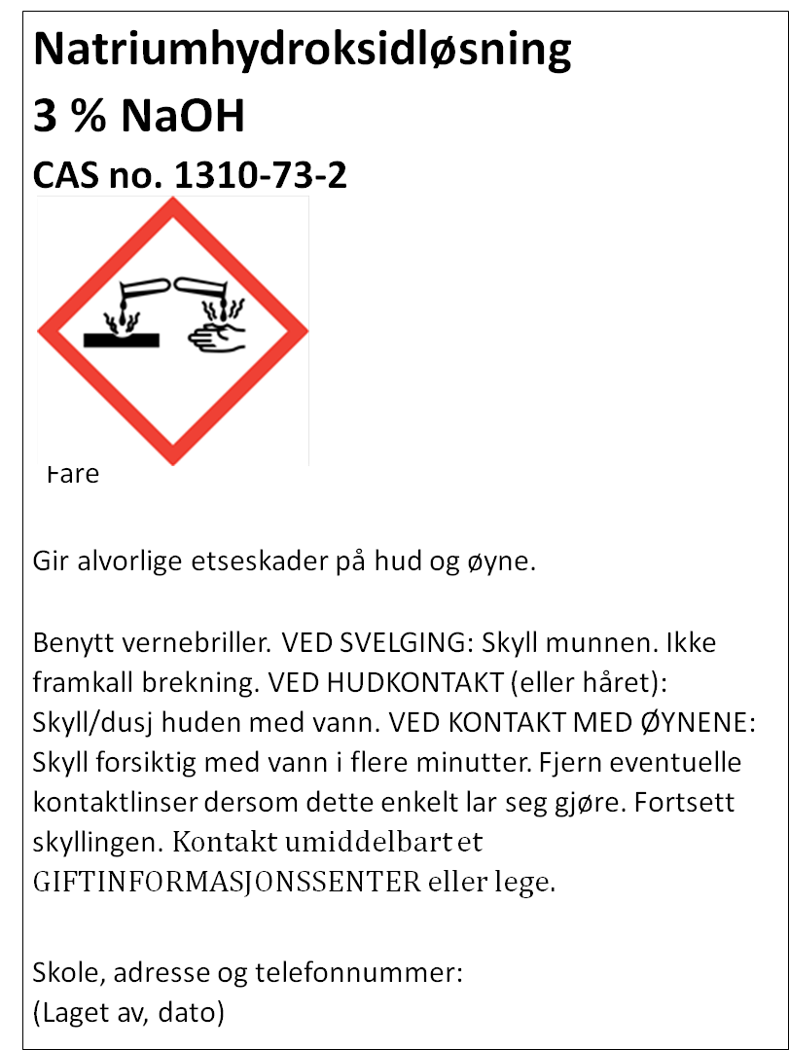
Fare

Slide 17
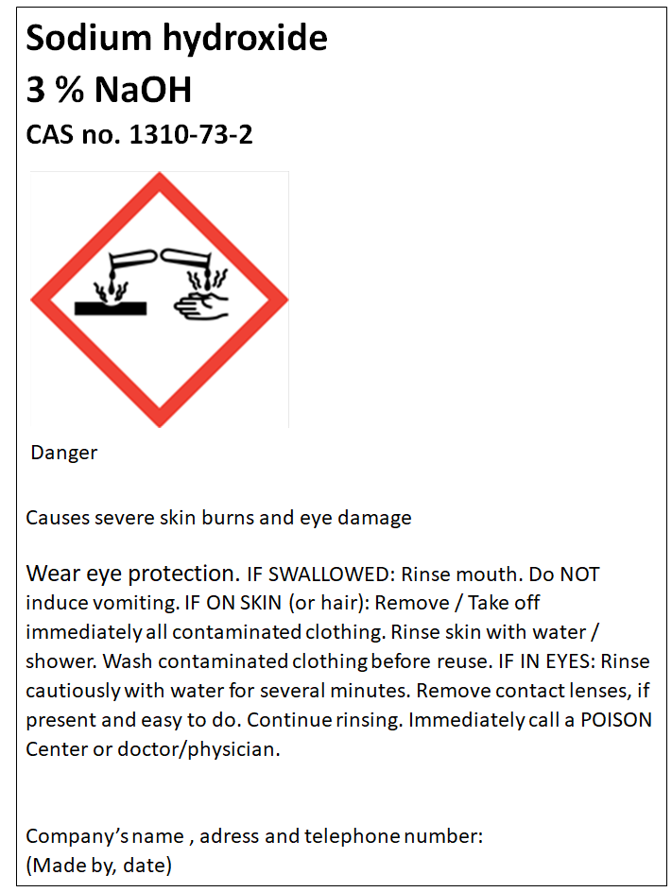

Slide 19
Exercises - CLP
2. Label for 15 % HCl in 1 L bottle

Slide 20
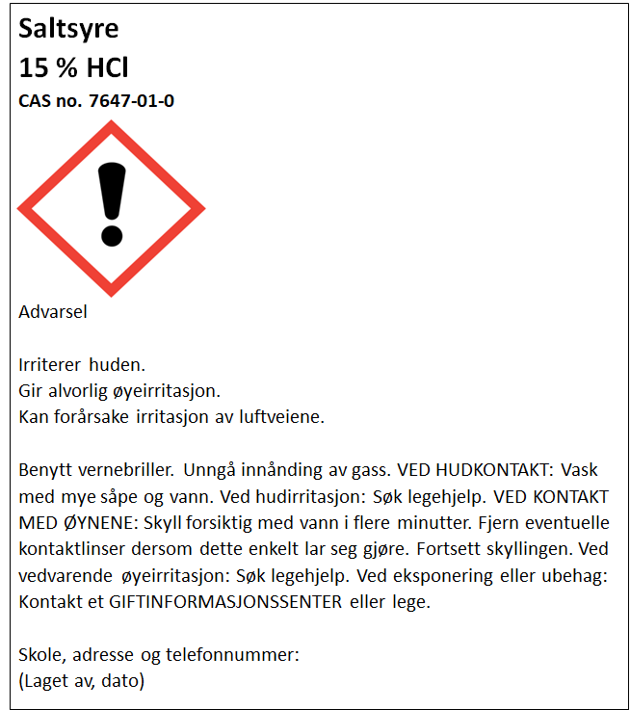

Slide 22
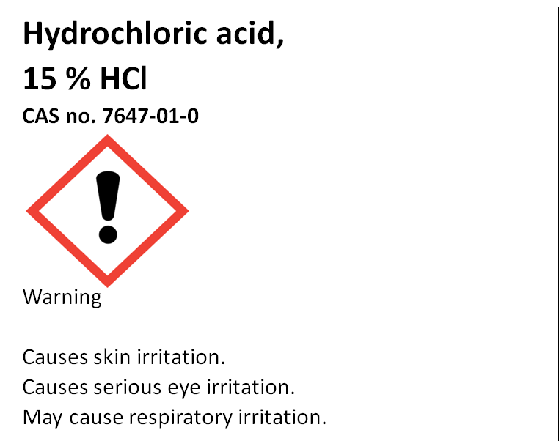

Slide 23
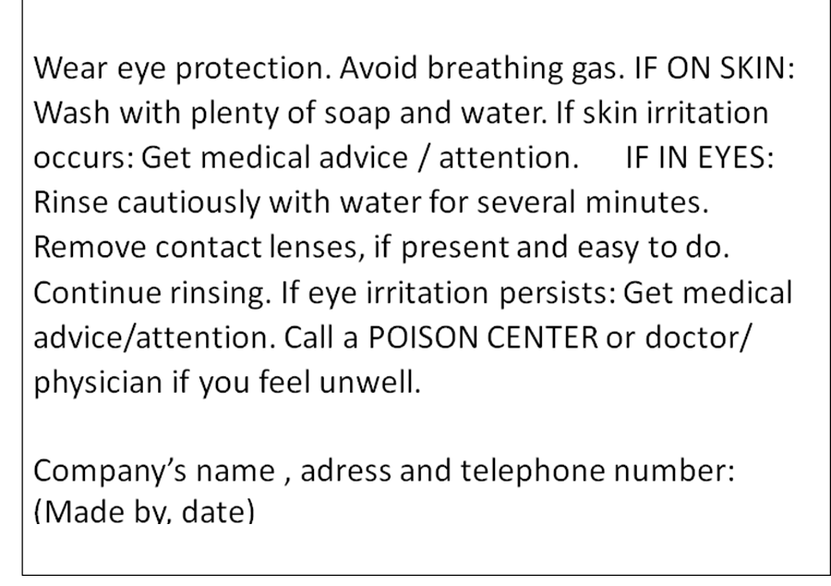

Slide 24

Labelling with only hazard pictogram and signal word
Exeptions for some hazard classes where the contents do not exceed 125 mL (see booklet)
Hydrochloric acid,
15 % HCl
Warning
Company’s name , adress and telephone number:
(Made by, date)
Saltsyre
15 % HCl
Advarsel
Skole, adresse og telefonnummer:
(Laget av, dato)

Slide 25
Concentration limits
Specific concentration limits and Generic concentration limits

Slide 26
Classification for acute or chronic aquatic hazard
L(E)C₅₀ from SDS
Product name Ammonia
SECTION 12: Ecological information
12.1. Toxicity
Acute aquatic, fish: Value: x mg/l, Method of testing: LC50 (Not ionized freshwater), Duration: 96h
Acute aquatic, Daphnia: Value: y mg/m³, Method of testing: LC50 (Freshwater), Duration: 96 h

Slide 27
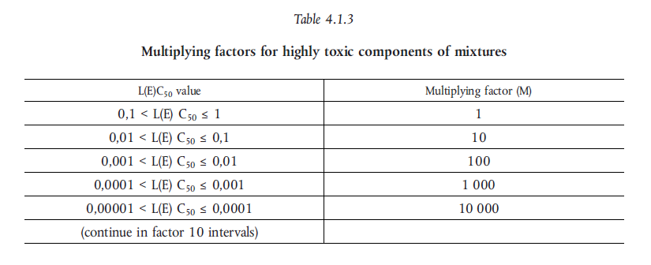
M - factor

Slide 28
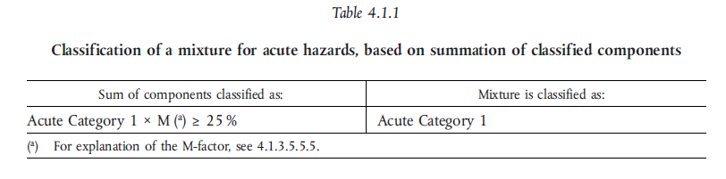
Classification – Aquatic acute

Slide 29
Exercises - CLP
3. Label for 9 % NH₃ in 1L bottle

Slide 30
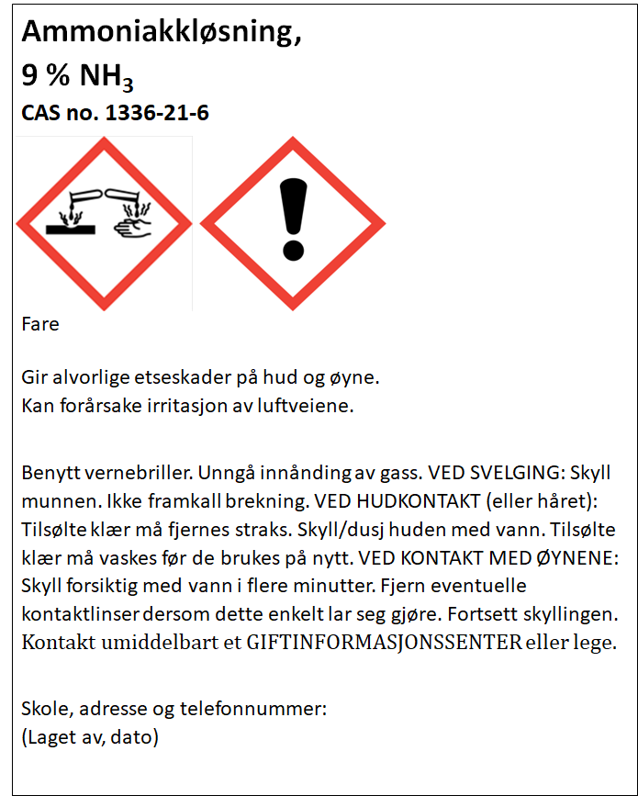

Slide 32
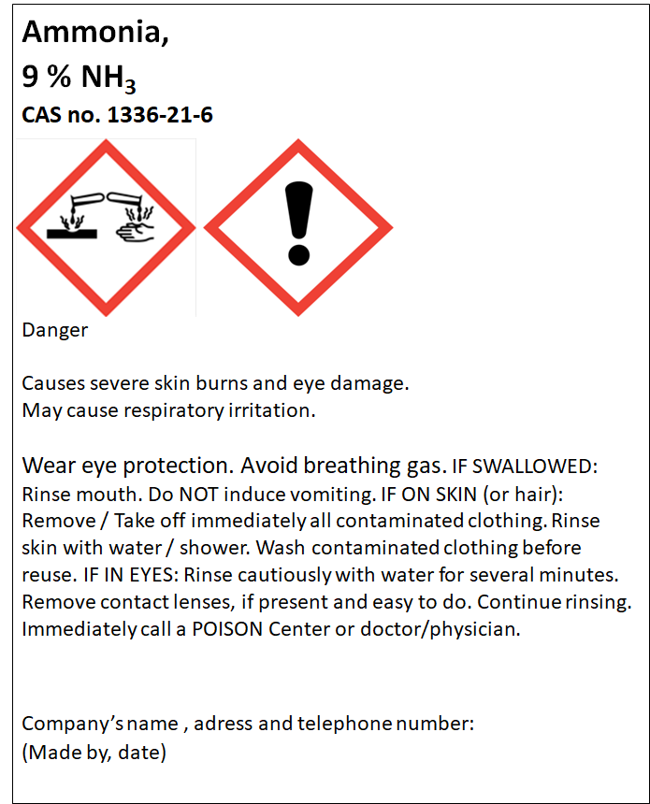

Slide 34
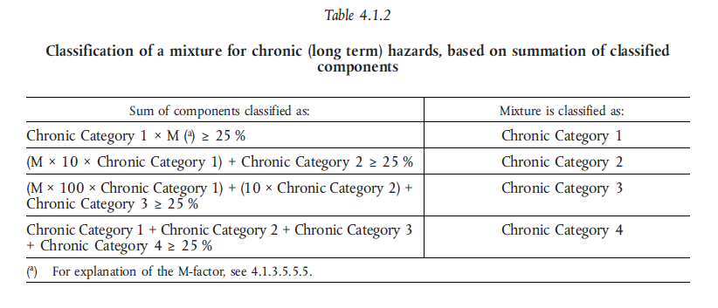
Classification – Aquatic chronic

Slide 35


Classification – Acute toxicity
ATE = Acute toxicity estimate

Slide 36
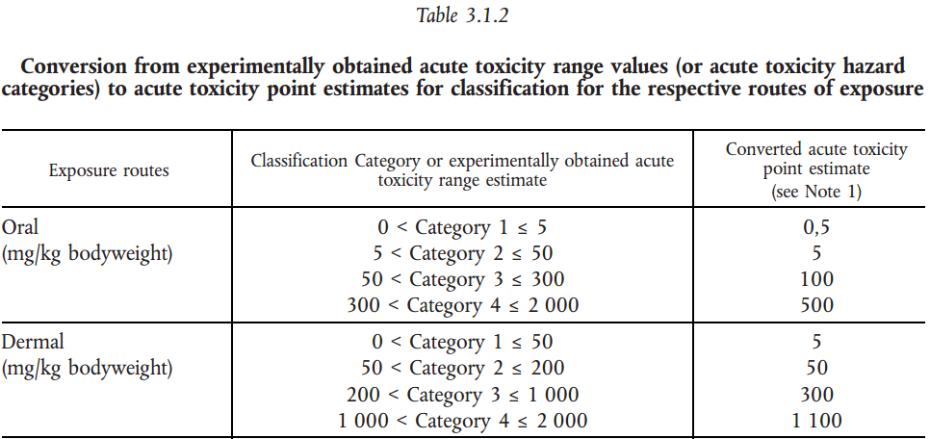

Acute toxicity
Example
A 5 % solution of a substance classified as acute tox. 3 – oral exposure
$${ATE}_{mix}=\frac{100∗{ATE}_{i}}{c_{i}}=\frac{100∗100}{5}=2000$$

Slide 37
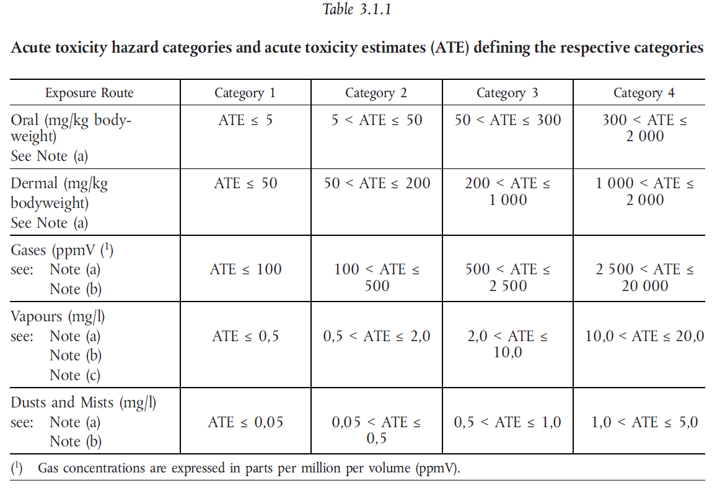

Slide 38
Acute toxicity
Example
A 5 % solution of a substance classified as acute tox. 3 – oral exposure
$${ATE}_{mix}=\frac{100∗{ATE}_{i}}{c_{i}}=\frac{100∗100}{5}=2000$$

Slide 39
Exercises - CLP
4. Label for 2 % CuSO₄ in 1 L bottle

Slide 40

Kobber(II)sulfatløsning,
2 % CuSO₄
CAS no. 7758-98-7
Giftig, med langtidsvirkning, for liv i vann.
Unngå utslipp til miljøet. Samle opp spill
Skole, adresse og telefonnummer:
(Laget av, dato)

Slide 41
copper(II)sulphate ,
2 % CuSO₄
CAS no. 7758-98-7
Toxic to aquatic life with long lasting effects.
Avoid release to the environment. Collect spillage.
Company’s name , adress and telephone number:
(Made by, date)

Slide 42
Labelling with only hazard pictogram and signal word
Exeptions for some hazard classes where the contents do not exceed 125 mL (see booklet).
Kobber(II)sulfatløsning,
2 % CuSO₄
Skole, adresse og telefonnummer:
(Laget av, dato)
copper(II)sulphate
2 % CuSO₄
Company’s name , adress and telephone number:
(Made by, date)

Slide 43
Exercise - CLP (optional)
5. Wich concentration of a nickel(II)sulfate solution is the lowest that will trigger any classification of the solution as hazardous according to the CLP regulation?
(see next slide)

Slide 44
Hazard class | To determine the classification of the mixture | Concentration limit for the mixture to be classified as hazardous
Acute Tox. 4;H302 | Oral | 25 %
Skin irrit. 2;H315 | Specific concentration limit C ≥ 20 % | 20 %
Skin Sens. 1;H317 | Specific concentration limit C ≥ 0,01 % | 0,01 %
Acute Tox. 4;H332 | Dust/mist | 30 %
Resp. Sens. 1;H334 | Generic concentration limit C ≥ 1,0 % - table 3.4.3 in the CLP regulation | 1 %
Muta. 2;H341 | Generic concentration limit C ≥ 1,0 % - table 3.5.2 in the CLP regulation | 1 %
Carc. 1A;H350i | Generic concentration limit C ≥ 0,1 % - table 3.6.2 in the CLP regulation | 0,1 %
Repr. 1B;H360D | Generisk konsentrasjonsgrense C ≥ 0,3 % - table 3.7.2 in the CLP regulation | 0,3 %
STOT RE 1;H372 | Specific concentration limit C ≥ 1 % | 1 %
STOT RE 2;H373 | Specific concentration limit 0,1 % ≤ C ≤ 1% | 0,1 %
Aquatic Acute 1 | ˂ 25 % ∙ 1(M) ˂ 25 % | 25 %
Aquatic Chronic 1 | ˂ 0,25 % ∙ 1 (M) ∙ 100 ˂ 25 % | 0,25 %

Slide 45
Harmonised classification
Harmonised classification (as provided in Annex VI to CLP), must always be used by a manufacturer
Harmonised classification normally applies to those properties of the highest concern
Where some, but not all hazard classes or differentiations within hazard classes have been harmonised, the remainder should be self-classified to complete the classification
Guidance on the Application of the CLP Criteria

Slide 46
Leads to different classification for the same mixture
Ammonia 25 % (Avantor)
Skin corrosion 1B
Aquatic acute, 1
STOT, SE, 3
Serious eyedamage, 1
Aquatic chronic, 2
Ammonia 25 % (Merck)
Skin corrosion, 1B
Aquatic acute, 1
STOT, SE, 3
Corrosive to metals, 1

Slide 47
CLP in scientific research
This Regulation (CLP) shall not apply to the following:
substances and mixtures for scientific research and development, which are not placed on the market, provided they are used under controlled conditions in accordance with Community workplace and environmental legislation.
http://eur-lex.europa.eu/LexUriServ/LexUriServ.do?uri=OJ:L:2008:353:0001:1355:en:PDF
Title 1, Article 1, 2d

Slide 48
How to label mixtures in your science lab
Mixtures that are to be use the same day do not require any labelling
Mixtures that are left over night requires a minimum labelling of:
  Name and molar concentration
  Hazard pictograms
  Hazard statements
  (Highly relevant precautionairy statements)

