Slide 1
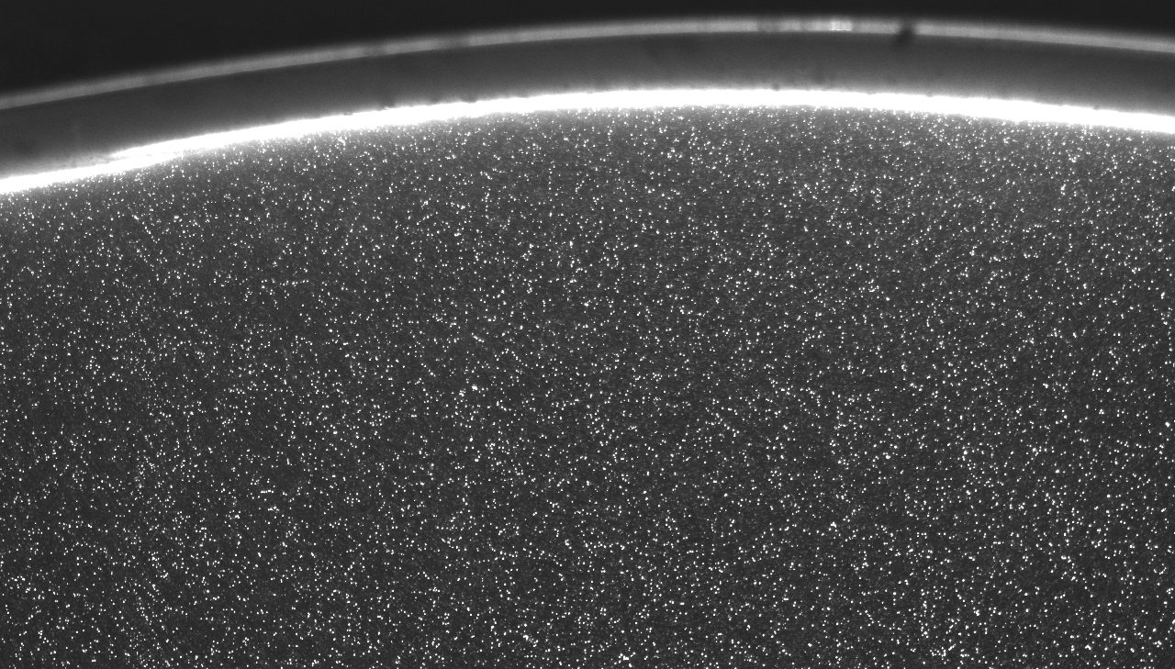
MEK400 – Experimental methods in fluid mechanics
Introduction to Particle Image Velocimetry (PIV)
26.2.2013
J. Kristian Sveen (IFE/FACE/UiO)

Slide 2
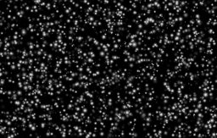
This presentation looks at how to use pattern matching to measure velocities
Pattern matching in PIV
Challenges – solutions
Laboratory application
  Seeding,
  illumination,
  imaging

Slide 3
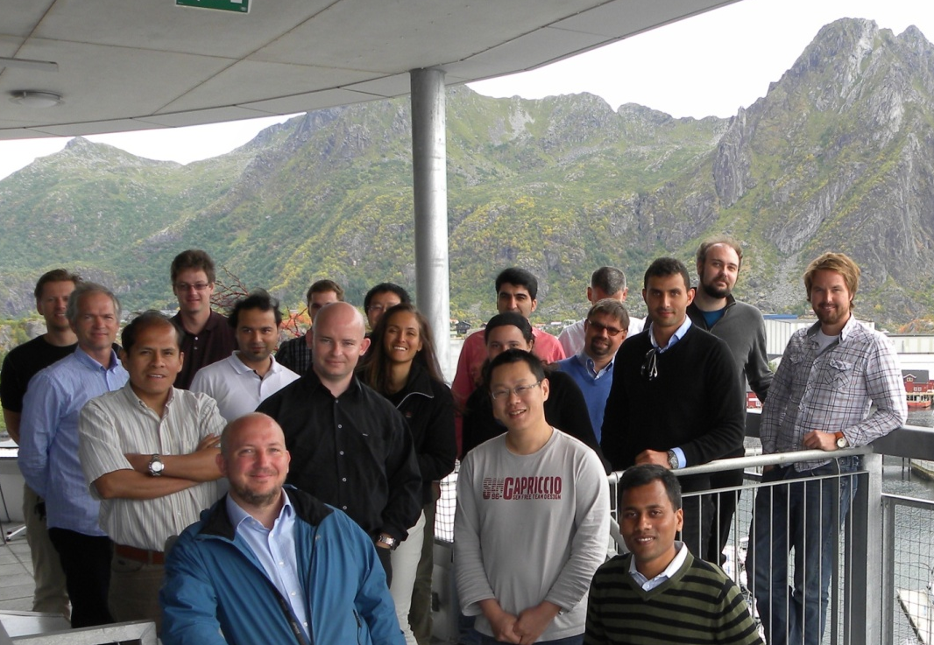
The human brain is great at matching patterns
Computers perhaps a little less great

Slide 4
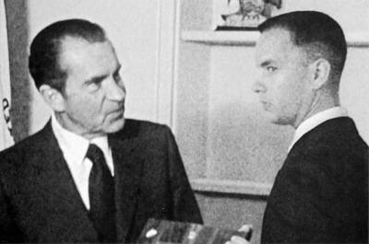

Pattern matching in everyday applications
Locating a face in an image
Identifying a number plate on a car
Finding motion of random patterns

Slide 5
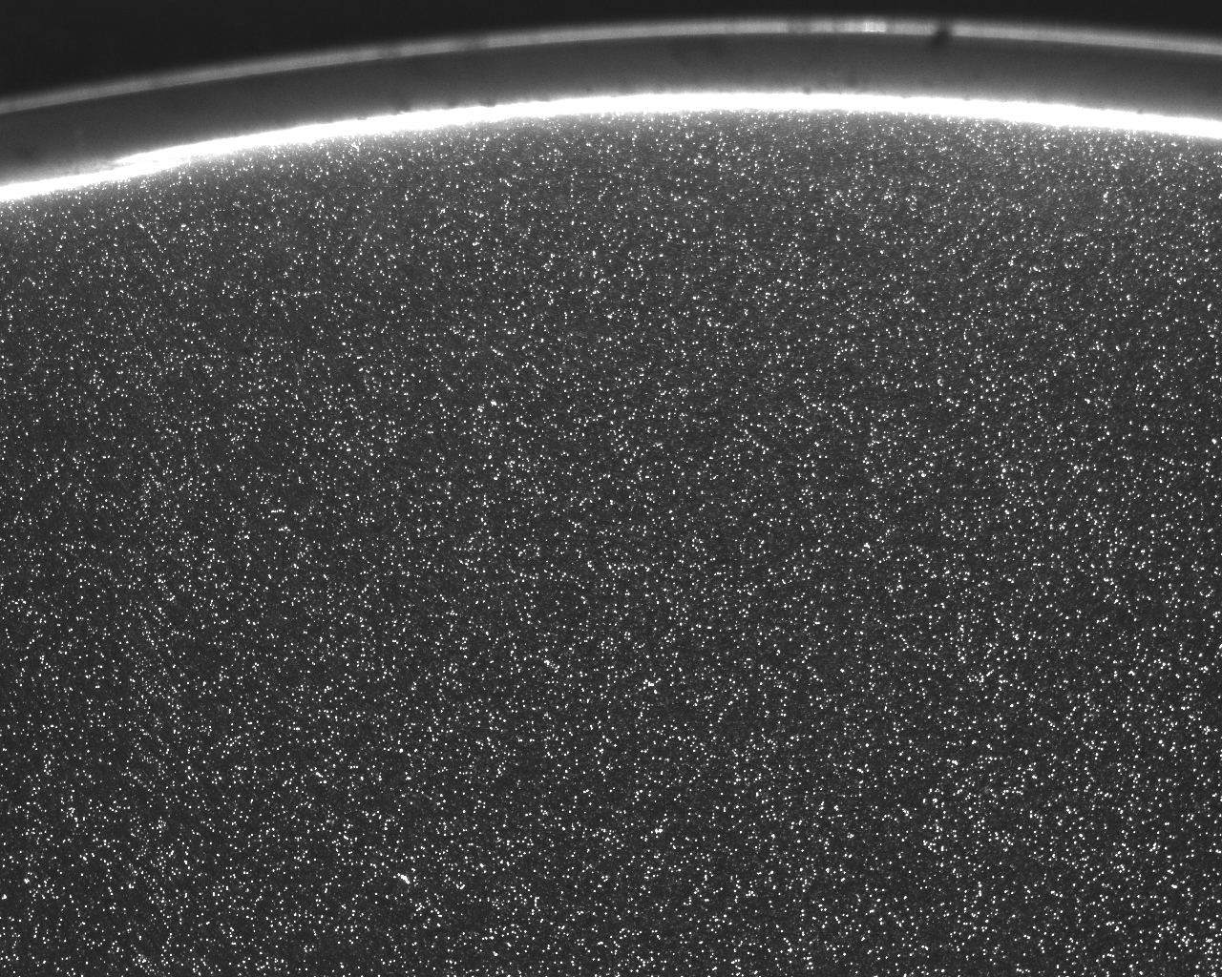
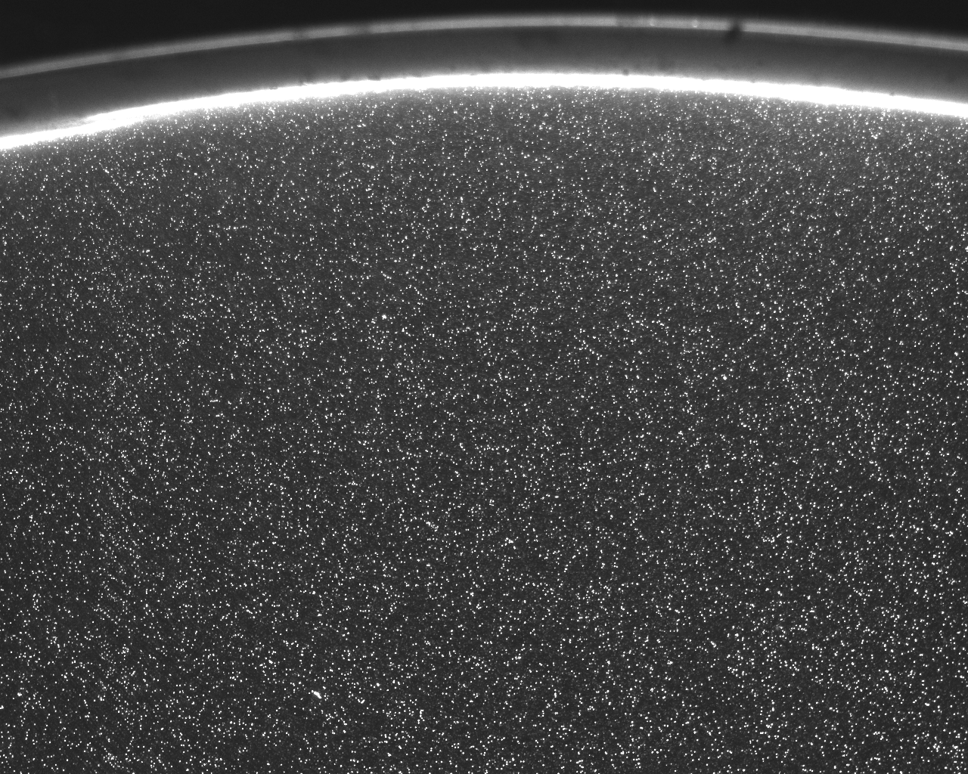
Pattern matching in PIV
Two consecutive images with known time spacing
Match pattern locally between corresponding grid cells
Divide into grid

Slide 6
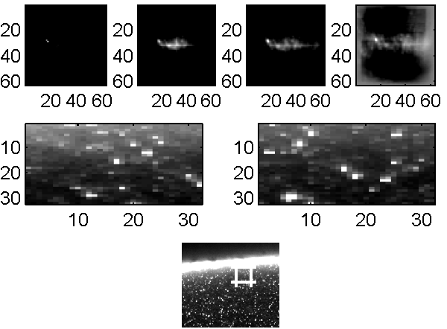
Pattern matching principles is the foundation for PIV
t₁
t₂

Slide 7
The principle of Pattern Matching in PIV is to measure similarity of a local pattern in two subsequent images
Distance Metrics:
In which overlapping position are two images
  The most alike?
  The least different?
(any) introductory book on image processing will point to
CROSS CORRELATION:

Slide 8
Cross correlation is a simple measure of similarity
For each sub-window pair
overlay sub-windows in all possible combinations
Matlab example (corrshifter.m)

Slide 9
Cross correlation may easily be calculated using FFT’s
Correlation theorem (look it up)
Sensitive to:
Amplitude change
Background gradients
Finite images (edge effects)
…

Slide 10
Sensitivity of cross correlation to image features
Amplitude – What happens if intensity in f is doubled from t₁ to t₂?
Background – What happens if background is non-zero and non-uniform?

Slide 11
Removing effects of background
Subtract background from f and g before calculating correlation
Correlation signal including background
Correlation signal with background removed

Slide 12
Normalization of correlation signal
Assuming means have been subtracted
Common simplification assumes evenly distributed pattern (standard deviation does not change locally):

Slide 13
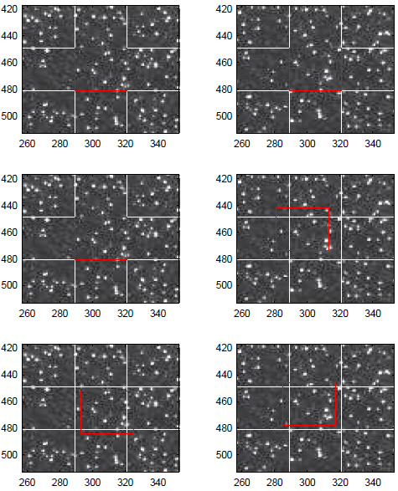
Correcting for loss of pattern
If pattern moves “many pixels” between frames information is lost
Only a part of the window (pattern) contributes to correlation signal
Same applies for large velocity differences across windows
Leads to a bias towards smaller values (see Westerweel, 1993)
Use window shifting to improve correlation

Slide 14
Sub-pixel displacement estimation
By interpolating the peak in the correlation plane, sub-pixel accuracy may be achieved.

Slide 15
Peak interpolation
3 common interpolation schemes
  Center of mass
  Parabolic fit
  Gaussian fit
R₀
R₋₁
R₊₁

Slide 16
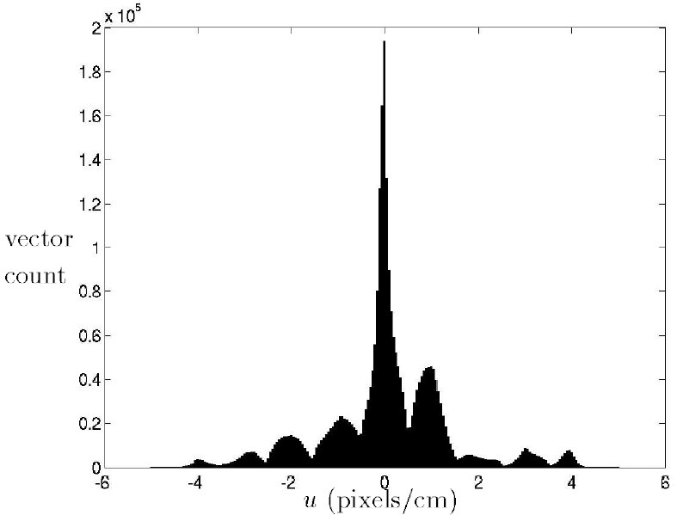
When the peak becomes narrow, sub-pixel resolution may be lost
May lead to “peak-locking”
-only the central lobe contributes

Slide 17
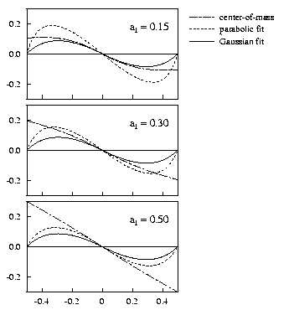
Also the interpolation scheme may contribute to peak locking
The traditional solution is to use sub-pixel window shifting
Requires substantial image interpolation and iteration
error

Slide 18

What happens in regions with background gradients?
Standard FFT based correlation
Background gradients have huge influence on result

Slide 19
Our image example
Our standard FFT based correlation
The correct peak
…a few other correlation functions

Slide 20
Vector validation
Our vector field…
Clearly some vectors are wrong?
How do we determine this?

Slide 21
Vector validation
– global view
Identify vectors that are significantly different from average
plot u vs v
Drawback: if mean is used, faulty vectors contribute to the mean

Slide 22
Vector validation
– local view
Use smaller regions for comparison
If vector is significantly different from 8 or 24 neighbors – it may be discarded
Use mean or median:
Median safer – less likely to be biased by the faulty vector(s)

Slide 23
Vector validation
– signal to noise ratio
Compare peak height to second highest peak in correlation plane
Quality of signal compared to level of noise
Often also referred to as a detectability measure

Slide 24
“Alternative” correlation functions
Often referred to as “Distance metrics”
Minimum quadratic difference (Gui&Merzkirch,2000):
Recognise this?

Slide 25
“Alternative” correlation functions
Normalised correlation is often a better choice over standard FFT based correlation since it handles pattern variation better

Slide 26
“Alternative” correlation functions
Looking back at the FFT based correlation:
If amplitude variations hamper the precision – is it possible to reduce the effect by, say, using Phase correlations?
Removing the amplitude works, but we loose precision

Slide 27
Phase correlations in PIV
Phase correlations have been applied in PIV by several authors due to robustness to noise
Use as a first iteration step
Phase corr
mqd

Slide 28
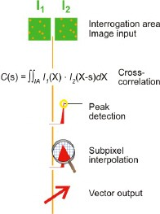
A short summary

Slide 29
PIV in the laboratory

Slide 30
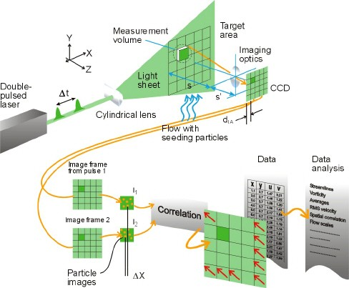
The practical aspects of PIV
So far: software principles
Next: what we do in the laboratory
From www.dantecdynamics.com

Slide 31
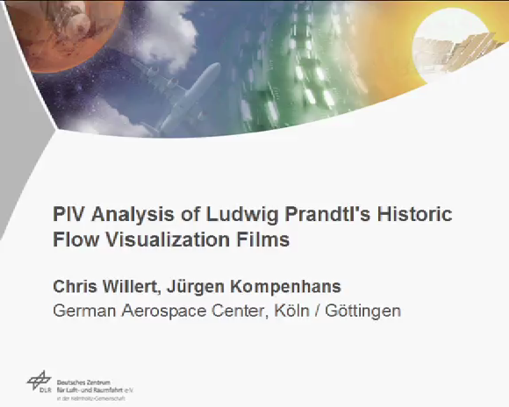
Seeding of flow
For pattern matching to work, we need
A pattern
Images of the pattern
Ludwig Prandtl used particles in visualization experiments in the 1920’s and 1930’s
- Small aluminum particles
See www.dlr.de

Slide 32
Types of seeding material
 | PSP Polyamide seeding particles | HGS Hollow glass spheres | S-HGS Silver-coated hollow glass spheres | FPP Fluorescent polymer particles
Mean particle size (µm) | 5, 20, 50 | 10 | 10 | 10, 30
Size distribution | 1 - 10 µm 5 - 35 µm 30 - 70 µm | 2 - 20 µm | 2 - 20 µm | 1 - 20 µm 20 - 50 µm
Particle shape | non-spherical but round | spherical | spherical | spherical
Density (g/cm3) | 1.03 | 1.1 | 1.4 | 1.19
Melting point (°C) | 175 | 740 | 740 | 125
Refractive index | 1.5 | 1.52 | — | 1.479
Material | Polyamide 12 | Borosilicate glass | Borosilicate glass | Poly (Methyl methacrylate)(Labeled with Rhodium B)
Requirement: passive tracers that follow the flow
Dust, smoke, aerosols, dirt, pollen, chemicals
- Anything that forms a pattern

Slide 33
Size of seeding particles
From the software side: particles need to cover more than ~2.35 pixels (diameter) to limit peak-locking errors
From the experimental side: how closely does the particle velocity V follow the fluid velocity v?
Compare slip velocity |v-V| to stokes drag on a sphere

Slide 34
Particle sizes
T=5-10s, ν=10⁻⁶, R=0.5mm
0.5-1% error

Slide 35
Imaging
We need to accurately acquire two consecutive images with a known time spacing
With a 10cmx10cm imaging area (Field of View), imaged by a camera with 1000x1000 pixels, implies 100 pixels per centimetre.
A flow of just 10cm/second = 1000 pixels per second
To recover this in a 32x32 interrogation window, the pattern should ideally move less than 16 pixels (why?)
→ 16p / 1000p/s = 16mseconds between frames → 62.5 frames per second (if regular camera)

Slide 36
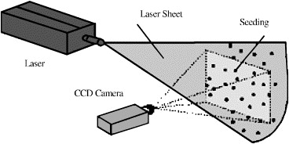
Imaging – types of cameras
Special purpose PIV cameras often used
Trigger by dual-cavity laser at end of frame 1 and start of frame 2
Very low interframe times possible (nanoseconds)
Alternative: high speed cameras (~7000 fps @ megapix resolution)

Slide 37
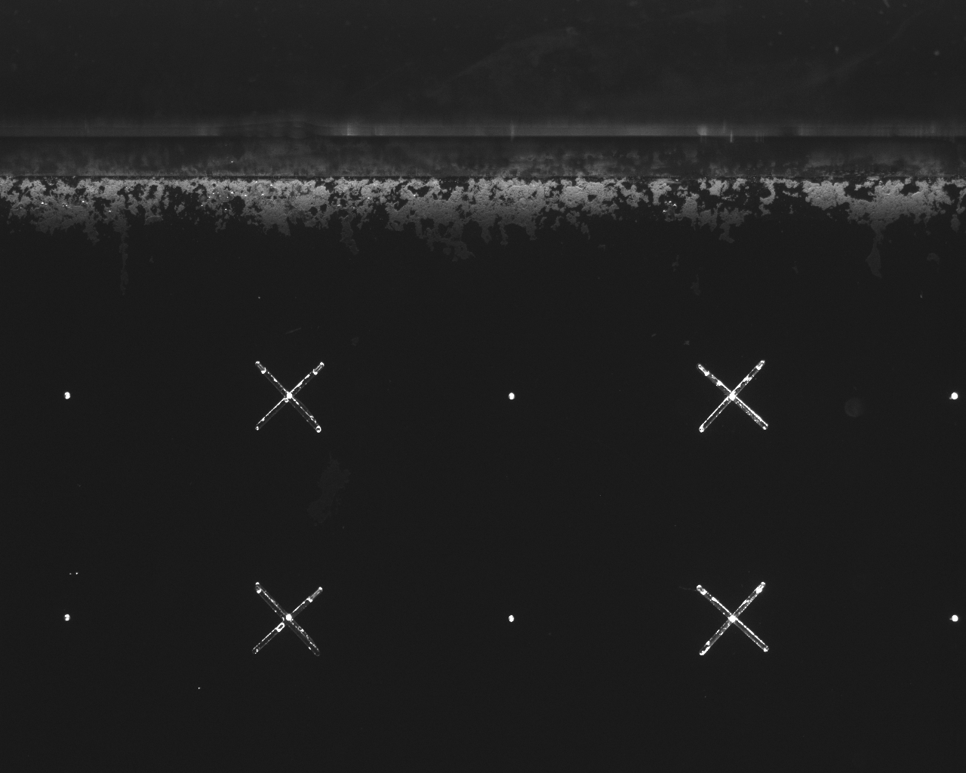
Calibration from pixels to centimeters
We need to convert from pixels to centimeters
Solution: image a grid with known spacing
Simple convertion
XX pixels = YY centimeters

Slide 38
Writing your own PIV code
Simple PIV

