Slide 1
Non-life insurance mathematics
Nils F. Haavardsson, University of Oslo and DNB Skadeforsikring

Slide 2
Insurance mathematics is fundamental in insurance economics
The result drivers of insurance economics:

Slide 3
The world of Poisson (Chapter 8.2)
Number of claims
I_{k-1}
I_{k}
I_{k+1}
t₀=0
t_{k-2}
t_{k-1}
t_{k}
t_{k+1}
t_{k}=T
What is rare can be described mathematically by cutting a given time period T into K small pieces of equal length h=T/K
On short intervals the chance of more than one incident is remote
Assuming no more than 1 event per interval the count for the entire period is
N=I₁+...+I_{K} , where I_{j} is either 0 or 1 for j=1,...,K
If p=Pr(I_{k}=1) is equal for all k and events are independent, this is an ordinary Bernoulli series
where
Assume that p is proportional to h and set
is an intensity which applies per time unit

Slide 4
Client
Policies and claims
Policy
Insurable object
(risk)
Claim
Insurance cover
Cover element
/claim type

Slide 5
Key ratios – claim frequency
The graph shows claim frequency for all covers for motor insurance
Notice seasonal variations, due to changing weather condition throughout the years

Slide 6
Random intensities (Chapter 8.3)
How varies over the portfolio can partially be described by observables such as age or sex of the individual (treated in Chapter 8.4)
There are however factors that have impact on the risk which the company can’t know much about
  Driver ability, personal risk averseness,
This randomeness can be managed by making a stochastic variable
This extension may serve to capture uncertainty affecting all policy holders jointly, as well, such as altering weather conditions
The models are conditional ones of the form
Let which by double rules in Section 6.3 imply
Now E(N)<var(N) and N is no longer Poisson distributed
Policy level
Portfolio level

Slide 7
Overview

Slide 8
Overview of this session
What is a fair price of insurance policy?
The model (Section 8.4 EB)
An example
Why is a regression model needed?
Repetition of important concepts in GLM

Slide 9
What is a fair price of an insurance policy?
The fair price
The model
An example
Why regression?
Repetition of GLM
Before ”Fairness” was supervised by the authorities (Finanstilsynet)
  To some extent common tariffs between companies
  The market was controlled
During 1990’s: deregulation
Now: free market competition supposed to give fairness
According to economic theory there is no profit in a free market (in Norway general insurance is cyclical)
Hence, the price equals the expected cost for insurer
Note: cost of capital may be included here, but no additional profit

Slide 10
Expected cost
The fair price
The model
An example
Why regression?
Repetition of GLM
Main component is expected loss (claim cost)
The average loss for a large portfolio will be close to the mathematical expectation (by the law of large numbers)
So expected loss is the basis of the price
Varies between insurance policies
Hence the market price will vary too
The add other income and costs, incl administrative cost and capital cost

Slide 11
Adverse selection
The fair price
The model
An example
Why regression?
Repetition of GLM
Too high premium for some policies results in loss of good policies to competitors
Too low premium for some policies gives inflow of unprofitable policies
This will force the company to charge a fair premium

Slide 12
Rating factors
The fair price
The model
An example
Why regression?
Repetition of GLM
How to find the expected loss of every insurance policy?
We cannot price individual policies (why?)
  Therefore policies are grouped by rating variables
Rating variables (age) are transformed to rating factors (age classes)
Rating factors are in most cases categorical

Slide 13
The model (Section 8.4)
The fair price
The model
An example
Why regression?
Repetition of GLM
The idea is to attribute variation in to variations in a set of observable variables x1,...,xv. Poisson regressjon makes use of relationships of the form
(1.12)
Why and not itself?
The expected number of claims is non-negative, where as the predictor on the right of (1.12) can be anything on the real line
It makes more sense to transform so that the left and right side of (1.12) are more in line with each other.
Historical data are of the following form
  n1 T1 x11...x1x
  n2 T2 x21...x2x
  nn Tn xn1...xnv
The coefficients b0,...,bv are usually determined by likelihood estimation
Claims exposure covariates

Slide 14
The model (Section 8.4)
The fair price
The model
An example
Why regression?
Repetition of GLM
In likelihood estimation it is assumed that nj is Poisson distributed where is tied to covariates xj1,...,xjv as in (1.12). The density function of nj is then
or
log(f(nj)) above is to be added over all j for the likehood function L(b0,...,bv).
Skip the middle terms njTj and log (nj!) since they are constants in this context.
Then the likelihood criterion becomes
(1.13)
Numerical software is used to optimize (1.13).
McCullagh and Nelder (1989) proved that L(b0,...,bv) is a convex surface with a single maximum
Therefore optimization is straight forward.

Slide 15
Poisson regression: an example, bus insurance
The fair price
The model
An example
Why regression?
Repetition of GLM
The model becomes
for l=1,...,5 and s=1,2,3,4,5,6,7.
To avoid over-parameterization put bbus age(5)=bdistrict(4)=0 (the largest group is often used as reference)

Slide 16
Take a look at the data first
The fair price
The model
An example
Why regression?
Repetition of GLM

Slide 17
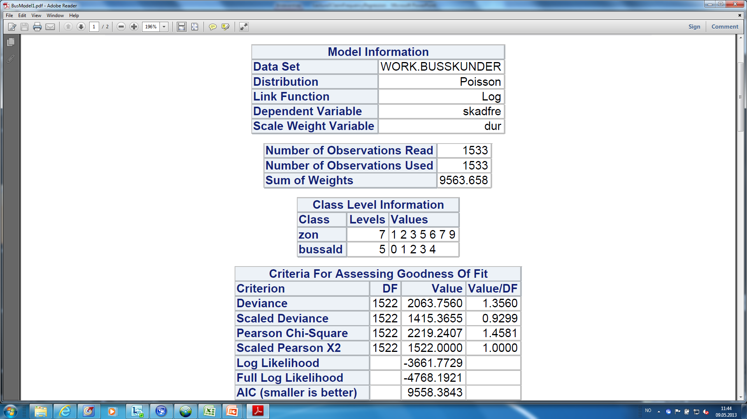
Then a model is fitted with some software (sas below)
The fair price
The model
An example
Why regression?
Repetition of GLM

Slide 18
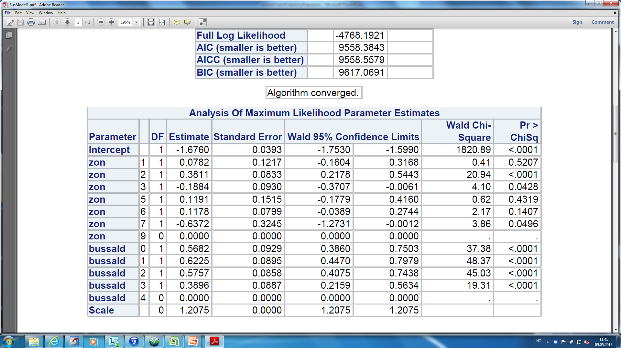
Zon needs some re-grouping
The fair price
The model
An example
Why regression?
Repetition of GLM

Slide 19
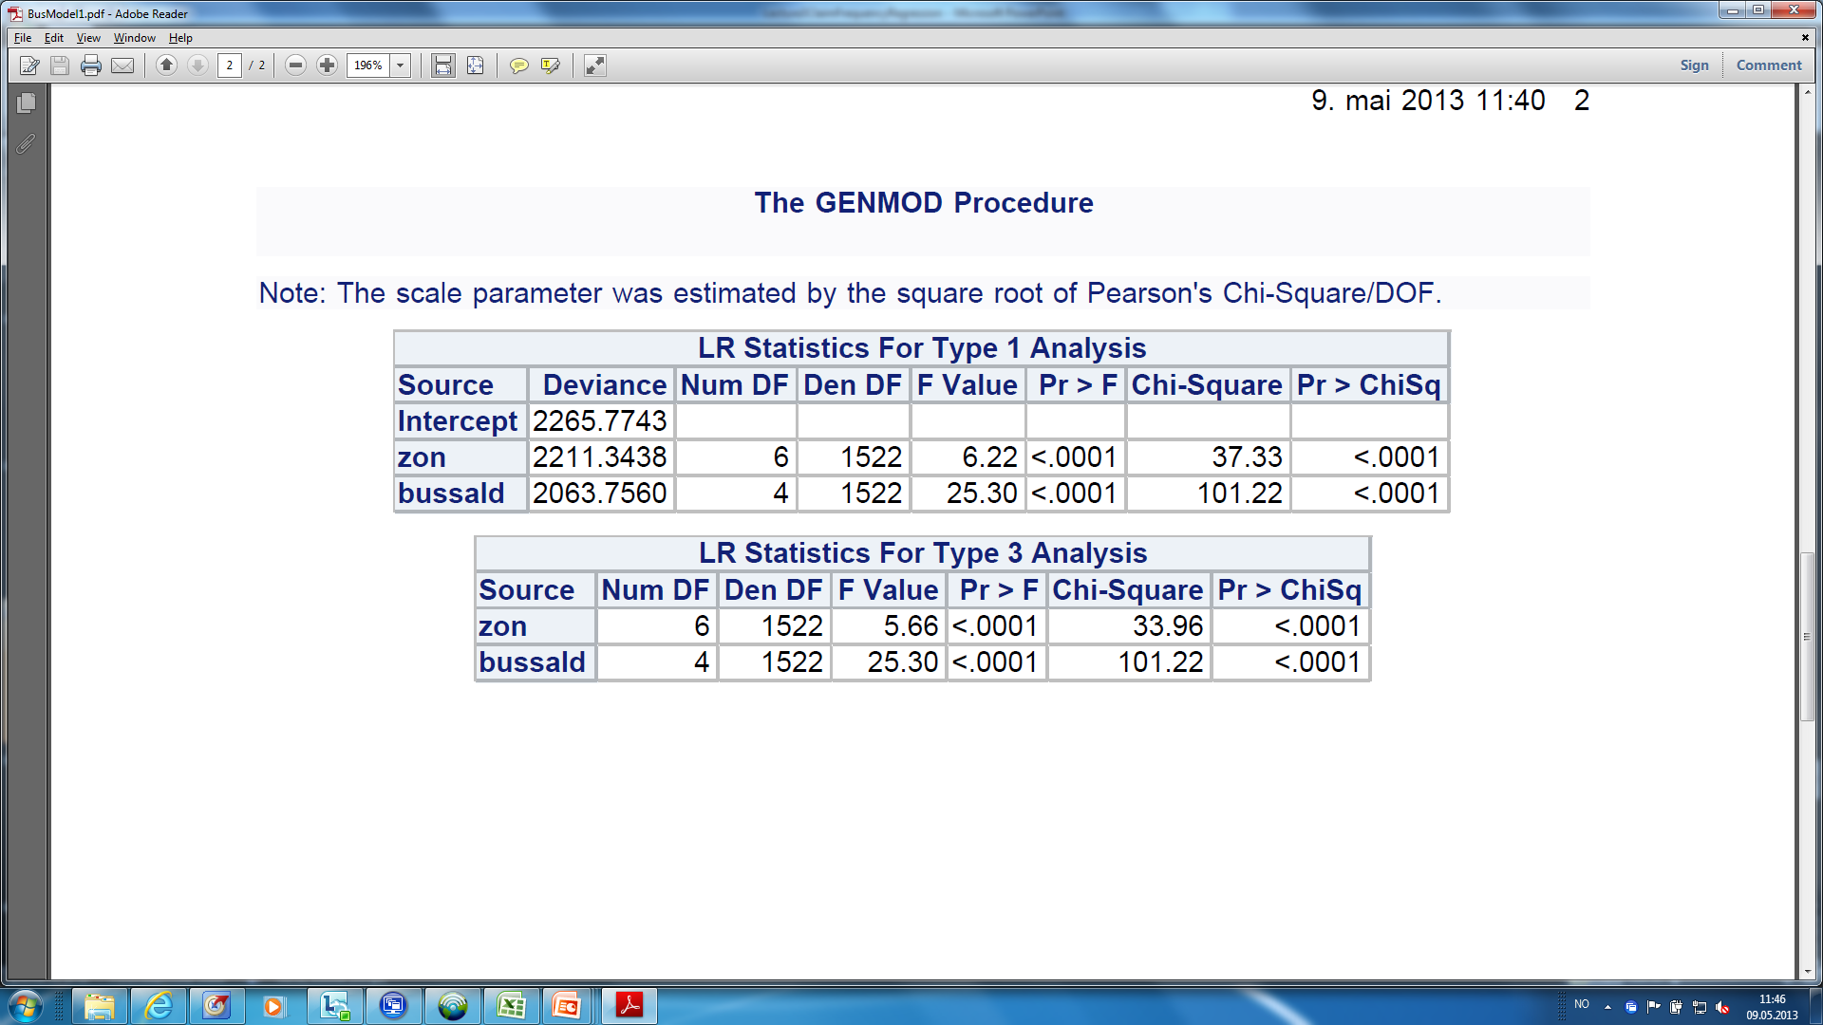
Zon and bus age are both significant
The fair price
The model
An example
Why regression?
Repetition of GLM

Slide 20
Model and actual frequencies are compared
The fair price
The model
An example
Why regression?
Repetition of GLM
In zon 4 (marked as 9 in the tables) the fit is ok
There is much more data in this zon than in the others
We may try to re-group zon, into 2,3,7 and other

Slide 21
Model 2: zon regrouped
The fair price
The model
An example
Why regression?
Repetition of GLM
Zon 9 (4,1,5,6) still has the best fit
The other are better – but are they good enough?
We try to regroup bus age as well, into 0-1, 2-3 and 4.
Bus age
Bus age
Bus age
Bus age

Slide 22
Model 3: zon and bus age regrouped
The fair price
The model
An example
Why regression?
Zon 9 (4,1,5,6) still has the best fit
The other are still better – but are they good enough?
May be there is not enough information in this model
May be additional information is needed
The final attempt for now is to skip zon and rely solely on bus age
Repetition of GLM
Bus age
Bus age
Bus age
Bus age

Slide 23
Model 4: skip zon from the model (only bus age)
The fair price
The model
An example
Why regression?
Repetition of GLM
From the graph it is seen that the fit is acceptable
Hypothesis 1: There does not seem to be enough information in the data set to provide reliable estimates for zon
Hypothesis 2: there is another source of information, possibly interacting with zon, that needs to be taken into account if zon is to be included in the model
Bus age

Slide 24
Limitation of the multiplicative model
The fair price
The model
An example
Why regression?
Repetition of GLM
The variables in the multiplicative model are assumed to work independent of one another
This may not be the case
Example:
  Auto model, Poisson regression with age and gender as explanatory variables
  Young males drive differently (worse) than young females
  There is a dependency between age and gender
This is an example of an interaction between two variables
Technically the issue can be solved by forming a new rating factor called age/gender with values
  Young males, young females, older males, older females etc

Slide 25
Why is a regression model needed?
The fair price
The model
An example
Why regression?
Repetition of GLM
There is not enough data to price policies individually
What is actually happening in a regression model?
  Regression coefficients measure the effect ceteris paribus, i.e. when all other variables are held constant
  Hence, the effect of a variable can be quantified controlling for the other variables
Why take the trouble of using a regression model?
Why not price the policies one factor at a time?

Slide 26
Claim frequencies, lorry data from Länsförsäkringer (Swedish mutual)
The fair price
The model
An example
Why regression?
Repetition of GLM
”One factor at a time” gives 6.1%/2.6% = 2.3 as the mileage relativity
But for each Vehicle age, the effect is close to 2.0
”One factor at a time” obviously overestimates the relativity – why?

Slide 27
Claim frequencies, lorry data from Länsförsäkringer (Swedish mutual)
The fair price
The model
An example
Why regression?
Repetition of GLM
New vehicles have 45% of their duration in low mileage, while old vehicles have 87%
So, the old vehicles have lower claim frequencies partly due to less exposure to risk
This is quantified in the regression model through the mileage factor
Conclusion: 2.3 is right for High/Low mileage if it is the only factor
If you have both factors, 2.0 is the right relativity

Slide 28
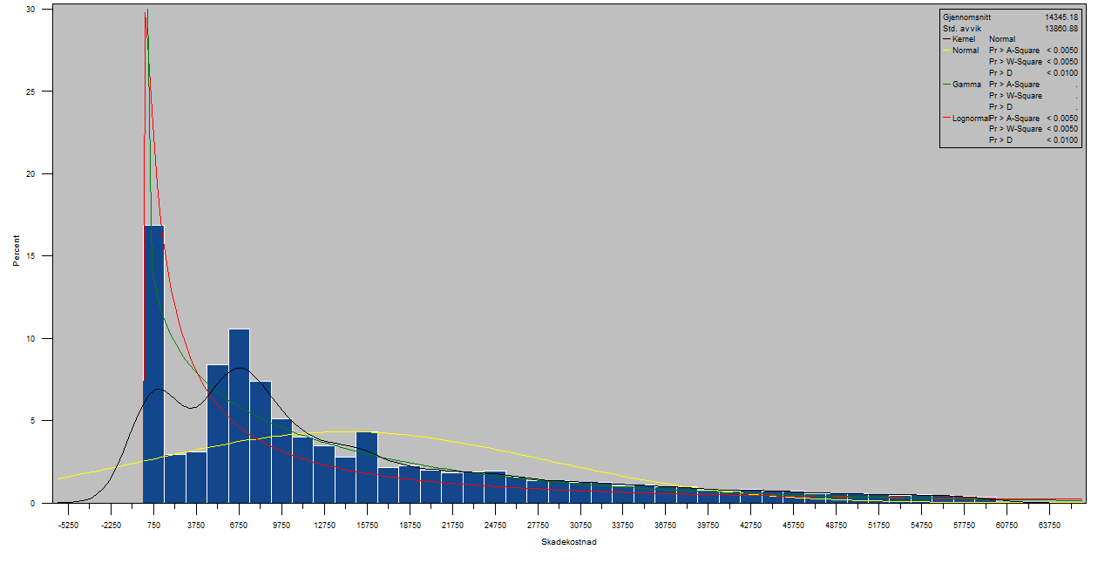
Example: car insurance
Non parametric
Log-normal, Gamma
The Pareto
Extreme value
Searching
Hull coverage (i.e., damages on own vehicle in a collision or other sudden and unforeseen damage)
Time period for parameter estimation: 2 years
Covariates:
  Driving length
  Car age
  Region of car owner
  Tariff class
  Bonus of insured vehicle
2 models are tested and compared – Gamma and lognormal

Slide 29
Evaluation of model
Non parametric
Log-normal, Gamma
The Pareto
Extreme value
Searching
The model is evaluated with respect to fit, result, validation of model, type 3 analysis and QQ plot
Fit: ordinary fit measures are evaluated
Results: parameter estimates of the models are presented
Validation of model: the data material is split in two, independent groups. The model is calibrated (i.e., estimated) on one half and validated on the other half
Type 3 analysis of effects: Does the fit of the model improve significantly by including the specific variable?
QQplot:

Slide 30
Fit interpretation

Slide 31
Result presentation

Slide 32
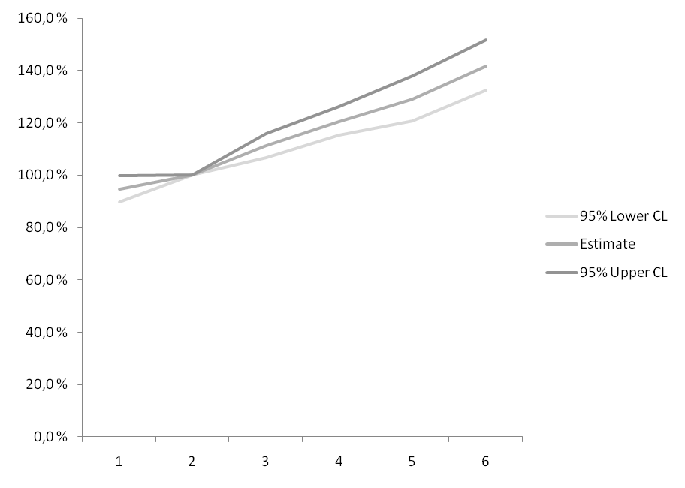
Result presentation
Tariff class

Slide 33
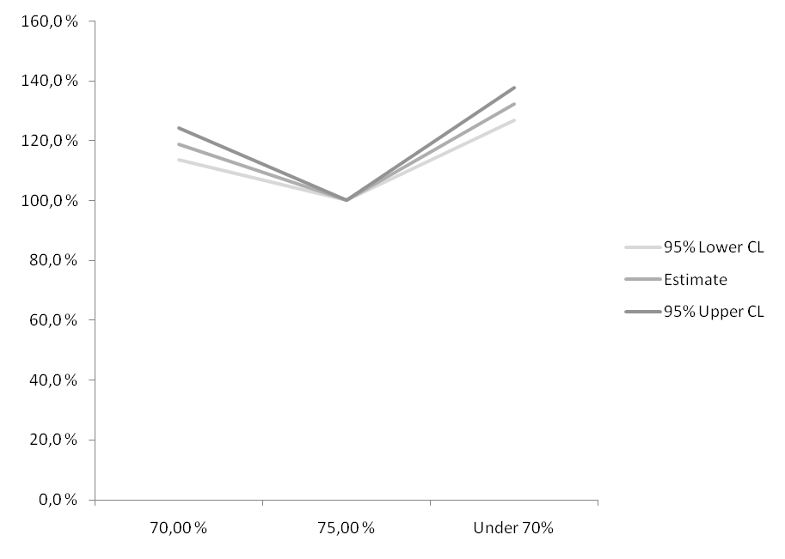
Result presentation
Bonus

Slide 34
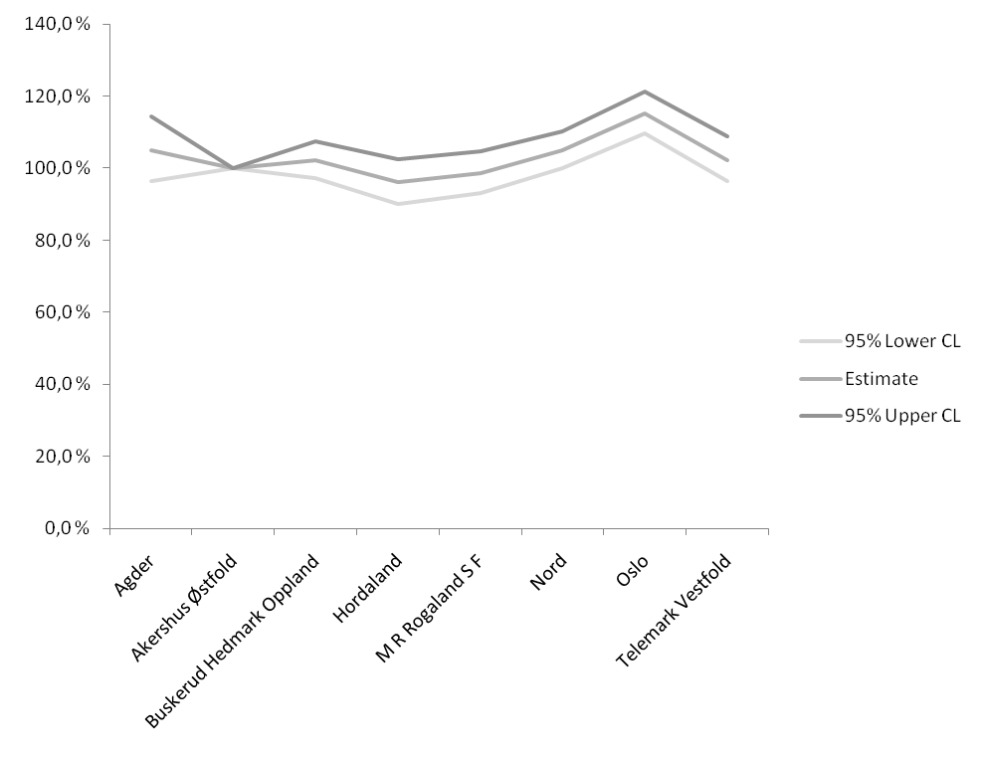
Result presentation
Region

Slide 35
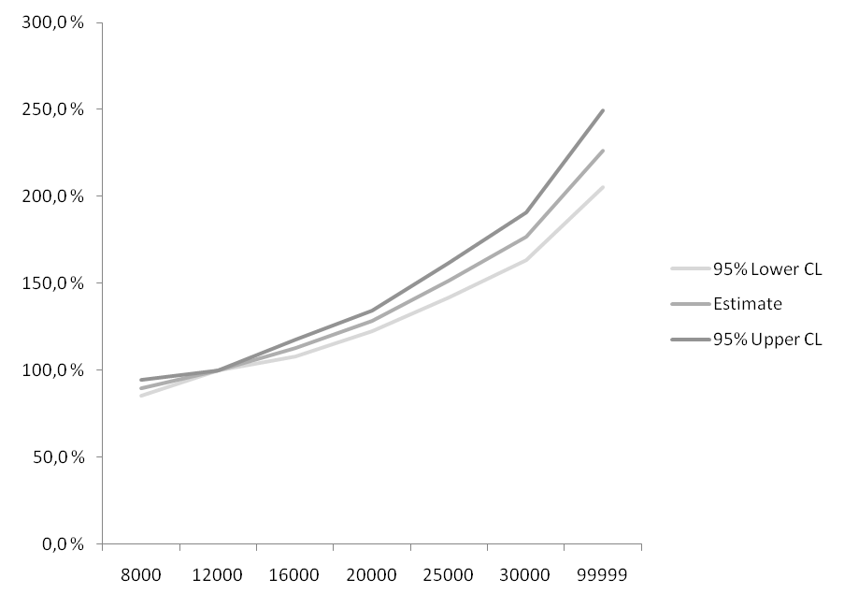
Result presentation
Driving Length

Slide 36
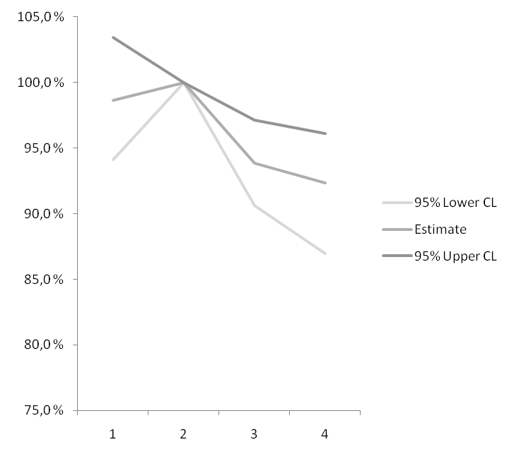
Result presentation
Car age

Slide 37
Validation

Slide 38
Type 3 analysis
Type 3 analysis of effects: Does the fit of the model improve significantly by including the specific variable?

Slide 39
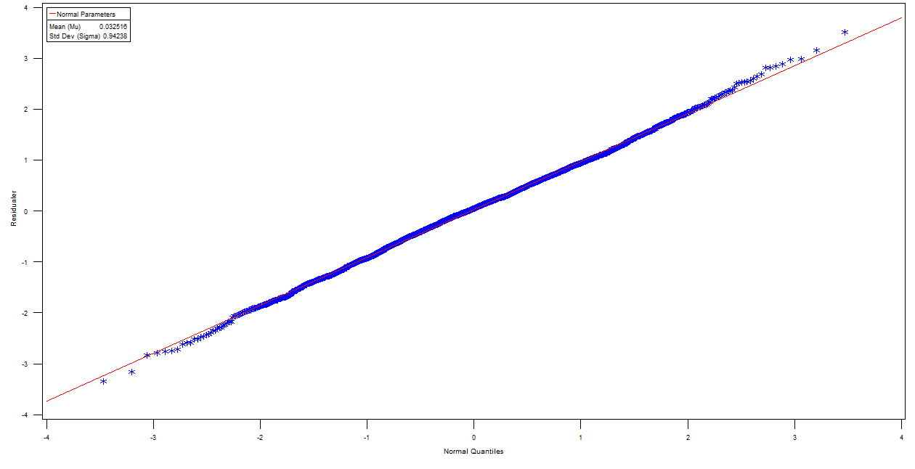
Type 3 analysis

Slide 40
Some repetition of generalized linear models (GLMs)
The fair price
The model
An example
Why regression?
Repetition of GLM
Exponential dispersion Models (EDMs)
Frequency function fYi (either density or probability function)
For yi in the support, else fYi=0.
c() is a function not depending on
C
twice differentiable function
b’ has an inverse
The set of possible is assumed to be open

Slide 41
Claim frequency
The fair price
The model
An example
Why regression?
Repetition of GLM
Claim frequency Yi=Xi/Ti where Ti is duration
Number of claims assumed Poisson with
LetC
Then
EDM with

Slide 42
Note that an EDM...
The fair price
The model
An example
Why regression?
Repetition of GLM
...is not a parametric family of distributions (like Normal, Poisson)
...is rather a class of different such families
The function b() speficies which family we have
The idea is to derive general results for all families within the class – and use for all

Slide 43
Expectation and variance
The fair price
The model
An example
Why regression?
Repetition of GLM
By using cumulant/moment-generating functions, it can be shown (see McCullagh and Nelder (1989)) that for an EDM
  E
  Ee
This is why b() is called the cumulant function

Slide 44
The variance function
The fair price
The model
An example
Why regression?
Repetition of GLM
Recall that is assumed to exist
Hence
The variance function is defined by
Hence

Slide 45
Common variance functions
The fair price
The model
An example
Why regression?
Repetition of GLM
Distribution Normal Poisson Gamma Binomial
Note: Gamma EDM has std deviation proportional
to , which is much more realistic than constant (Normal)

Slide 46
Theorem
The fair price
The model
An example
Why regression?
Repetition of GLM
Within the EDM class, a family of probability distributions is uniquely characterized by its variance function
Proof by professor Bent Jørgensen, Odense

Slide 47
Scale invariance
The fair price
The model
An example
Why regression?
Repetition of GLM
Let c>0
If cY belongs to same distribution family as Y, then distribution is scale invariant
Example: claim cost should follow the same distribution in NOK, SEK or EURO

Slide 48
Tweedie Models
The fair price
The model
An example
Why regression?
Repetition of GLM
If an EDM is scale invariant then it has variance function
This is also proved by Jørgensen
This defines the Tweedie subclass of GLMs
In pricing, such models can be useful

Slide 49
Overview of Tweedie Models
The fair price
The model
An example
Why regression?
Repetition of GLM

Slide 50
Link functions
The fair price
The model
An example
Why regression?
Repetition of GLM
A general link function g()
Linear regression: identity link
Multiplicative model: log link
Logistic regression: logit link

Slide 51
Summary
The fair price
The model
An example
Why regression?
Repetition of GLM
Generalized linear models:
Yi follows an EDM:
Mean satisfies
Multiplicative Tweedie models:
Yi Tweedie EDM:
Mean satisfies

