Slide 1
Bootstrap
STK9200 – Fall 2021
Lars Henry Berge Olsen

Slide 2
Who is Bradley Efron?
“Those who ignore Statistics are condemned to reinvent it.”
- Bradley Efron

Slide 3
Life of Bradley I
Today a Professor at Stanford working on BigData and empirical Bayes.
Won many honors: National Medal of Science, International Prize in Statistics.
Has 172 437 citations on Google Scholar.
Born in St. Paul, Minnesota the 24th of May 1938.
Helped his truck driver dad with keeping score for the baseball and bowling league.
Grew up thinking he would be a mathematician.
Scholarship to Caltech: “I got a real break there. That was the first year they offered the scholarship, and but for that I couldn't have gone.”
Didn’t like modern abstract math, enjoyed numbers.
Litle statistics at Caltech. Reading course: Harald Cramér's book Mathematical Methods of Statistics.
Graduated in Mathematics in 1960.
Applied to schools in statistics, Berkley vs. Stanford:
Accepted Stanford as they replied with their humour magazine Stanford Chaparral . (3rd oldest humor magazine in the world)
First year in Maths Department: “Too smart to do statistics” – Caltech teacher.
Became editior of The Chaparral. Suspeded for six months for publishing a pardoy edition of Playboy.
“I believe that for a few weeks I was the most famous I have ever been.”
After this he started taking stats courses.
Ph.D. (1964) under the direction of Rupert Miller and Herbert Solomon, in the Department of Statistics.
BRADLEY

Slide 4
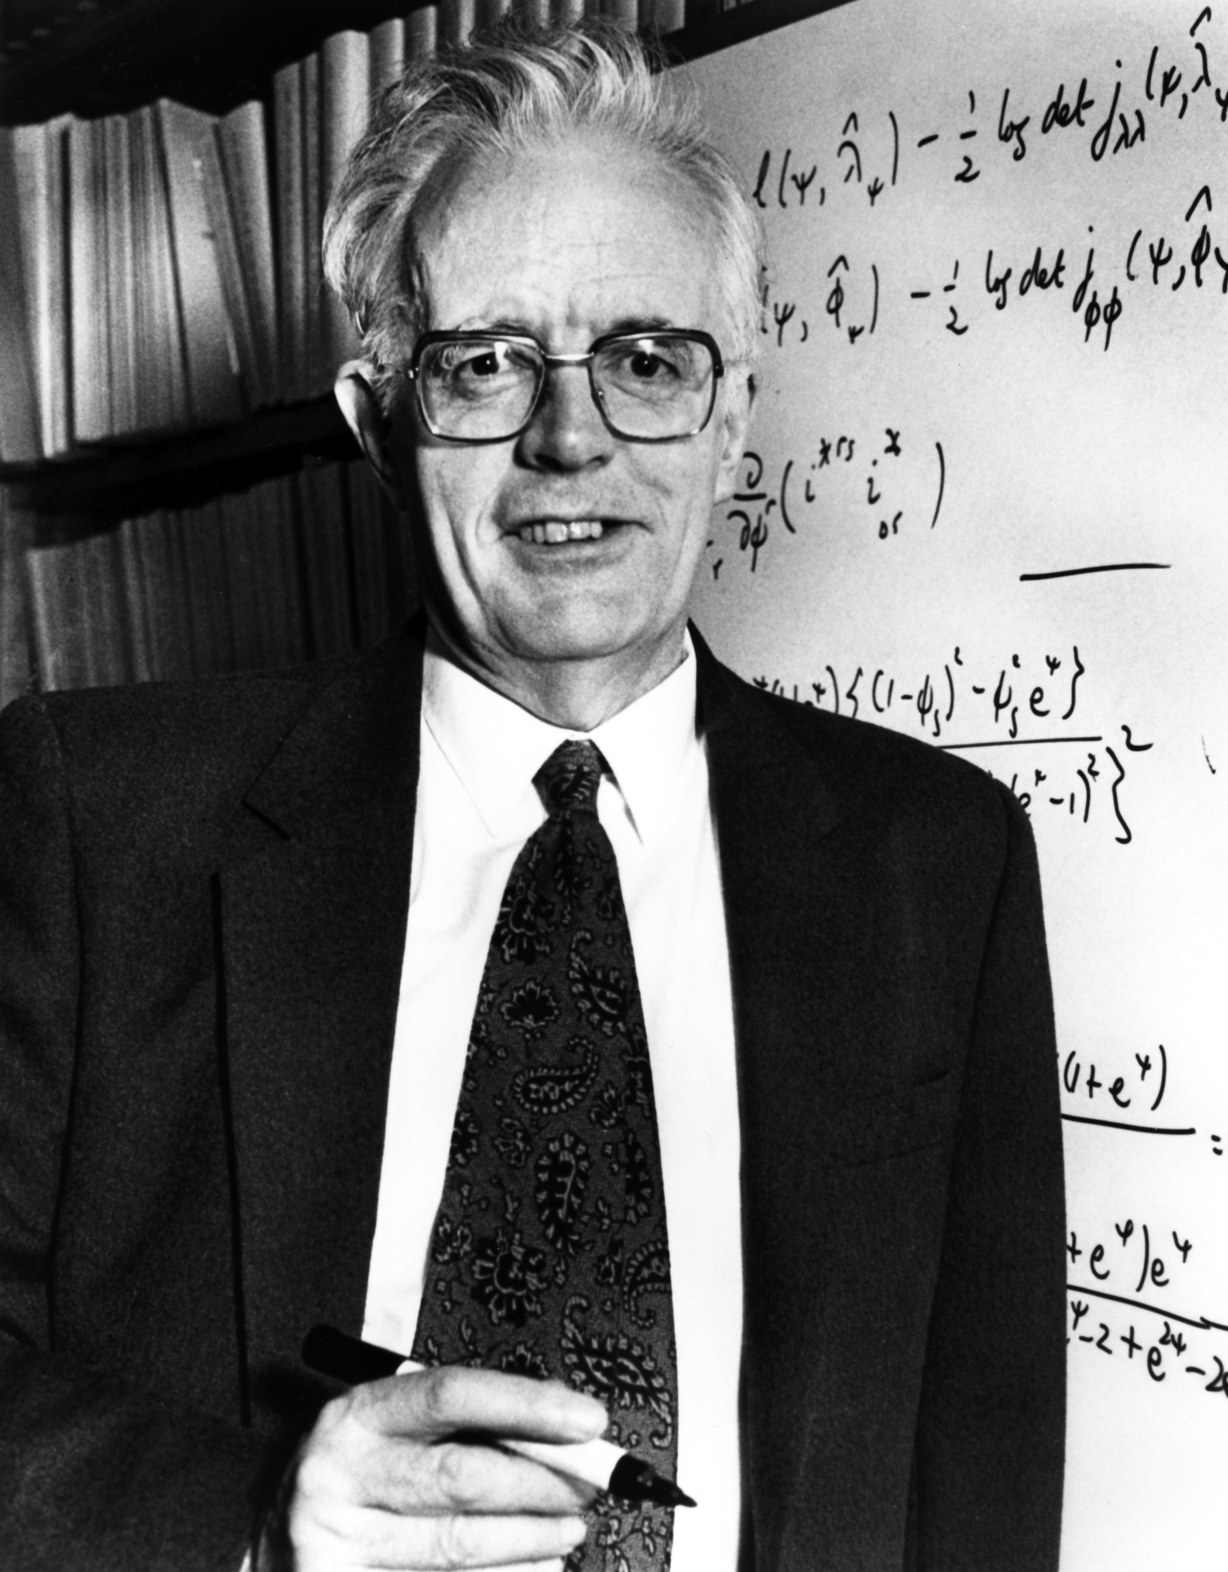
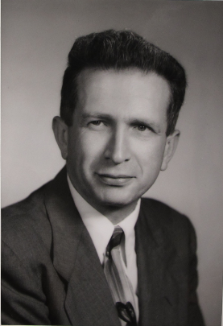
Life of Bradley II
In 1972 he took a sabbatical year at Imperial College.
Rupert Miller wrote a paper called ‘A Trustworthy Jackknife’.
“Sir David Cox asked me in his pleasant aside manner if I thought there was anything in this jackknife business.”
A few years passed before the spark took fire.
Could throw more and more bits of assumptions away.
Trouble getting the paper accepted. Annals of Statistics, 1979.
Same year, presentation in Seattle, Jack Wolfowitz stuck up his hand and said...
Fellow statisticians: bootstrap was not mathematically elegant.
Bootstrap: use the data itself to tell you more about the data.
Controversial and did not become popular straight away.
“Anyway, I spent the next dozen years and dozen papers sorting out bootstraps. Like many things, the first effort is the successful one, everything else is cleaning up afterwards.”
Mr Efron, do you have any theorem? Because there doesn't seem to be any theorem in the paper at all!

Slide 5
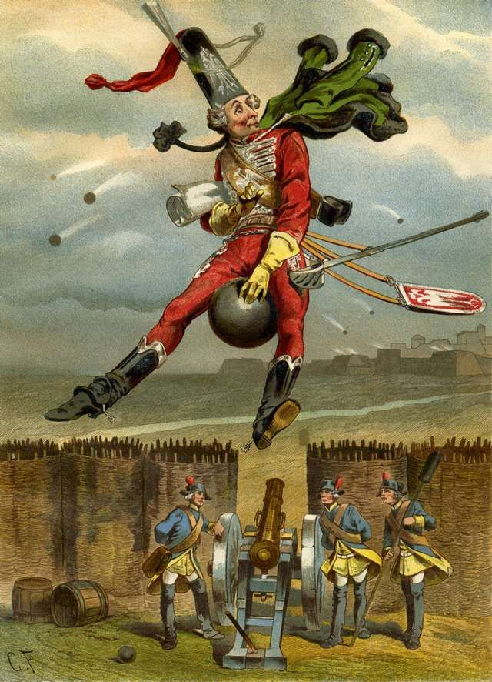
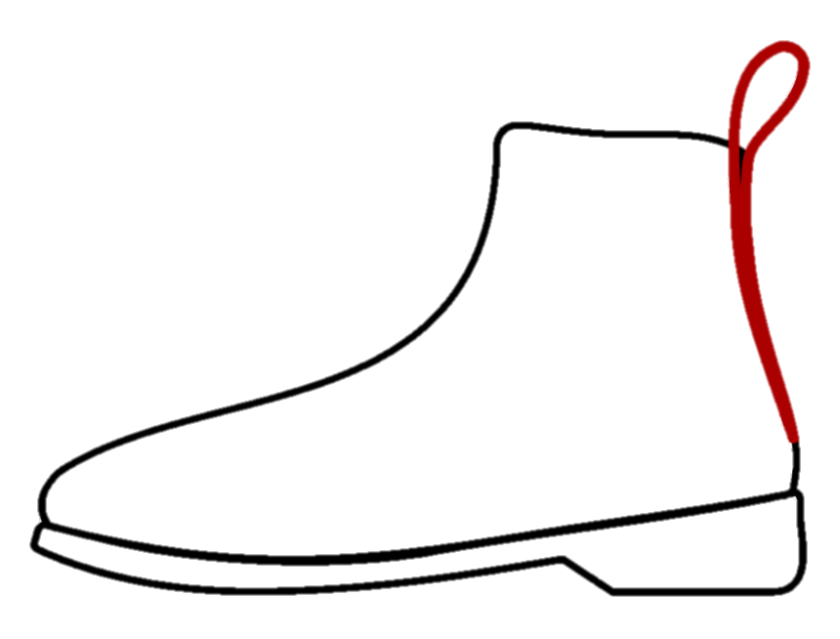
Why the name “Bootstrap”?
Original name was the combination distribution, but …
Needed more competitive name.
Rudolf Erich Raspe’s Baron Münchhausen’s Narrative of his Marvellous Travels (1785).
Improbable tall tales.
Baron saves himself from drowning in a bog by pulling himself out by his bootstraps.
Critique: little known outside Germany/UK.

Slide 6
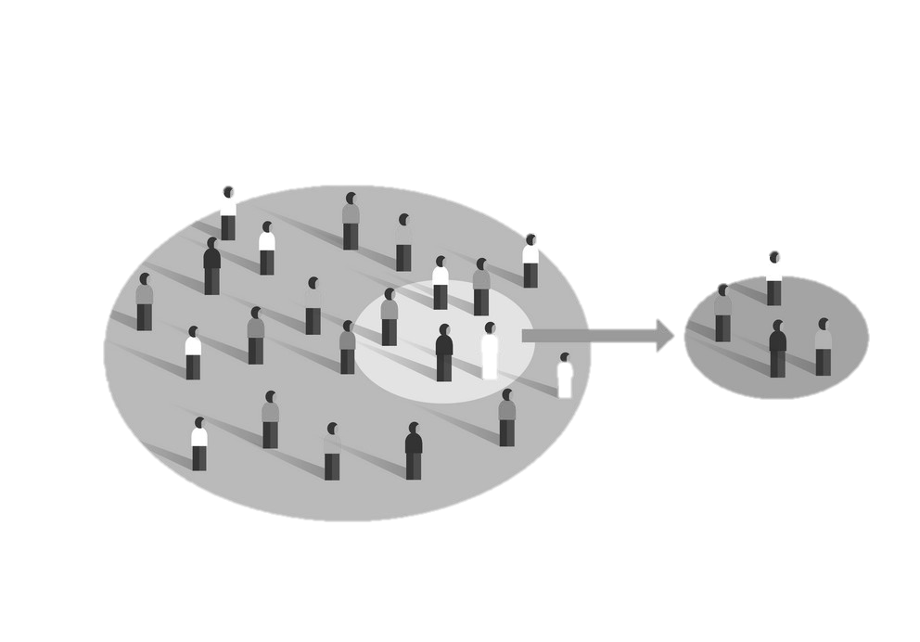
bootstrap
Random sample $X=\left(X_{1}, X_{2}, …, X_{n}\right)$, where $X_{i}∼_{ind}F.$
Observed realizations $x=\left(x_{1}, x_{2},…, x_{n}\right).$
Problem: estimate the sampling distribution of a RV $R\left(X, F\right)$, on the basis of $x$.
Parameter of interest $θ\left(F\right)$, e.g., mean, correlation, et cetera.
Estimator $t(X)$, e.g., sample mean, sample correlation, et cetera.
Jackknife estimate the mean and and variance of $R\left(X,F\right)=t\left(X\right)−θ\left(F\right).$
Recompute $t\left(⋅\right) n$ times, removing one component of X from consideration each time.
Second choice: $R\left(X, F\right)=\frac{t\left(X\right)−\hat{Bias}\left(t\right)−θ\left(F\right)}{√\hat{Var}(t)}∼t_{n−1}$
Bootstrap:
Put mass $1/n$ at each $x_{i}$, construct sample probability distribution $\hat{F}.$
Draw bootstrap sample $X^{∗}=(X_{1}^{∗}, …, X_{n}^{∗})$, $x^{∗}=\left(x_{1}^{∗}, …, x_{n}^{∗}\right),$ $X_{i}^{∗}=x_{i}^{∗}, X_{i}^{∗}∼_{ind}\hat{F}$, for $i=1,2,…, n.$
Approximate sampling distribution of $R(X,F)$ by the bootstrap distribution of $R^{∗}=R\left(X^{∗}, \hat{F}\right).$

Slide 7
The three methods of Bootstrap
Direct theoretical calculation:
Derive the distribution of $R^{∗}=F\left(X^{∗}, \hat{F}\right)$ directly.
Monte Carlo approximation to the bootstrap distribution:
Repeated realizations of $X^{∗}$ are generated by taking random samples of size $n$from $\hat{F}.$
Create histogram of $R\left(X^{∗1}, \hat{F}\right), …, R\left(X^{∗B}, \hat{F}\right)$, where $B$ is the num. of bootstrap repetitions.
Taylor series expansion methods (or the delta method):
Approximate the mean and variance of bootstrap distribution of $R^{∗}$.
The same as using the Jaeckel’s infinitesimal jackknife.
Differs only in detail from Tukey’s jackknife.
Personal perception:
Today, mostly the second is used due to easy access to fast computers. (?)

Slide 8
Example
Consider $F=_{d} Bernoulli\left(p\right)$.
Parameter of interest: $p=θ\left(F\right)=\underset{F}{Pr}{(X=1)}$.
Random variable of interest: $R\left(X, F\right)=\overline{X} −θ(F)$, where $\overline{X}=\frac{1}{n}\sum_{i=1}^{n}{X_{i}}$.
Observed $X=x$, bootstrap sample $X^{∗}=\left(X_{1}^{∗}, …, X_{n}^{∗}\right)$, where ${ X}_{i}^{∗}=\left\{\begin{aligned}1, with prob. \overline{x}=θ\left(\hat{F}\right) \\ &0, with prob. 1−\overline{x}. \end{aligned}\right.$
Standard binomial results:
${\overline{X}}^{∗}∼Bin\left(n, \overline{x}\right)$, so $R^{∗}=R\left(X^{∗}, \hat{F}\right)={\overline{X}}^{∗}−\overline{x}$ has $E_{∗}\left({\overline{X}}^{∗}−\overline{x}\right)=0$ and $V_{∗}\left({\overline{X}}^{∗}−\overline{x}\right)=\frac{\overline{x}\left(1−\overline{x}\right)}{n}.$
*-notation indicate probability calculation relating to dist. of $X^{∗}$, with $x$ and $\hat{F}$ fixed.
Can the computer do the job for us?

Slide 9
estimating the median
Skip this section.
Demonstrate how to compute the bootstrap distribution using Method 1 and 2.
Compare with known asymptotic properties, which bootstrap approaches.
Compare with standard jackknife, which is asymptotically inconsistent.
Consider extra steps to take if $F$ is symmetric, reflect the observations.
Add moderate smoothness to $F$ when $X$ is continuous. “Window” around each $X_{i}.$
Simulation study: $n=13, X_{i}∼N\left(0,1\right), i=1,2,…,n.$
Method 2.
Simplest form of bootstrap, just as good as symmetric and smoothed. All overshoots true value.
Could be different for other $R\left(X, F\right).$

Slide 10
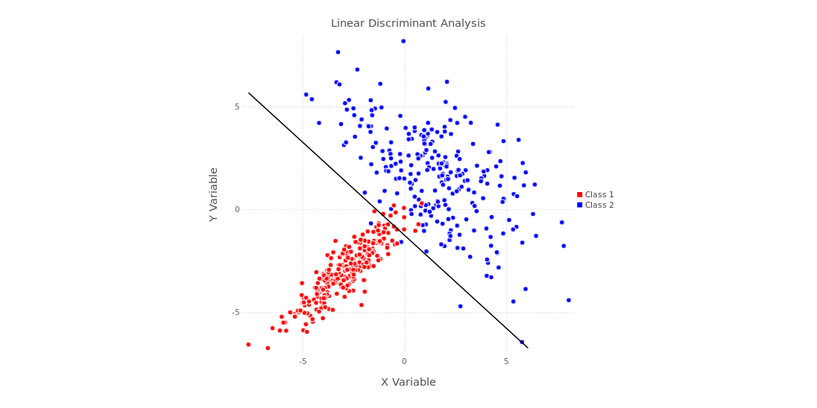
Error rate: Discriminant analysis I
$X_{i}=x_{i}, X_{i}∼_{ind}F, i=1, 2,…, m$ and $Y_{j}=y_{j}, Y_{j}∼_{ind}G, j=1, 2,…,n.$ Assumed continuous and $k$-dimensional.
Partition $R^{k}$ into two complementary regions $A$ and $B$.
${\hat{error}}_{F}=\frac{\#\left\{x_{i} ∈ B\right\}}{m}$, underestimates $error_{F}=\underset{F}{Pr}{(X∈B)}$.
Interested in $R\left(\left(X, Y\right), \left(F, G\right)\right)=error_{F}−{\hat{error}}_{F}$. $G$ too.
$B= \left\{z :{\left(\overline{y} −\overline{x}\right)}^{T}S^{−1}\left(z −\frac{\overline{x}+\overline{y}}{2}\right)>\log{\frac{m}{n}}\right\}$, where $S=\frac{1}{m+n}\left[ \sum_{i}{(x_{i}−\overline{x})}{\left(x_{i}−\overline{x}\right)}^{T} +\sum_{j}{\left(y_{i}−\overline{y}\right){\left(y_{i}−\overline{y}\right)}^{T}}\right]$.
MLE of optimum division under multivariate normal theory.

Slide 11
Error rate: Discriminant analysis II
Method 2:
$X_{i}^{∗}=x_{i}^{∗}, X_{i}^{∗}∼_{ind}\hat{F}, i=1, 2,…, m$ and $Y_{j}^{∗}=y_{j}^{∗}, Y_{j}^{∗}∼_{ind}\hat{G}, j=1, 2,…,n.$
Yields region $B^{∗}$using ${\overline{x}}^{∗}, {\overline{y}}^{∗}, S^{∗}$, instead of $\overline{x}, \overline{y}, S$.
Bootstrap random variable: $R^{∗}=R\left(\left(X^{∗}, Y^{∗}\right), \left(\hat{F}, \hat{G}\right)\right)=\frac{{\#\{x}_{i} ∈ B^{∗}\}}{m} − \frac{{\#\{x}_{i}^{∗} ∈ B^{∗}\}}{m}$.
$R^{∗1}, …, R^{∗N}$ approximate boot dist of $R^{∗}$ estimate dist of $R$.
Use $E_{∗}\left[R^{∗}\right]=\frac{1}{N}\sum_{j=1}^{N}{R^{∗j} }$to estimate $E_{F, G}[R]$.
Notes:
The difference between the actual error rate, actual now being defined with respect to the “true” distribution F-hat, and the apparent error rate obtained by counting errors in the bootstrap sample.

Slide 12
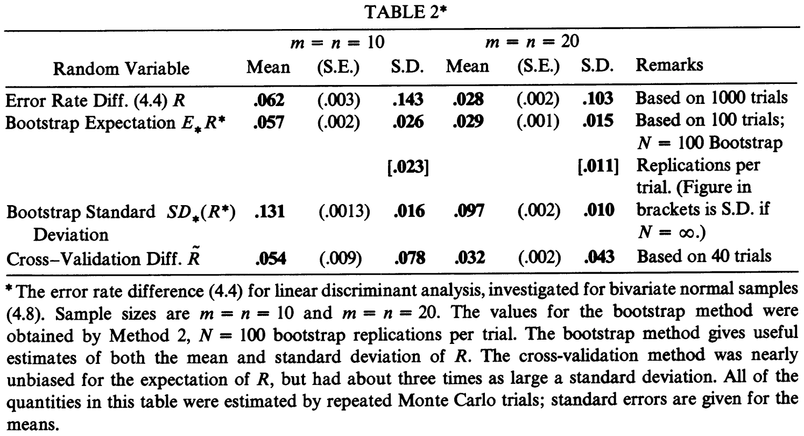
Error rate: Discriminant analysis III
Bivariate normal simulation study:
$F:X∼N_{2}\left(\left[\begin{matrix}−\frac{1}{2} \\ 0\end{matrix}\right], I\right)$, $G:Y∼N_{2}\left(\left[\begin{matrix}\frac{1}{2} \\ 0\end{matrix}\right], I\right)$.
$m=n=10$, and $m=n=20$.
Trials: $1000$ (“truth”), $100$ (boot), $40$ (cv).
$N=100$ bootstrap replications per trial.
Better than cross-validation. (high var)
$E_{∗}\left[R^{∗}\right]$almost unbiased est. of $E_{F, G}[R]$.
Increase replicates?
Component of variance analysis.
Remark A: one trial for 20 setting, 0.15s and cost 40 cents.
Notes:
The difference between the actual error rate, actual now being defined with respect to the “true” distribution F-hat, and the apparent error rate obtained by counting errors in the bootstrap sample.

Slide 13
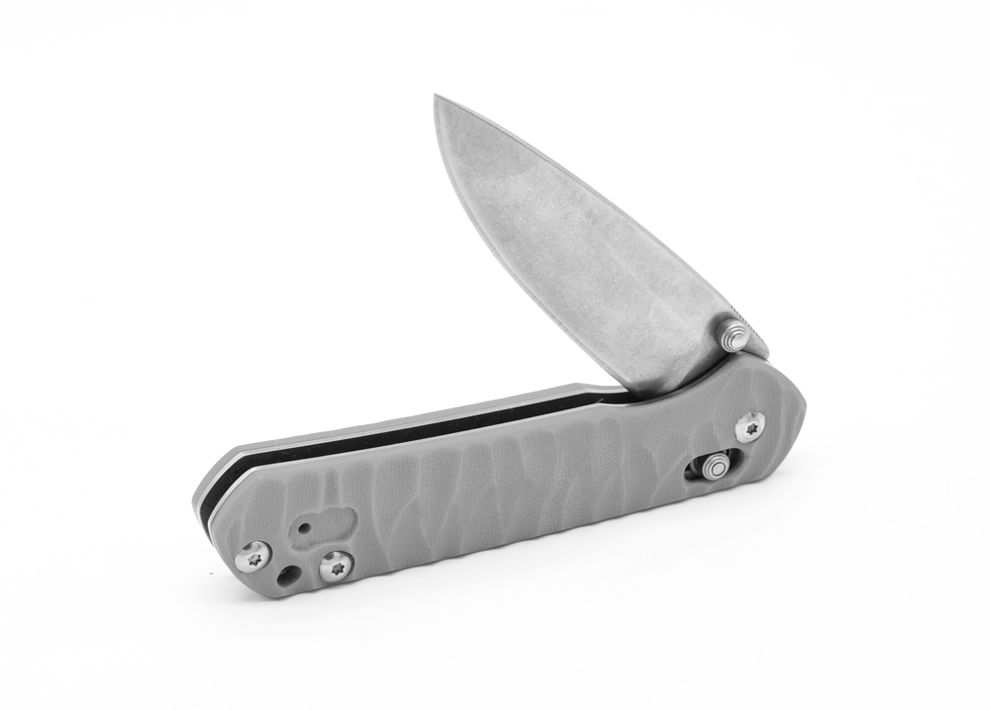
Relationship with the jackknife
Skip this section.
Method 3: approximate the mean and variance of the bootstrap distribution.
Taylor series expansion → same as Jaeckel’s infinitesimal jackknife.
One-sample: $P_{i}^{∗}=\frac{N_{i}^{∗}}{n}$, where $N_{i}^{∗}=\#\left\{X_{i}^{∗}=x_{i}\right\}$.
Then $P^{∗}=\left(P_{1}^{∗}, P_{2}^{∗}, …, P_{n}^{∗}\right)∼ \text{Multinomial}$.
$E_{∗}\left[P^{∗}\right]=\frac{e}{n}$, where $e=\left[1, 1,…,1\right]$, and $Cov_{∗}{(P}^{∗})=\frac{I}{n^{2}}−\frac{e^{T}e}{n^{3}}$, where $I$ is the identity matrix.
Bootstrap realization of random variable of interest: $R\left(P^{∗}\right)=R(X^{∗}, \hat{F})$.
Assume that $R(X,F)$ is symmetric. Sufficient to know $N^{∗}=nP^{∗}$ in order to evaluate $R\left(X^{∗}, \hat{F}\right).$
Approximate bootstrap dist. of $R(X^{∗}, \hat{F})$ by expanding $R(P^{∗})$ in a Taylor series around $P^{∗}=\frac{e}{n}.$
$R\left(P^{∗}\right)≈R\left(\frac{e}{n}\right)+\left(P^{∗}−\frac{e}{n}\right)U+\frac{1}{2}\left(P^{∗}−\frac{e}{n}\right)V{\left(P^{∗}−\frac{e}{n}\right)}^{T}.$
$U$ is the vector of $\frac{∂R(P^{∗})}{∂P_{i}^{∗}}$ and $V$ is the matrix of $\frac{∂^{2}R(P^{∗})}{∂P_{i}^{∗}∂P_{j}^{∗}}$.
$E_{∗}\left[R(P^{∗})\right]≈R\left(\frac{e}{n}\right)+\frac{1}{2n^{2}}\sum_{i=1}^{n}{V_{ii}}$ and $Var_{∗}\left(R\left(P^{∗}\right)\right)≈\frac{1}{n^{2}}\sum_{i=1}^{n}{U_{i}^{2}}.$
Essentially the jackknife expressions for bias and variance.

Slide 14
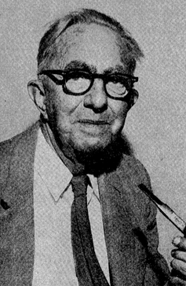
Wilcoxon’s statistics
Skip this section.
Two-samples: $F$ and $G$ continuous dist. on the real line.
Parameter of interest: $θ\left(F, G\right)=P_{F,G}\left(X<Y\right).$
Wilcoxon’s statistic: $\hat{θ}=θ\left(F, G\right)={\frac{1}{mn}∑}_{i=1}^{m}\sum_{i}^{n}{I(X_{i}< Y_{j})}$.
Method 1 for the bootstrap variance: standard results.
What about Method 3? “Unbalanced” situations (leave one out).
Jackknife: leave out one $x_{i}$ at a time and then one $y_{i}$ at the time.
Let $R=R(\left(X, Y\right), \left(F, G\right))$ be $\hat{θ}$, so ${\hat{θ}}^{∗}=R\left(\left(X^{∗},Y^{∗}\right), \left(\hat{F}, \hat{G}\right)\right).$
Let $I_{ij}^{∗}=I\left(X_{i}^{∗}< Y_{j}^{∗}\right),$then ${\text{Var}}_{∗}\left({\hat{θ}}^{∗}\right)= \frac{1}{mn}\left[\left(n−1\right)\left(\hat{α}−{\hat{θ}}^{2}\right)+\left(m−1\right){\left(\hat{β} −\hat{θ}\right)}^{2}+\hat{θ}(1−\hat{θ})\right]$, where $\hat{α}=E_{∗}\left[I_{ij}^{∗}I_{ij^{′}}^{∗}\right]$ and ${\hat{β}=E}_{∗}\left[I_{ij}^{∗}I_{i^{′}j}^{∗}\right]$.
Method 3 yields: ${\text{Var}}_{∗}\left({\hat{θ}}^{∗}\right)= \frac{1}{mn}\left[n\left(\hat{α} −{\hat{θ}}^{2}\right)+m(\hat{β}−{\hat{θ}}^{2})\right]$.

Slide 15
Regression model
Assume regression model $X_{i}=g_{i}\left(β\right)+ε_{i}.$
$g(⋅)$ is known function of the unknown parameters $β$.
$ε_{i}∼_{ind}F$, centered at zero, e.g., $E_{F}\left[ε\right]=0$.
Estimate $β$ using e.g., least squares: $\hat{β} :\min_{β}{\sum_{i=1}^{n}{{\left[x_{i}−g_{i}(β)\right]}^{2}.}}$
We want to say something about the sampling distribution of $\hat{β}$.
Method 2:
Let $\hat{F}$ be the sample probability distribution of the residuals ${\hat{ε}}_{i}$. Mass $\frac{1}{n}$ at ${\hat{ε}}_{i}=x_{i}−g_{i}\left(\hat{β}\right).$
Bootstrap sample, given $\left(\hat{β}, \hat{F}\right)$, is $X_{i}^{∗}=g\left(\hat{β}\right)+{\hat{ε}}_{i}^{∗}$, where $ε_{i}^{∗}∼_{ind}\hat{F}.$
This yields a realization ${\hat{β}}^{∗} :\min_{β}{\sum_{i=1}^{n}{{\left[x_{i}^{∗}−g_{i}\left(β\right)\right]}^{2}.}}$ Repeat.
Linear model: g$\left(β\right)=Cβ$, where $C$ is the design matrix with first column being $1$.
Let $G=C^{T}C$, then OLS $\hat{β}=G^{−1}C^{T}X$, with $E_{F}\left[\hat{β}\right]=β$ and ${Cov}_{F}\left(\hat{β}\right)= σ_{F}^{2}G^{−1}.$
Bootstrap values $ε_{i}^{∗}$ are ind. with mean zero and variance ${\hat{σ}}^{2}=\frac{1}{n}\sum_{i=1}^{n}{{\left[x_{i}−g\left(\hat{β}\right)\right]}^{2}}$.
Hence, ${\hat{β}}^{∗}=G^{−1}C^{T}X^{∗}$ has bootstrap mean $E_{∗}\left[{\hat{β}}^{∗}\right]=\hat{β}$ and variance $Cov_{∗}\left({\hat{β}}^{∗}\right)={\hat{σ}}^{2}G^{−1}$. (Traditional)
Jackknife: $Cov\left(\hat{β}\right)≈G^{−1}C^{T}diag\left({\hat{ε}}^{2}\right)CG^{−1}$. (“This does not look like the results above”).
Can “symmetrize” the data by adding hypothetical data points. (Bootstrap implicitly does this)

Slide 16
Efron’s Other remarks
Method 2 to obtain the bootstrap distribution is easy to implement on the computer.
Bootstrap distribution is invariant under monotonic transformations.
Infinitesimal jacknife is the delta method.
Confidence intervals, continuity correction, pivotal quantities.
Bootstrap approximate frequency statements and not likelihood statements.
Hypothesis testing using the bootstrap distribution instead off Tukey’s $t$-distribution.
Finite sample space. Asymptotic validity easily verified in this framework.
Jackknife in finite sample space.
Confidence statements for estimated parameters.
Grouped jackknife.
Parametric bootstrap, assuming a parametric distribution of $F$ fitted using MLE.

Slide 17
Remark B – invariance
Instead of estimating $θ(F)$ with $t(X)$, we transform $φ=g(θ)$, $s=g(t)$, and estimate $φ\left(F\right)=g(θ\left(F\right))$ with $s\left(X\right)=g(t\left(X\right))$.
Consider the random variable $S\left(X, F\right)=s\left(X\right)−φ(F)$ instead of $R\left(X, F\right)=t\left(X\right)−θ\left(F\right).$
Effect off $g\left(⋅\right)$on bootstrap:
$R^{∗}=R^{∗}\left(X^{∗}, \hat{F}\right)=t\left(X^{∗}\right)−θ\left(F\right)$ transform into $S=S\left(X^{∗}, \hat{F}\right)=g\left(t\left(X^{∗}\right)\right) −g\left(θ\left(\hat{F}\right)\right)$, or more simply $S^{∗}=g\left(R^{∗}+\hat{θ}\right) −g\left(\hat{θ}\right)$.
Bootstrap distribution of $R^{∗}$transform into that of $S^{∗}$ by equation above.
Example from Miller regarding Pearson correlation $ρ$ of $9$ pairs.
Apply $arctanh$transformation to make the bootstrap sample ${\hat{ρ}}^{∗}−\hat{ρ}$ more pivotal and improve the inference process.
Related to Remark E.
Bootstrap approximate frequency statements and not likelihood statements.

Slide 18
Remark K – Parametric bootstrap
Only difference is that $\hat{F}$ is chosen to be the parametric MLE for $F$.
Usually be in close agreement with non-parametric version if $n$ is moderate.
Can be beneficial if $n$ is small and the right parametric assumption is made.
Parametric version of Method 3, applied on estimating the variance of the MLE in a one parameter family, gives the usual approximation: one over the Fisher information.

Slide 19
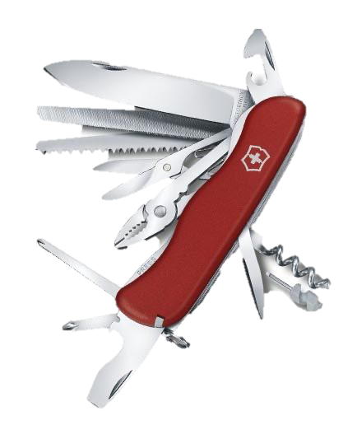
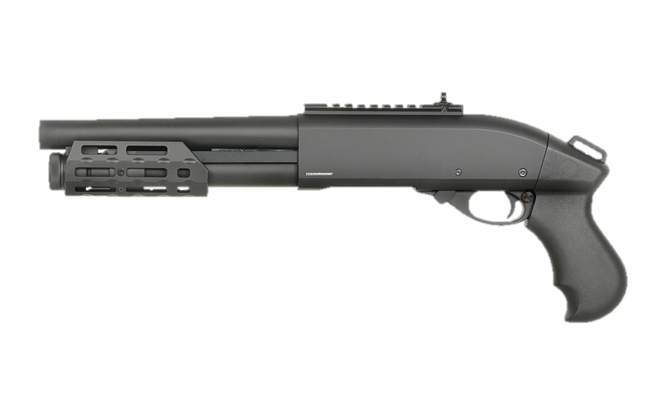
The Swiss Army knife
The meat axe
“Can blow the head off any problem if the statistician can stand the resulting mess.”
– John Tukey
The shotgun

Slide 20
“I believe I have more trouble understanding things than most people. I really don't have a good mind for technical detail. I get confused easily and I am always working things over in my mind to try to simplify them. I wish there were more simplifications.”
- Bradley Efron

Slide 21
Citations
Champkin, J. (2010), Bradley Efron. Significance, 7: 178-181. https://doi.org/10.1111/j.1740-9713.2010.00460.x
Cramér, H. (2016). Mathematical Methods of Statistics (PMS-9), Volume 9. Princeton university press.
Efron, B. (1992). Bootstrap methods: another look at the jackknife. In Breakthroughs in statistics (pp. 569-593). Springer, New York, NY.
Jaeckel, L. A. (1972). The infinitesimal jackknife. Bell Telephone Laboratories.

