Slide 1
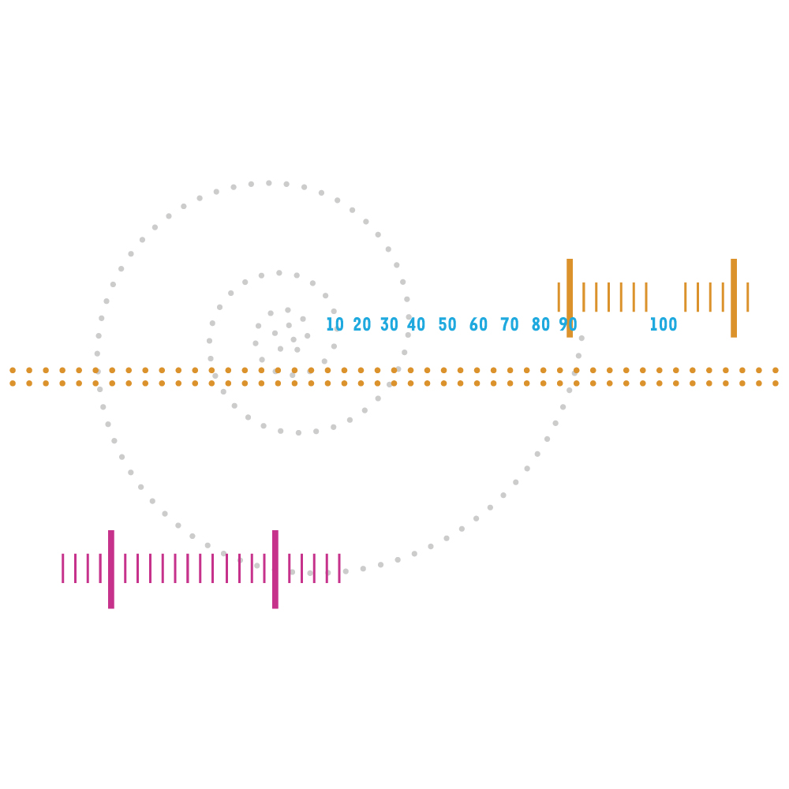
Popularisation of Science Challenges and rewards in science communication
Nina Kristiansen, forskning.no November 2011

Slide 2
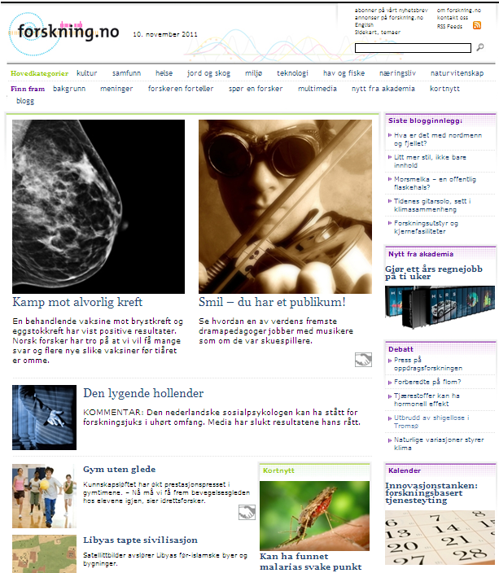
Online newspaper on science
Started in 2002
Owned by 72 research institutions
Editorial staff in Oslo, plus members’ contributions
Norwegian and international science
All fields of research
News, background, blog, debate
Editorial freedom

Slide 3
72”editorial rooms”
Half of the articles come from our members. forskning.no assumes editorial responsibility, decide about publicaton and edit the articles. The articles from our members give us a broad og good coverage of Norwegian research.
The other half of the articles are written by 10 journalists in forskning.no.
Agderforskning
Atferdssenteret
Bioforsk
Christian Michelsen Research
Det teologiske Menighetsfakultetet
Fafo
Finansmarkedsfondet
Fiskeri- og havbruksnæringens forskningsfond
Forskningsetiske komiteer
Handelshøyskolen BI
Havforskningsinstituttet
Høgskolen i Akershus
Høgskolen i Bergen
Høgskolen i Bodø
Høgskolen i Gjøvik
Høgskolen i Lillehammer
Høgskolen i Nord-Trøndelag
Høgskolen i Oslo
Høgskolen i Vestfold
Institutt for samfunnsforskning
International Research Institute of Stavanger (IRIS)
KILDEN Informasjonssenter for kjønnsforskning
Kreftforeningen
Nasjonalt kunnskapssenter for helsetjenesten
NIFES
NILU - Norsk institutt for luftforskning
Nofima
NordForsk/NICe
Nordlandsforskning
Norges forskningsråd
Norges geologiske undersøkelse
Norges Geotekniske Institutt
Norges Handelshøyskole
Norges idrettshøgskole
Norges musikkhøgskole
Norges Tekniske Vitenskapsakademi (NTVA)
Norges veterinærhøgskole
Norsk institutt for skog og landskap
Norsk Polarinstitutt
Norsk Regnesentral
Norsk Romsenter
Norsk Utenrikspolitisk Institutt
Norut
NOVA
NTNU
Polarmiljøsenteret
Politihøgskolen
RBUP Øst og Sør
Senter for internasjonalisering av høgre utdanning
Simula Research Laboratory
Standard Norge
Statens institutt for rusmiddelforskning – SIRUS
Statens kartverk
Statistisk sentralbyrå
Trøndelag Forskning og Utvikling
Universitetet for miljø- og biovitenskap
Universitetet i Agder
Universitetet i Bergen
Universitetet i Oslo
Universitetet i Stavanger
Universitetet i Tromsø
Universitetssenteret på Kjeller
Universitetssenteret på Svalbard (UNIS)
Veterinærinstituttet

Slide 4
Readers
350.000 unique visits per month
200.000 unique visitors per month
From 27 to 50 percent daily readers (07-10)
Visibility in other media
33 % increase in quotations from2008 to2010
forskning.no as inspirations
Cooperation: Aftenposten, Nationen, (NRK), videnskab.dk, RadioNorge

Slide 5
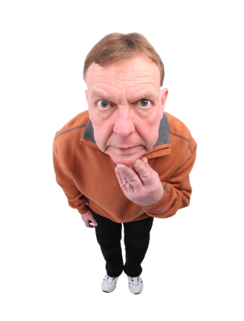
Who are the readers?
More men than women
Readers in all ages
5 percent are young (under 19)
Readers from all parts of Norway
80 percent have higher education
Researchers, students, journalists, teachers, public servants / private businesses
forskning.no is a spare time activity
Looking for news, but also specific topics
Are satisfied: quality, credibility, useful
Do not read about science on institutional websites

Slide 6
Different interests
Men say they are mostly interested in natural sciences
Women say they read mostly about culture and social sciences
But all read about health
Women of all ages do not read about natural sciences
Young women read as much about technology as men.

Slide 7
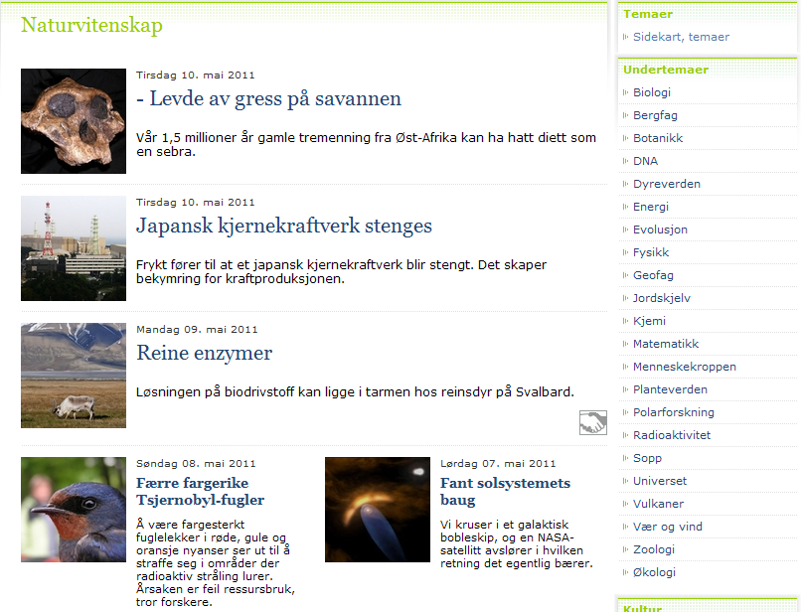

Slide 8
The sources
Researchers are satisfied with how their research was presented, and a majority was contacted by other media after the article was published on forskning.no.
Researchers can also write at forskning.no – in selected columns

Slide 9
Different interests

Slide 10
The researchers
Want their studies to be presented in depth
(Preferably on a full page in Aftenposten or Sånn er livet / Verdt å vite in NRK).
(With all references.)
Motives:
Bring attention to a topic
Social duty
To give back to informants / patients
More money
Honour and glory

Slide 11
The research institutions
Social duty
Results back to informants / patient groups
Honour and glory / academic recognition
Research communication as marketing of institution / program to government, financing sources, other institutions and private business.

Slide 12
The journalist
Wants a good story fast from a easy talking scientist who doesn’t emphasise details and who dears talk outside own field of research.

Slide 13
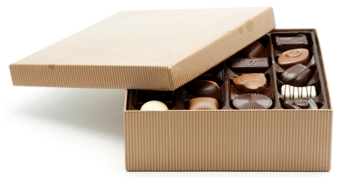
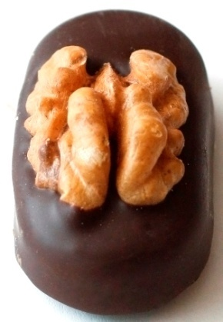
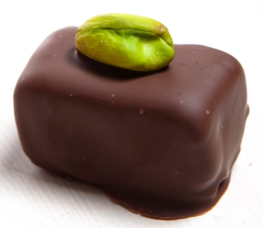
Research presented
Godsaker
The Implementation of PMTO in Norway: An Examination of Collective Efficacy, Therapist Clustering and Organizational Social Context
Ny teknologi, gamle forestillinger. Kloning og kunstige mennesker i Shelleys Frankenstein, Goethes Faust II og Huxleys Brave New World
Velg én
Maks to

Slide 14
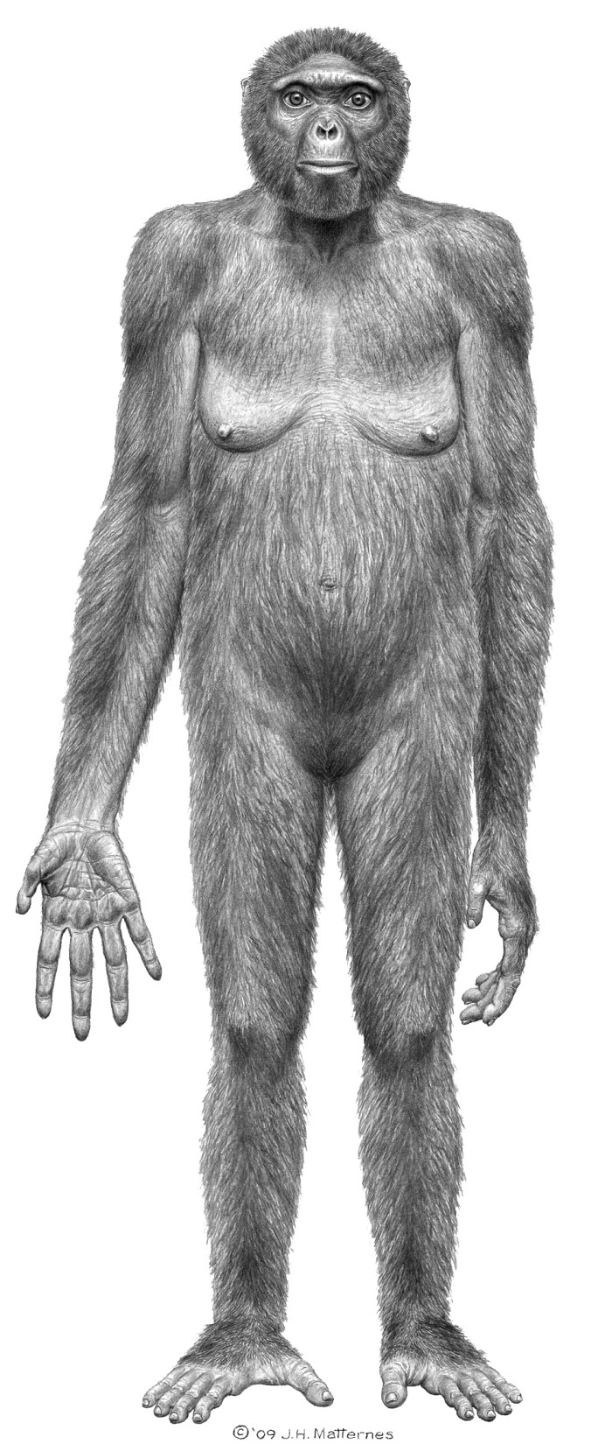
Think like a journalist
News - unusual, deviation from the expected
Current interest
Important: matters to many
Conflict: disagrement, crisis, competition
Strange
Closeness: personal, geography

Slide 15
Concider your own preferences
EU research – experiences
EU research – trends and development
The e-mail you must not send
Praise gets you high
The cursed research director

Slide 17
Most important
Give it all at the top
Newer more than three topics
Use cases from own research as examples
Use channels you are comfortable with
Communicate with readers – not colleguaes
Stop
The journalist is no expert
The journalist has not read your book / articles
Science journalists are kind
Check quotes, but be generous

Slide 18
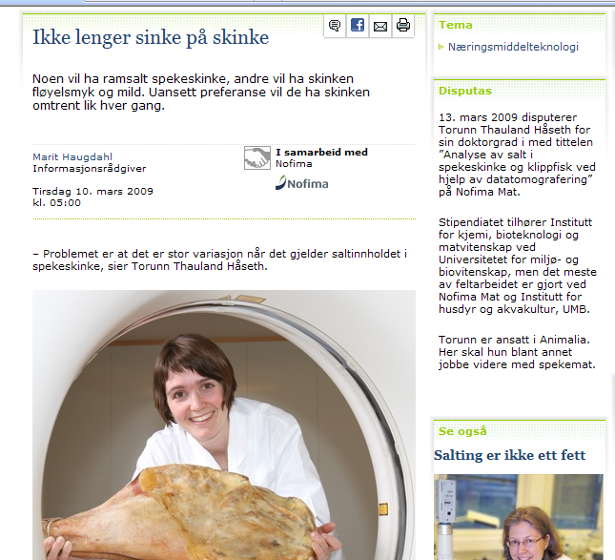

Slide 19
Forget:
Reservations / limitations
Emphasis on own modest role
Tables / statistics
More numbers than 3
All references to other people
The theoretical basis for your work
Partners
Financing sources
Bragging of own institution
Prizes, jubilees, starts, new buildings

Slide 20
Satisfy all!
Fact boxes
More information below
Links to more information
Link to publication
References

Slide 21
In forskning.no
We look for the good story
Write news
Cooperate with the researcher
Simplify, but not banalize
Use examples and pictures
Focus on reader

Slide 22
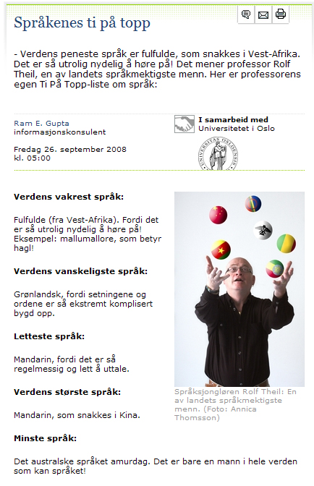
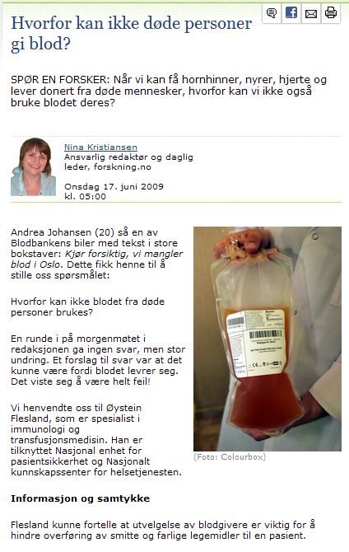
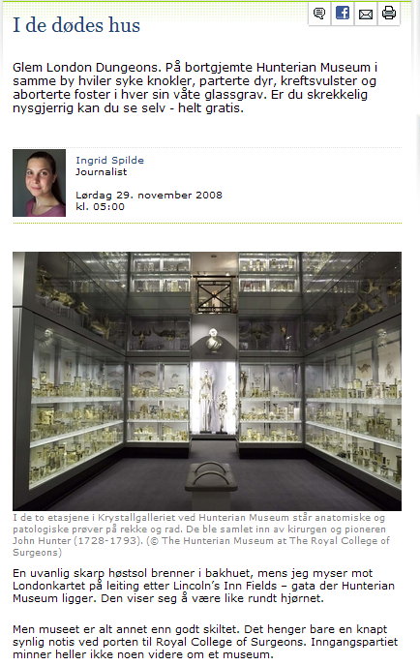
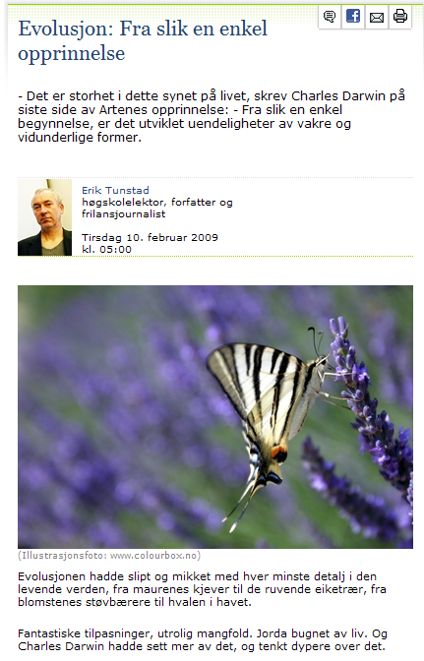
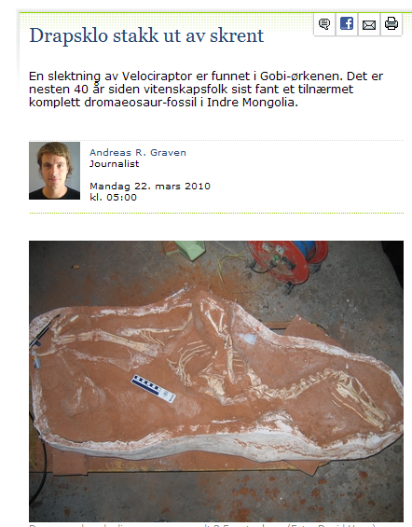
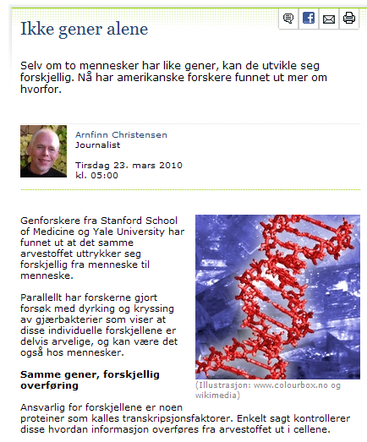
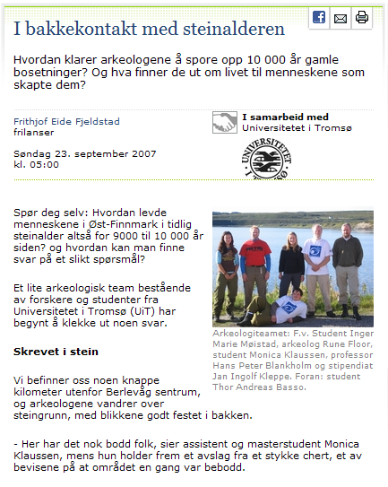
Articles
News: the result
Contribution to debate
Research process
Background
Feature
Curiosity
Entertainment

Slide 23
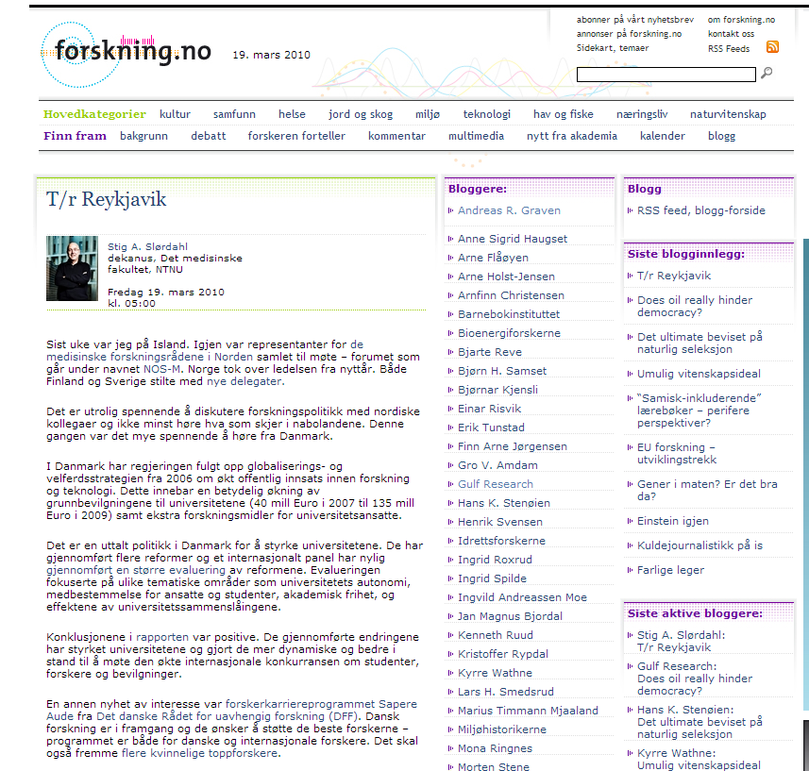
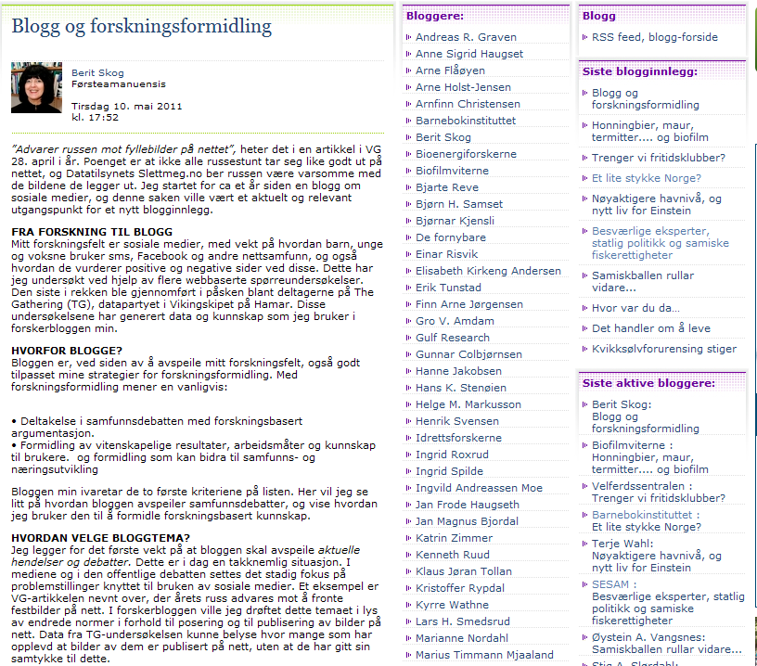

Slide 24
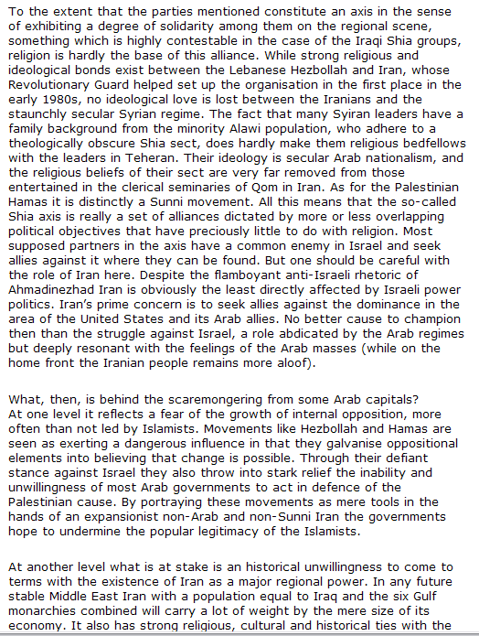
Blog
Topic: research
Dutch treat (one text per day)
Allow academic format
50 bloggers (11 groups)
Stig Slørdahl: 27.000 readers in 8 months

Slide 25
Pain is temporary
Glory is forever!

