Slide 1
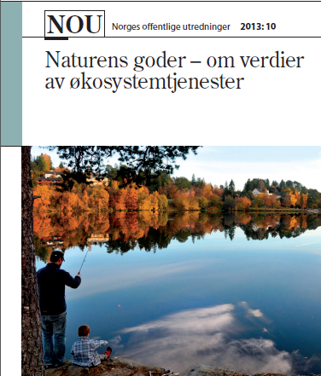

Slide 2
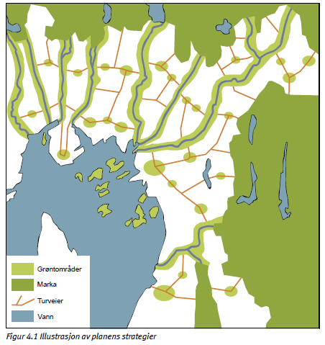
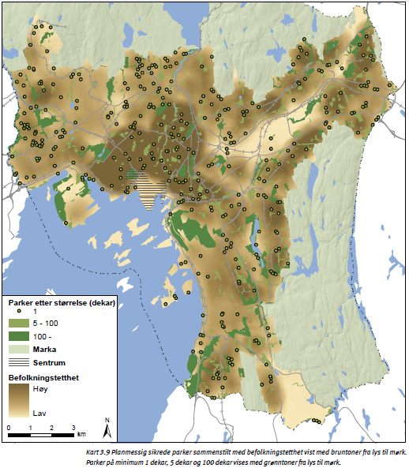
Blue-green infrastructure
Spatial heterogeneity of inhabitants preferences
Source: Oslo Kommune (2009)

Slide 3
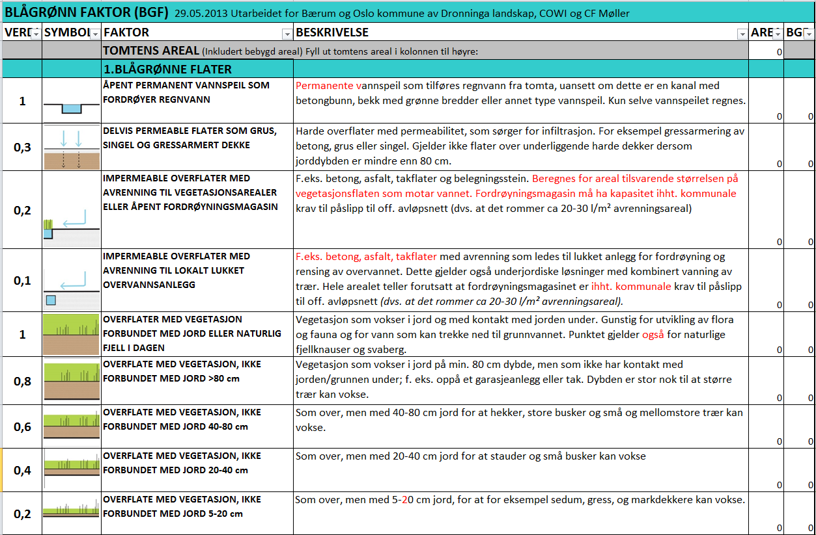
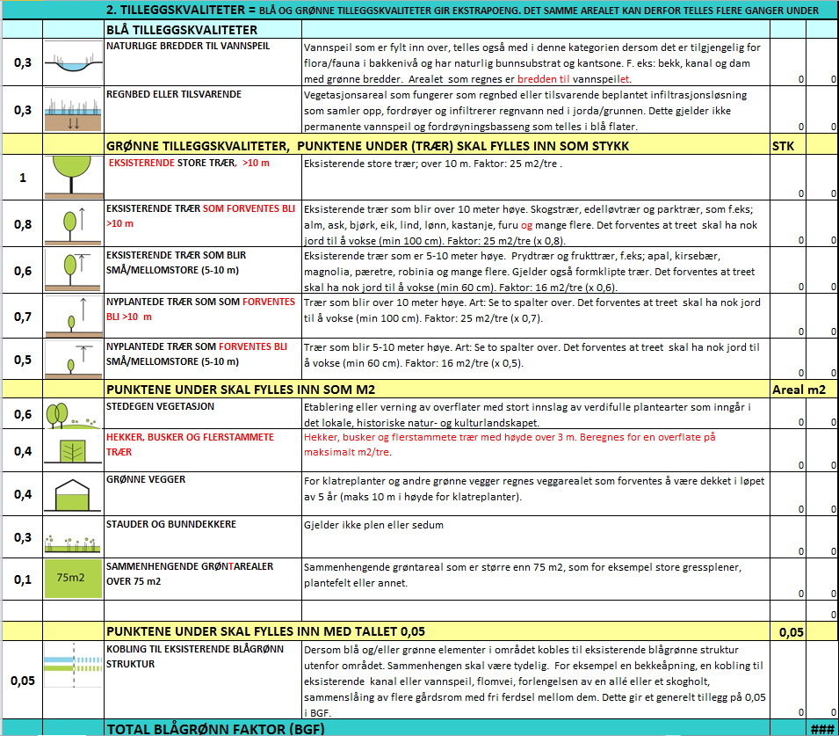
Blue-Green Factor (BGF) scoring for new urban developments in Oslo
Source: Municipality of Oslo, Planning and Building Agency

Slide 4
Indicators of ecosystem services
Blue-green factor (BGF)
Non-economic valuation
Ecosystems and biodiversity
Economic valuation
Biophysical structure
(trees, bushes, vegetation surfaces, soil structure, water courses ..)
Human well-being
Function
(habitat, open space, infiltration, regulation..)
Services
(user interests..)
Benefits
(health, recreation, avoided flood damange..)
Economic value
(willingness to pay, property prices, compensation,
mitigation costs..)
Source cascade diagram: adapted from NOU 2013:10 adapted from TEEB(2010) adapted from Haines-Young and Potchin (2010) and Maltby (ed. 2009)

Slide 5
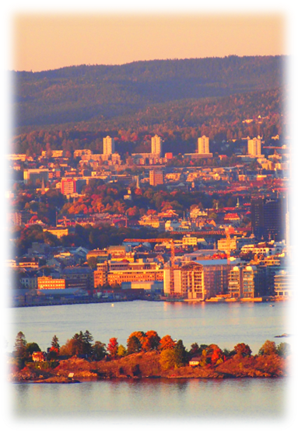
M.Sc. Thesis topics
Choice experiment of willingness to pay for blue-green structures
(stated preference)
Hedonic property pricing study
(revealed preference)

Slide 6
Contacts: Case study coordinator: henrik.lindhjem@nina.no david.barton@nina.no Communication and media: rasmus.reinvang@vista-analyse.no Oslo Municipality, urban environment department: tove.dyblie@bym.oslo.kommune.no

Slide 7
The ESOP Student Scholarships
ESOP has two types of scholarships:
The ESOP scholarship (4 scholarships)
The ESOP scholarship in Gender and Economics (2 scholarships)
To apply for the ESOP scholarship the thesis must be relevant to one or more of ESOP’s research ares
To apply for the ESOP scholarship in Gender and Economics the thesis must in addition have a clear focus on gender related issues.
The application deadline is October 20, 2014 for students writing their thesis in spring or fall 2015.
Applicants should have at least one supervisor among the ESOP research staff

Slide 8
What’s in it for you?
Each scholarship is 15 000 NOK
A personal work space with computer
The possibility to attend ESOP’s research seminars and workshops
You may receive financial support for project related travels
Might be asked to present part of your thesis for the ESOP research staff
What you should do:
Get more information on the ESOP scholarships and ESOP’s research areas, see examples of theses written by former recipients and find out what ESOP researchers are working on: www.esop.uio.no
Find a supervisor from ESOP and let them know you want to apply for a scholarship
Use your research proposal in your application for the scholarship.

Slide 9
The Science Shop/Vitenskapsbutikken - where employers and students meet
Facilitates project collaboration between students and the industry
Gives you the opportunity to write your thesis in cooperation with the industry
30 partners – 70 projects: ministries, research institutions, NGOs and consulting companies
What’s in it for you?: Networking, insight, relevance, access, mentor & scholarship

Slide 10
The Science Shop/Vitenskapsbutikken Projects available to you
Projects tagged with «economics»

Slide 11
Master Thesis Meeting, February 6, 2014
Advanced-Methods/Research Scholarships

Slide 12
Some Details
Three grants
NOK 15 000 per grant
Office space with computer
Invitation to all Department Seminars
Conditions
choose Advanced Methods/Research
complete two requisite 5000 courses
(write thesis suitable for doctoral studies)
Application deadline: April 1, 2014

Slide 13
Master thesis at Oslo Fiscal Studies (OFS)
Oslo Fiscal Studies is a centre for public economics (cooperation SSB, Frisch-centre, Economics Dep), http://www.sv.uio.no/econ/english/research/centres/ofs/
Several students writing their thesis through the centre today, examples are
Regional variation in the take-up of home care allowance (kontantstøtte)
Bunching at kink-points in the tax schedule
The dual income tax and economic growth
Tax evasion and the inheritance tax
Students are supervised by OFS-affiliates
Pure theory and data analysis

Slide 14
Some tentative examples
Corporate taxation after Scheel-commission
Characteristics of tax evaders
Estimation of bequest motives
Finding the right tax mix. Using simulation models to discuss effects of different tax packages
Interactions between spouses in the labor market under different tax regimes
Responses to the wealth tax. Do people try to avoid the wealth tax?
Required after-tax rates of returns for oil companies under different tax systems

Slide 15
The OFS Student Scholarships
There are 4 OFS scholarships
To be considered for the OFS scholarships, the thesis must be relevant to one or more of OFS’s research areas.
The application deadline is October 20, 2014 for students writing their thesis in spring or fall 2015.
What’s in it for you?
Each scholarship is 15 000 NOK
The possibility to attend OFS’s research seminars and workshops
You may receive financial support for project related travels
Applicants should have at least one supervisor among the OFS research staff

Slide 16
What you should do:
Get more information on the OFS scholarships and OFS’s research areas, and find out what OFS researchers are working on:
http://www.sv.uio.no/econ/english/research/centres/ofs/projects/scholarships/
2) Find a supervisor from OFS and let them know you want to apply for a scholarship
3) Use your research proposal in your application for the scholarship.

Slide 17
Contact information
You may get in touch with Vidar Christiansen (room 1120), Thor Olav Thoresen (room 1125, Fridays, email: thor.olav.thoresen@ssb.no or t.o.thoresen@econ.uio.no ) or other OFS affiliates.

Slide 18
The Research Department at Statistics Norway
Around 80 employees, most with Ph.Ds or equivalents
Research, focus on international publication
Cooperation with other research institutions
Also focus on Norwegian policy debate / advice to government
Wide use of SSB data, both aggregate and individual-based
Dynamic research environment
Currently 8 full-time Ph.D. students
and several master students
Organized as six Research Groups:
Microeconomics: Rolf Aaberge, roa@ssb.no
Public economics: Nils Martin Stølen, nms@ssb.no
Social and demographic research: Kjetil Telle, tel@ssb.no
Macroeconomics: Torbjørn Eika, tea@ssb.no
Environmental economics: Taran Fæhn, tfn@ssb.no
Energy economics: Mads Greaker, mgr@ssb.no
Notes:
«research institutions»: fremragende forskere over hele verden
Forskningsvirksomheten skal være en kilde til faktisk kunnskap
Forskningsvirksomheten skal omfatte utvikling av analyseverktøy for samfunnsplanlegging
Forskningsvirksomheten skal omfatte analyse av SSBs statistikk
The main objectives:
- To be a source of factual information
- To promote the development of models for social and economic policy analyses
- To analyse statistics compiled at Statistics Norway

Slide 19
Historical economics at SSB
A lot of data on Norway from ca 1850 onwards (and some even earlier)
Individual micro data (digitized censuses of 1801, 1865, 1900, 1910 are freely available)
Income distribution data (from tax records)
Social statistics, education, industry statistics, and much more
Often large geographical as well as time variation
Can analyze specific time periods, or very long time-series
Local or national cases
For ideas, see http://www.ssb.no/a/histstat/publikasjoner/
Some data is digitized at «kommunedatabasen» at www.nsd.no
Census micro data 1910 and earlier: www.nappdata.org
Contact:
Jørgen Modalsli, mod@ssb.no, 21094312
Rolf Aaberge, roa@ssb.no, 20194864
Notes:
Please get in touch. I do recommend that you think about a proposal, suggest you spend some time with the historical publications.
Language: many historical publications are dual language Norwegian-English. (before ca 1930s: Norw-French)

Slide 20
CREE – Oslo Center for Research on Environmentally friendly Energy
Partners:
Frisch center
Department of Economics, UiO
Research Department, Statistics Norway
Tilburg Sustainability Center (Holland)
Opportunities:
CREE master thesis grant
Participate on ongoing projects

Slide 21
Research profile and organization
Head of CREE: Snorre Kverndokk, Frisch center
International climate- and energy policy (e.g. sectorial treaties)
Mads Greaker, Statistics Norway
Policy measures and the innovation process (e.g. innovation prizes)
Rolf Golombek, Frisch center
Regulation and functioning of electricity markets (e.g. capacity markets)
Nils-Henrik M. von der Fehr, UiO
Evaluation of policy for the climate-energy nexus (e.g. energy efficiency)
Bente Halvorsen, SSB
Next generation numerical models (e.g. MSG with end. tech. change)
Brita Bye, Statistics Norway

Slide 22
Writing your masters thesis at the Frisch Centre
Oddbjørn Raaum

Slide 23
The Frisch Centre
Applied research institute on campus
Research on
Labor market
Health
Environmental policies and climate change
Behavioral economics

Slide 24
What can we offer?
Students take part in ongoing research projects
Access to data
Supervision
Office space
Scholarship NOK 20.000; application before 1 March, see www.frisch.uio for details

Slide 25
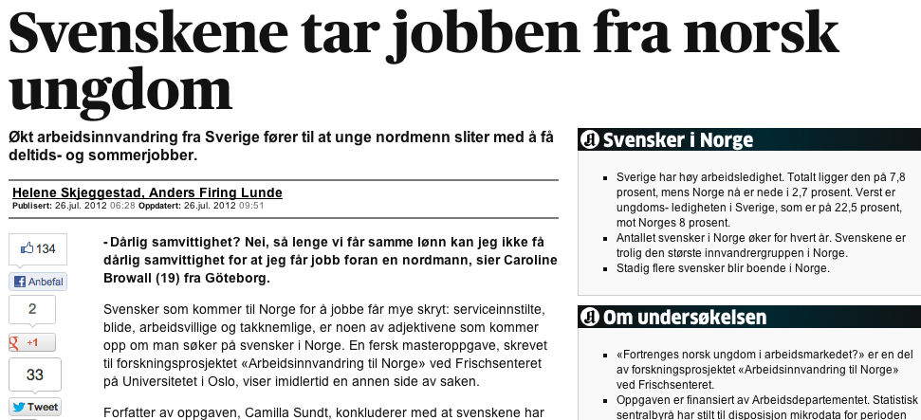
What have others done?

Slide 26
TELENOR ASA
A global mobile operator present in 13 countries (the richest and one of the poorest). A main strategic goal is to deliver internet for all
TELENOR RESEARCH
40 + researchers with PhD’s in many fields, of which
8 economists that work full time with
- To do excellent research
To provide Telenor with top advise
Contact: Gorm-Andreas.Gronnevet@telenor.com

Slide 27
We target five key research areas:
Competition
Data Analytics
Service Innovation
Next Generation Network Technology
Next Generation Services
The team develops insight on competitors, customers and regulations in order to navigate the complex competitive landscape
Leveraging our data, using all tools and sources available, to enhance customer insight and improve decision making
Transforming Telenor into a customer centric company based on
service design, customer insight and organizational analysis
Researching the future network technologies and service network architectures with focus on disruptive changes
Explore the use of next generation mobile, web and Internet technologies for developing and delivering services on various devices

Slide 28
Telenor master grants (50 000 NOK)
We are looking for good analytical skills. All applicants are therefore free to formulate their own master research. It should be relevant for Telenor.
Example topics
Pricing How should we price and price discriminate in social networks?
Radio Spectrum How should governments manage this resource to benefit their society?
Competition What is a good strategy in a growing market when fixed costs are large and marginal costs are zero?
Regulation - how to efficiently regulate the telecom markets?

Slide 29
Applied Development Economics
Tanzania land market (AmbTanz)
Formalization+growth→increase land price
Make survey data set
Brazil local content in oil (NFR-LA)
Learned anything from old ISI?
Organize and analyze dataset
http://www.nibrinternational.no/brazilian_industrial_policy/

Slide 30
Colombia land restitution (MFA-PR)
Create peace or conflict?
600 household survey
www.colombialandgender.org
Dedicated student – Make a difference!
Office at NIBR, Forskningsparken
Paid related RA work

Slide 31
NUPI (Norwegian Institute of International Affairs)
Multi-disciplinary but with separate department for International Economics
About 10 people, 4 full-time researchers
International economics, trade and development
Supervision
«Interns», if related to projects: Some scholarships
Sometimes: research assistant opportunities
Limited capacity, you can ask
arne.melchior@nupi.no or fulvio.castellacci@nupi.no
Upcoming projects, examples:
Trade integration in the FSU area
Firm heterogeneity and the organization of international trade

