Slide 1
Development Economics
ECON 4915
Lecture 8
Andreas Kotsadam

Slide 2
Outline
Possible exam question and a recap.
Political and Cultural change
    Quotas for women in Politics (Beaman et al. 2009).
    Cable TV (Jensen and Oster 2009).

Slide 3
Possible exam questions
Qian tests if there are economic incentives for parents to prefer girls/boys. How? What empirical strategies?
What are the results? What are the possible mechanisms and how does she discriminate between them?

Slide 4
Mechanisms in Qian
Changed perceptions of daughters’ future earnings.
Girls may be luxury goods. (ruled out by orchard results)
If mothers prefer girls and if it improves mothers’ bargaining power.
Pregnancies are costlier as womens labor is valued more. (ruled out by education results?)

Slide 5
Political and cultural change.
Can we expect change to happen rapidly?
Does change have to come from policies and what is the role of markets?
We will look at both types of changes within the same country (India).
    Quotas for women in Politics (Beaman et al. 2009).
    Cable TV (Jensen and Oster 2009).

Slide 6
Detour on Norms
Social norms influence expectations, values, and behaviors.
They define and constrain the space for people to exercise their agency.
As such they can prevent laws, better services, and higher incomes from removing constraints to agency.
Social norms are typically most resilient in areas that directly affect power or control.

Slide 7
Beaman et al. 2009
Research question: Does exposure to female leaders reduce bias?
    Interesting? Yes: Important topics, quotas are very common and cultural change is important.
    Original? Yes: Little is known about the effects of quotas on attitudes.
    Feasible? Yes: By using experiments and the 1993 quota reform.

Slide 8
Detour on political participation
Women hold less than 20 percent of seats globally
Affirmative action in more than 100 countries
Women tend to be less engaged in politics than men, with party affiliation rates on average about half those of men

Slide 9
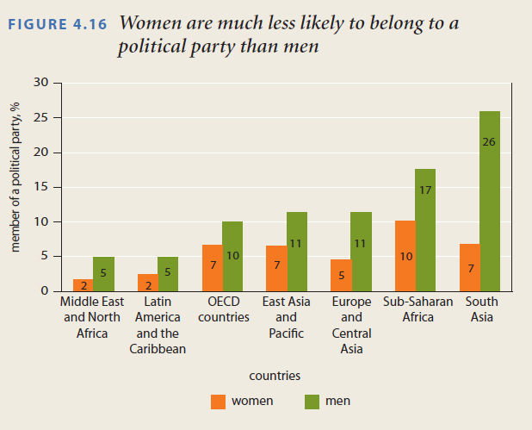

Slide 10
Different mechanisms.
Time constraints
lack of professional networks.
Direct norms.
Gap in political participation is important as it reproduces existing inequalities!

Slide 11
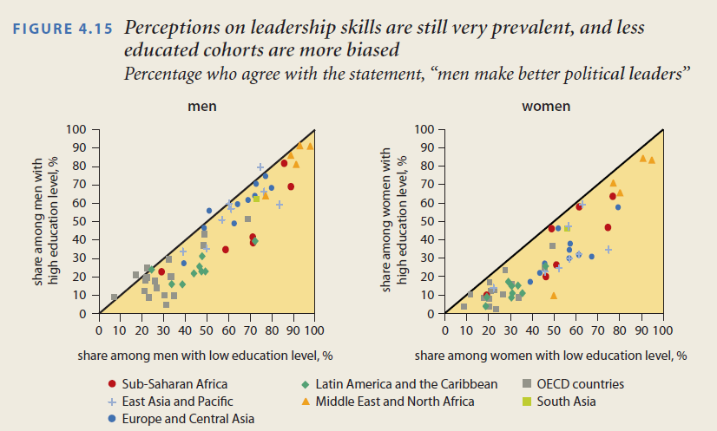

Slide 12
Should we expect quotas to change norms in women´s favor?
No, people may dislike quotas as voter choice becomes limited.
No, as quotas may violate gender norms about what women should do.
Yes, if it provides information to risk averse individuals.
Yes, if it changes perceptions about what men and women should do.

Slide 13
Empirical strategies
First of all they exploit random variation in quotas for female leaders in India.
Since 1993 1/3 of all councilor positions and 1/3 of all chiefs (pradhan) must be women.
These reservations were randomly allocated so identification is straightforward.

Slide 14
Empirical strategies
Using this random variation they investigate whether women are more likely to be elected in areas previously reserved for women.
Then they move on to investigate whether change in voter attitude is a mechanism using survey data.

Slide 15
Empirical strategies
Vignettes with recorded speeches are further used to get experimental variation in bias against women.
IATs were used to measure gender-occupation stereotypes as well as taste based discrimination.

Slide 16
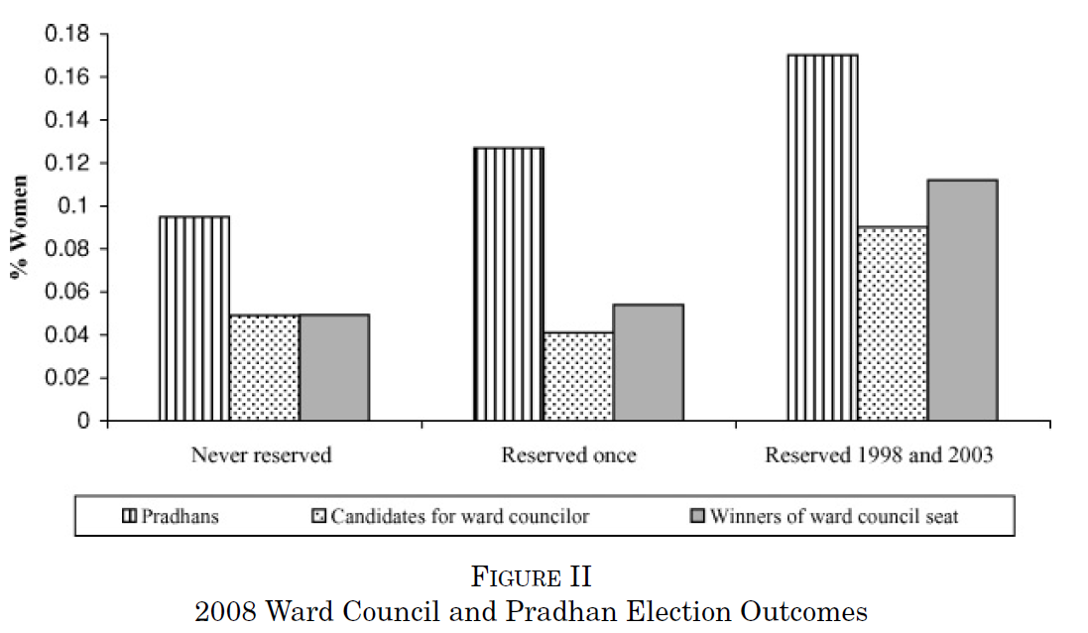
Reservation makes it easier for women to become elected in later years

Slide 17
Several mechanisms may be at play
First, female pradhans may act as important role models and mentors.
Second, female pradhans may have also helped create and strengthen political networks that benefit women politicians.
Third, women leaders take different policy decisions.
Fourth, exposure to a female pradhan may change voter attitudes.

Slide 18
Test of changed attitudes
First they use survey data asking respondents to evaluate their pradhans and their satisfaction with level of public goods provision.
Then the survey elicited experimental data on villager evaluation of hypothetical leaders.

Slide 19
Evaluations of leaders (1)
Evaluations in villages reserved once were significantly worse than in never-reserved villages.
In contrast, in twice-reserved villages there was no difference as compared to never-reserved villages.
Why? They examine two plausible explanations: Relative to first generation female pradhans, second generation female pradhans either have different characteristics or act differently.

Slide 20
Evaluations of leaders (2)
No indication that observable differences between male and female pradhans drive the evaluation gap.
And male pradhans do not outperform female pradhans (women leaders provide more public goods of equal quality and are less likely to take bribes).

Slide 21
Evaluations of leaders (3)
However, the bundle of public goods chosen by female leaders may be less valued by male villagers.
Alternatively, the evaluation gap may reflect the fact that first-time women leaders are simply worse at getting credit for their work.
Or are less willing (or able) to bribe influential villagers.

Slide 22
Experimental evidence
Use vignettes and IATs to capture both taste based and statistical discrimination.
Vignettes follow the ”Goldberg paradigm”, the gender of the protagonist is randomly varied in a tape recorded leader speach.
One activity based and two taste based IATs were used.

Slide 23
Implicit association tests
An IAT is a computerized test that aims to measure attitudes of which respondents may not be explicitly cognizant.
It uses a double-categorization task to measure the strength of respondent association between two concepts.

Slide 24
Task 1 (practice):
Pleasant | Unpleasant
Suffering
Press E to classify as Pleasant or I to classify as Unpleasant

Slide 25
Task 2 data collection
Black/ | White/
Pleasant | Unpleasant
Happiness
Press E to classify as Black or Pleasant or I to classify as White or Unpleasant

Slide 26
Implicit association tests
The time a respondent takes to accomplish each categorization task is recorded in milliseconds.
A stronger association between two concepts makes the sorting task easier and faster.
https://implicit.harvard.edu/implicit/

Slide 27
Activity and taste based IATs
An activity-based IAT to assess whether villagers exposed to reservation are less likely to associate women with domestic activities and men with leadership activities.
The first taste IAT assesses the associational strength between male and female names and positive (e.g., nice) and negative (e.g., nasty) attributes.
The second measures the association between these attributes and images of male and female politicians (e.g. pictures of either men or women giving speeches).

Slide 28
Results
A significant bias among men in never-reserved villages in the vignettes and reservation reverses this bias.
Both genders associate leadership activities more strongly with men in never-reserved areas and quotas reduces this association among male respondents.
No effects on taste for female leaders

Slide 29
To conclude
Internal validity: Clear cut.
Mechanisms: Extremely nice with experiments on experiments, but it would have been even nicer with some test of e.g. risk aversion.
External validity: Quotas need not produce the same results in other settings.

Slide 30
Jensen and Oster 2009
Research question: Does cable tv affect women’s status?
    Interesting? Yes: Important topic (empowerment, especially in India), market based mechanism for cultural change.
    Original? Yes: Few rigorous empirical studies of the impacts on social outcomes.
    Feasible? Yes: By using panel data and Diff in diff.

Slide 31
Why should we care about television?
Number of TV’s exploded in Asia.
Television increases the availability of information about the outside world and exposure to other ways of life.
Especially true in rural areas.
Main argument: Exposing rural households to urban attitudes and values via cable tv may improve the status for rural women.

Slide 32
Data
Main data set: A three year panel between 2001 and 2003.
180 villages.
Cable was introduced in 21 of the villages.

Slide 33
Main measures
Son preference: “Would you like your next child to be a boy, a girl, or it doesn’t matter?”
Domestic violence: A husband is justified in beating his wife if X, Y, Z.
Autonomy: Who decides on X, Y, Z? Need permission to X, Y?
Fertility: Currently pregnant, and birth histories.

Slide 34
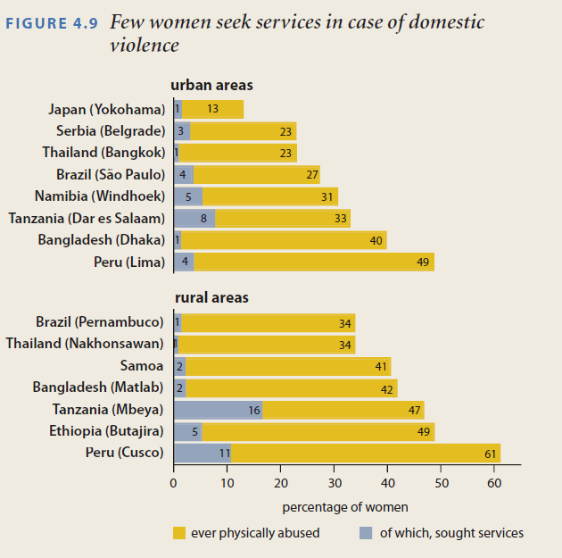

Slide 35
Empirical strategy
”…relies on comparing changes in gender attitudes and behaviors between survey rounds across villages based on whether (and when) they added cable television” (p. 1059).
= Difference in differences (DD).

Slide 36
Recap DD
Typical DD assumption: ”villages that added cable would not otherwise have changed differently than those villages that did not add cable. ”

Slide 37
The typical DD problem
”… we cannot rule out with our data is that there is some important unobservable that simultaneously drives year-to-year cable introduction and year-to-year variation in our outcome measures. Although this seems unlikely, and we are unable to think of plausible examples, it is important to keep this caveat in mind.”

Slide 38
They are concerned about omitted variables
“A central empirical concern is the possibility that trends in other variables (e.g., income or “modernity”) affect both cable access and women’s status.” (p. 1059f).
First of all, they have to describe the factors determining which villages got cable.

Slide 39
Determinants of cable
Interviews with cable operators: access to electricity and distance to the nearest town.
A survey of cable operators: main reason for no cable was that the village was too far away or too small.
Merge villages with administrative data from an education database and the SARI data

Slide 40
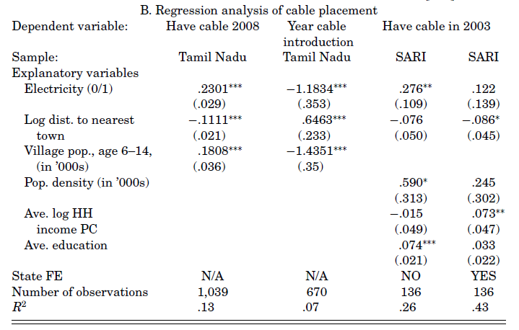
Determinants of cable
Table 1
Only within state variation

Slide 41
But this is hardly enough
”Under the assumption that these variables constitute the primary determinants of access, controlling for them should allow us to more convincingly attribute the changes in the outcomes to the introduction of cable.”
Well, yes, but ”we certainly cannot rule out that there is some important variable that drives cable introduction that was not mentioned by cable operators and that also has an impact on our outcomes of interest.”

Slide 42
Estimation

Slide 43
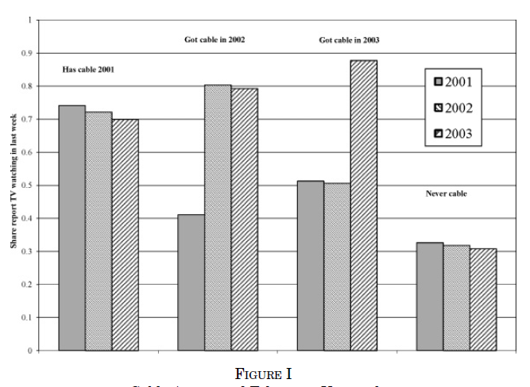
Large jumps (and of similar magnitude)
precisely when they get cable
Get tired of it,
nothing new.
Lower level, and similar trend,
nothing new on tv.

Slide 44
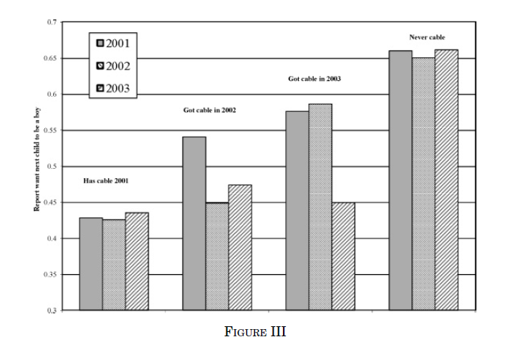

Slide 45
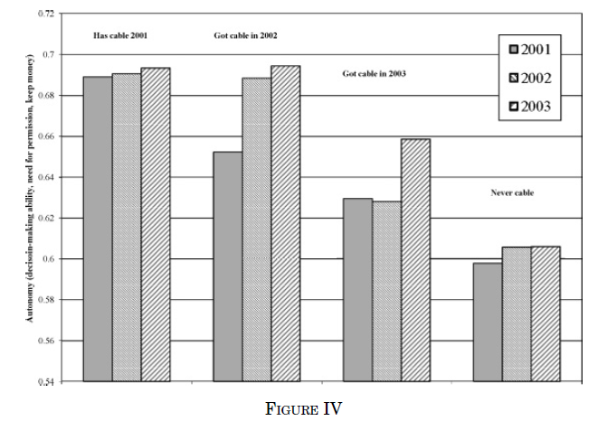

Slide 46
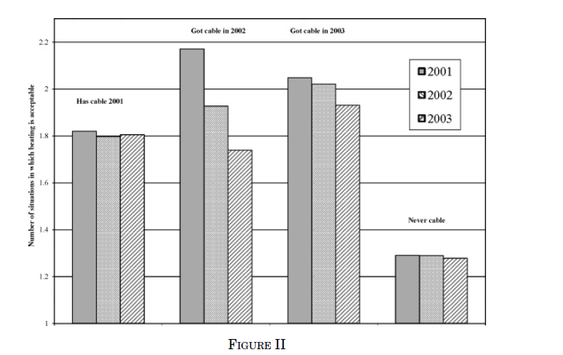
Is this a problem?

Slide 47
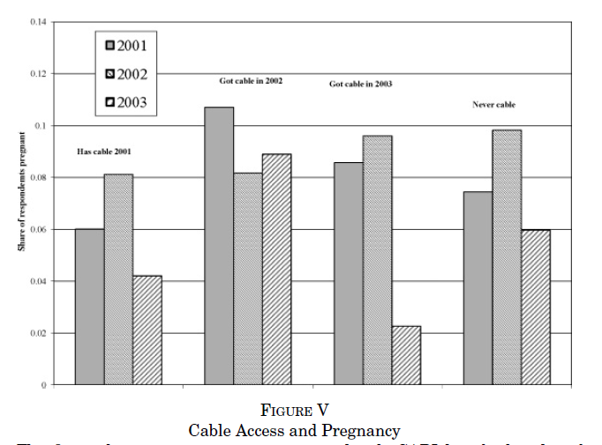
Is this a problem?

Slide 48
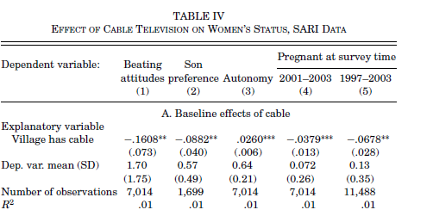
We don’t really explain that much. Is this a problem?

Slide 49
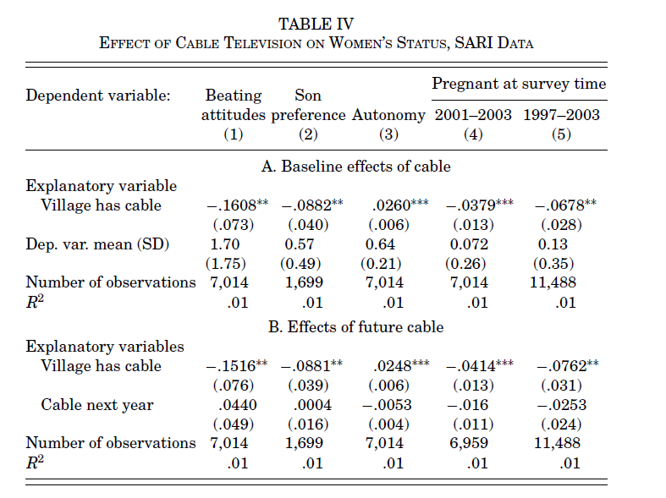
S
Similar magnitudes
PLACEBO

Slide 50
Mechanisms
Why does it have an effect?
    Provides information on birth planning?
    Change the value of time?
    Men’s leisure time is higher?
    Or, their pick: Exposure of urban lifestyles
We don’t really know. More research is needed.

Slide 51
External validity and data issues
Main dataset includes only hh with oldies.
It is not really rural-urban, it’s capital-rural.
Men were not interviewed, would have helped for the mechanism discussion.

Slide 52
What do you think?
Did cable TV have an effect?
Why did it have an effect?
Is it policy relevant, should we subsidize cable tv?

Slide 53
Could they have done it differently?
Why not exploit access to electricity and distance to the nearest town?
Why not compare villages just outside of reach of the cable (Fuzzy RD or more comparable DD)?
Why not use (plausibly exogenous) geographic factors? E.g. Yanagizawa-Drott 2010. “Propaganda and conflict, theory and evidence from the Rwandan genocide”.

Slide 54
Exploits The Topography of Rwanda.

Slide 55
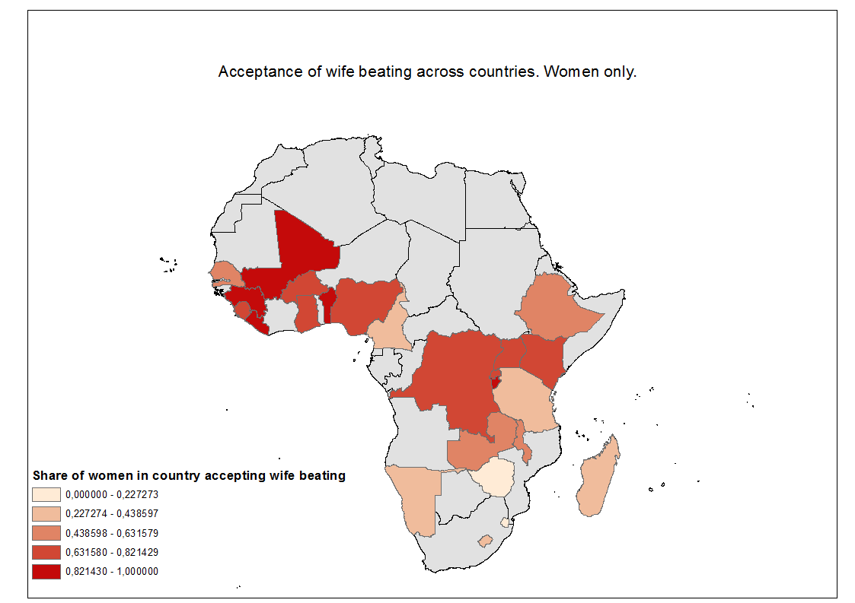
They only look at attitudes

Slide 56
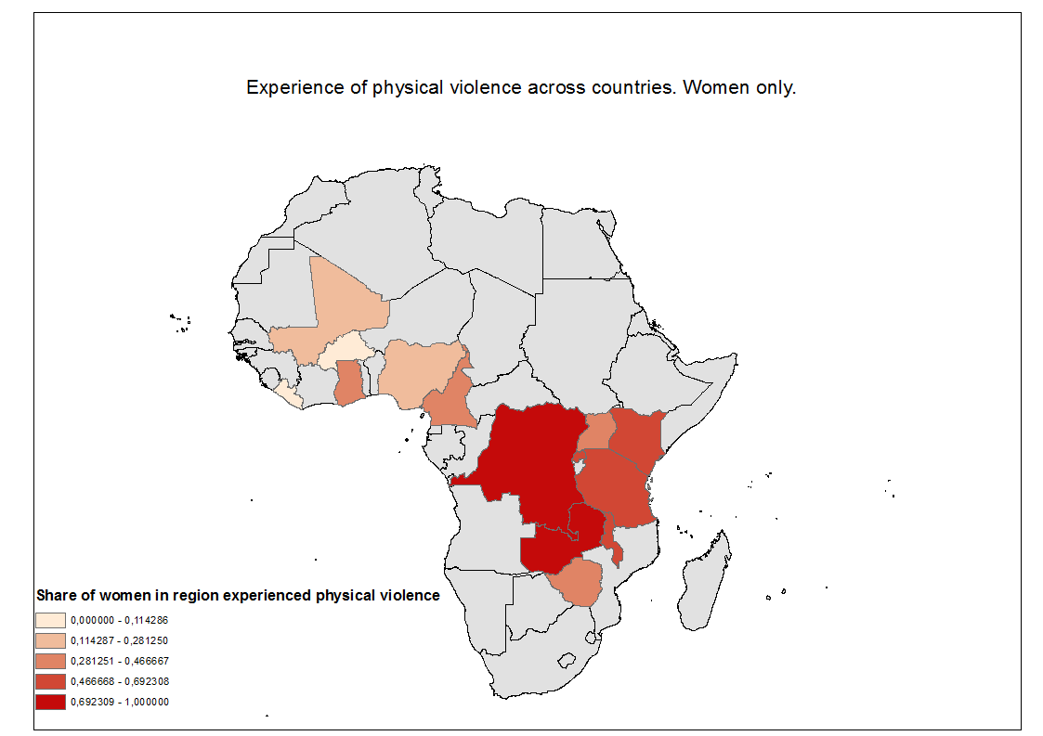
Correlation with actual beating?

Slide 57
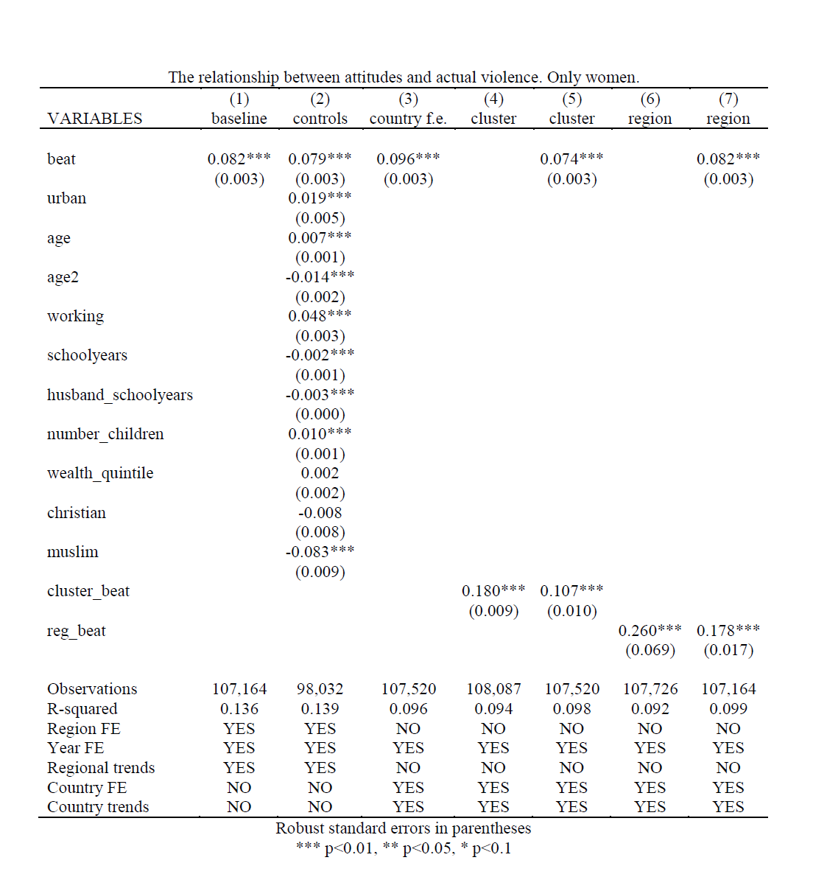
I ran some regressions

