Slide 1
ECON 4921: Lecture 2
Jon Fiva, 2009

Slide 2
Institutions and economic performance
We are interested in establishing the causal effect of institutions on long run economic performance.
However, this is not straight forward: Correlation is not causation.
Institutions are endogenous to economic performance.
  Causality runs both ways
    E.g. poor countries lack the resources to build effective institutions
  Omitted variable bias
    Underlying conditions (e.g. geography, religion, history, culture) that lead to both institutions and economic performance.

Slide 3
Possible Solution
Detour: The experimental ideal
In the absence of experimental data a possible solution is instrumental variable (IV) techniques.
Need a variable (z) that fulfill two criteria:
  Relevance
  Excludability
Observables
Unobservables
Institutions
Z
Economic Performance

Slide 4
The colonial experiment
In a similar fashion to HJ, AJR use European colonialism to isolate potential exogenous variation in current institutions.
Key difference between HJ and AJR identifying assumption:
  Colonizer characteristics vs. conditions in colonies
Proposed Z : Settler mortality
Observables
Unobservables
Institutions
Settler Mortality (M)
Economic Performance

Slide 5
Settler mortality
In the tropics, 80 percent of European deaths were caused by malaria and yellow fever.
  Europeans in Africa, India and Caribbean faced very high death rates.
  But death rates for the adult local population were much lower (developed immunity).
  Yellow fever in W. Africa was ’a strangers disease’.
  … and had little effect on the health and economy of indigenous people.
Settler mortality = Mortality of soldiers, bishops and sailors between 17th and 19th century.

Slide 6
AJR approach rests on three premises
  Different types of colonization policies created different sets of institutions.
    ’Extractive states’ e.g. Congo, Nigeria, Tunisia
      No protection of private property
      No checks and balances against government.
      Confiscatory taxation
    Neo-Europes, i.e. US, NZ, AUS.
      Protection of private property
      Law and order
  Feasibility of settlements affected the probability of different sets of institutions.
      Do not argue that Eur. Influence in itself was positive or negative
      Exploit variation generated by local disease environment, proxied by Europeans’ mortality rates
  Early institutions affect current institutions

Slide 8
Reduced form show strong negative relationship between settler mortality and current economic performance.
  AJR interpretation: Reflects impact of settler mortality on current institutions

Slide 9
Current institutions
Focus: property rights and checks against government power (’property rights institutions’)
Proxy for institutions: Protection from expropriation risks.
  Vary from 0 to 10, for each country for each year.
  AJR use average over 1985-1995
  Extractive state → low value on this index.
Broad measure of property rights.
Data from Political Risk Services
  Private company which assess the risk that foreign investment will be expropriated in different countiries.

Slide 10
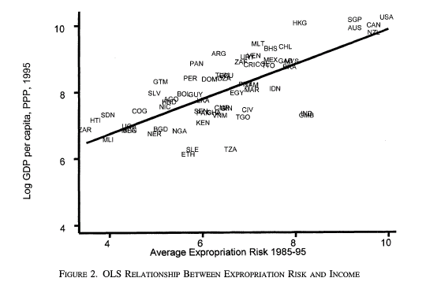

Slide 11
The equation of interest

Slide 12
OLS
Plain OLS estimates of eq (1) find a strong assocation between R and Y. Also when controlling for latitude and continent dummies.
But this does not necessarily show a causal effect
  Rich economies may prefer (or afford) better institutions
  Omitted variables
  Measure of institutions created ex post
  Attenuation bias (due to poor institution measure)
Does this suggest an upward or downward bias in OLS?

Slide 13
IV
Solution, treat R as an endogenous variable.
The first stage:
Isolate exogenous variation by using predicted values of R from first stage regression in the second stage.

Slide 20
IV cont.
IV estimates suggest a large and statistically significant effect of institutions on national income.
  Differences in institutions account for over 75% of the variation in income per capita today
  Improving the institutions of Nigeria to the level of Chile would lead to a 7-fold increase in Nigeria’s income.
    (in practice the difference is 11-fold)
  No impact of geography, when institutions are treated as an endogenous variable
    ”These results suggest that Africa is poorer than the rest of the world not because of pure geographic or cultural factors, but because of worse institutions” (p. 1372 AJR).

Slide 21
IV cont.
Results robust to:
  Different subsamples
  Controlling for continent dummies, geography.
  Controlling for current prevalence of malaria and life expectancy
  Only using yellow fever as an instrument (eradicated today)

Slide 22
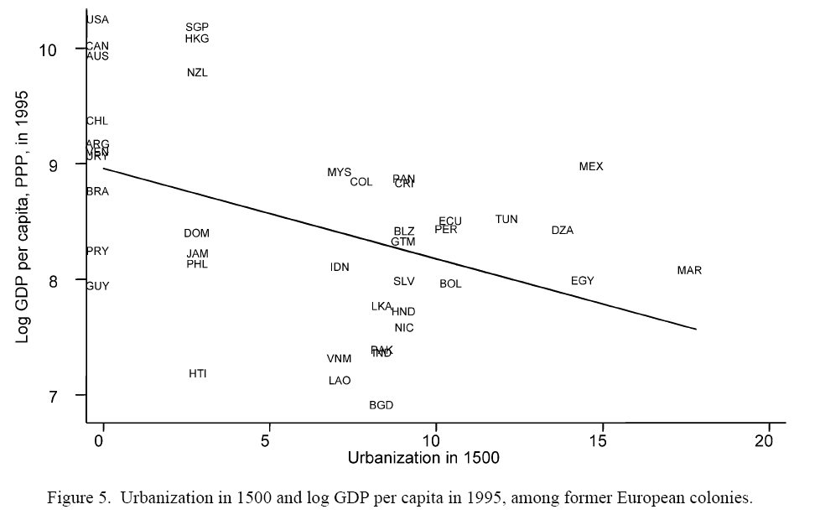
Reversal of fortune
Many of the areas that were colonized in the tropical zone were richer and more densely populated in 1500 than the temperate areas later settled by Europeans.
  e.g. Mughals in India/Aztecs and Incas in Americas vs. North America, Australia.
Proxy for pre-industrial income per capita : urbanization
Source: Acemoglu et al. 2002, QJE

Slide 23
Reversal of fortune cont.
Geography or culture can hardly explain the reversal
But AJR suggest:
  Relatively rich places got worse institutions (’extractive’).
  Relatively poor places, where colonizers settled in large numbers, got better institutions protecting property rights of a broad cross-section of society.
  Can explain timing of reversal (19th century): When there are more investment opportunities, institutions should be more important.

Slide 24
Main point
The work of AJR suggest that institutions are the fundamental cause of long run growth.
  good institutions prevent the government or elite to extract rents from society.

Slide 25
Unbundling institutions
AJR focus on property rights institutions, i.e. institutions constraining government and elite expropriation.
A closely related literature focus on contracting institutions, i.e. institutions supporting private contracts.
      Several papers by Shleifer and co-authors (e.g. La Porta et al JPE1998, La Porta et al. JEL2008)
      Main division: common vs. civil law
      Colonial transplantation of the legal system
Acemoglu and Johnson (to be discussed at the seminar) aim to ’unbundle institutions’
Main findings:
  Weak contracting institutions do not have a negative effect on long-run economic performance, while property rights institutions do.

Slide 26
Conditions in the colonies
A key aspect of AJR is that it is not the identity of the colonizer that matters, but conditions in the colonies.
  Clearly depart from HJ where European influence in itself is deemed beneficial
Related to the work of Engerman and Sokolof (1997, 2000).
  The Caribbean islands illustrate the adverse affects of Europeans, which set up repressive regimes based on slavery and forced labor.
  Factor endowments such as geography, climate and soil conditions help explain the builings up of ’good institutions’ in nortern am. And ’poor institutions’ in Lat. Am.

Slide 27
Paths of development
North am. Of relatively ”marginal econ. Interest compared with the extraordinary opportunities available in the Caribbean and Lat. am” (ES2000)
Haiti probably richest country in the world (on per cap basis) in 1790
Puzzle: Why did US/CAN experience sustained econ. Growth in 18th and early 19th century?

Slide 28
Factor endowments
Some econ. Historians have explained the divergence due to the identity of the colonizer.
  But striking differences within the identity of the colonizer (e.g. US, Can vs. Barbados, Jamaica, e.g. Argentina vs Peru) calls for other explanation.
AJR explain the divergence as a result of institutions.
ES: Factor endowments (incl. Climate, soil, density of native population)
  Predisposed North am. Colonies towards relatively equal distributions and corresponding institutions favoring a broad range of the population in commercial activity.
    Suitable for grains and livestock
    → no economics of scale → Small family farms
  Predisposed Lat. Am, Caribbean colonies to highly unequeal distributions and institutions that protected the elite.
    Suitable for cultivating sugar and other highly valued commodities
    → economics of scale → extensive use of slaves, and the densely populated native population.

Slide 29
Persistence
”In those societies that began with extreme inequality, elites were better able to establish a legal framework that insured them disproportionate shares of political power, and to use that greater influence to establish rules, laws, and other government policies that advantaged members of the elite relative to non-members – contributing to persistence over time of the high degree of inequality”. (ES2000)
Inequality → elite with strong political power → institutions
  E.g. consider the extension of franchise in North Am. Vs Lat. Am.

Slide 30
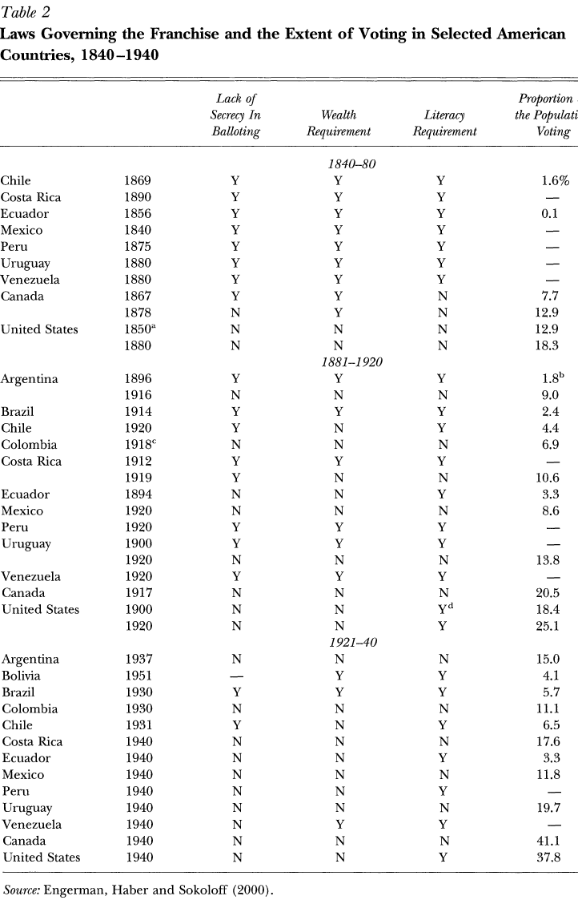

Slide 33
Further reading
Acemoglu, Johnson and Robinson 2002, QJE, Reversal of fortune: http://www.jstor.org/page/termsConfirm.jsp?redirectUri=/stable/pdfplus/4132478.pdf
Engerman and Sokoloff 2000: http://www.jstor.org/view/08953309/di014723/01p02397/0
Rafael La Porta , Florencio López de Silanes, Andrei Shleifer , and Robert Vishny . "Law and Finance" Journal of Political Economy 106 (1998): 1113-1155. http://www.journals.uchicago.edu/cgi-bin/resolve?JPEv106p1113PDF
Rafael La Porta , Florencio López de Silanes, Andrei Shleifer. ”The Economic Consequences of Legal Origin”, Journal of Economic Literature 46 (2008), 285-332 http://www.economics.harvard.edu/faculty/shleifer/files/consequences_JEL_final.pdf

