Slide 1

Developmental Language Disorders
Professor Courtenay Norbury
c.norbury@ucl.ac.uk

Slide 2
By the end of this lesson you will be able to…
Complete a causal model of DLD
Discuss the changes and the RATIONALE for changes to diagnostic criteria and terminology to DLD (formerly ‘specific language impairment’)
Outline key findings of longitudinal studies of DLD & discuss implications for research & practice
Describe cognitive theories of language disorder

Slide 3
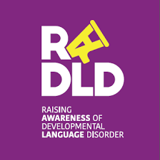
What do you notice about:
Language children are using
Social communication skills
How do they describe the impact of DLD?
https://www.youtube/RADLD

Slide 4
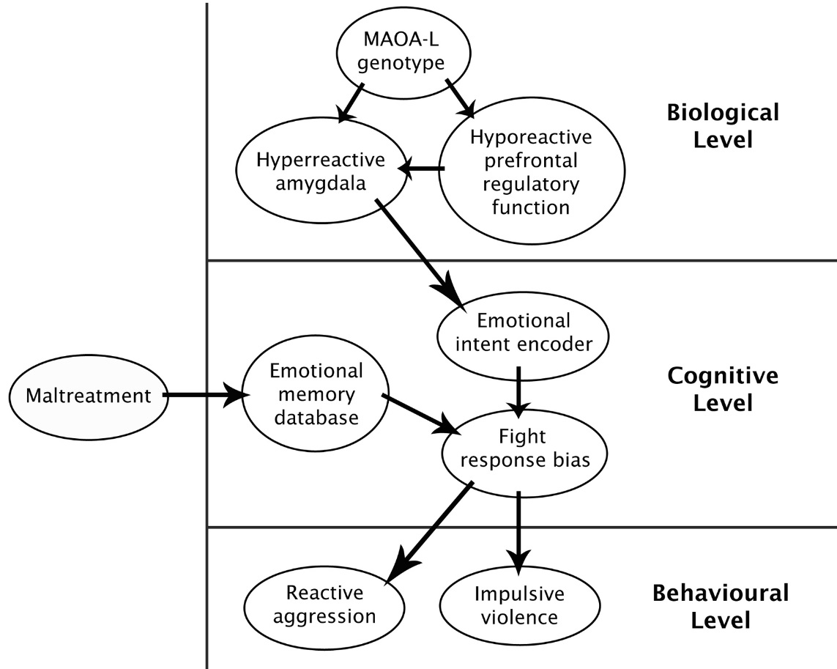
Morton & Frith (1995) Causal Modelling
Framework for Developmental Disorders
genetic and neurological risk factors
environment
how information is perceived, processed, learned
non-genetic influences on development, incl. CHANCE
phenotype or observed features of the condition

Slide 5
(Developmental) Language Disorder – DSM5 (APA 2013)
child’s language abilities are below chronological age expectations
language deficits are not explained by other developmental concerns such as sensory impairment, autism, extreme deprivation, head injury, global developmental delay
  although language impairment is frequently associated with other developmental concerns
language impairments interfere with everyday life at home or at school

Slide 6
Phonology
the sounds of language
Syntax/morphology
the rules that control sentence formation and word endings (plural, past tense)
Language
Semantics
the meaning of individual words & words in context
Pragmatics
the use of language in context & social exchanges (narrative/discourse)

Slide 7
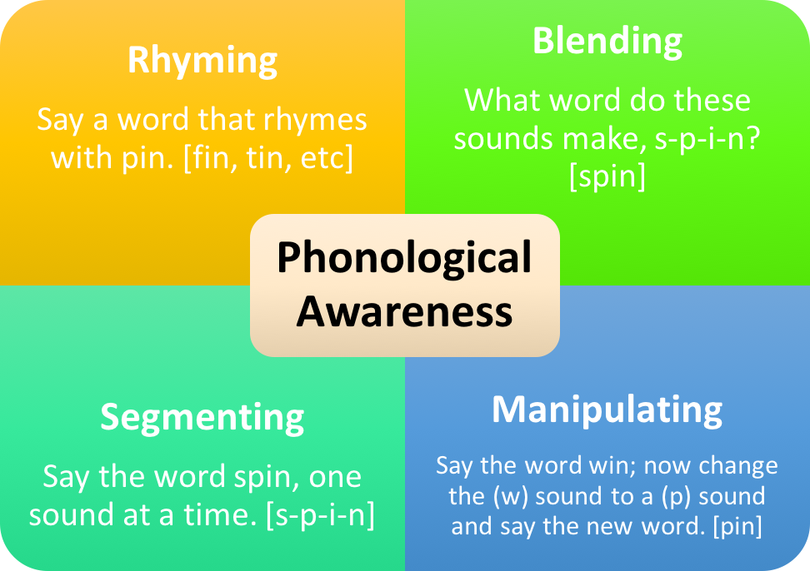

phonology
articulation: accurate production of speech sounds

Slide 8
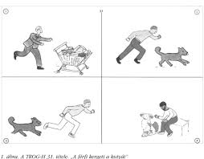
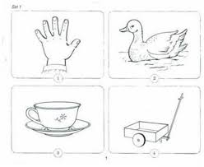
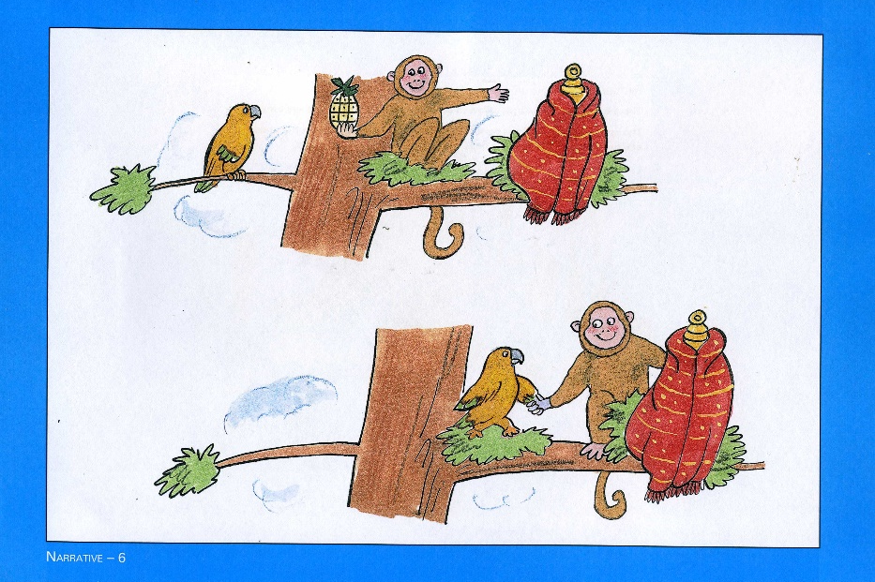
Receptive language measures
‘the man was chased by the dog’
‘show me the duck’
What was hiding under the red blanket?
Why did the parrot follow the monkey to the red blanket?
‘which two words mean
Almost the same thing?’:
boat skateboard ferry
Joyous ecstatic melancholy

Slide 9

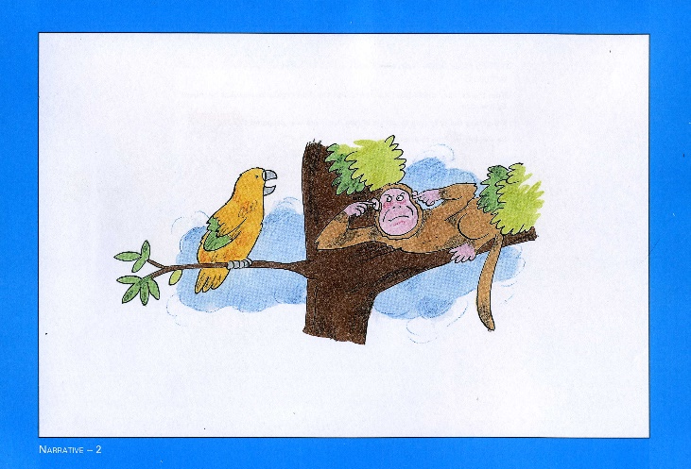
expressive language
Definitions (e.g. WISC):
What is a shoe?
What does freedom mean?
Picture naming
grammar – sentence repetition:
Narrative:
Story generation
Story retell
With or without pictures!
Information score and/or
Grammar score
The swan that the deer [chased] [knocked] over the plant (10)

Slide 10
narrative retell examples
(both aged 5 ½)
c it was a really hot day.
c the only thing that they could hear was chirping.
c (the m) a monkey was hanging on the tree.
c a parrot com/ed along and talk/ed and talk/ed and talk/ed (yeah) on the branch.
c and he talk/ed and talk/ed and talk/ed.
c he said i will leave if you bring me some treasure.
c he don’t know what’s treasure.
c (yeah) he didn’t believe him.
c that’s the only way he will leave.
c so he go/ed and find treasure.
c he find/ed a>
c (i don’t know what’s called).
c a pineapple.
c and it got a crown on your head.
c (it was) he came so tired he come to a village.
c he (k) see/d a real scarf.
c and he hav/ed a idea.
c come and that doesn’t look like treasure to me it’s this way over this.
c he putt/ed him (in the) in the cage.
c and he hear/ed a really large bang.
c he won’t be talking for a while.
c the end.
c it was too hot.
c the monkey didn't want the parrot near it.
c (um) treasure.
c i don't know.
c he was looking for the treasure.
c (what is that for)?
c not sure.
c he found a (pile) pineapple.
c spongebob lives in the pineapple.
c he found a scarf and i don't know what else.
c treasure.
c (um) he was picking the piece of pineapple in his mouth so it couldn't talk.
c nope.
c he ate bananas (i don't kn) i'm not know anything else.

Slide 11
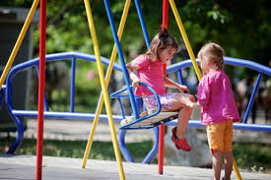
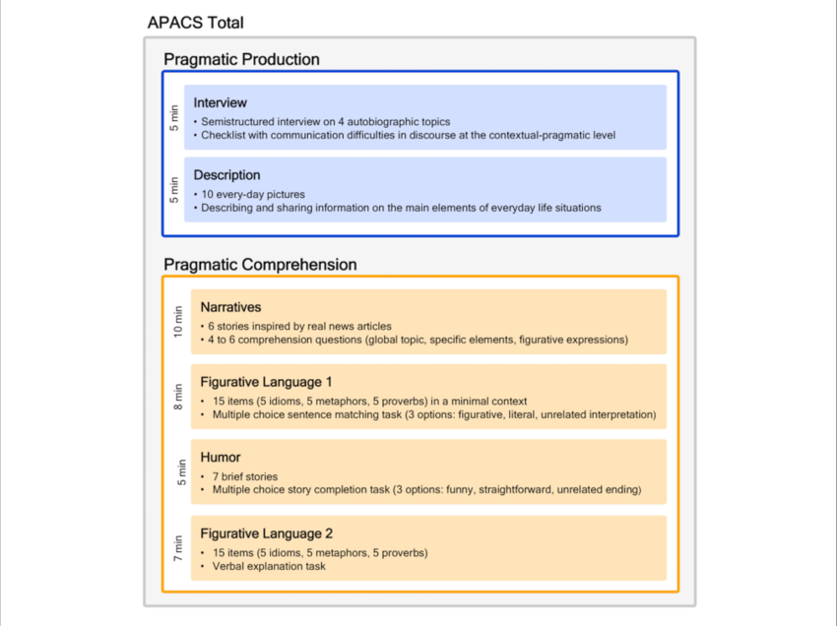
pragmatic language
CCC-2 (Bishop, 2003)
Sub-scales
Speech
Semantics
Grammar
Coherence
Initiation
Use of context
Non-verbal communication
Stereotyped language
Social Relationships
Interests
direct observation:
MIPO (Gibson et al. 2013)
POM-2 (Cordier et al. 2014)
parent/teacher report
standardised test

Slide 12
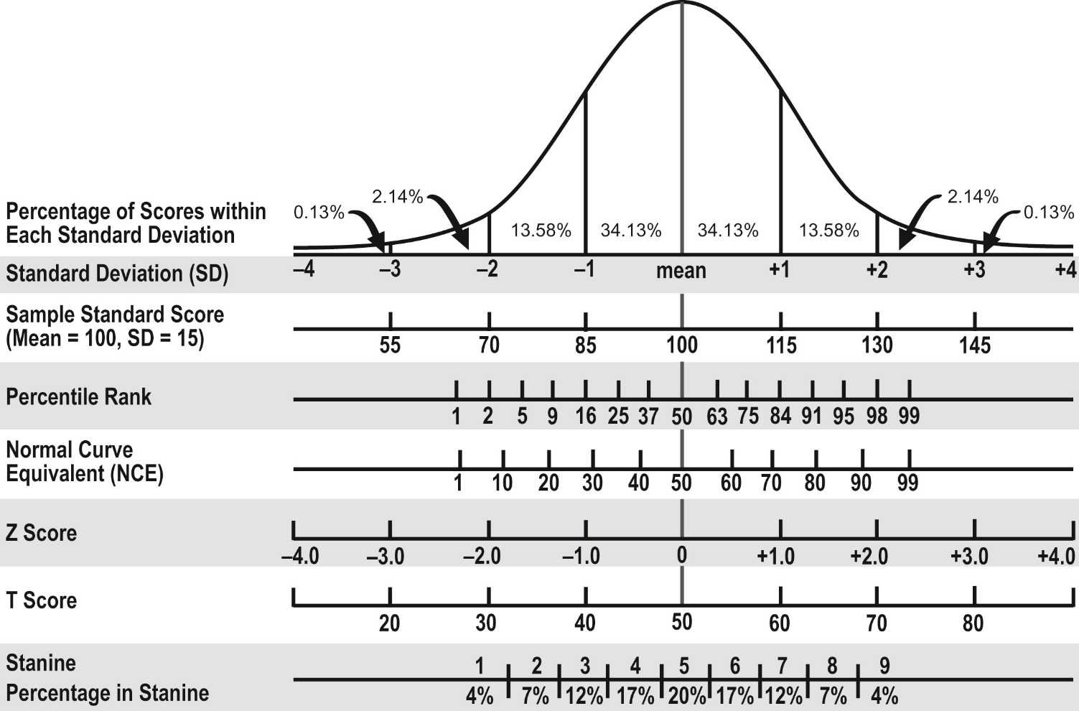
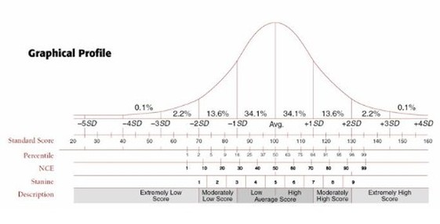
how low can you go?

Slide 13
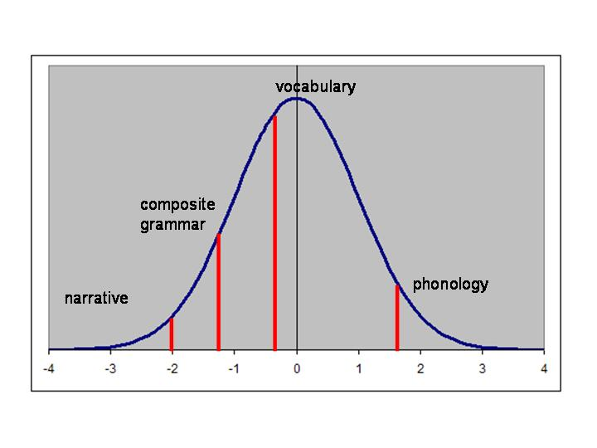
what aspects of language?

Slide 14

consensus on terminology and diagnostic criteria
Bishop, D., Snowling, M. J., Thompson, P. A., Greenhalgh, T., and the CATALISE-2 consortium (2017). Phase 2 of CATALISE: a multinational and multidisciplinary Delphi consensus study of problems with language development: Terminology. Journal of child & psychology and psychiatry, and allied disciplines, 58(10), 1068–1080. doi:10.1111/jcpp.12721
Bishop D. (2017). Why is it so hard to reach agreement on terminology? The case of developmental language disorder (DLD). International journal of language & communication disorders, 52(6), 671–680. doi:10.1111/1460-6984.12335

Slide 15
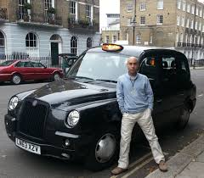
the taxi driver test….
Language disorder
Language delay
Language
learning impairment
Speech language and communication need
Language processing difficulties
Specific language impairment
Primary language impairment
High-level language difficulty

Slide 16
why ‘specific’ language impairment?
term ‘SLI’ took hold in era of universal grammar
  Language is modular / innate
  Can be selectively impaired
non-verbal cognitive abilities limit language development
  ICD-10: significant language deficit (-2SD) with normal NVIQ – ‘cognitive referencing’
  Language impairment ‘in line’ with mental age is different to LI when discrepancy
  Children with low non-verbal ability don’t learn as fast or respond to therapy

Slide 17
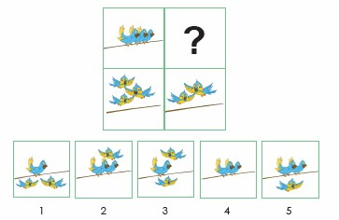
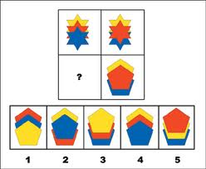
what is the causal relationship between language and non-verbal ability?
language is a fantastic problem solving tool!!

Slide 18
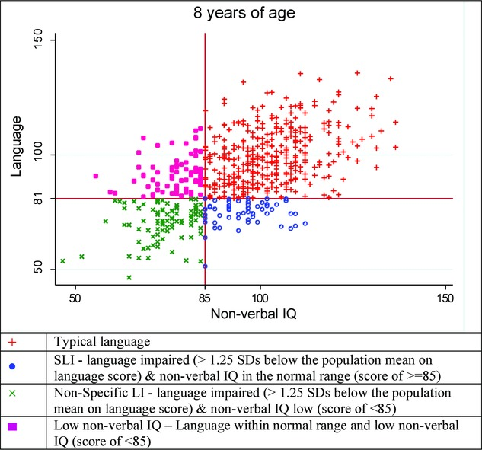
cut-off points are completely arbitrary!
biological evidence does not support distinct ‘groups’
could improving language drive other kinds of learning?
Reilly et al. (2014) IJLCD

Slide 19
START
Child presents with difficulty producing or understanding language that affects everyday functioning
Unfamiliar with local language?
Competent in another language? [4]
Yes
No
No
Yes
Features suggestive of poor prognosis? [3]
No
Yes
Language disorder [2]

Slide 20
START
Child presents with difficulty producing or understanding language that affects everyday functioning
Under 3-4 years:
Prediction from language delay in preschoolers to subsequent language disorder at school age is surprisingly weak.
Indicators are:
Fail to combine words at 24m
Comprehension problems
Don’t communicate via gesture
Don’t imitate body movements
Poor social responsiveness and joint attention
Family history of language or literacy problems
Socio-economic disadvantage
Unfamiliar with local language?
Competent in another language? [4]
Yes
No
No
Yes
Features suggestive of poor prognosis? [3]
No
Yes
Language disorder [2]

Slide 21
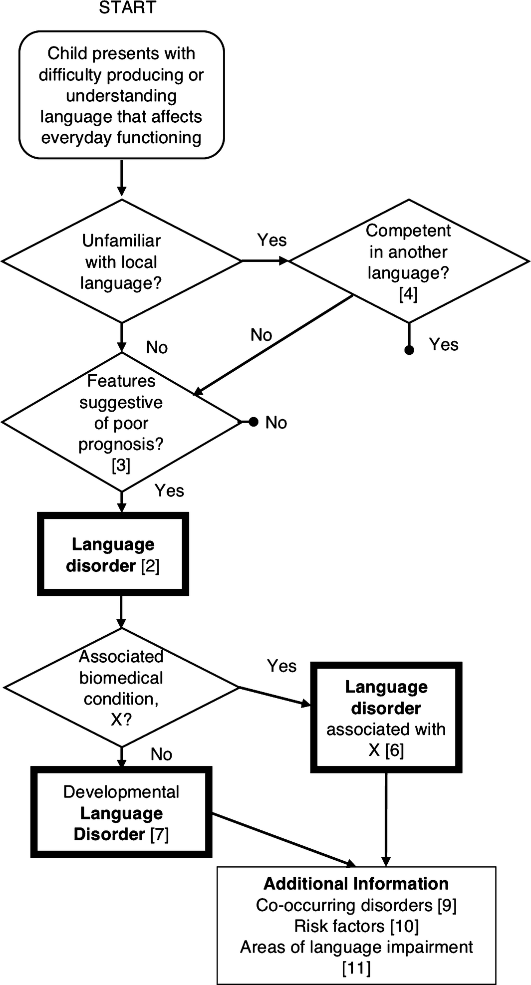
Language Disorder with Associated biomedical conditions (examples)
brain injury,
acquired epileptic aphasia in childhood,
certain neurodegenerative conditions,
genetic conditions such as Down syndrome,
cerebral palsy
sensori-neural hearing loss.
autism spectrum disorder (ASD)
intellectual disability
Poor prognosis

Slide 22
Developmental Language Disorder
“developmental” means “emerges in the course of development”
Does not mean child might ‘grow out of’ problem
Does not mean child unable to develop language
Large discrepancy between verbal and non-verbal ability not required
Children with lower non-verbal IQ (but not intellectual disability) can be included as cases of DLD
Risk factors noted, but not used as exclusions
Poor prognosis

Slide 23
START
Child presents with difficulty producing or understanding language that affects everyday functioning
Unfamiliar with local language?
Competent in another language? [4]
Yes
No
No
Yes
Features suggestive of poor prognosis? [3]
No
Yes
Co-occurring disorders
  Attention (e.g., ADHD)
  Motor (e.g., dyspraxia, dysarthria)
  Literacy
  Speech
  Adaptive behaviour
  Behaviour/emotional problems
Language disorder [2]
Associated biomedical condition, X?
Yes
Language disorder associated with X [6]
No
Developmental
Language
Disorder [7]
Additional Information
Co-occurring disorders [9]
Risk factors [10]
Areas of language impairment [11]

Slide 24
what difference do these changes make to prevalence and clinical presentation of DLD?

Slide 25
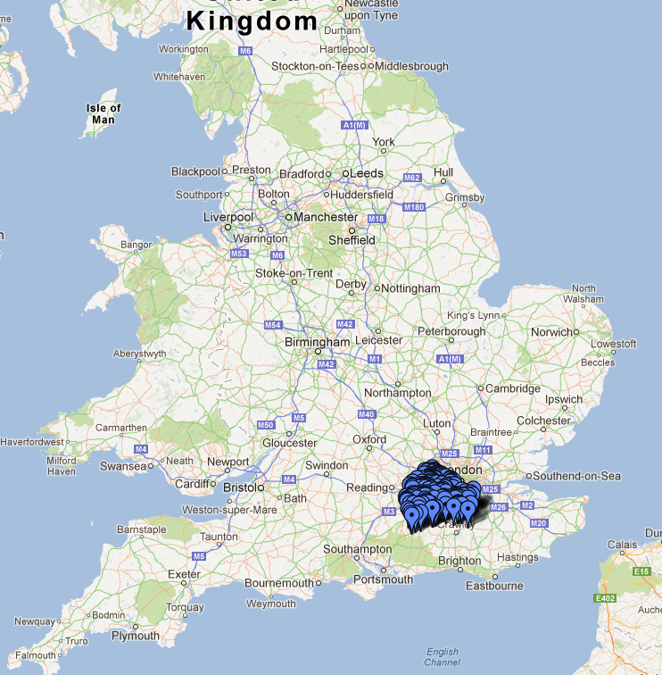

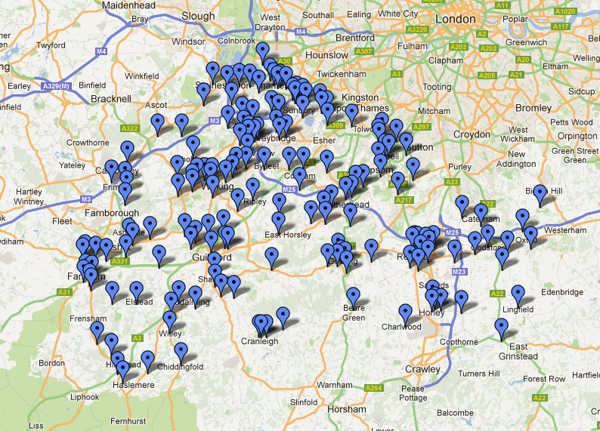

Norbury, CF., et al. (2016). The impact of nonverbal ability on prevalence and clinical presentation of language disorder: evidence from a population study. Journal of Child Psychology and Psychiatry,

Slide 26
SCALES: diagnostic framework
(after Tomblin et al. 1997)
-1.5SD on 2/5 composite scores
(bottom 7th centile)
NVIQ >70
(above 3rd centile)
ROWPVT
Receptive vocabulary
EOWPVT
Expressive vocabulary
Vocabulary
composite
TROG
receptive grammar
SASIT-E32
sentence recall
Grammar
composite
ACE Narrative
comprehension
ACE Narrative Recall
(info units)
Narrative
composite
Comprehension
composite
Expression
composite
Non-verbal ability assessed using WPSSI block design and matrix reasoning
Notes:
SASIT = school-aged sentence imitation test
Starting with replication of the Tomblin approach (2/5 domains), but having educational outcomes to hand means we can establish what cut-offs or combinations of assessment yield the greatest impact on the child’s daily functioning
Why did we chose -1.5??
children scoring below average (i.e. -1SD) on only one aspect of language unlikely to have longer term deficits
Tomblin's cut of -1.25 yielded high number of false positives and out of line with other areas of psychopathology
Similar criteria to Weindrich et al. (2000)
In keeping with DSM V – no requirement for discrepancy between language and NVIQ or for NVIQ > 85

Slide 27
Differences between
Tomblin (1997) & SCALES (2016)
Exclude those with NVIQ < 87 (SS)
Exclude children with other developmental conditions
Language cut-off = -1.25SD
NVIQ cut-off = 87(SS)
NVIQ in three bands
  <70 (intellectual disability)
  71-84 (no man’s land – included in DLD –’low’ IQ)
  85 or better (included in DLD – ‘high’ IQ)
Other dev conditions included (LD + plus)
Lang cut-off = -1.5SD
NVIQ cut-off = 70(SS)

Slide 28
Prevalence Year 1 | % of population
Language Disorder (cause unknown) | 7.58%
higher NVIQ | 4.80%
lower NVIQ | 2.78%
Language Disorder (known cause and/or intellectual impairment) | 2.34%
Total Language Disorder | 9.92%

Slide 29
Diagnostic criteria affect prevalence estimates & populations:
 | prevalence | Achieving Good Level of Development (functional impact)
SCALES: DLD Language -1.5SD, NVIQ > 70 | 7.58% | 11%
Tomblin: SLI Language -1.25SD, NVIQ > 85 | 7.74% | 27.60%
Tomblin: DSM-5 Language -1.25SD, NVIQ > 70 | 11.11%
ICD-11 (proposed): SLI Language -2SD, NVIQ > 85 | 1.07%

Slide 30
Clinical profile by diagnosis & non-verbal IQ band
 | High NVIQ (>= -1SD) | Low NVIQ (>-2SD & <-1SD) | Lang Disorder+
IDACI rank | 17770 | 17987 | 18923
Communication checklist | 18.06 | 19.61 | 25.24
Language composite (z-score) | -1.60 | -1.88 | -2.16
% Social, emotional, behavioural problems | 9.85 | 9.38 | 51.36
Academic attainment | 28.32 | 27.20 | 25.79
% referred to SLT | 31.50 | 52.05 | 66.00
Notes:
Weighted group comparisons using linearised SEs

Slide 31
summary so far: prevalence and clinical presentation
CATALISE: key changes:
  DLD is the agreed diagnostic term
  Non-verbal IQ does NOT feature in diagnostic critera
  Language deficits must be persistent with likely poor prognosis (assessment at two time points to confirm diagnosis)
Prevalence estimates are affected by diagnostic criteria
  When evaluating studies be sure to check:
    Severity of language criteria used
    Breadth of language tests included
    What exclusion criteria are in place
NVIQ in ‘no man’s land’ (btwn 70-85):
  No greater severity in language, communication, learning or behavioural profiles
LD in combination with other clinical conditions:
  More severe deficits across the board

Slide 32
longitudinal cohort studies
Rutter studies (Bartak et al. 1975) – DLD and autism, 5 to 30s
Ottawa Study (Beitchman et al. 1986) – SLI, school entry to age 30
Iowa Study (Tomblin et al. 1997) – SLI, school entry to 20s
Manchester Language Study (Conti-Ramsden et al. 1997) – children in language units, age 7 – 20s
Early Language in Victoria Study (Reilly et al. 2017) – SLI, birth cohort to teens
SCALES (Norbury et al. 2016) – Language Disorder, school entry to teens

Slide 33






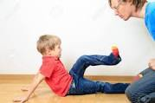
long term functional impact
Academic underachievement
At school entry: language/ communication below age expectations…
Poor literacy
unemployment
Behaviour
Problems
Increased risk poor mental health
Problems with peer relationships

Slide 34
Break!

Slide 35
what causes DLD?
Biology
genes and brains
Environment
Cognition
Behaviour
Small vocabulary
Grammar errors
Associated conditions
limited narratives
Literacy probs

Slide 36
Genetic influences on DLD
Family aggregation: rates of language/learning difficulties higher in relatives of those with language disorder, compared with controls
DLD
Control

Slide 37

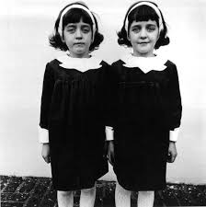

Twin Study Method
MZ twins: genetically identical
DZ twins: share 50% of polymorphic genes
Question:
Is concordance for disorder higher in MZ twins…
than in DZ twins?
note: all twins living at home – NOT adoption study!

Slide 38
diagnostic criteria also affects heritability estimates!

Slide 39
genetic influences on DLD
Heritability of ‘traits’ rather than reliance on diagnostic criteria
Clinical marker of DLD:
  Heritable (Bishop, North & Donlan, 1994)
  Discriminates cases and controls well
  Deficits apparent in first degree relatives (‘endophenotype’)

Slide 40
Let’s try it!

Slide 41
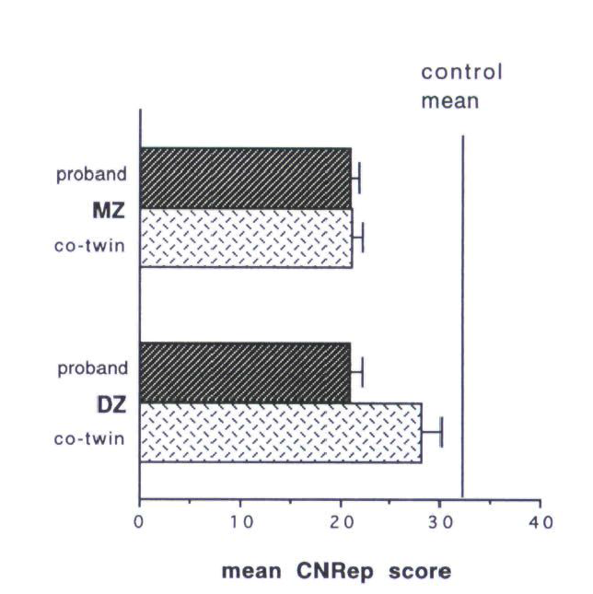
non-word repetition highly heritable
genetic influences on DLD
Bishop, North & Donlan (1994)

Slide 42
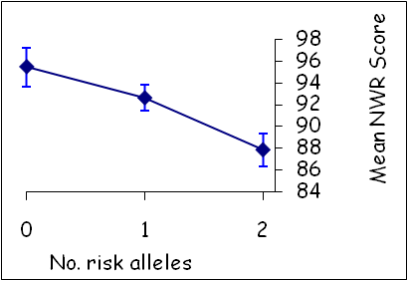
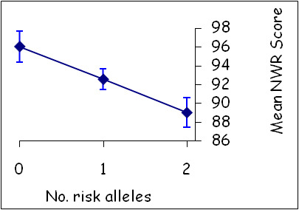
tracking down genes associated with DLD
compare language scores of people with different genotypes
Newbury et al (2009) found two genes on chromosome 16 associated with poor phonological short-term memory (NWR score) in a language-impaired sample
‘Risk’ alleles
common in
general population
and have small
effect size
Gene 1: CMIP
Gene 2: ATPTC2
42
Newbury, D., et al. (2009).
Notes:
42

Slide 43
neurobiology of DLD
generally reduced brain size (Preis et al. 1998 – but see Herbert et al 2003)
decreased size of left hemisphere language structures (Gauger et al 1997)
most (but not all) studies find reduced or reversed asymmetry in children with language/literacy problems (Plante et al 1991; Jackson & Plante 1996; Herbert et al 2005 – but see Preis et al 1998)
some evidence for reduced functional ‘lateralisation’of language to the left hemisphere (de Guibert et al. 2011)

Slide 44
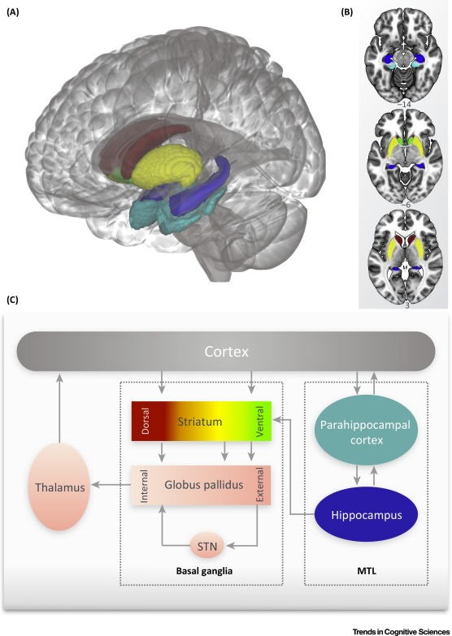
disorder of language or learning?
Early language learning involves multiple cortical/sub-cortical systems
  Modularity long-term outcome of learning process
Propose children with DLD have deficient cortistriatal loops involving the dorsal striatum
These circuits implicated in complex rule-governed LEARNING
Krishnan, Watkins & Bishop (2016) Trends in Cognitive Sciences
Notes:
Blue = hypocampus
Cyan = parahippocampal gyrus
Green = nucleus accumbens (ventral striatum)
Red = caudate nucleus
Yellow = putamen (dorsal striatum: includes the caudate nucleus & the putamen)

Slide 45
just because a condition has a biological basis does NOT mean we are powerless to intervene!!
Phenylketonuria (PKU)

Slide 46
Chromosome 16
Reduced asymmetry
Biology
Procedural memory circuits
Environment
Cognition
Behaviour
Small vocabulary
Grammar errors
Associated conditions
limited narratives
Literacy probs

Slide 47
clear ‘social gradient’ in language and language disorder
Year 1
~ 34.2% of the low SES group met the criteria for language disorder, compared to only 7.9% of the higher SES group.
Language composite z-score
Griffiths, Yeomans & Norbury (in preparation)

Slide 48
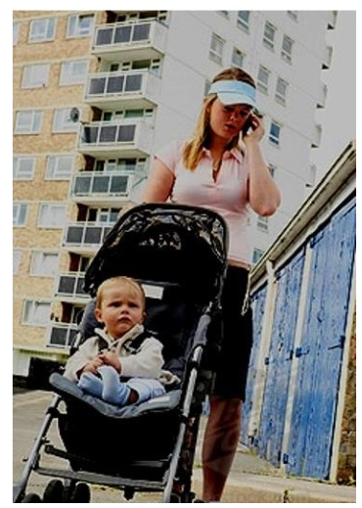
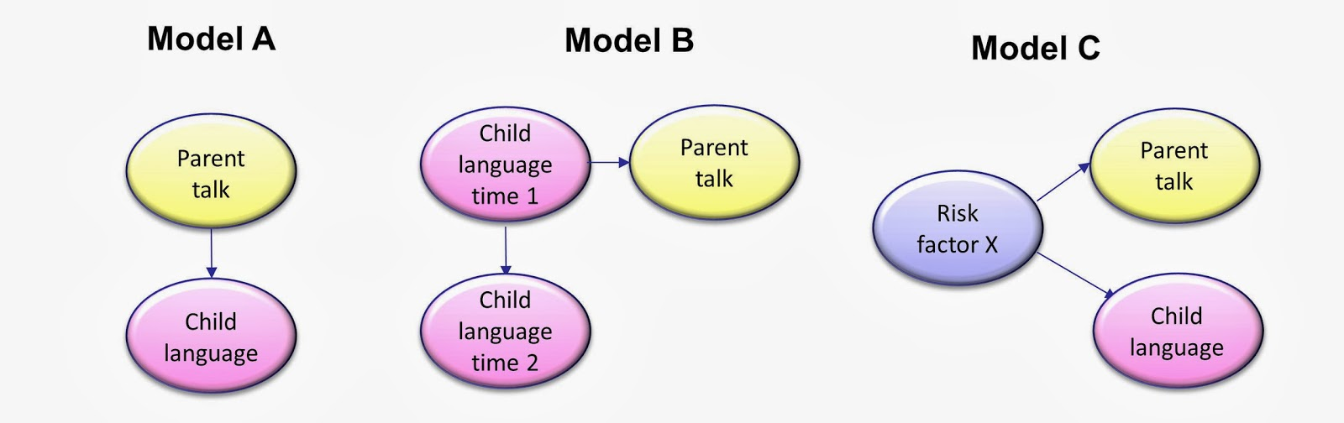
do parents cause language disorder?

Slide 49
do parents cause language disorder?
Pointing image here…

Slide 50
do parents cause language disorder?
what looks like ‘environmental’ influence (e.g. social disadvantage) may well reflect genetic vulnerability

Slide 51
associated
with disadvantage
Chromosome 16
Reduced asymmetry
Biology
Procedural memory circuits
G X E
Environment
Cognition
few known environmental causes, but can influence developmental course
Behaviour
Small vocabulary
Grammar errors
Associated conditions
limited narratives
literacy probs

Slide 52
cognitive theories of DLD
Linguistic theories: deficits in “innate” linguistic rules
  Rice & Wexler extended optional infinitive (EOI)
Auditory theories: failure to process rapid speech cues
  Tallal’s rapid auditory processing hypothesis
Cogntive theories: limited capacity system
  Gathercole and Baddeley’s phonological memory hypothesis
  Leonard’s Surface Hypothesis
Learning theories
  Ullman & Pierpont’s Procedural Deficit hypothesis

Slide 53
grammatical deficit: optional infinitive
Wexler 1994
  The Optional Infinitive Stage (OI)
  … is characterized by the appearance of non-finite verbs, most typically root infinitives (run, walk, sing) and present participles (running, walking, singing), as possible grammatical forms that may co-exist with finite forms
  Children with DLD realise grammatical markers of finiteness inconsistently (‘optional’) in obligatory contexts
    Yesterday she walk__ to school

Slide 54
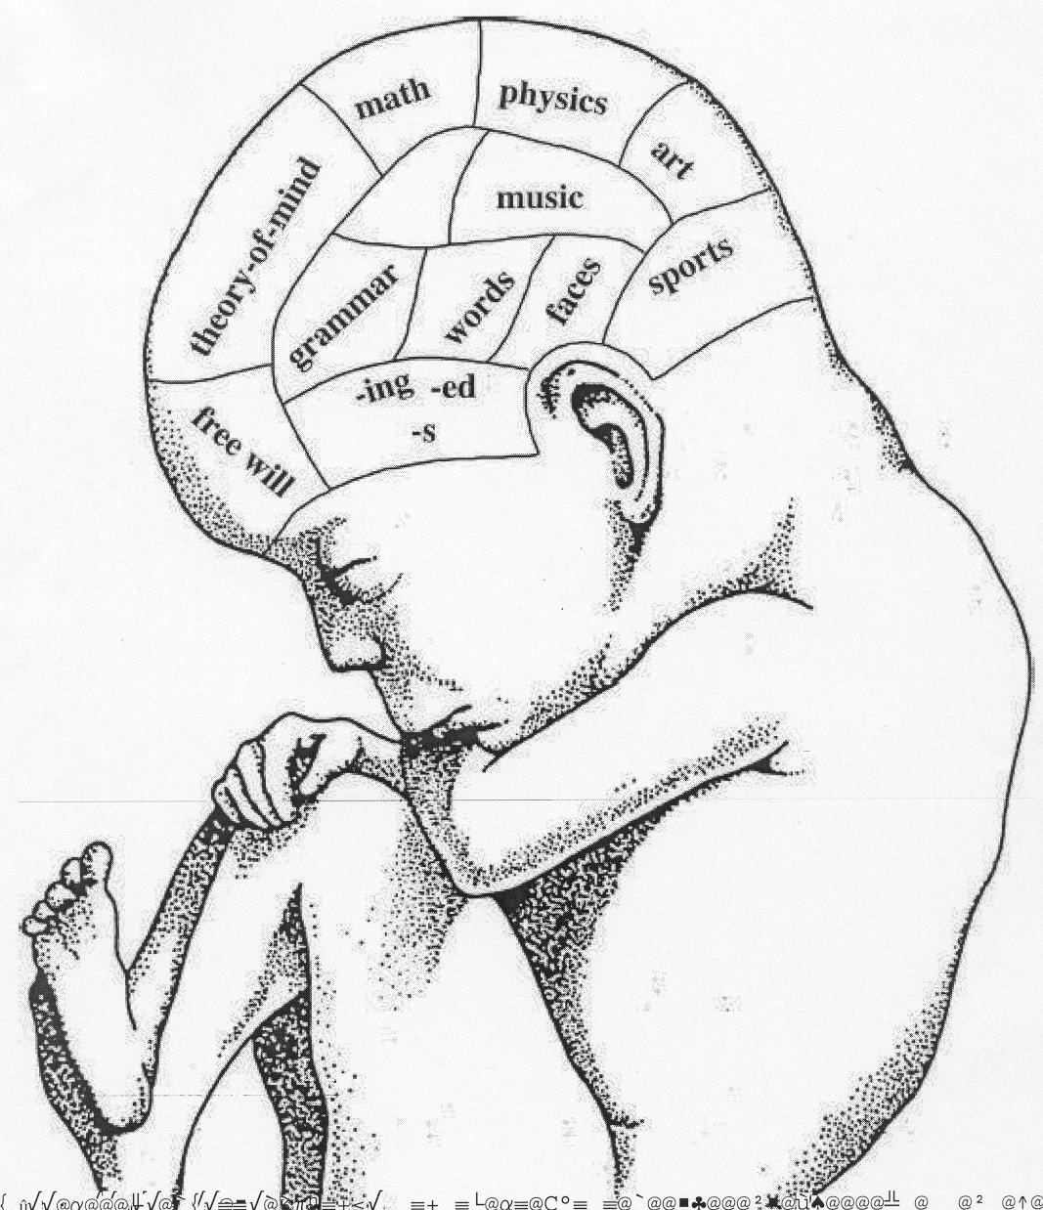
grammatical deficit: optional infinitive
Also 3rd person singular -s (she eat_ toast) but not plural –s (she eat_ apples)
Problems with case marking (him eat_ apples)
  Infer not a perceptual or a general problem of feature blindness
not predicted by vocabulary, NVIQ, maternal ed. level
discrete inherited grammatical ability; timing mechanisms (Rice, 2013)

Slide 55
limitations of grammatical accounts
less biologically plausible (no discrete neurobiological differences in young children)
does not address origins of broader linguistic deficits
does not address co-morbidities or ASSOCIATIONS with other developmental concerns

Slide 56

auditory processing deficit
Paula Tallal and colleagues:
  children with DLD are impaired in their ability to discriminate rapid, brief tones of different frequency
  assessed using Auditory Repetition Test (ART)
  why would this affect language development?
  what makes this task easier?
we will revisit this theory when we discuss intervention

Slide 57
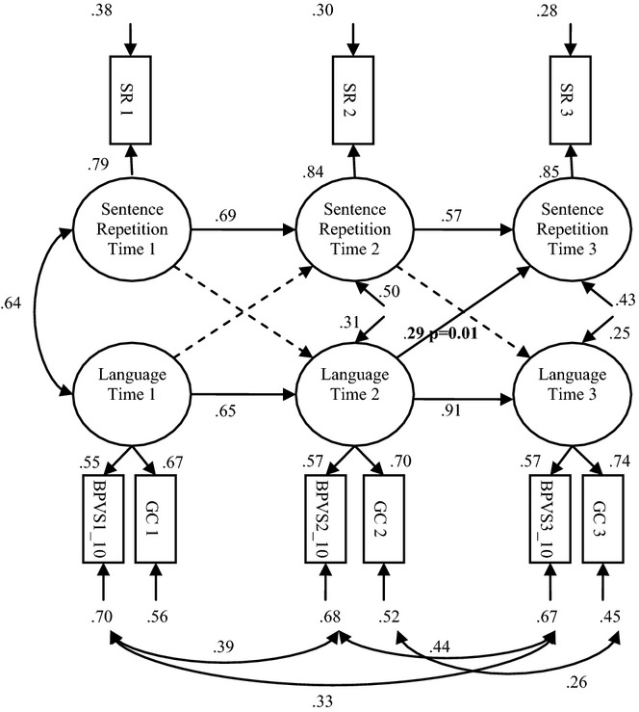
a limited capacity system?
deficits in verbal working memory
  Sentence repetition
  Competing language processing task
Children with DLD cannot retain verbal information long enough to notice and store new language and/or grammatical contrast (Leonard, Surface Hypothesis)
Klem et al. (2015)

Slide 58
a limited capacity system?
deficits in verbal working memory
  Sentence repetition
  Competing language processing task
Children with DLD cannot retain verbal information long enough to notice and store new language and/or grammatical contrast (Leonard, Surface Hypothesis)
BUT… memory tasks REFLECT underlying language ability
Klem et al. (2015)

Slide 59
a deficit of language or learning?
Ullman and Pierpont (2005)
  Procedural learning underpins rule-governed tasks that involve implicit, sequence learning
  Grammar/phonology are:
    Rule governed
    Learned implicitly
    Involve motor sequences
  DLD could arise from impairments to procedural memory circuits in the brain
    Poor grammar /phonology
    Co-morbidities (esp. motor differences)

Slide 60
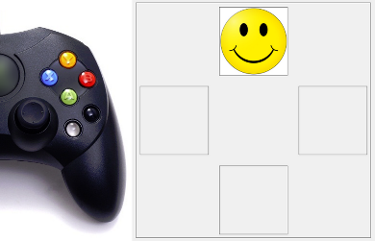
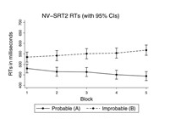
implicit sequence learning: SRT tasks
These implicit learning tasks have poor reliability
They do not correlate with measures of attainment (language, literacy, or maths)
Measures of explicit learning are more reliable and correlate highly with attainment
Attention may affect performance on learning tasks
West et al. (2017). Developmental Science

Slide 61
associated
with disadvantage
Chromosome 16
Reduced asymmetry
Biology
Procedural memory circuits
G X E
Environment
Cognition
deficits in implicit learning
perception, attention, memory?
few known environmental causes, but can influence developmental course
Behaviour
Small vocabulary
Grammar errors
Associated conditions
limited narratives
literacy probs

Slide 62
Key references
Bishop, D., and the CATALISE-2 consortium (2017). Phase 2 of CATALISE: a multinational and multidisciplinary Delphi consensus study of problems with language development: Terminology. Journal of child nowling, M. J., Thompson, P. A., Greenhalgh, T., & psychology and psychiatry, and allied disciplines, 58(10), 1068–1080. doi:10.1111/jcpp.12721
Klem, M., Melby-Lervåg, M., Hagtvet, B., Halaas Lyster, S-A., Gustafsson, J-E. and Hulme, C. (2015). Sentence repetition is a measure of children's language skills rather than working memory limitations. Developmental Science, 18(1): 146–154.
Krishnan, S., Watkins, K. E., & Bishop, D. (2016). Neurobiological Basis of Language Learning Difficulties. Trends in cognitive sciences, 20(9), 701–714. doi:10.1016/j.tics.2016.06.012
Newbury, D. F., & Monaco, A. P. (2010). Genetic advances in the study of speech and language disorders. Neuron, 68(2), 309–320. doi:10.1016/j.neuron.2010.10.001
Norbury, C.F., Gooch, D., Wray, C., Baird, G., Charmand, T., Simonoff, E., . . . & Andrew, P. (2016). The impact of NVIQ on prevalence and clinical presentation of language disorder: Evidence from a population study. Journal of Child Psychology and Psychiatry, 11, 1247–1257.
West G, Vadillo MA, Shanks DR, Hulme C. (2017). The procedural learning deficit hypothesis of language learning disorders: we see some problems. Developmental Science, 00:e12552.

Slide 63
Food for thought
What do longitudinal studies tell us about outcomes for children with DLD?
Why and how have diagnostic criteria for DLD changed?
How do twin studies give us insights into the genetic AND environmental influences on DLD?

