Slide 1
Language profiles in other developmental conditions
Professor Courtenay Norbury
March 2020

Slide 2
Overview of this session
Language in autism spectrum conditions
Language in attention deficit hyper-activity disorder (ADHD)
Language in intellectual disorders

Slide 3
What is the usual profile of developmental language disorder?

Slide 4
autism spectrum disorder/condition
social communication and social interaction
restricted repertoire of interests and behaviours
social-emotional reciprocity
nonverbal
communicative behaviours
developing and maintaining relationships
Stereotyped behaviour
Routines, rituals & rigidity
Highly restricted, fixated interests
unusual sensory interests
autism
Lord et al. (2020)

Slide 5
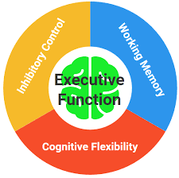

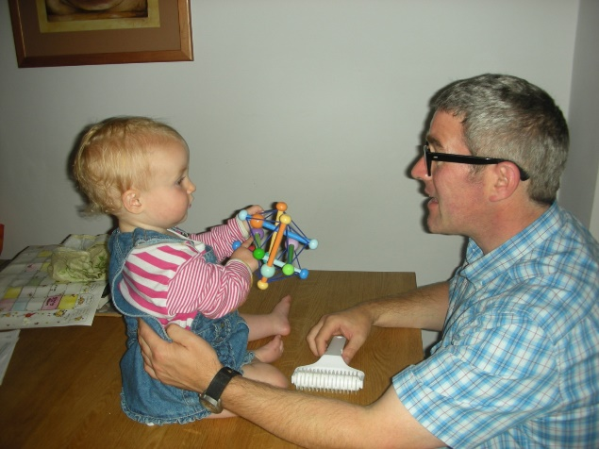
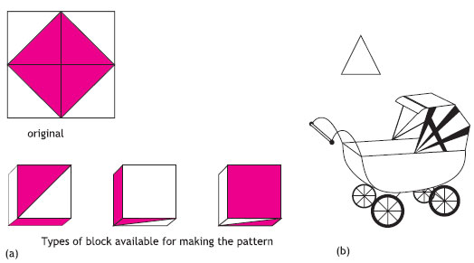
together, these core deficits should really challenge language acquisition
Predictive coding
Weak central coherence
Social & social-cognitive deficits

Slide 6
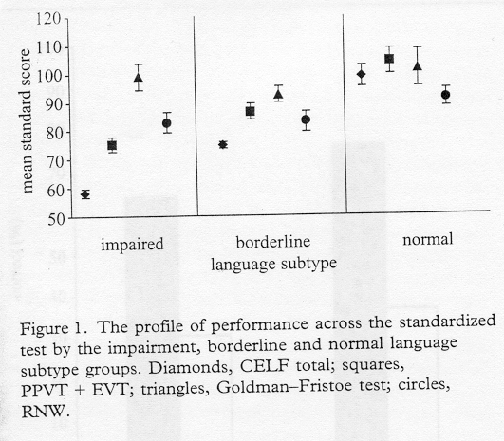
language profiles of this group similar to DLD
how ‘normal’ is ‘normal’?
is language impairment in ASD a ‘co-morbid’ condition? (Tager-Flusberg & Joseph, 2003)
Kjelgaard & Tager-Flusberg, 2001
Notes:
47% of her total sample scored within the impaired range (more than 2SD below the mean) on an omnibus test of language ability (CELF).
These children also had characteristic impairments on measures that have been hailed as ‘clinical markers’ of SLI. These include omission of past tense and 3rd singular verb morphology; and poor performance on a test of non-sense word repetition.

Slide 8
 | autism (n =13) | typical (n = 13) | t-value | p-value | Cohen's d
Age (months) | 86.46 | 85.00 | 1.02 | 0.32 | 0.40
Receptive Vocabulary (raw score) | 73.54 | 73.85 | 0.08 | 0.93 | 0.03
Receptive Vocabulary (SS) | 100.54 | 102.31 | 0.50 | 0.62 | 0.20
WASI Matrix Reasoning | 51.31 | 51.77 | 0.11 | 0.91 | 0.05
WASI Definitions | 40.00 | 51.23 | 3.05 | 0.006 | 1.73
Do autistic children use social cues to learn words?
NOTE: know lots of words, but differences in what they know about those words….
Norbury, Griffiths & Nation (2010) Neuropsychologia
Notes:
all about 7 years
All ASD in mainstream education, receiving varying degrees of specialist support

Slide 9
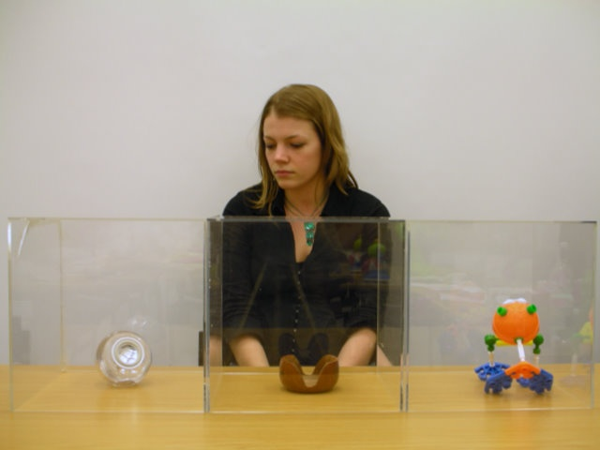
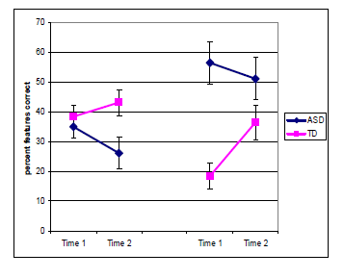
‘show me the kellow’
fixations to face
neutral
bias
Define the object
Phonological Recall
Notes:
First exposure to novel word occurred in a neutral context. Here, there is an equal probability of these three items being a ‘kellow’
On the biased trials, the head/eye gaze cue should constrain the child’s choice to the object the woman is gazing at

Slide 10
many verbal autistic children are very good at learning and retaining phonological information
  informs facility of these children to learn from text? (Lucas & Norbury, 2013)
strong prediction that autistic children with language impairment will have additional phonological deficits
    extending to speech motor deficits in children with minimal language? (Saul & Norbury, 2020)

Slide 11
typically developing (TD)
autism: language ‘normal’ (ALN)
autistic symptoms
Developmental language disorder (DLD)
autism: language ‘impaired’ (ALI)
language impairment
(standard tests of vocabulary and sentence processing)

Slide 12
typically developing (TD)
autism: language ‘normal’ (ALN)
autistic symptoms
Developmental language disorder (DLD)
autism: language ‘impaired’ (ALI)
language impairment
(standard tests of vocabulary and sentence processing)

Slide 13
Test of Weak Central Coherence – how do autistic children, with & without language impairment, use linguistic context to solve ambiguous messages?
coach
Norbury 2005

Slide 14
Bill saw the COACH
Bill listened to the COACH

Slide 15
Integrating information in context depends on good language!
Bill saw the coach
Bill listened to the coach
DLD
Norbury 2005 see also Eberhardt M, Nadig A. (2018) and Hahn, N. , Snedeker, J. and Rabagliati, H. (2015)
Notes:
Your study so describe it how you like!

Slide 16
implications
Interventions designed to improve social skills, coherence, executive function etc may not yield improvements in oral language skills
For some children, need to target oral language directly in any interventions

Slide 17
Meta-analyses of language intervention in autism
Brignell A, Chenausky KV, Song H, Zhu J, Suo C, Morgan AT. Communication interventions for autism spectrum disorder in minimally verbal children. Cochrane Database Syst Rev. 2018;11(11):CD012324. Published 2018 Nov 5. doi:10.1002/14651858.CD012324.pub2
Hampton LH, Kaiser AP. ( 2016). Intervention effects on spoken-language outcomes for children with autism: a systematic review and meta-analysis. J Intellect Disabil Res. 60(5):444–463. doi:10.1111/jir.12283
Parsons L, Cordier R, Munro N, Joosten A, Speyer R. A systematic review of pragmatic language interventions for children with autism spectrum disorder. PLoS One. 2017;12(4):e0172242. Published 2017 Apr 20. doi:10.1371/journal.pone.0172242

Slide 18
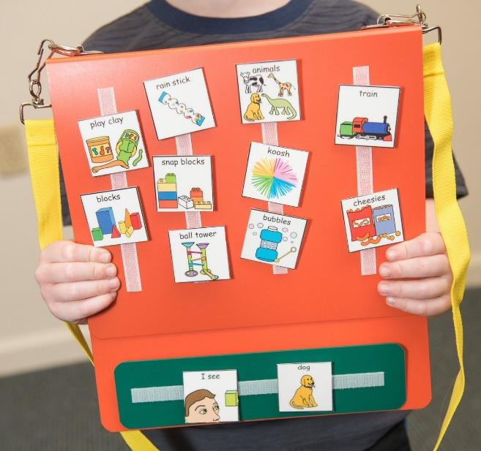
Brignell A, et al. (2018) doi:10.1002/14651858.CD012324.pub2
Quality of evidence is poor
Neither intervention improved expressive language
?initiations, but not maintained over time
Notes:
Only two RCTs for this population and the quality of the evidence was very poor (Largely due to blinding of assessors and risk of contamination from control to treat groups)
Studies were very different:
Howlin et al. looked at PECS – AAC system. Intervention occurred at school and included children ages 4-11 years
Sillers et al. = Focused playtime intervention, parent-mediated in child’s home for under-6s

Slide 19
Kaiser et al. (2016)
g = .26
dosage not associated with treatment effect
Intervention at different ages had same effects (i.e. no bonus for EARLY)
Combined parent + specialist is best
Notes:
26 studies
1738 participants, average age 3.3 years
Included both RCTs and quasi-experimental (control group, but no randomisation)
Many have co-morbid intellectual disabilities, but no indication of how this associates with treatment outcome
Highly variable dosage ranging from less than 1 to more than 30 hours per week, some for 52 weeks in total!

Slide 20

Parsons et al. (2017)
RCTs for pragmatic language intervention in children with autism
21 studies reviewed and 15 included in meta-analysis
None included adolescents
Wide range of outcome measures and respondents
Huge range in duration and intensity
  4 – 1196 total hours(!)
  30mins/wk to 29 hours/wk (!)
https://journals.plos.org/plosone/article?id=10.1371/journal.pone.0172242

Slide 21
Caveats:
Including parents in sessions/coaching important
Parent training in isolation was not effective
Group interventions had larger ES than individual only focus
  Including typical peers increases social interactions in autistic group
Parent report yields better outcome than observation
Children with co-morbidities tended to be excluded
Few measures of generalisation or long-term follow-up
No analysis of cognitive/linguistic factors that influence treatment outcome
Notes:
~half of the studies show no effect
Biggest ES when wait-list group is comparison group – no differences when alternative therapy/TAU is the comparison

Slide 22
Summary: language in Autism
Language outcomes are highly variable and not directly correlated with social/behavioural symptoms
  Consider impact of language on other aspects of autism presentation
  Interventions that address core autism symptoms may have little impact on language
Language trajectories are highly stable after age 6
Focused language interventions overall have at best small impacts on language outcomes
  Few robust studies for children with minimal language
  Few studies of older children with oral language deficits
  Limited understanding of conditions under which intervention might be most efficacious

Slide 23
Key Autism papers
Kjelgaard MM, Tager-Flusberg H. An Investigation of Language Impairment in Autism: Implications for Genetic Subgroups. Lang Cogn Process. 2001;16(2-3):287–308. doi:10.1080/01690960042000058
Lord C, Brugha TS, Charman T, et al. Autism spectrum disorder. Nat Rev Dis Primers. 2020;6(1):5. Published 2020 Jan 16. doi:10.1038/s41572-019-0138-4
Norbury CF, Griffiths H, Nation K. Sound before meaning: word learning in autistic disorders. Neuropsychologia. 2010;48(14):4012–4019. doi:10.1016/j.neuropsychologia.2010.10.015
Norbury CF. Barking up the wrong tree? Lexical ambiguity resolution in children with language impairments and autistic spectrum disorders. J Exp Child Psychol. 2005;90(2):142–171. doi:10.1016/j.jecp.2004.11.003
Pickles A, Anderson DK, Lord C. Heterogeneity and plasticity in the development of language: a 17-year follow-up of children referred early for possible autism. J Child Psychol Psychiatry. 2014;55(12):1354–1362. doi:10.1111/jcpp.12269

Slide 24
ADHD
https://www.youtube.com/watch?v=JwlKOmMMJFk
Luo Y, Weibman D, Halperin JM, Li X. A Review of Heterogeneity in Attention Deficit/Hyperactivity Disorder (ADHD). Front Hum Neurosci. 2019;13:42. Published 2019 Feb 11. doi:10.3389/fnhum.2019.00042

Slide 25
DSM-5: diagnostic criteria
DSM-5 (2013) equal weight given to inattention and hyperactivity-impulsivity (child must have 6 or more symptoms of inattention and/or hyperactivity)
DSM-5 splits ADHD into three sub categories:
  predominantly inattentive type,
  predominantly hyperactive-impulsive
  combined type
The symptoms must be pervasive across situations (e.g. home and school)
Symptoms must have developed before the age of 12 years
Lead to impairment in functioning
Notes:
Currently there are two main diagnostic systems the DMS which is the American psychiatric association so is mostly used in the US and the ICD-10 used more so in Europe
In the DSM system there are 3 subtypes of ADHD-predominantly hyperactive/impulsive, predominantly inattentive and combined type
Inattention is the most stable trait over time
Hip and imp are strongly correlated with ODD and CD
ICD-10 = Hyperkinetic disorder – all three components must be present
Combined subtype: marked response to stimulant medication, poor response to behavioural treatments; more likely to be associated with co-morbid disorders such as LI and motor difficulties

Slide 26
assessment of ADHD
Diagnosis usually by psychiatrist or multi-disciplinary team
Teachers and clinicians may informally observe behaviours and/or use checklists to gather evidence of ADHD-type symptoms
  Child Behavior Checklist (CBCL)
  Conners' Parent Rating Scale (CPRS-R:S)
  Strengths & Difficulties questionnaire (https://sdqinfo.org/py/sdqinfo/b3.py?language=Norwegianqz(Nynorsk))
Oerbeck B, et al. (2017) Early Predictors of ADHD: Evidence from a Prospective Birth Cohort doi:10.1177/1087054717696765
Notes:
in small groups – take a look at some checklists

Slide 27
language deficits in children identified as having ADHD
Korrel et al. (2017) JCPP:
  meta-analysis of 21 studies comprising 17 different language measures
  strong evidence that ADHD associated with weakness in several different language domains/modalities
  consistent evidence of pragmatic language deficits
  few longitudinal studies
Children with DLD more likely to have clinically significant attention deficits
Why, and what difference does it make?

Slide 28
Phenocopy hypothesis
(Redmond, 2016)
same behaviour occurs for different underlying reasons:
  Does not follow through on instructions & finishes school work/chore
  Does not follows adult requests or rules
  Does not seem to listen to what is being said
when these items are removed, discrimination between DLD (syntactic) and ADHD improves (Redmond, 2016)
is that a wise thing to do?

Slide 29

Data from the SCALES study…
Debbie Gooch
NOTE: 57% response rate parents; 65% response rate teachers
No systematic bias in teacher responders, parent responders have higher SES and children with less severe language deficits
Gooch, Maydew & Norbury (2017). BMC Psychiatry

Slide 30
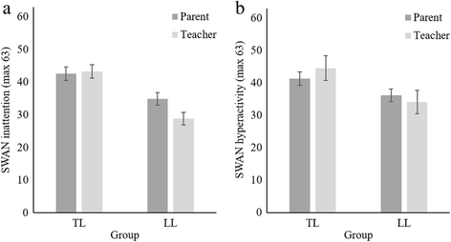
Inattention scale
Hyperactivity scale
Children with low language rated as having more severe ADHD symptoms
More severe symptoms of inattention vs hyperactivity
Bigger difference between teachers and parents on the inattention scale
Gooch, Maydew & Norbury (2017). BMC Psychiatry

Slide 31
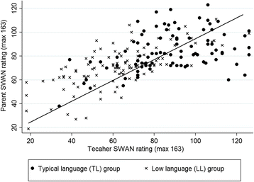
Parent/teacher agreement on the SWAN
Moderate correlation between parents and teachers
‘Caseness’ depends in part on who does the rating…
Of children with language deficits:
  Parents identify 11.34% as ADHD ‘cases’
  Teachers identify 32.08% as ADHD ‘cases’
r = .64
Agreement on “caseness” fair (TD) to poor (LD)
Gooch, Maydew & Norbury (2017). BMC Psychiatry

Slide 32
why does language moderate parent/teacher discrepancies and case agreement?
Different environments influence ‘halo’ effects?
  ‘phenocopy’ argument…
Language deficit impacts attention – esp noticeable in the classroom?
  SWAN is measuring functional impact of DLD?
Classroom expectations appropriate?
IMPLICATION – teachers perceive that children with DLD have significant inattention that is impacting success in the classroom

Slide 33
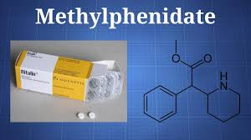
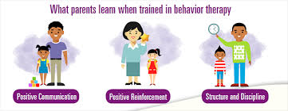
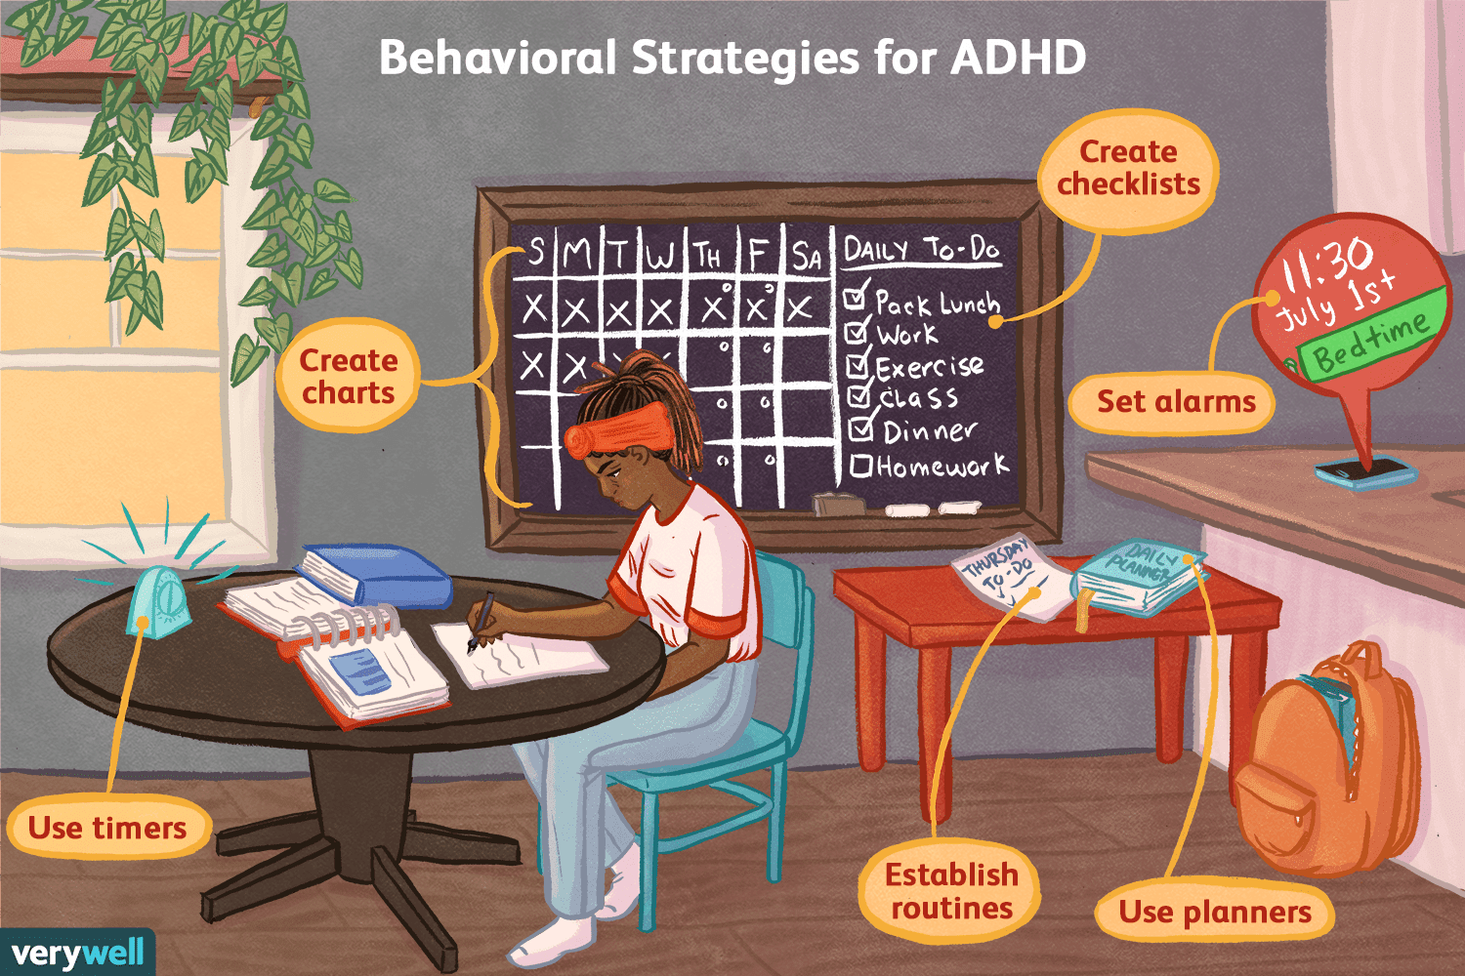
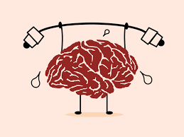
Treatment optionS for ADHD
+

Slide 34



?
Good evidence that pharmacological interventions reduce ADHD symptoms….
BUT does this improvement lead to functional gains in language, literacy or general academic success?
~

Slide 35
Does ADHD treatment improve reading outcomes?
ADHD only Tx
READ only Tx
COMBINE Tx
Medication + parent training
9 group sessions over 10 weeks
Lower adherence to programme
17% stop taking meds
Broad reading intervention (decoding, spelling, fluency, comp)
4x 45 minute sessions for 16 weeks
Good adherence to programme
22.5% taking meds
Post-study – 1/3 children in each group receiving remedial reading support at school…
Tamm, L., et al. (2017) https://doi.org/10.1037/ccp0000170

Slide 36
Does ADHD treatment improve reading outcomes?
NOTE: no ‘no-treatment’ group
ADHD only Tx
READ only Tx
COMBINE Tx
ADHD symptoms (teacher rated)
gs = .67; .36 inatt
gs = .50; .41 hyper
ADHD
=
COMBINE
<
READ
decoding
READ
=
COMBINE
>
ADHD
gs = .23; .32
gs = .39; .39
word reading
READ
=
COMBINE
>
ADHD
Tamm, L., et al. (2017) https://doi.org/10.1037/ccp0000170

Slide 37
summary
Medication may allow children to demonstrate what they know, rather than changing underlying reading system
High rates of co-morbidity between ADHD and language/literacy disorders
  will affect academic progress – need to assess both sets of behaviour/skill
  may affect response to language/reading based interventions
Explicitly treat/teach the thing you want to change!!

Slide 38
Readings for ADHD
Gooch D, Maydew H, Sears C, Norbury CF. Does a child's language ability affect the correspondence between parent and teacher ratings of ADHD symptoms?. BMC Psychiatry. 2017;17(1):129. Published 2017 Apr 5. doi:10.1186/s12888-017-1300-8
Korrel H, Mueller KL, Silk T, Anderson V, Sciberras E. Research Review: Language problems in children with Attention-Deficit Hyperactivity Disorder - a systematic meta-analytic review. J Child Psychol Psychiatry. 2017;58(6):640–654. doi:10.1111/jcpp.12688
Tamm L, Denton CA, Epstein JN, et al. Comparing treatments for children with ADHD and word reading difficulties: A randomized clinical trial. J Consult Clin Psychol. 2017;85(5):434–446. doi:10.1037/ccp0000170

Slide 39
Intellectual disability
Nordahl‐Hansen, A., Donolato, E., Lervåg, A., Norbury, C. F., & Melby‐Lervåg, M. (2019). PROTOCOL: Language interventions for improving oral language outcomes in children with neurodevelopmental disorders: A systematic review. Campbell Systematic Reviews, 15 (4). doi:10.1002/cl2.1062

Slide 40
observations
What is similar about the strengths and challenges for these children?
What is different?
What are your thoughts on environmental influences (not causing the disorder itself, but in influencing developmental outcomes)?
https://www.youtube.com/watch?v=kjXcAqRBnsE
  Down syndrome
https://www.youtube.com/watch?v=EmSii88rQoc
  William syndrome
https://www.youtube.com/watch?v=LVbqu7V0_0E&feature=related
  Fragile X
although there is a ‘known’ genetic cause, the phenotype is still extremely variable – even in Fragile X, which is a single gene disorder!

Slide 41
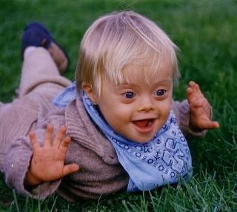
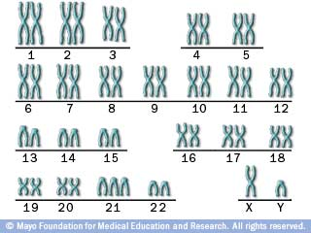
Down syndrome
first described in 1866: cluster of physical symptoms associated with intellectual impairments
not until 1960s that trisomy on chromosome 21 was discovered to be cause of DS
currently affects ~1 in 700-1000 live births
leading genetic cause of intellectual impairment, but is typically NOT heritable
increased risk of:
  congenital heart disease
  leukaemia
  gastrointestinal abnormalities
  hearing impairments
  early onset dementia
Notes:
eyes which slant upwards
small ears
protruding tongue
white spots on the iris, known as Brushfield spots
short fingers & loose joints
loose joints
shorter stature

Slide 42
Cognitive characteristics of Down syndrome
intellectual impairment and trajectory
  plateau of cognitive abilities after first few years of life – decline in IQ scores
  early onset Alzheimer’s disease
    marked by changes in behaviour, rather than memory loss
slowed speed of processing
  both orientation to, processing of and response to environmental inputs (esp. verbal)
executive function deficits
  inhibition, set-shifting, planning
  these may be linked to verbal ability

Slide 43
Language characteristics of Down syndrome
uneven profiles across language domains – nature/degree of impairment depends on what is being measured
problems with speech intelligibility (link to motor deficits and/or hearing impairments)
substantial delays in acquisition of first words/phrases
comprehension generally better than language expression (by 24 months)
vocabulary generally better than aspects of grammar
    vocabulary comprehension related to chronological rather than mental age
    expressive grammar predicted by both chronological and mental age
    narrative predicted more by mental age and/or grammar comprehension
Overall profile resembles Developmental Language Disorder
see Naess et al. (2011)

Slide 44
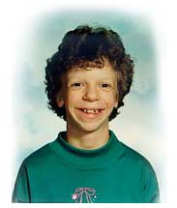
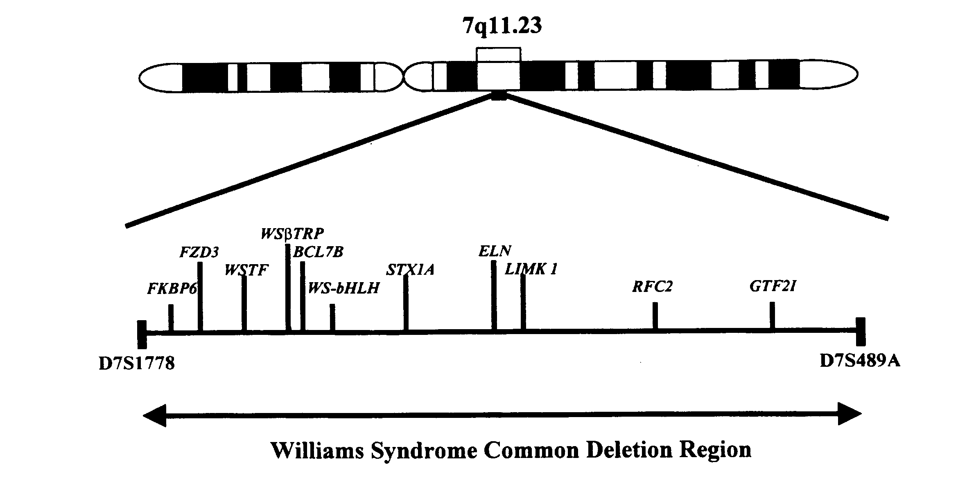
Williams syndrome
SOCIAL/COGNITIVE PHENOTYPE
extremely social and friendly
but, limited understanding of basic social norms
difficulty making/maintaining social relationships
high rates of co-morbidity:
  ADHD
  aspects of ASD
  anxiety disorders & phobias
  depression (as adults)
GENOTYPE
rare deletion of genes on Chromosome 7
implicated in heart defects and tissue abnormalities

Slide 45
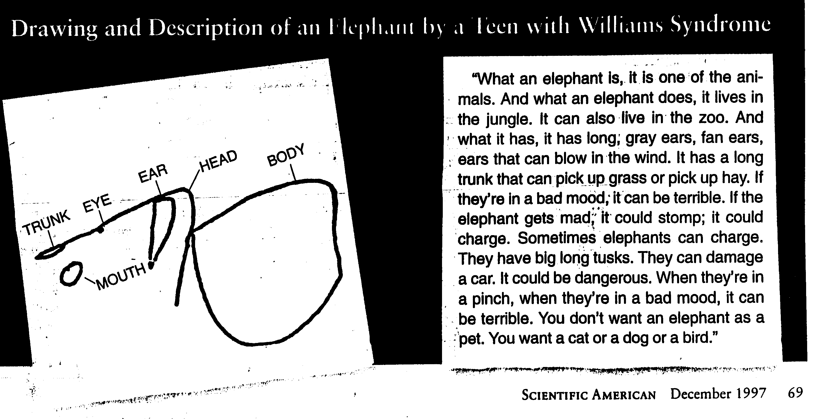
WS deficit in visuo-spatial construction
  b. far worse than verbal abilities

Slide 46
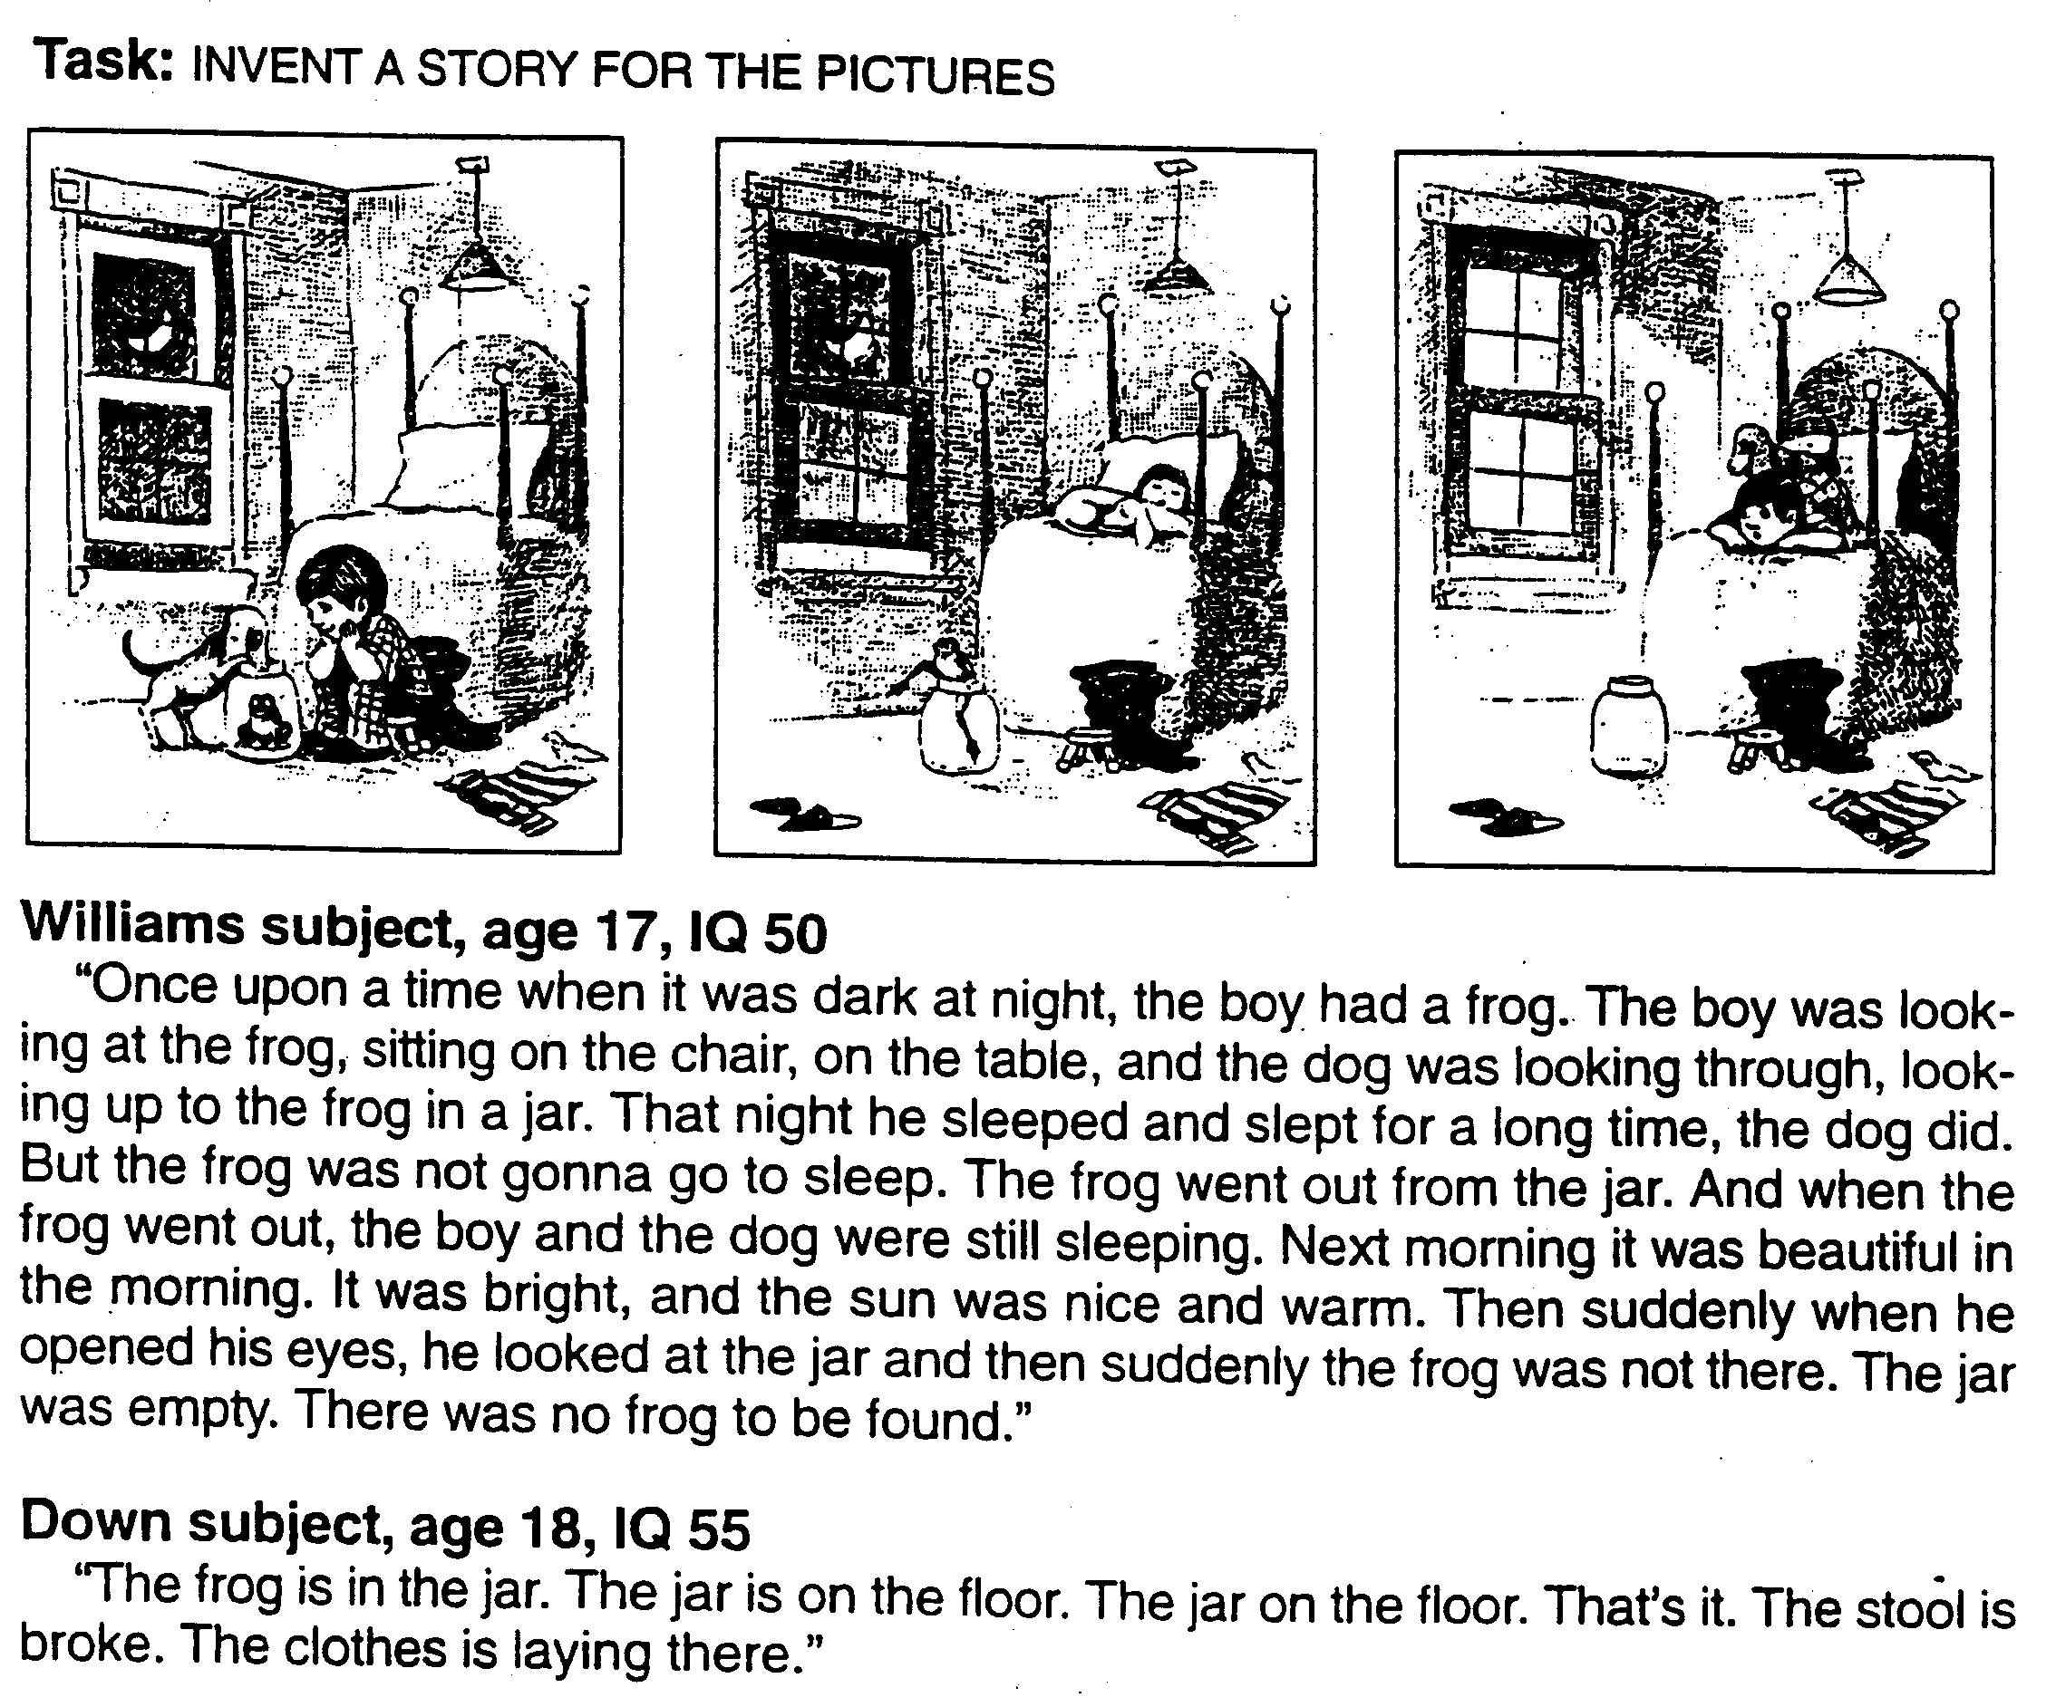
2. WS ‘intact’ language abilities?
Notes:
language better than expected given overall level of IQ – though note when bigger samples employed this discrepancy is not always significant

Slide 47
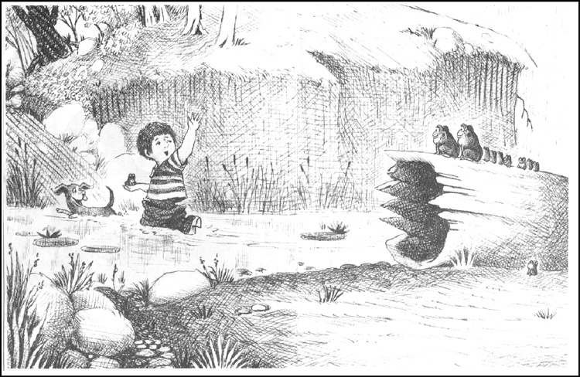
DLD
9;3 They found a family of frogs. Thats it.
10;4 And the boy and the dog are happy and the boy gots a frog.
10;9 They take one of the babies and go.
WMS
9;0 And he said \Hey frogs; we’re all together!" The end! That was great wasn’t it?
10;0 Heres the frog and hes in love! And he says ‘‘Hooray! Hooray! Hooray! I found my froggie!" And then he says ‘‘Byeeee!’’
10;9 And they found the frog and they lived happily ever after:
Notes:
‘Striking’ differences between SLI (score within normal limits on non-verbal measures) language and WMS language

Slide 48
language in WS is surprising, but not typical!
delayed language acquisition
  early cognitive development and early language development closely linked
receptive vocabulary scores better than other aspects of language
  some qualitative differences in vocabulary knowledge (poor relational vocabulary, poor abstract knowledge)
pragmatic language impairments
narrative difficulties
  Reilly et al. (2004): WMS and DLD did not differ:
    amount said (number of words/sentences)
    number of morphosyntactic errors
    grammatical complexity/diversity
narrative differences between DLD and WMS:
  children with WMS:
    far more likely to make ‘evaluative’ comments (narrators interpretation of events)
    far more likely to comment on the affective states of story characters
    far more likely to use character speech
    far more likely to use emphatic speech (audience hookers)
Language of children with WS reflects their social-cognitive profiles!

Slide 49

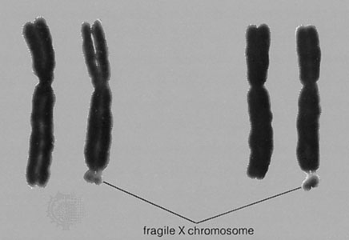
Fragile X
Inherited, single gene mutation on X chromosome
expansion of trinucleotide repeats (CGG) in Fragile X Mental Retardation 1 (FMR1) gene
  typical population: 5-44 repeats
  premutation: 55-200 repeats
  full mutation: >200 repeats
full mutation affects ~ 1 in 4000 males; 1 in 8000 females
is most common inherited form of intellectual impairment
is implicated in 2-6% of cases of autism spectrum disorder
intellectual impairment
  ~90% males; ~25- 50% females have IQs below 70
  slow rate of ‘growth’: age-dependent gradual decline in IQ
high rates of autistic behaviours
  20-50% males meet full criteria for autism
  another 30% meet criteria for “pervasive developmental disorder”
    social anxiety, gaze avoidance, repetitive behaviours, sensory hypersensitivity
significant attention difficulties
  impulsivity, problems with inhibitory control, distractibility

Slide 50
Language characteristics of fragile x
Delays in early language milestones
Expressive language impaired relative to comprehension
Expressive vocabulary and grammar impaired relative to mental age
Significant pragmatic language impairments
  tangential speech, perseverative/repetitive, delayed echolalia, non-contingent conversational responses

Slide 51
Value of cross-disorder comparisons
identify ‘unique’ language profiles that align with particular clinical conditions
with longitudinal design, can start to pinpoint where/when/why trajectories diverge
can (begin) to give hypotheses about mechanisms that differentiate performance on tasks in different groups
  Role of non-verbal cognitive ability
  Role of co-morbid autism / attention-deficit
do unique profiles require qualitatively different approaches to intervention/education

Slide 52
challenges of cross-disorder comparisons
small groups – no differences are difficult to interpret
need to ‘match’ groups on variable(s) of interest…. But impossible to match on all measures of interest
typically developing children matched for age
typically developing matched for raw scores on non-verbal reasoning tests (i.e. non-verbal mental age)
  What is TD group like?
  What are the groups NOT matched on?
typically developing matched on verbal ability
  What are the groups NOT matched on?
  What aspect of verbal ability is most important to ‘control’
Similar issues if matching two or more clinical groups

Slide 53
Clinical group average age at intake = 10 years versus peers = 5 years
Groups broadly matched at intake for non-verbal ability
Language scores ~2 years below non-verbal ‘mental age’ for clinical groups
Clinical profile: semantics > pragmatics > syntax (particular area of difficulty)
No differences between three clinical groups on semantic scale
DS < both FXS on measures of syntax
FXS-ASD < FXS-only on pragmatic language
Very slowed rate of language growth relative to typical language peers
Martin GE, et al. (2013). Int J Lang Commun Disord. 48(4):432–443

Slide 54
Approaches to intervention
NOTE: consider what goals of intervention could/should be…
NOTE: more likely to involve augmentative & alternative forms of communication
Early intervention! (challenges with quality & power of studies)
Often parent-led – needs to be frequent, consistent & long-term
  Increased use of remote parent-coaching (McDuffie, … Abbeduto, 2018, Developmental Neurorehabilitation, 21:1, 48-63, DOI: 10.1080/17518423.2017.1369189)
    Shared book reading via increasing parent behaviour-management and communication facilitation strategies
Improvements in explicit expressive language targets
Minimal generalisation to different situations or language targets
Increase content-relevant talk; but limited increase in sentence complexity

Slide 55
Readings for intellectual impairment
Luyster RJ, Seery A, Talbott MR, Tager-Flusberg H. Identifying early-risk markers and developmental trajectories for language impairment in neurodevelopmental disorders. Dev Disabil Res Rev. 2011;17(2):151–159. doi:10.1002/ddrr.1109
Martin GE, Losh M, Estigarribia B, Sideris J, Roberts J. Longitudinal profiles of expressive vocabulary, syntax and pragmatic language in boys with fragile X syndrome or Down syndrome. Int J Lang Commun Disord. 2013;48(4):432–443
Morris CA. The behavioral phenotype of Williams syndrome: A recognizable pattern of neurodevelopment. Am J Med Genet C Semin Med Genet. 2010;154C(4):427–431. doi:10.1002/ajmg.c.30286
Næss KA, Lyster SA, Hulme C, Melby-Lervåg M. Language and verbal short-term memory skills in children with Down syndrome: a meta-analytic review. Res Dev Disabil. 2011;32(6):2225–2234. doi:10.1016/j.ridd.2011.05.014
https://health.ucdavis.edu/team/search/11661/leonard-abbeduto---autism---psychology---neurodevelopmental-disorders-sacramento

