Slide 1

Intervention part 1I: targeted & specialist approaches
Courtenay Norbury
c.norbury@ucl.ac.uk
SECTION 1

Slide 2
Overview of the session
What to look for in an intervention trial
Tiered approach to thinking about language interventions
  Universal
  Targeted – Part 1
  Specialist – Part II
What are professional roles at each Tier?
Evidence for effectiveness at each Tier
Remaining questions

Slide 3
EFFICACY: Evidence supporting the treatment
EFFECTIVENESS: Treatment in Practice
10. Replication & weight of evidence
A. Treatment in common use as designed
9. Systematic review, synopsis studies
B. Practitioners’ clients improve as result of intervention (using designs 1-10)
8. Meta- analysis
7. Between-subject control (random assignment)
C. Practitioners show evidence of ability to carry out intervention accurately
Positive results
6. Between-subject control (non-random assignment)
Negative results
D. Practitioners show evidence of being able to use aspects of intervention
5. Within-subject control
4. Feasibility studies (pilot studies)
E. Practitioners say know how to use intervention
3. Change in standard score
F. Course / resources popular
2. Change in raw score
1. Anecdotes / clinical experience
G. Course / resources available
Credit: Susan Ebbels

Slide 4
variables to consider
outcome measures: questionnaires, standard tests, bespoke measures. what aspects of language / behaviour?
  What aspects of language/communication are biggest barriers to everyday function?
  What is within the ‘zone of proximal development’?
context: at school, home, clinic
  Balance feasibility with need for sustained input…
who will deliver: direct intervention, parents as agents of change, training school staff/support workers
when: does developmental age matter?
  Almost certainly – what foundational skills are necessary to success?
therapy content: language focus? How to decide targets?
dosage: frequency, intensity, duration
  Balance resource constraints with input required for success
  Little & often OR infrequent but intense (see Holly Storkel and/or Laura Justice)

Slide 5
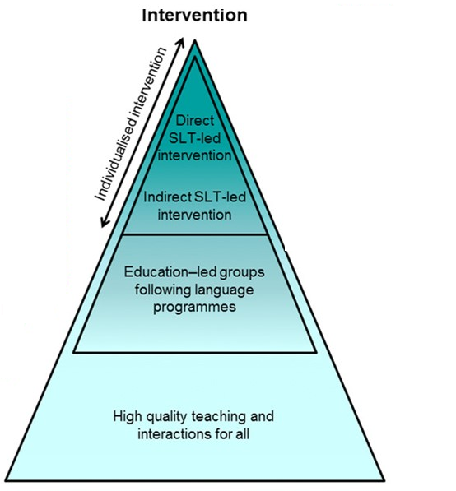
targeted:
provision follows manualised programme
assessment/diagnosis not needed to access or plan treatment
may be adapted to child progress in session
likely to be delivered by a non-specialist (parent or teaching support staff)
expected outcome is to move children to ‘normal range’
  e.g. small groups for children at risk (pre-school)
  e.g. parent-child interaction sessions (late-talkers)
NOTE: children still have access to universal provisions!!

Slide 6
What do targeted interventions look like?
Clarke et al. (2010) Psychological Science, https://doi.org/10.1177/0956797610375449

Slide 7
What do targeted interventions look like? Building vocabulary
Clarke et al. (2010) Psychological Science, https://doi.org/10.1177/0956797610375449

Slide 8
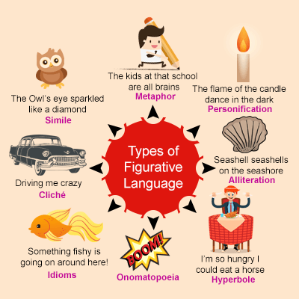
What do targeted interventions look like? Listening comprehension
Embed figurative language into passages & discuss meaning
Games that involve defining figurative expressions & using them in sentences
Listen to narrative or conversation
Structured dialogue between adult and children about the passage
Reciprocal teaching – children take turns to act as ‘teachers’

Slide 9
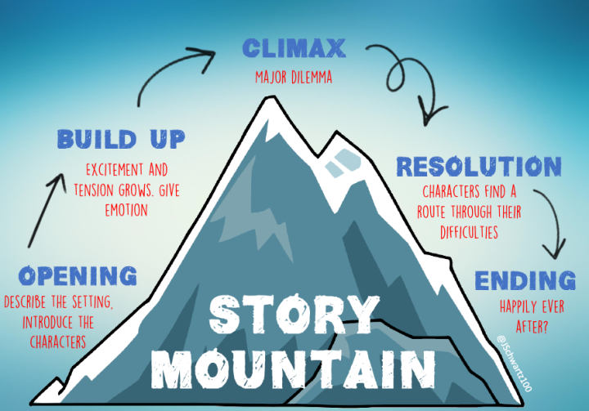
What do targeted interventions look like? Developing narrative skills
Listening to stories
Explicit instruction about story structure
Sequencing activities
Planning and telling stories
Helicopter stories – say it, write it, act it out!
https://www.youtube.com/watch?v=BNoBkwSPRjU

Slide 10

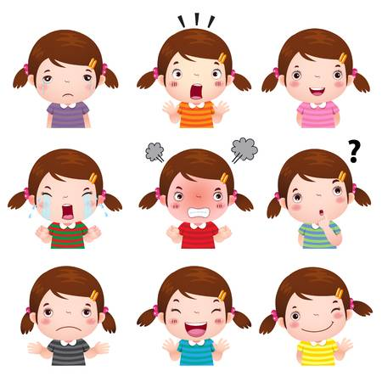

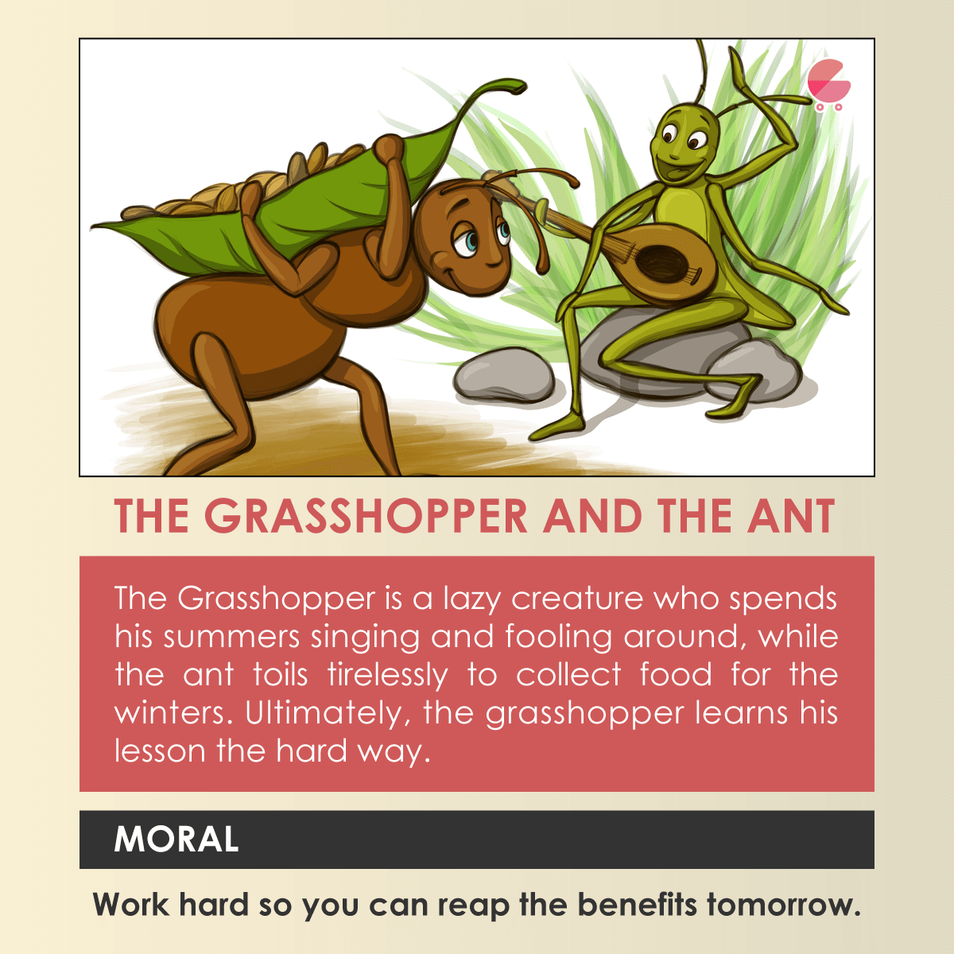
What do targeted interventions look like? Inferencing skills
‘she pedalled to school’
‘the flowers were in full bloom’

Slide 11
targeted interventions (non-specialists): key findings
a number of rigorous studies now report significant (though often modest) gains
  for primary-aged children
  taking part in small group work (at least 3x 30 mins per week)
  with highly trained (4+ days) and very regularly supported (at least fortnightly) school assistants
  for improving expressive language, narrative, vocabulary and reading comprehension, but not listening comprehension
    Clarke et al. (2010) - ReadMe
    Fricke et al. (2013) – Nuffield Early Language Intervention
    Bowyer-Crane et al. (2008; 2011) – Language 4 Reading
    Hagen et al. (2017) – Norwegian trial
Summary of education-based meta-analyses: https://educationendowmentfoundation.org.uk/pdf/generate/?u=https://educationendowmentfoundation.org.uk/pdf/toolkit/?id=159&t=Teaching%20and%20Learning%20Toolkit&e=159&s

Slide 12
Oral language interventions do not necessarily lead to improvements in reading comprehension…
Implementation matters!
Study features associated with better outcomes:
Researchers deliver the intervention
Implementation quality is good
Small groups (versus whole class)
Rogde et al. (2019) Campbell Collaboration DOI: 10.1002/cl2.105

Slide 13
few of studies of targeted intervention involve clinical specialists…
…do they need to?
Manualised – training can be offered to staff, schools may be willing to pay for training
BUT… again, fidelity is poor if staff are not supported
Most trials do not include children with clinical conditions:
  indications that rate of improvement is similar across severity range
  rare to include children with complex needs /co-morbid conditions

Slide 14
CHALLENGES:
Takes time to change language!
Costly: time and resources that schools provide
Takes children out of core education sessions
Outcome measures / treatment focus aligns with school priorities – children may not have foundational skills
Longer term outcomes often fade
Appear to be limits on generalisation to reading comprehension (?other curriculum areas)

Slide 15
CONCLUDE:
not a substitute for specialist
interventions for children with severe language disorders
(2) can be informative in ‘response to intervention’ models (where access to specialist services requires evidence of progress with other supports first)
(3) all therapists should be aware of evidence around such interventions and be able to advise schools/parents on approaches that are most likely to be effective

Slide 16
specialist:
Highly individualised
SLT has a duty of care (in UK)
Child need is on-going
May focus on specific language/communication targets
Cure is not goal
Teach a new skill
Teach a new strategy
Adapt environment to accommodate current skill level
NOTE: all children still receiving excellent universal provision

Slide 17
What do specialist interventions look like?
Direct: therapist provides intervention to the child – but does engage with others!
Indirect: therapist maintains duty of care but delivers via parent or other professional
Law J, Garrett Z, Nye C. The efficacy of treatment for children with developmental speech and language delay/disorder: a meta-analysis. J Speech Lang Hear Res. 2004;47(4):924–943. doi:10.1044/1092-4388(2004/069) – plans to update, but still waiting!

Slide 18
Intervention should be Theoretically motivated
Poor statistical learning
phonological/grammatical contrasts
language impairment
Repeated exposures to language structures of interest
Make the rules of grammar/language explicit

Slide 19
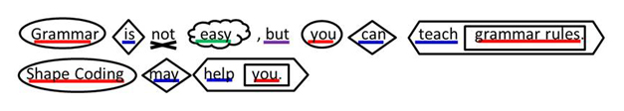
make rules of language EXPLICIT: shape coding

Slide 20
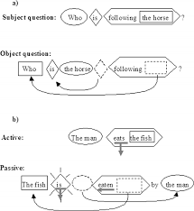
Explicit grammatical intervention: shape coding
therapy for adolescence with severe and persistent language disorder
delivered by highly specialist speech-language therapist
typical focus on one aspect of grammar for therapy block (e.g. co-ordinating conjunctions)
very small groups

Slide 21
RCT: n = 14 per group
Ebbels SH, Marić N, Murphy A, Turner G. (2014) Int J Lang Commun Disord. 49(1):30–48. doi:10.1111/1460-6984.12047

Slide 22
RCT: n = 14 per group
Four hours of intervention
significant change, but very small steps!

Slide 23
RCT: n = 14 per group
Effects quite item specific – but can learn!
Generalisation: use of conjunctions in other language tasks
Transfer: improving language have any effect on other academic and/or social skills??
Cost/benefit?

Slide 24
direct SLT intervention: summary of findings
effective in changing specific language targets across a range of language behaviours
language comprehension tends to be harder to improve
Few (any?) measure transfer or generalisation to other skills
https://www.moorhouseschool.co.uk/_site/data/files/research/Ebbels%20intervention%20research%20IJSLP%20accepted%20version.pdf

Slide 25

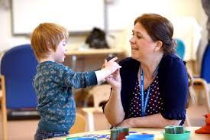
Indirect intervention
The clinician sets targets (with family/other significant people)
The clinician outlines a programme of work
The clinician *should* monitor programme delivery
The clinician reviews progress against targets
The ‘programme’ is delivered by someone else (parents, therapy assistants, school staff)

Slide 26
indirect intervention: summary of findings
Wave 3A intervention can be effective
  for primary school-aged children
  with expressive difficulties only (Boyle et al. 2009)
  delivered at least 3x30 mins per week, for a total of at least 20 hours
  by well-trained assistants under direct control of SLTs or researchers
  for improving expressive language and vocabulary
But they do not improve
  listening comprehension
  receptive or expressive language in children with receptive language difficulties

Slide 27
indirect intervention: what makes it effective?
Who employs provider
  McCartney et al. (2011). Intervention provided by school staff under “consultative model” was not effective
  If assistant is provided to the school by a research project (Boyle et al. 2009), or SLT services (Mecrow et al., 2010) intervention can be effective, but not for those with receptive language difficulties.
Training and support
  McCartney et al. (2011)
    little training / support (targets, manual & materials provided)
    limited monitoring from SLTs (one mid-intervention meeting)
    school staff do not provide intervention as planned
Amount of intervention provided (need for monitoring)
  McCartney et al. (2011): 10 hours (aimed for 20)
  Boyle et al (2009): 20 hours
  Mecrow et al. (2010): 29 hours
  The current UK consultancy model, exemplified by ‘usual therapy’ delivered via local SLT services in the RCT and by the specific approach delivered by school staff in the cohort study, may offer low levels of language-learning activity, and (unsurprisingly) prove to be less efficacious in improving children's expressive language scores than some 20-plus hours of targeted input.

Slide 28
indirect therapy takes time
SLT:
  Specify intervention in detail, possibly by constructing a therapy manual
  Train provider in the intervention method (4+ days?)
  Support provider throughout the intervention (fortnightly?)
  Monitor provider to ensure intervention happens (fortnightly?)
Provider:
  Training (4+days?)
  Intervention (20+ hours)
  Access support from SLT (fortnightly)
  plus preparation, planning, record keeping and evaluation
Need more evidence that this approach is more feasible and/or cost-effective than direct therapy…

Slide 29
CHALLENGES:
Costly & not enough clinical specialists to meet demand
Progress often small steps and cure is not the goal – hard to sell!
What constitutes ‘good’ outcome for these children with multiple challenges?

Slide 30
Levels of evidence approach

Slide 31
Theoretically motivated approaches…
poor auditory processing
phonological/grammatical contrasts
language impairment
“This optimal learning experience means that students who use Fast ForWord products often make an average 1 - 2 years gain in reading skills in as little as 8 to 12 weeks.”
e.g. Temporal Processing Theory (Tallal, 1976; Tallal & Piercy, 1973)
train auditory processing skills, slow speech, exaggerate contrasts

Slide 32
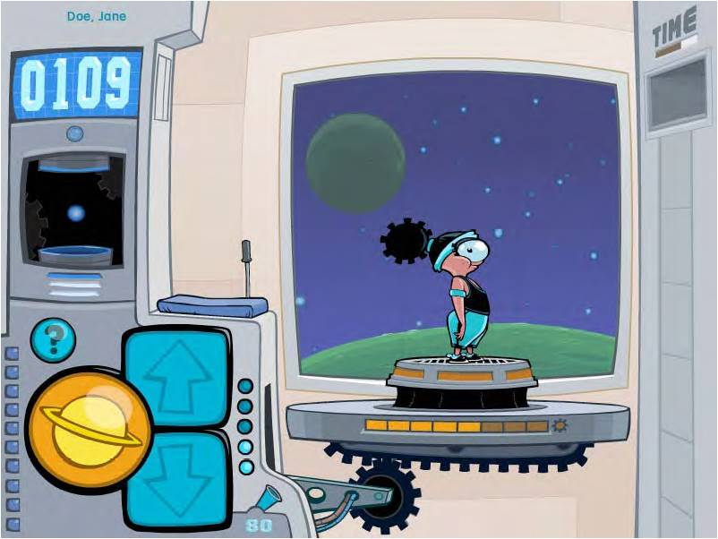
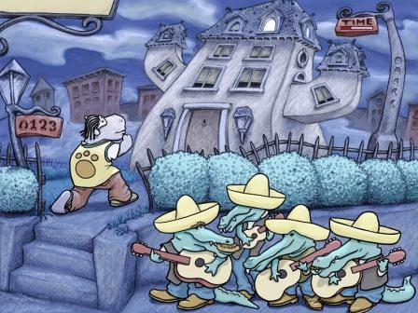
FastForWord intervention
Variety of language activities
Adaptive programme – get harder as child gets better
sound (intensity/speed) modified as child progresses
Rewarding!
Individual sessions
90 minute session, 5 times a week for 6 weeks (!!!)
Intervention trial in SCIENCE! (Tallal et al. 1996)
N = 11 per group
Not-randomised to treat or control

Slide 33
Cohen, et al.(2005). JSLHR, 48, 715-729.
77 children aged 6-10
  clinically referred, severe language disorder (Wave 3)
  scores on language test in bottom 10th centile
  scores on non-verbal reasoning tests within the normal range
randomly assignment:
FastForWord (modified speech), n = 23
‘active’ control: computerised language games, n = 27
‘TAU’ control: treatment as usual, n = 27

Slide 34
results: standard scores on primary outcome
McArthur et al. (2008)
significantly improves auditory processing…
…but this doesn’t improve language

Slide 35
Strong et al. (2012). JCPP. Meta-analysis of FFW trials

Slide 36
Train the aspects of language you want to change!

Slide 37
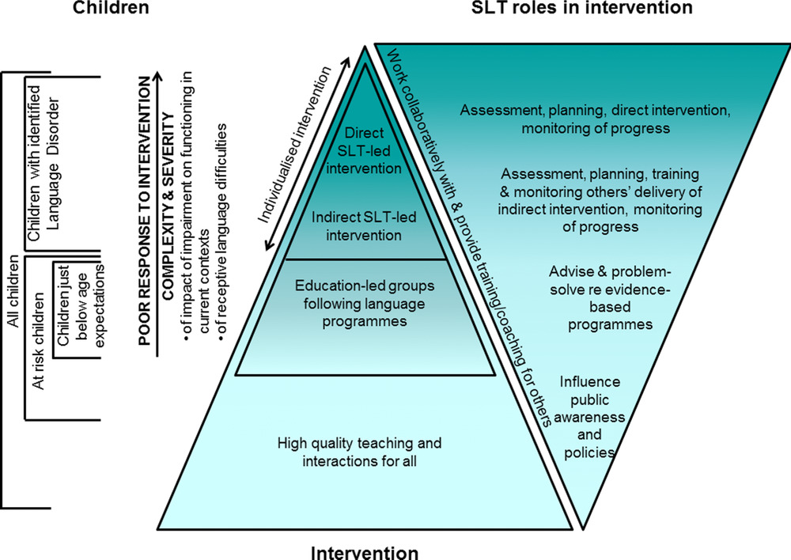

Slide 38
Clarke PJ, Snowling MJ, Truelove E, Hulme C. (2010). Ameliorating children's reading-comprehension difficulties: a randomized controlled trial. Psychol Sci. 2010;21(8):1106–1116. doi:10.1177/0956797610375449
Cohen W, Hodson A, O'Hare A, et al. (2005). Effects of computer-based intervention through acoustically modified speech (Fast ForWord) in severe mixed receptive-expressive language impairment: outcomes from a randomized controlled trial. J Speech Lang Hear Res. 48(3):715–729.
Ebbels SH, Marić N, Murphy A, Turner G. (2014). Improving comprehension in adolescents with severe receptive language impairments: a randomized control trial of intervention for coordinating conjunctions. Int J Lang Commun Disord. 2014;49(1):30–48. doi:10.1111/1460-6984.12047
McCartney E, Boyle J, Ellis S, Bannatyne S, Turnbull M. (2011). Indirect language therapy for children with persistent language impairment in mainstream primary schools: outcomes from a cohort intervention. Int J Lang Commun Disord. 46(1):74–82. doi:10.3109/13682820903560302
Rogde, K, Hagen, ÅM, Melby‐Lervåg, M, Lervåg, A. (2019). The effect of linguistic comprehension instruction on generalized language and reading comprehension skills: A systematic review. Campbell Systematic Reviews. 15:e1059. https://doi.org/10.1002/cl2.1059
Storkel HL, Komesidou R, Pezold MJ, Pitt AR, Fleming KK, Romine RS. (2019) The Impact of Dose and Dose Frequency on Word Learning by Kindergarten Children With Developmental Language Disorder During Interactive Book Reading. Lang Speech Hear Serv Sch.;50(4):518–539. doi:10.1044/2019_LSHSS-VOIA-18-0131
Strong GK, Torgerson CJ, Torgerson D, Hulme C. (2011). A systematic meta-analytic review of evidence for the effectiveness of the 'Fast ForWord' language intervention program. J Child Psychol Psychiatry. 52(3):224–235. doi:10.1111/j.1469-7610.2010.02329.x

Slide 39
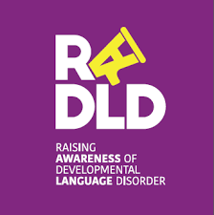
Find out more about language disorder and the impact of language disorder on children and young people!
https://www.youtube.com/RADLD
http://www.lilac-lab.org
c.norbury@ucl.ac.uk

