Slide 1
Welcome to Asia and Middle East Studies:
Chinese Culture and Society

Slide 2
Programme structure
The course of study consists of a total of 120 ECTS credits:
Compulsory courses, 40 credits
Elective courses, 20 credits
Thesis preparation, 30 credits (different options) + Master’s thesis, 60 credits

Slide 3
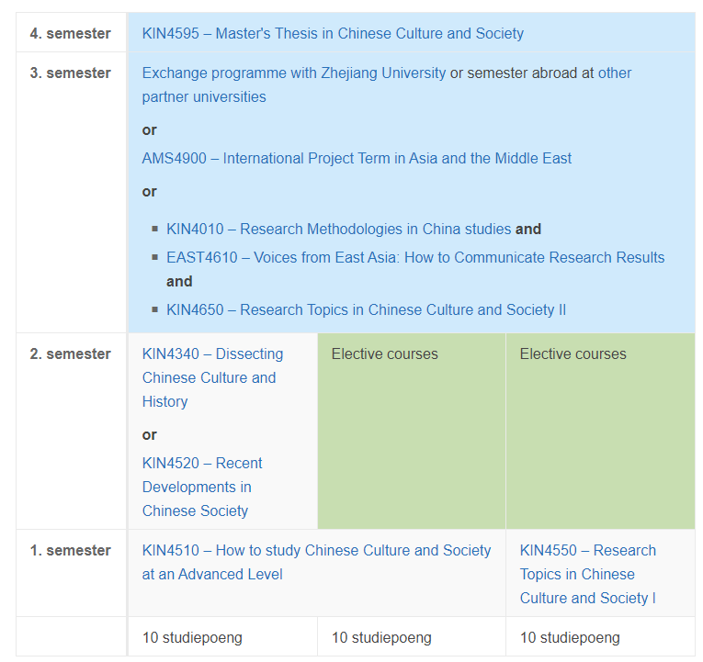
https://www.uio.no/english/studies/programmes/aas-master/programme-options/chics/structure/

Slide 4
AMS4900 - International Project Term in Asia and the Middle East
Third semester
Internship that will give you an opportunity to get relevant
work experience, use your academic skills in a practical manner,
and present yourself in an international work environment
The internship must be carried out at an
embassy/consulate or in an organization/company in East Asia
Internship through UiO's agreement with the Ministry of Foreign Affairs (UD) - only for students with a Norwegian citizenship
Information meeting in the spring. Contact: international@ikos.uio.no

Slide 5
INTPART
Third semester
The INTPART exchange
programme with Zhejiang University
Scholarships of 72.000 NOK
Contact: international@ikos.uio.no
https://www.uio.no/english/studies/programmes/aas-master/programme-options/chics/abroad/intpart-exchange-programme.html

Slide 6
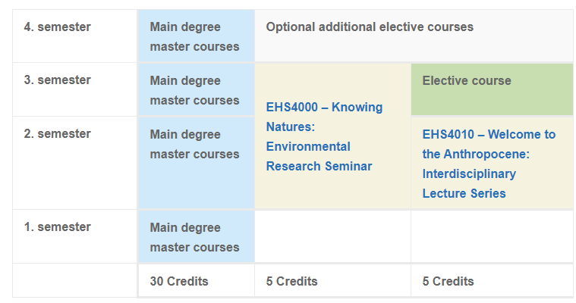
https://www.uio.no/english/studies/programmes/ehs/

Slide 7
Registrations every semester
Register and apply for courses in Studentweb
Pay the semester fee and the Kopinor fee
Registration deadline:
Autumn: 1 September
Spring: 1 February
https://www.uio.no/english/studies/registrations/
Notes:
Kari

Slide 8
Student ID and student card
Digital student ID app on your mobile phone
Register as a student in Studentweb
Pay the semester fee
Student card
Access to buildings and rooms, retrieving printouts, library card
SiO Customer Service in the Kristian Ottosen building
Bring valid semester receipt and passport/national ID
https://www.uio.no/english/studies/registrations/card/
Notes:
Kari

Slide 9
Studying for a MA degree at IKOS
Reading room at IKOS – 3rd floor PAM
→ Closed at the moment – but will open as soon as we have a booking system online
Automatic access with student card
Lockers
Student advisor will notify you when it’s open
https://www.hf.uio.no/ikos/english/studies/master/
Notes:
Anders

Slide 10
Grants and funding
Field work should be relevant to your Master's thesis project and must be approved by your supervisor.
Grants will be made of up to NOK 5000 per applicant depending on the number of applicants.
https://www.hf.uio.no/ikos/english/studies/master/field-work/

Slide 11
MA thesis – guidelines for structure and submission
Deadline:
Spring semester: 1st of June at 11:00 AM
Autumn semester: 1st of December at 11:00 AM
https://www.hf.uio.no/ikos/english/studies/master/structuring-your-masters-thesis/

Slide 12
Special needs and leave of absence
Special needs in everyday study situation
Special examination arrangements
Leave of absence and reduced study progression
Contact your student advisor!
Application deadline: 1. September/1. February
https://www.uio.no/english/studies/special-needs-leave-part-time/

Slide 13
Fall 2020
Mandatory infection prevention course
https://www.uio.no/english/studies/registrations/infection-prevention/
KIN4510 + KIN4550 will have physical teaching, but stream them for international students only
If you have special needs and cannot attend the physical teaching, contact the student advisor as soon as possible.
Formal documentation of absence during compulsory activites is presently not required.
https://www.uio.no/english/studies/examinations/compulsory-activities/hf-oblig.html
Remember to keep everyone safe by:
Washing hands
Keeping your distance (1 metre)
Staying home if you are sick
Stay updated about the Corona situation at UiO https://www.uio.no/english/about/hse/corona/index.html

Slide 14
Contact information
Student advisor: Lene Ørbech Jensen
Meetings by appointment – send me an email first
Fall 2020: Due to Covid-19 only meetings at Zoom, phone or questions on email
E-mail: l.o.jensen@ikos.uio.no
Phone: +47 22 85 52 34

